Slide 1

Brain, Mind and Spirituality; Who is In-charge of a Human?
www.egr.msu.edu/~aslam
Abstract: Pre-birth, post-birth, childhood, early/school/college education, professional education, life, and retirement life all affect quality & longevity of human life. What is the role of brain, mind, and spirituality? Who is the decision maker for a human? This talk for the first time provides a scientific definition of mind as an algorithm based on EEG data generated along Microbiome-Gut-Brain-Axis (MGBA). Mind is the decision maker for everything a human does while brain is the decision maker for survival of a human. Thus, mind affects quality and longevity of life. Spirituality, with no scientific definition, seems to be related to mind.
Using an example of a mind-controlled LEGO robot, this talk, for the first time, generates new ideas for the development of algorithms for anxiety, depression, empathy & narcissism, ADD, ADHD and other neural problems. This talk also reveals creative ideas for explaining Nanotechnology education and outreach.
DEAN M. ASLAM
DIRECTOR OF BIOMEMS MIND LAB
ELECTRICAL AND COMPUTER ENGINEERING
MICHIGAN STATE UNIVERSITY
E. LANSING, MI 48824 USA
PRIOR UNIQUE RESEARCH:
Single-material MEMS
Micro- and Nano-fabrication Technologies for Polycrystalline Diamond (Poly-C) & Carbon Nanotubes
Cognitive Mind-controlled Lego Robots
Poly-C Piezoresistive Sensors
Biochemical Nano-sensors
Poly-C RFMEMS Micro and Nano Resonators
CNT growth in Micro-Gas Chromatograph Channels
Poly-C BioMEMS (Cochlear & Neural Probes)
Single-Material MEMS Packaging
THIS TALK: See Abstract on Right

Slide 2
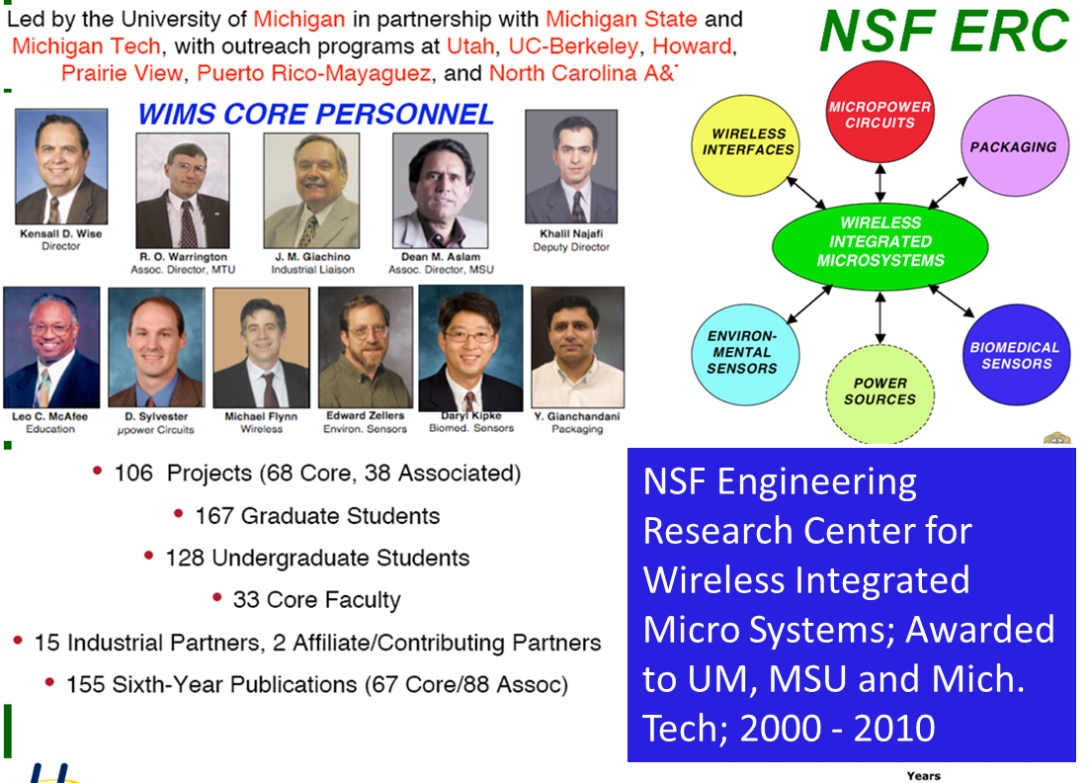
Dean Aslam Provided Center-wide Leadership in Diamond MEMS and K-16 Outreach
Single-material MEMS
Micro- and Nano-fabrication Technologies for Polycrystalline Diamond (Poly-C) & Carbon Nanotubes
Cognitive Mind-controlled Lego Robots.
Poly-C Piezoresistive Sensors,
Biochemical Nano-sensors,
Poly-C RFMEMS Micro and Nano Resonators
CNT growth in Micro-Gas Chromatograph Channels
Poly-C BioMEMS (Cochlear & Neural Probes)
Single-Material MEMS Packaging
2000 -2010
2000 -2010
Euisik Yoon

Slide 3
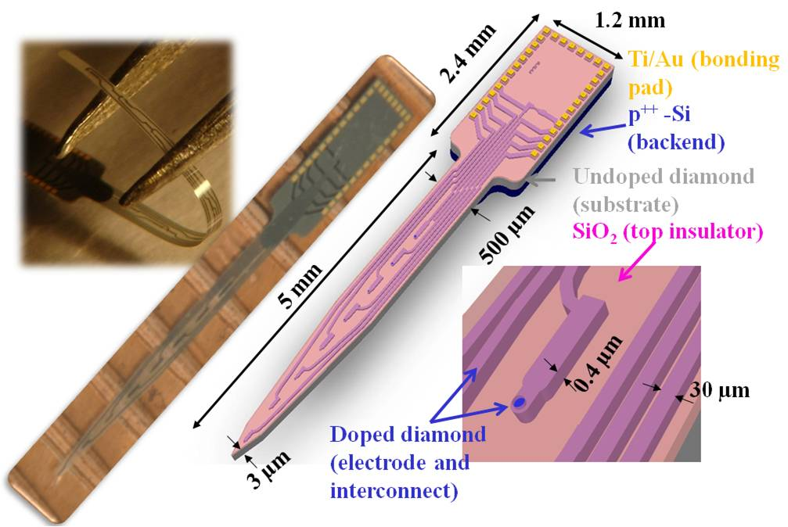
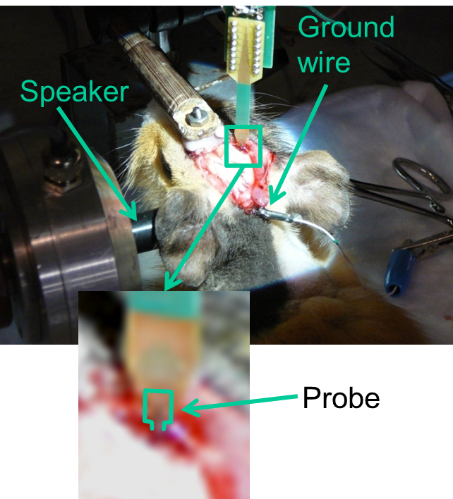
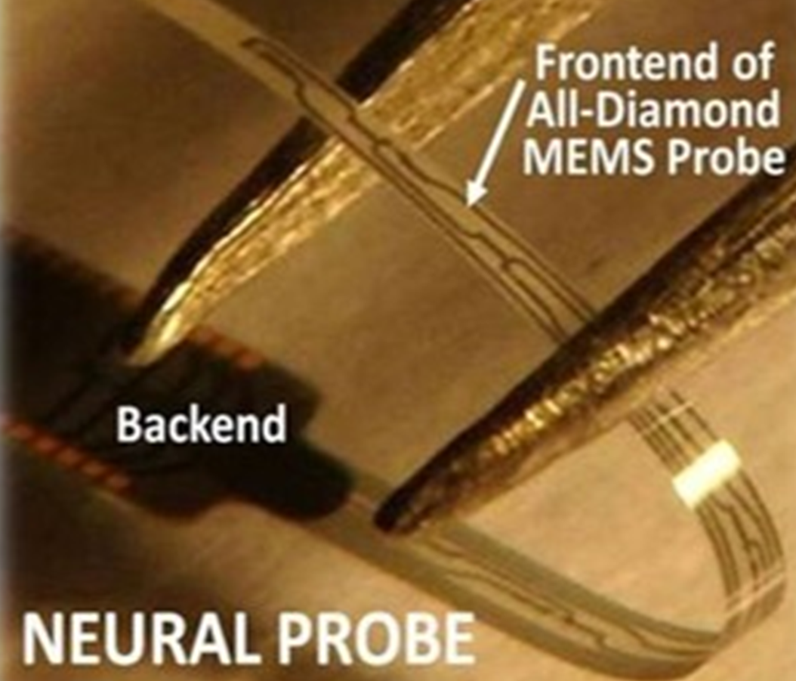
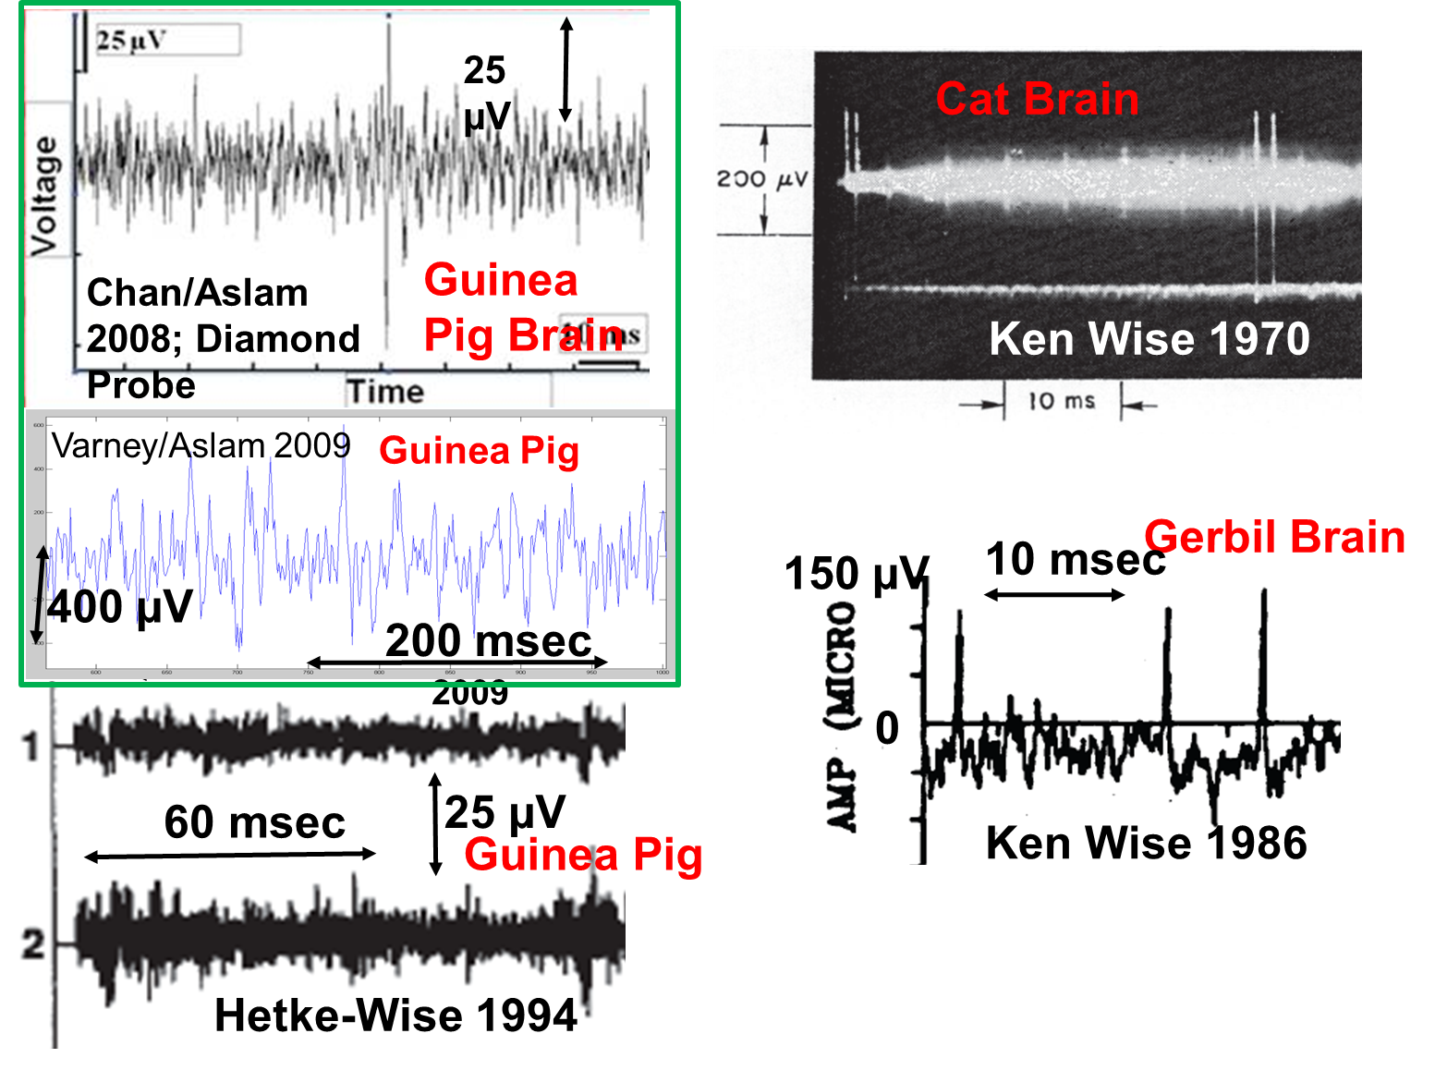
INTEREST IN BRAIN RESEARCH STARTED IN2003: ALL-DIAMOND NEURAL PROBE
Hoyin Chan & Mike Varney, MSU doctoral students 2003 - 2010: Fabrication and testing at UM Lurie Nanofabrication Facility

Slide 4
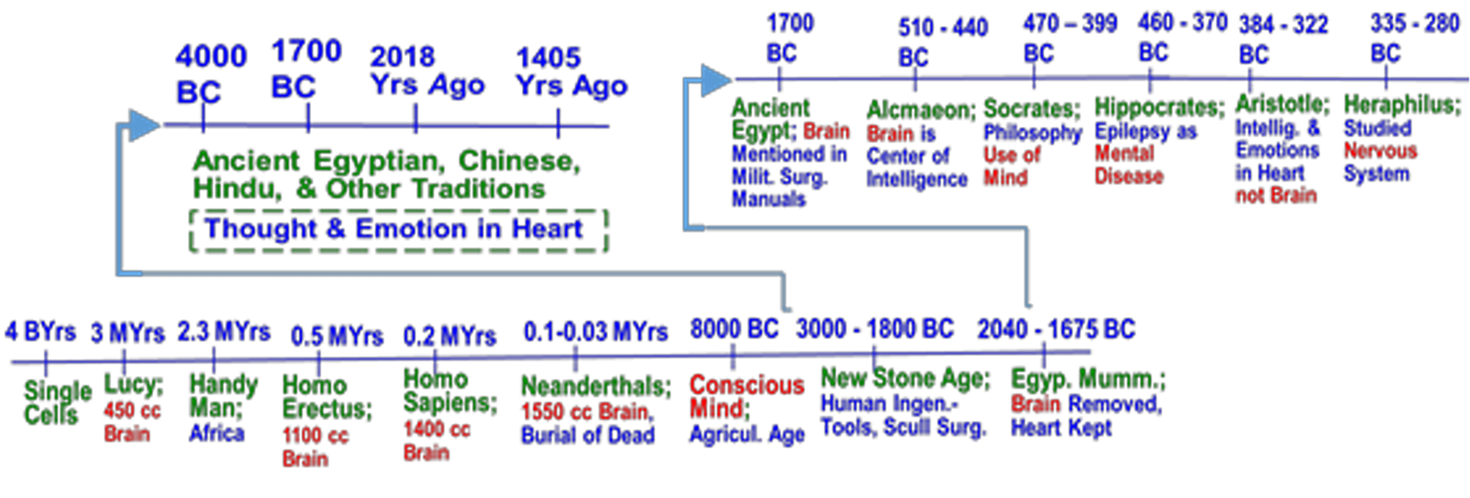
Heart Known, Brain Unknown, Mind-related Experiences
https://ijarcce.com/wp-content/uploads/2020/01/IJARCCE.2019.81216.pdf
DEAN ASLAM DEVELOPED CREATIVE/UNIQUE IDEAS AFTER DOING ABOVE REVIEW

Slide 5
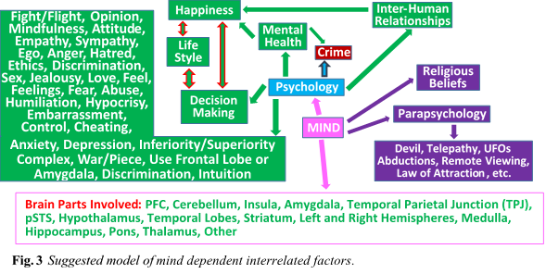
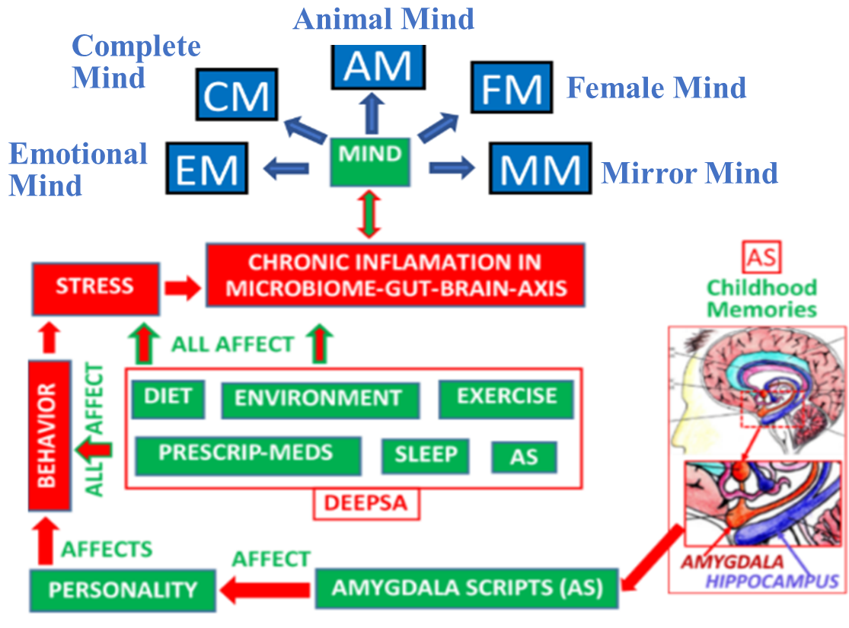
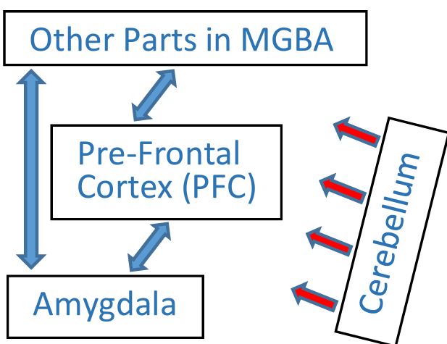
Mind as EEG-Data-Based Algorithm
https://ijarcce.com/wp-content/uploads/2020/01/IJARCCE.2019.81216.pdf (Intriguing Aspects of New Scientific Mind Model as EEG Data Based Algorithm)
https://ijarcce.com/wp-content/uploads/2021/05/IJARCCE.2021.10502.pdf (Self-Study and -Care of Human Health Problems Guided by New Scientific Mind Model)
https://ijarcce.com/wp-content/uploads/2021/06/IJARCCE.2021.10701.pdf (Neuroscience Engineering Education Using Self-learning by Mind-controlled LEGO Robots)
Comprehensive Mind Model
Important to Understand Changes in Brain Biochemical Composition from Fetus to Older Age?

Slide 6
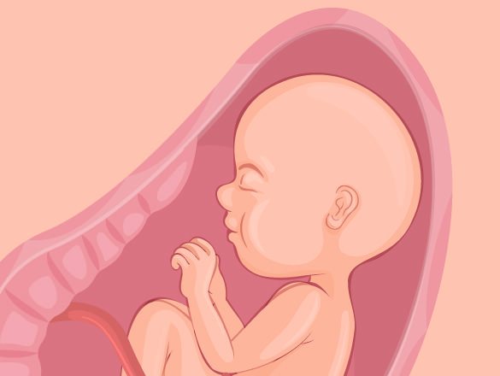
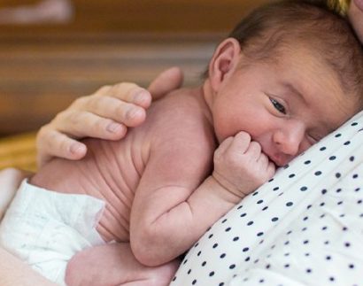
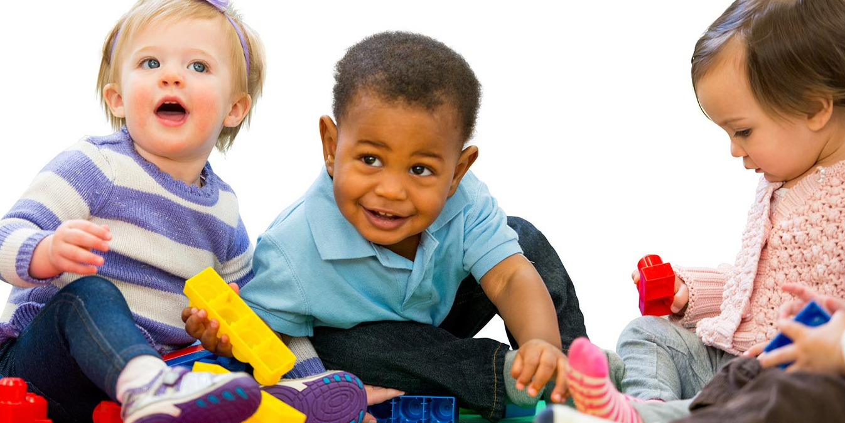




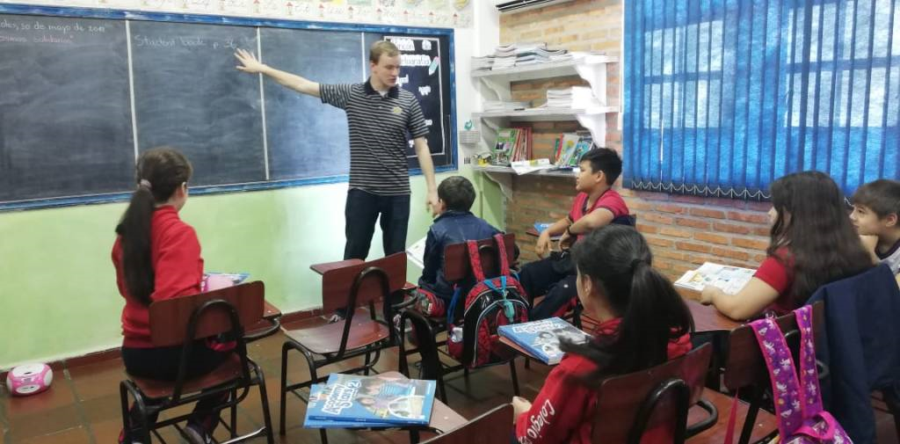
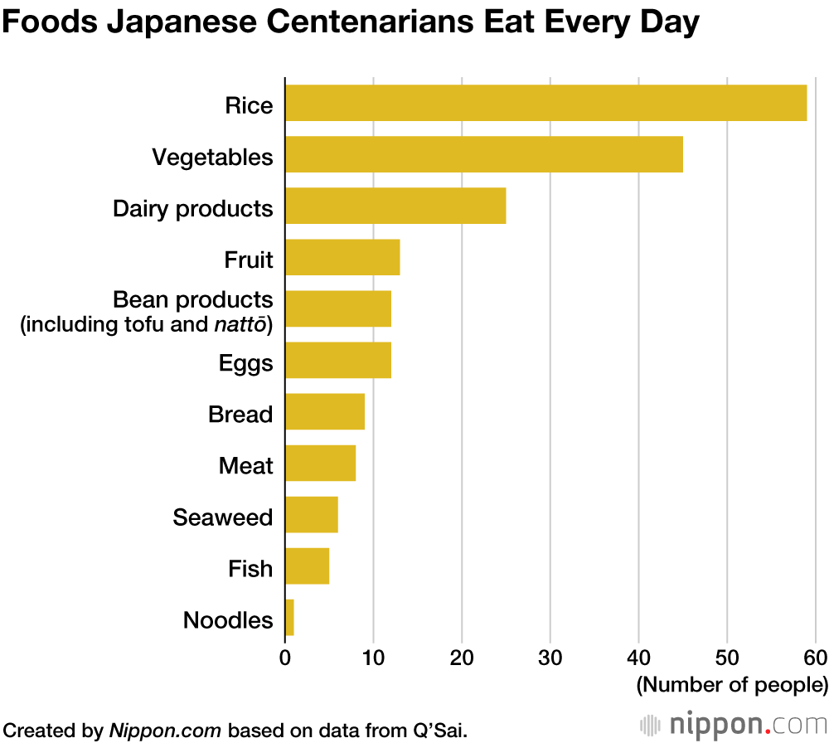
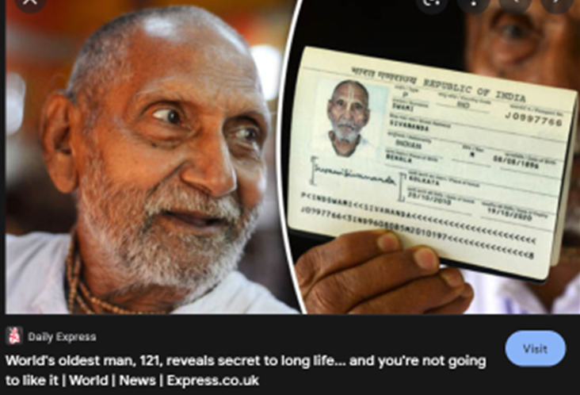
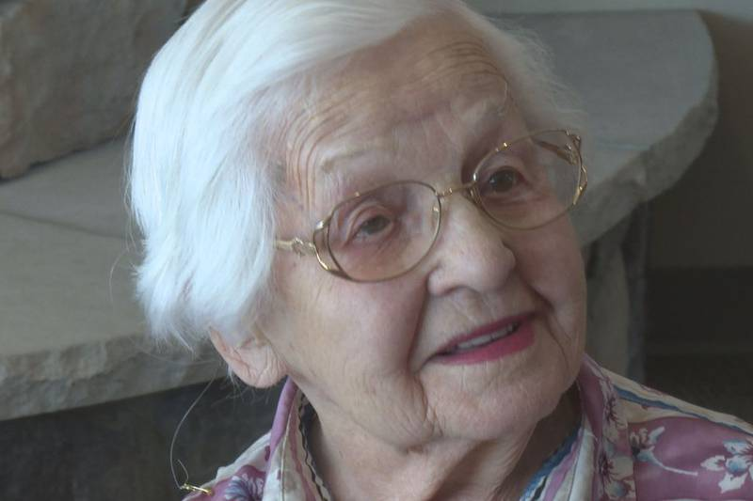
EIGHT STAGES OF LIFE: Contributing to Stress, Happiness & Longevity
1
Post-birth
Early-education
Elementary School
Pre-birth
4
3
2
Middle/High-School/College
Work
Retirement
Graduation
6
5
8
7
9
Foods; Japanese
9
121 Years
108 Years

Slide 7
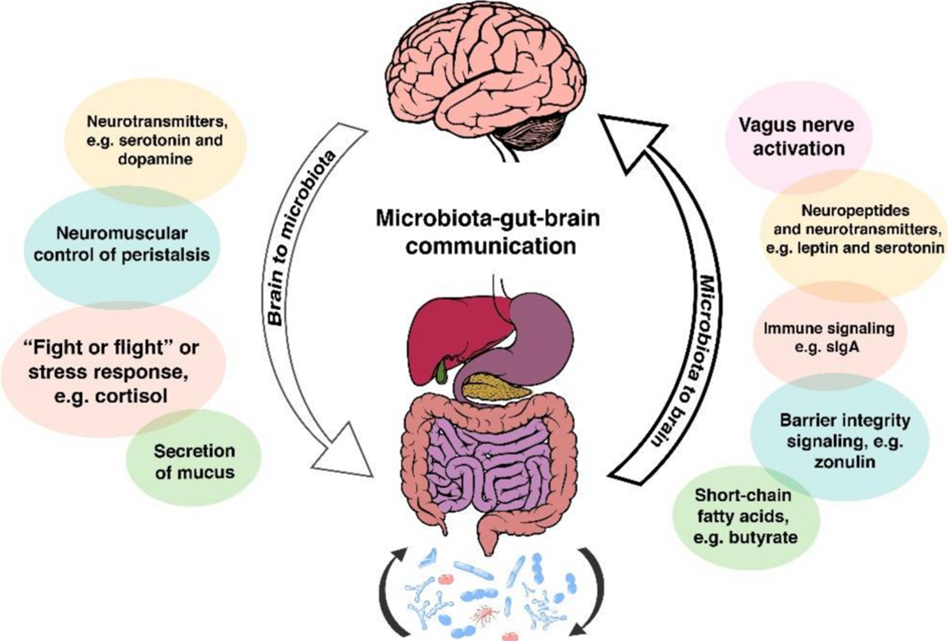
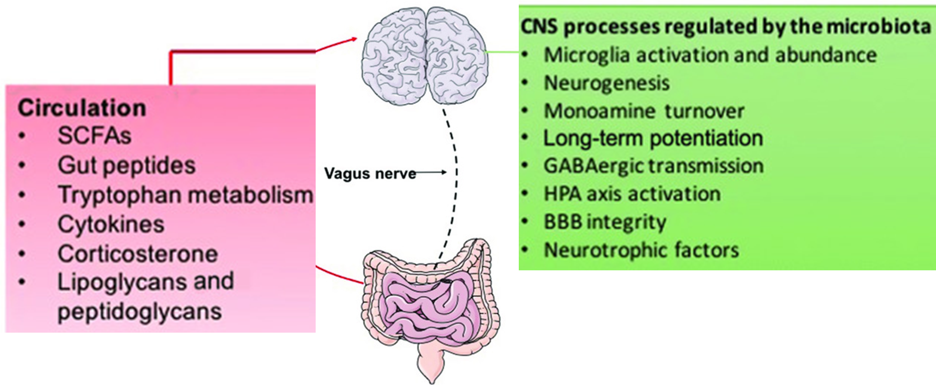
MGBA Communication & Processes by Vagus Nerve
https://www.bing.com/images/search?q=Microbiome-gut-brain%20axis&qs=n&form=QBIR&sp=-1&ghc=2&pq=microbiome-&sc=8-11&cvid=E93833434F374421AD166EA3F6073DF3&first=1&tsc=ImageHoverTitle

Slide 8
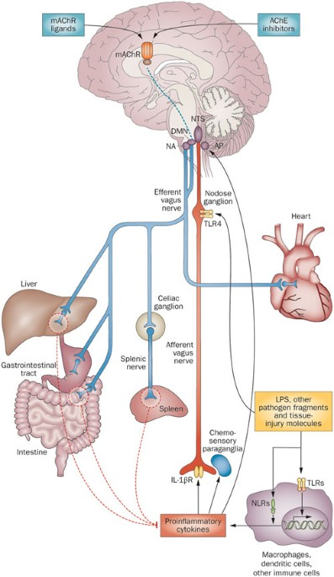
WHY VAGUS NERVE IS KEY TO GOOD HEALTH; Brain Checks the Whole System Every 30 mS Using the Vagus Nerve
Stages of Brain Development?
Neurogenesis/Gliogenesis (generation of glial cells (non-neuronal cells) in the nervous system (both central and peripheral nervous systems).
Neural Migration. Neuronal stem cells move to specified areas of the nervous system.
How to Get Information From Past Life Stages?
Found Through MGBA EEG Studies
Dendrite and Axon Growth.
Synapse Formation.
Neuron Death (Apoptosis) /Synaptic Pruning.
Formation of Myelin.
Develop EEG-Data-Based Algorithms
Example: Amygdala Scripts, “What Freud Did not Know” by Timothy Stokes; Childhood Memories
Algorithms for Quality/Longevity of Life, Stress, Diseases, Problems, Etc., Can be Developed Using MGBA EEG Data.

Slide 9
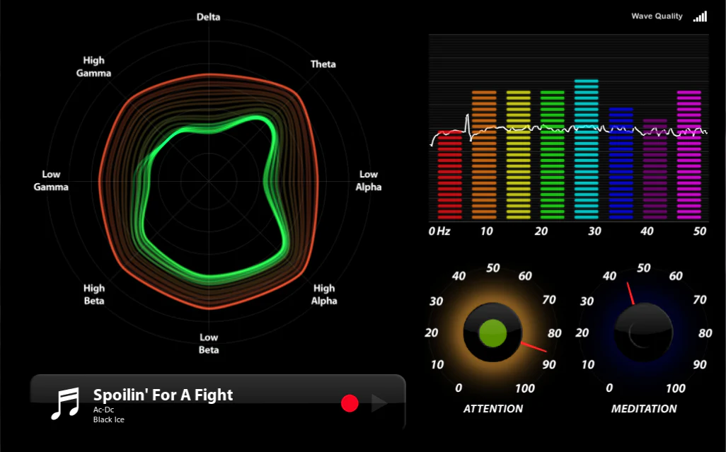
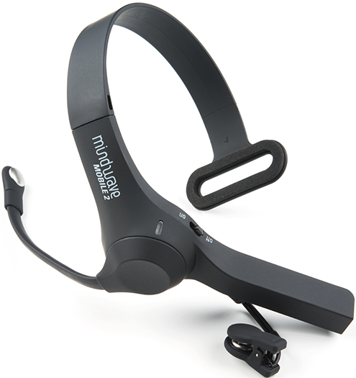
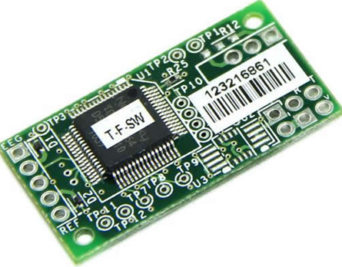
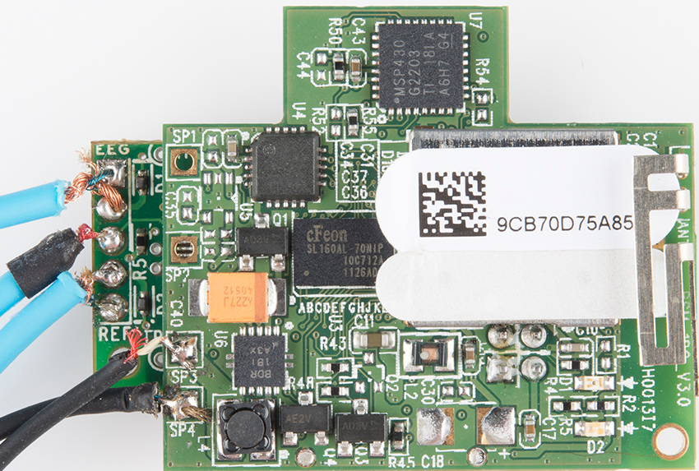
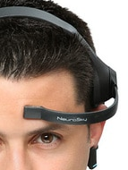
EEG (Electroencephalogram): Raw Signal, Delta, Theta, Alpha, Beta & Gamma Waves, Attention & Meditation Levels; Anxiety, Depression, ADD, ADHD, Empathy, etc., Algorithms
MINDWAVE MOBILE 2
TGAM Board
Self-Study of Psychological/Other Health Problems
WHY Self-Study?

Slide 10
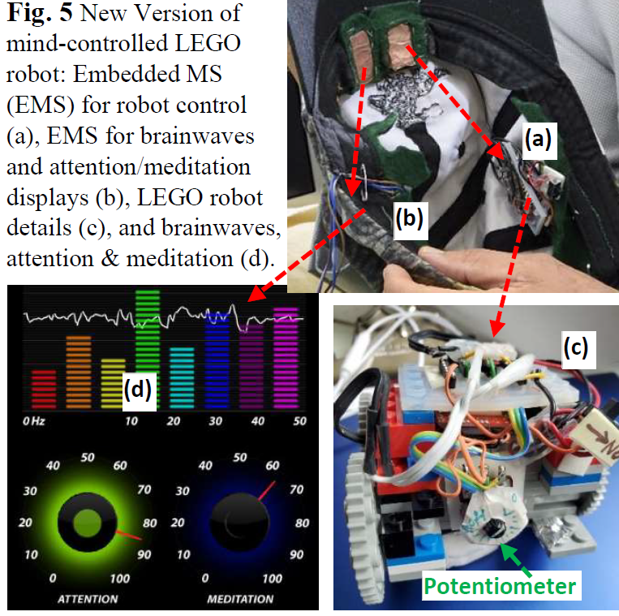

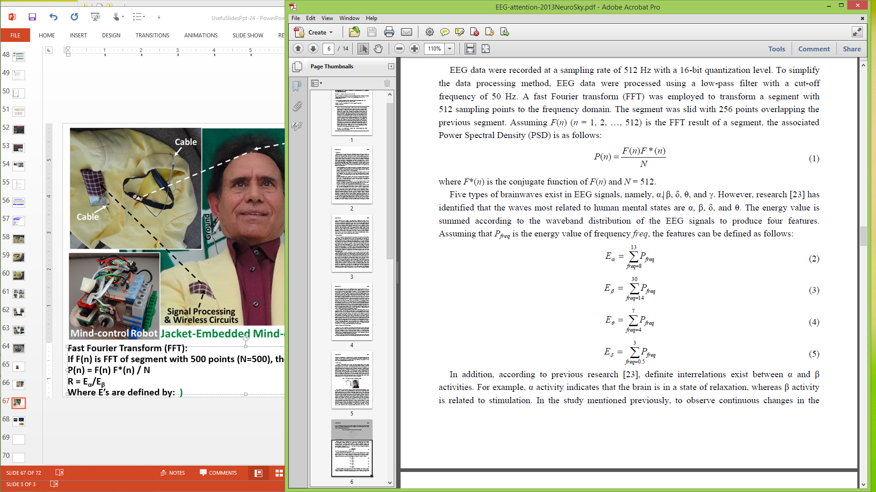
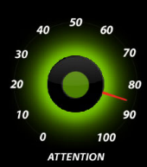
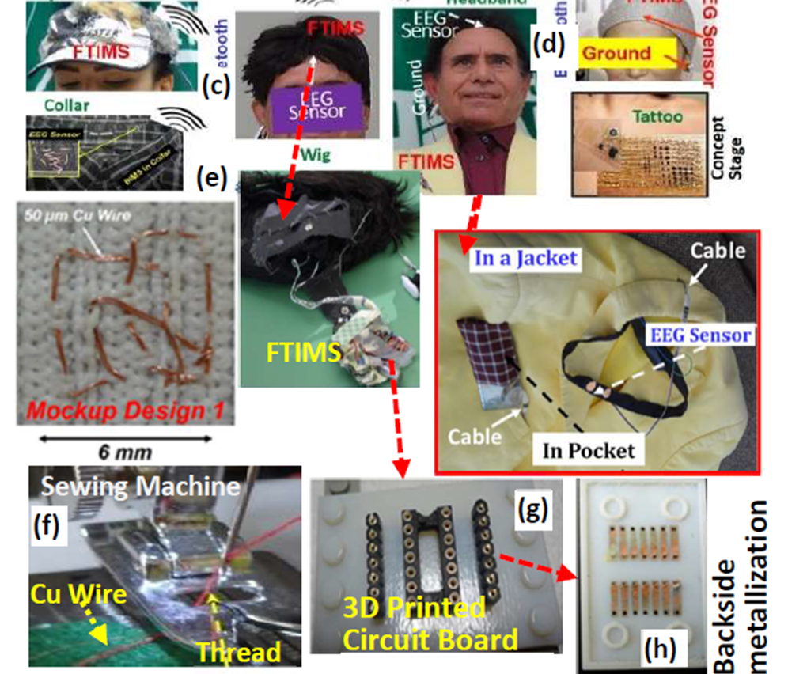
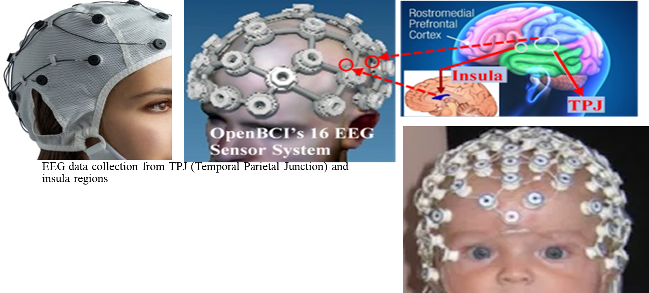
Latest Versions of Mind-controlled Robot and 8/16 Sensor OpenBCI System
Attention Level:
R = E_{α}/E_{β}

Slide 11
EXAMPLES OF EXCITING/CREATIVE RESEARCH:
Mind-controlled LEGO Robot; http://www.egr.msu.edu/nsferc/40sec-Mindcontrol%20Robot.mp4
Anxiety-controlled LEGO ROBOT
LEGO Robots Controlled by :
  Depression
  ADD & ADHD
  Autism
  Schizophrenia
  Empathy; Narcissist
  Sociopath, Psychopath

Slide 12
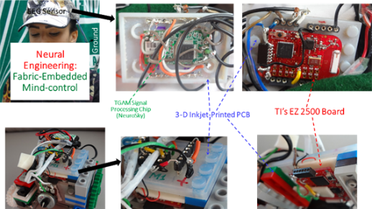
Mind-controlled Robot; microsystems/circuits
Control Microsystem in Cap
LEGO Robot
P(n) = F(n) F*(n)/N; Attention Algorithm, R = E_{α}/E_{β}
  PRELIMINARY STUDY: Anxiety-controlled LEGO Robot; In anxiety, attention and meditation levels are low. AA (Anxiety Algorithm) = Attention x Meditation; lower the AA value higher the anxiety

Slide 13
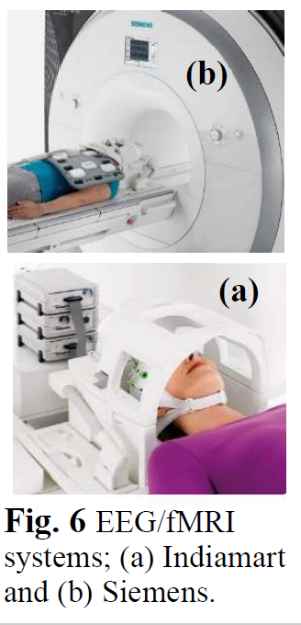
ADVANCED STUDIES TO BE DONE: fMRI/EEG Measurement in the Same System
https://ijarcce.com/wp-content/uploads/2021/06/IJARCCE.2021.10701.pdf (Neuroscience Engineering Education Using Self-learning by Mind-controlled LEGO Robots)
The relatively low cost and ready availability of the LEGO robot components will provide researchers with a non-invasive, versatile tool to study Interoception in a variety of real-world settings. As shown in Fig. 6, the follow up study uses fMRI and EEG in the same system. fMRI/EEG study can identify brain parts involved in Interoception.
Combination of fMRI and EEG Measurements for EEG Data From Specific Brain Parts:
An important aspect of this research, to be investigated, is identifying the EEG signal coming from specific brain part/parts. For example, EEG signal coming from parts responsible for empathy is important for self-study of empathy related problems. Develop algorithm by finding FFT (Fast Fourier Transform) of relevant EEG data and test these algorithms under different conditions is very important.
This can answer questions like what part of total EEG signal comes from a specific Brain part such as Insula.

Slide 14

WHO IS DECSION MAKER? BRAIN, MIND OR SPIRTUALITY?
BRAIN IS THE DECISSION MAKER FOR HUMAN SURVIVAL.
MIND IS THE DECISSION MAKER FOR EVERTHING & ANYTHING HUMANS DO.
SPIRITULATY, WITH NO SCIENTIFIC DEFINITION, RELATES TO MIND. IT IS VERY IMPORTANT FOR 8 STAGES OF LIFE AND K-16 OUTREACH.
PROVOCATIVE QUESTIONS:
WHY GROUPS WITH A PHYSICAL LEADER MAY HAVE STRONG DIFFERENCE OF OPINION AND EVEN FIGHT WITH EACH OTHER? FOR EXAMPLE, RELIGIOUS AND POLITICAL GROUPS.
WHY GYPSIES AND ANTS DON’T FIGHT AMONG THEMSELVES? (Gypsies originated in the Punjab region of northern India as a nomadic people and entered Europe between the eighth and tenth centuries).

Slide 15
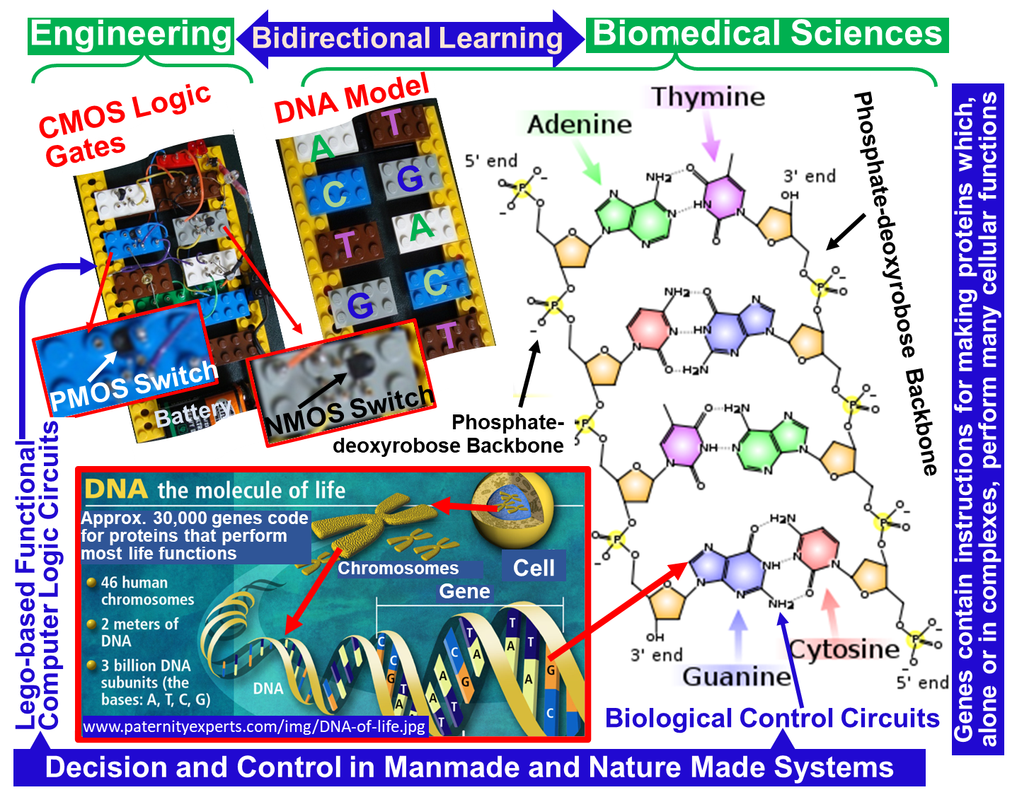
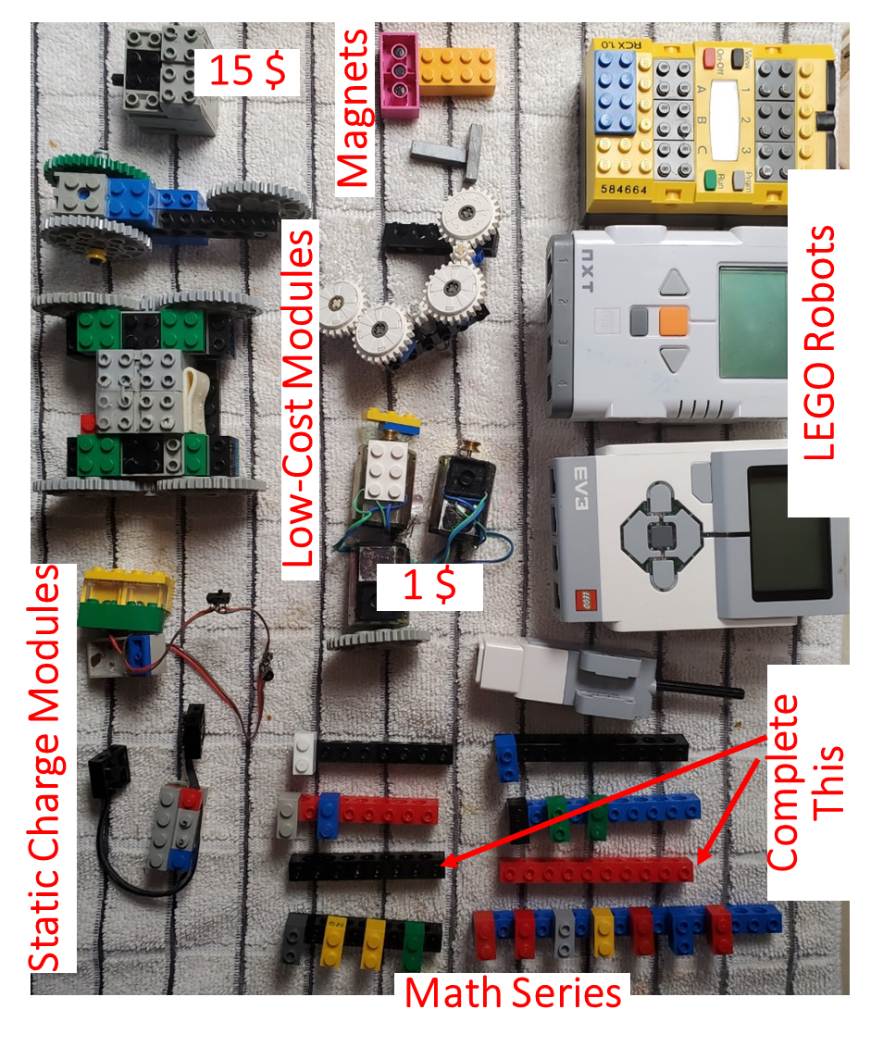
Nanotechnology Education and Outreach
K-16 Papers and Papers With Recorded Videos can be Downloaded From This Link:
https://www.egr.msu.edu/nsferc/K-12%20Modules/

Slide 16
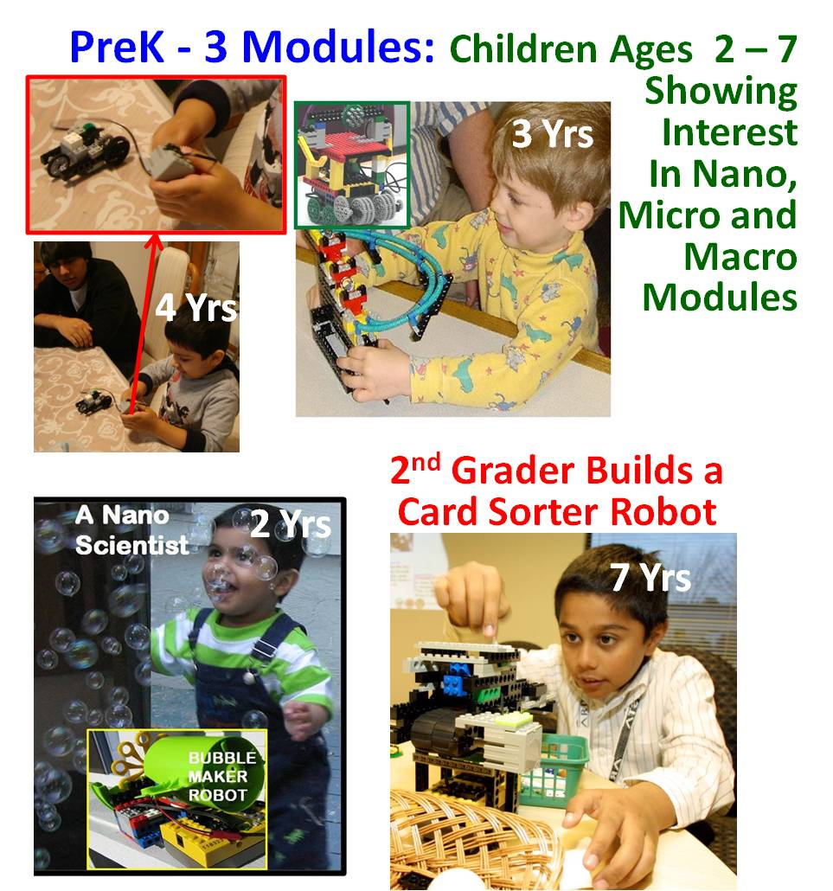
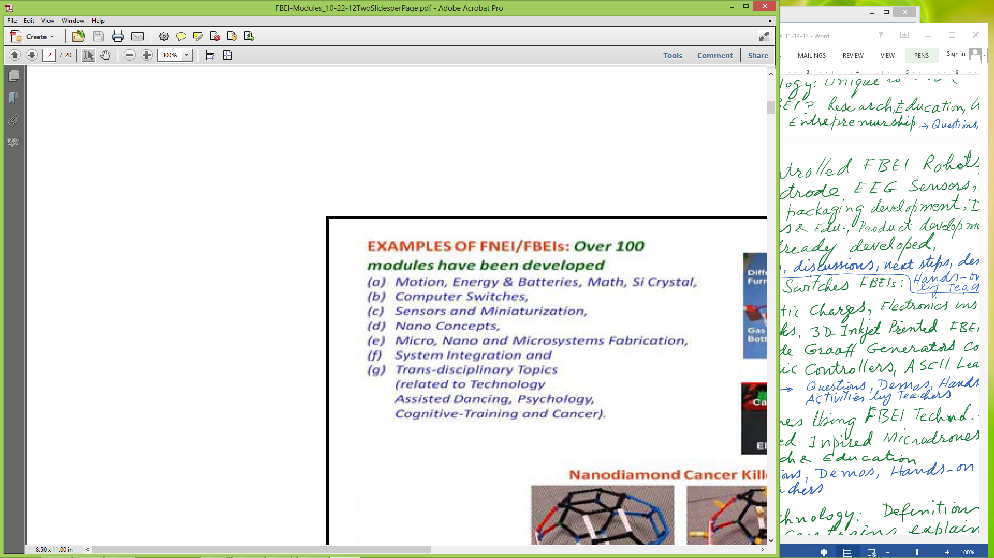
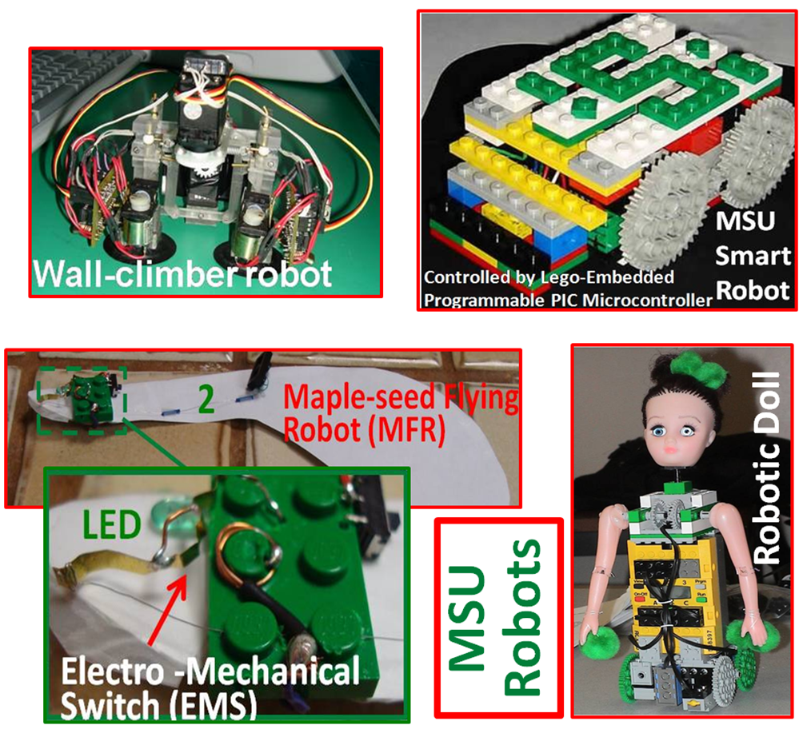
https://ijarcce.com/wp-content/uploads/2020/06/IJARCCE.2020.9605.pdf; Creative Functionalized Bricks with Embedded Intelligence (FBEI) For Research-Oriented Provocative STEM and Workforce Learning

Slide 17
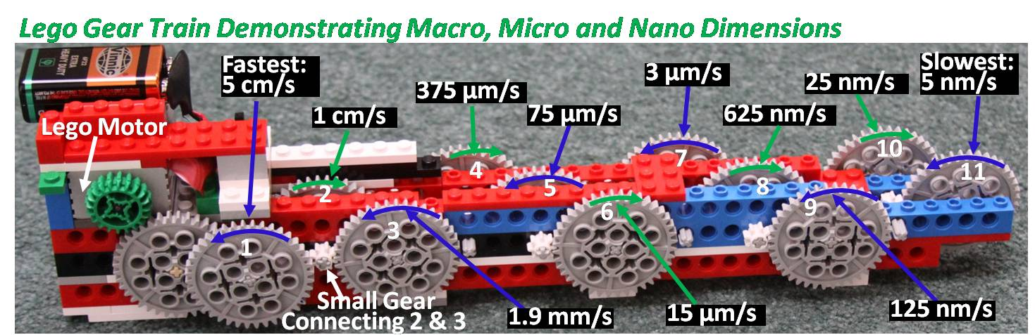
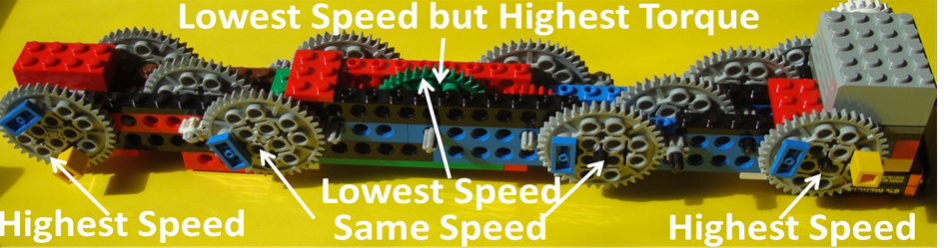
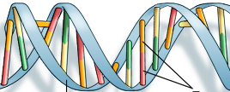
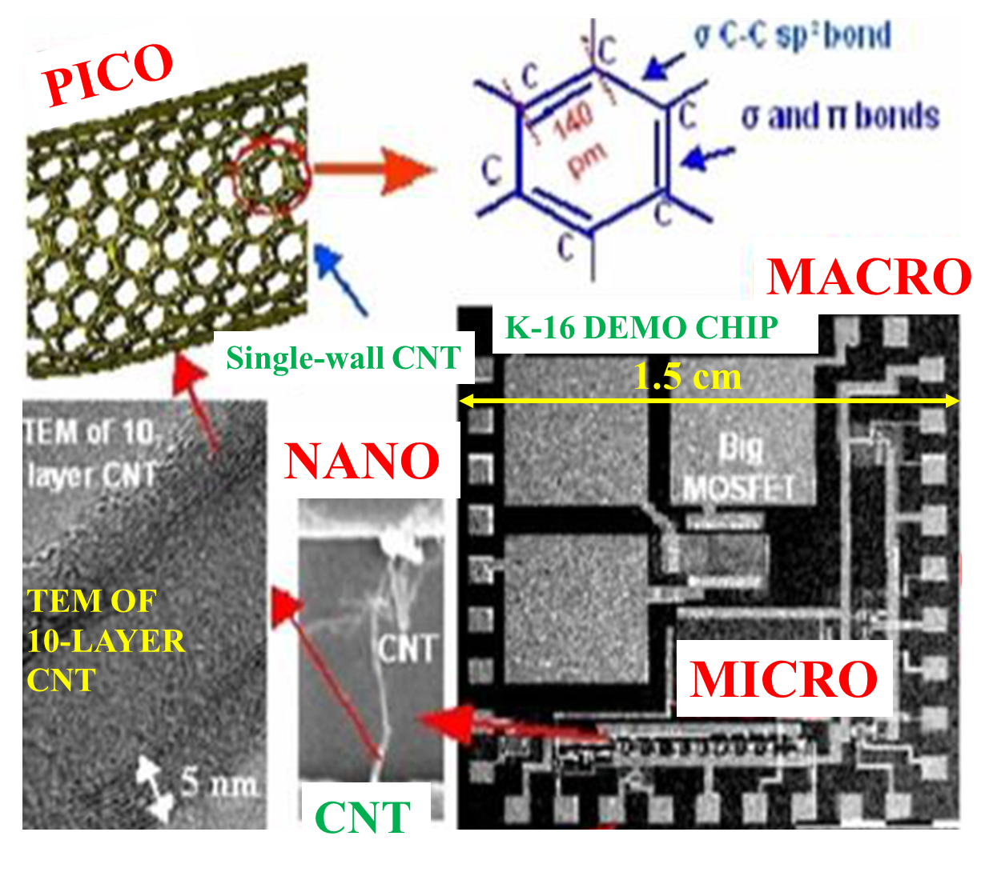
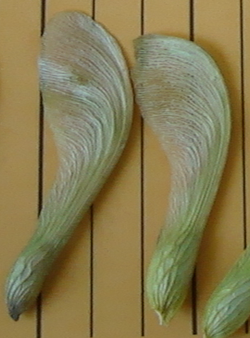
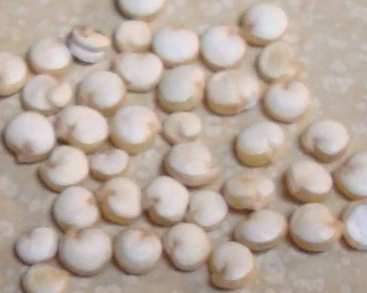
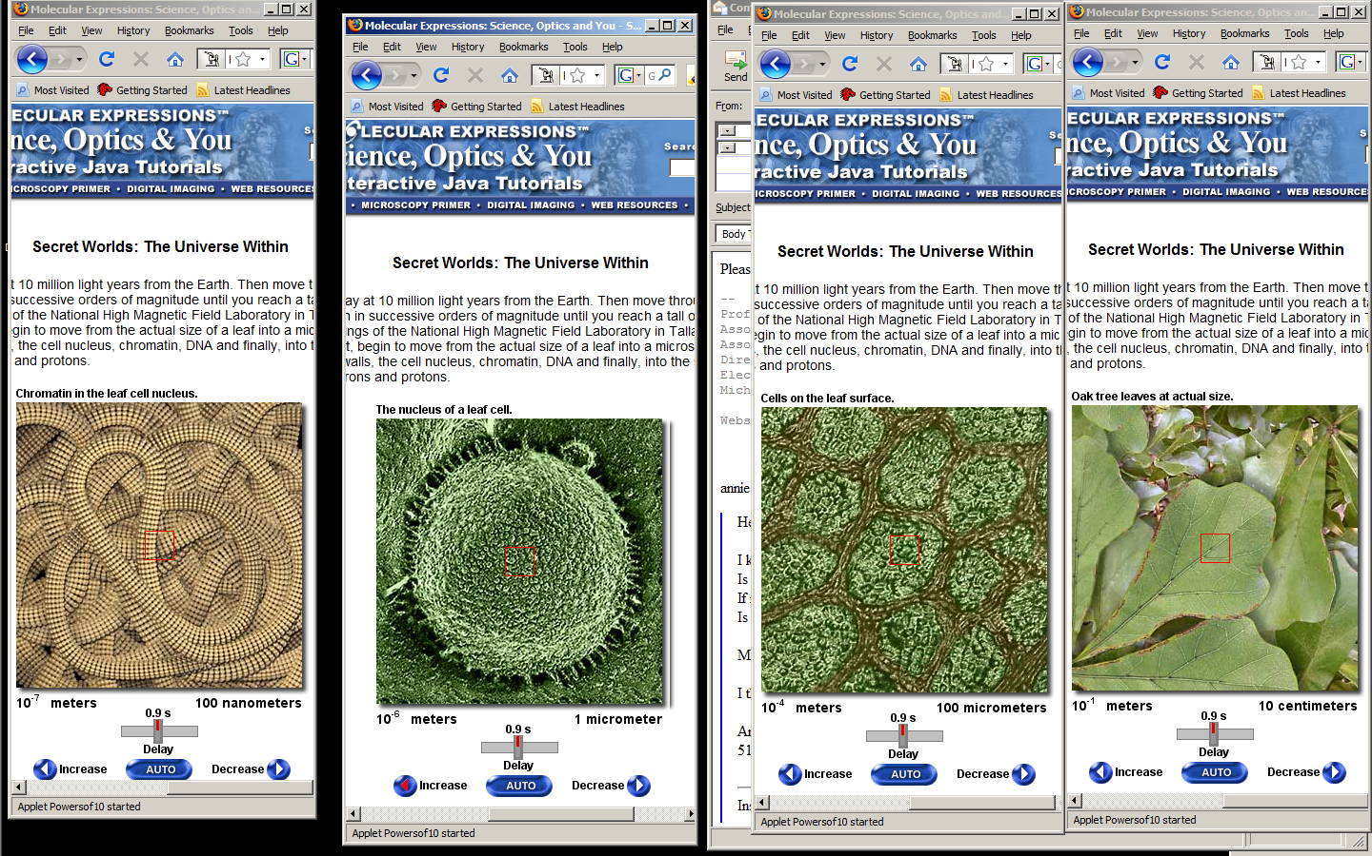
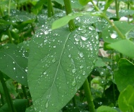
NANOTECHNOLOGY EDUCATION AND OUTREACH
LEAVES
3.6 nm
Z
Quinoa Grains (Contain 8 Amino Acids)
100 nm
2 nm
Lansing to New York
Base Pairs
Chromatin in a Cell
340 pm
Moon's Orbit
Particles Causing Static Charge
10⁹
10⁶
10³
10⁰
10⁻³
10⁻⁶
10⁻⁹
10⁻¹²
10⁻¹⁵
Gm
Mm
km
meter
mm
μm
nm
pm
fm
K-16 Test Chip
Satellite Height; 3.6x10⁷ m
Definition of Nano:
Sizes < 100 nm:
Physical Properties Change
New Science Needed to Explain
Cell Nucleus in a Leave
1 Meter = 1000 Millimeters
1 mm = 1000 Micrometers
1 µm = 1000 Nanometers
1 nm = 1000 Picometers
1 pm = 1000 Femtometers
Leaves
1 µm
http://micro.magnet.fsu.edu/primer/java/scienceopticsu/powersof10/

Slide 18
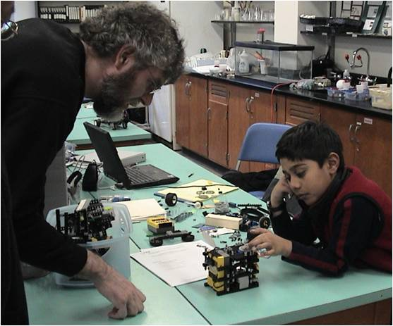
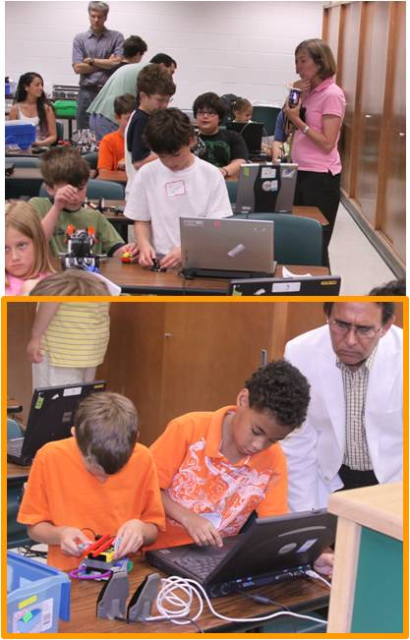
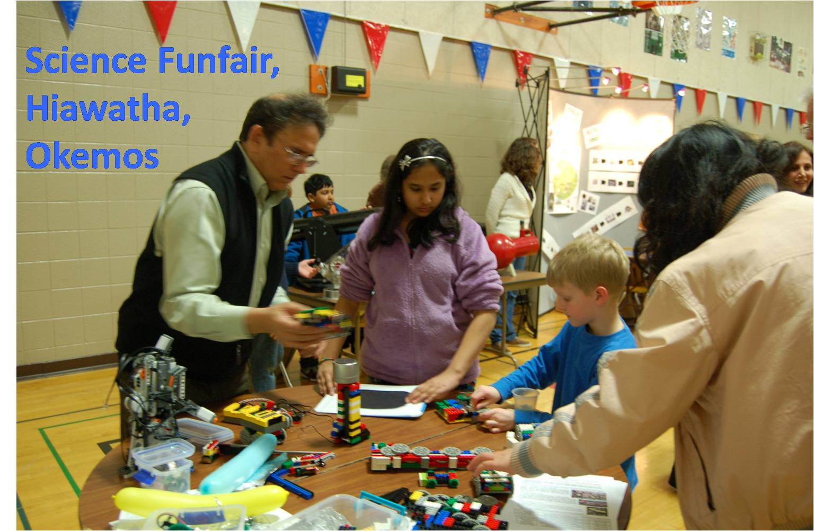
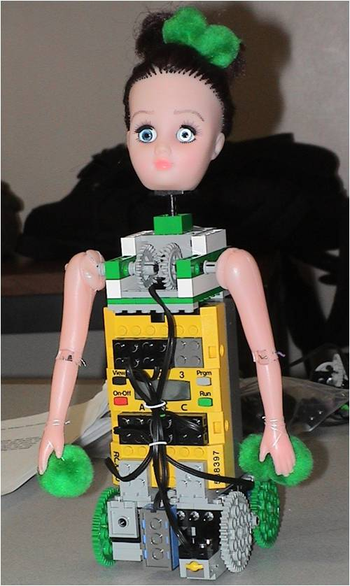
ROBOTICS & NANOTECHNOLOGY CAMPS/WORKSHOPS
www.egr.msu.edu/~aslam
aslam@msu.edu
KNOWLEDGE FLOW?
ROBOTICS & NANO CAMPS/WORKSHOPS

Slide 19
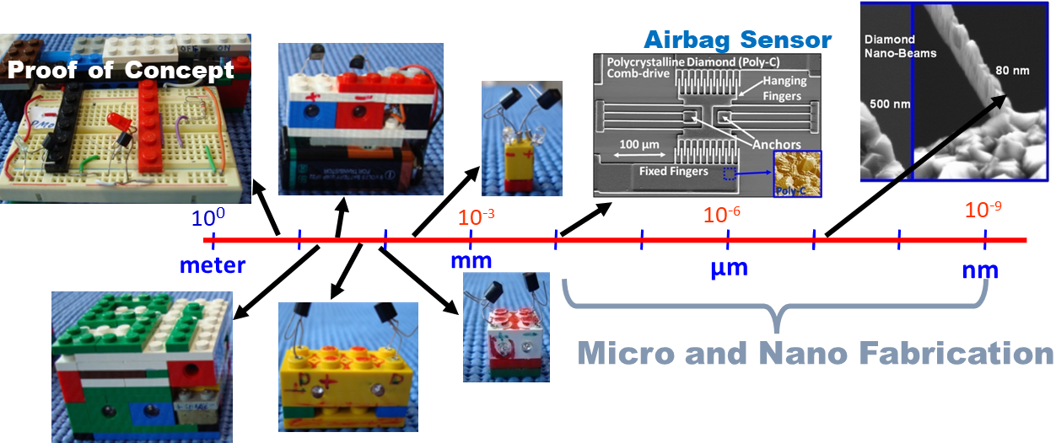
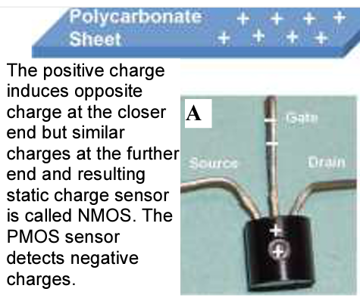


MINIATURIZATION OF SENSORS & MEMS (Micro Electro Mechanical System)
Static Charge Sensors Made by Dean Aslam
Fabricated by Dean Aslam’s Doctoral Students

Slide 20


Slide 21

DESIGN, FABRICATION AND TESTING OF LEGO V-D GRAAF GENERATORS (Designed, Built & Tested by Dean Aslam)

Slide 22



Slide 23





Maple-Seed Robotic Fliers
Initial Test
Microfabricated
Monitor the Environment; Detect Viruses?
(Original Idea by Dean Aslam in 2012)
Now: A joint project guided by Profs. Xiaogan Liang (UM) and Dean Aslam (MSU)

