Slide 1
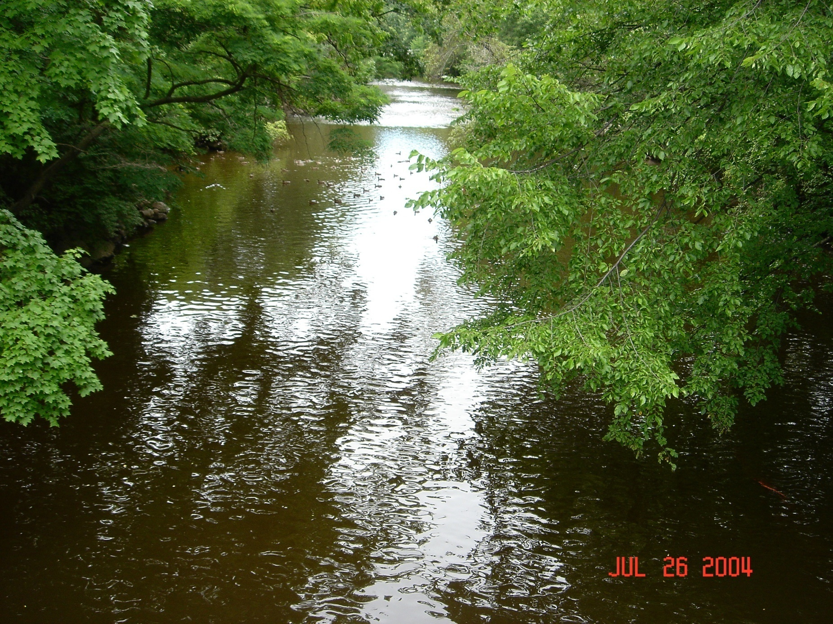
Nanotechnology Education and Outreach
Dean M Aslam, Ph.D.
Professor Emeritus, Michigan State U
(aslam@msu.edu) www.egr.msu.edu/~aslam
Adjunct Professor, Roswell Cancer Institute (Dean.Aslam@RoswellPark.org)
Member of National Academy of Inventors (NAI)
NAI Webinar; https://www.youtube.com/watch?v=rK8w3f8Cks8
Abstract: This talk for the first time provides creative ideas for ‘Nanotechnology Education and Outreach’. Using examples of (a) Nanotechnology concepts and (b) mind-controlled LEGO robots, this talk, for the first time, generates new ideas for education and outreach. For example, how the number of transistors in a microcontroller in 2020 compares to number of neurons in the human brain? This K-16 Outreach, that served over 10,000 learners worldwide during 2001 – 2015, will be restarted in January 2023.
Dean Aslam’s UNIQUE RESEARCH:
Single-material MEMS
Micro- and Nano-fabrication Technologies for Polycrystalline Diamond (Poly-C) & Carbon Nanotubes
Cognitive Mind-controlled Lego Robots
Poly-C Piezoresistive Sensors
Biochemical Nano-sensors
Poly-C RFMEMS Micro and Nano Resonators
CNT growth in Micro-Gas Chromatograph Channels
Poly-C BioMEMS (Cochlear & Neural Probes)
Single-Material MEMS Packaging
Neural Concepts Applied to Self-Learning
THIS TALK: See Abstract on Right
Notes:
Unique research in macro, micro and nano technologies in diamond/carbon-nanotubes (CNT) and nanotech education & outreach

Slide 2
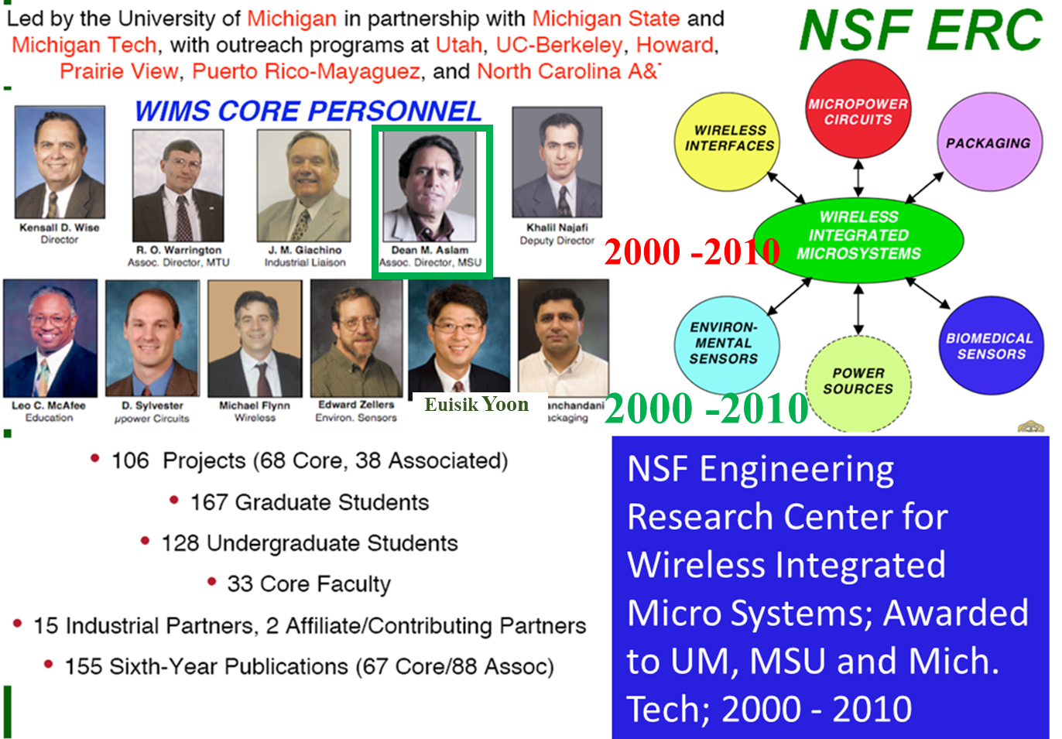
Dean Aslam’s Past & Current Research
CREATIVE/UNIQUE RESEARCH:
Past: Supported By NSF-Funded WIMS ERC (See Picture on Right); Dean Aslam Provided Center-wide Leadership in K-16 Education/Outreach and Diamond MEMS/BioMEMS
Single-material MEMS
Micro- and Nano-fabrication Technologies for Diamond (Poly-C) & Carbon Nanotubes
Cognitive Mind-controlled Lego Robots.
Poly-C Piezo-Sensors,
Biochemical Nano-sensors,
Poly-C RFMEMS Micro and Nano Resonators
CNT growth in Micro-Gas Chromatograph Channels
Poly-C Cochlear & Neural Probes
Single-Material MEMS Packaging
Current: Neural Concepts Applied to Self-Study
Self-Learning, Cancer Survivor Self-Study, ADD, ADHD, Narcissism, etc.
Self-Study of Stress, Anxiety, Neural Problems, Stress by Cancer Survivors
Micro and Nano Outreach Using Cognitive Mind-controlled Lego Robots
Notes:
My past and current creative & unique research. During 2000 – 2010, as Assoc. Director of NSF WIMS ERC at UM, I provided center-wide leadership in diamond & CNT and technology/outreach for K-16 serving over 10,000 K-16 learners through Summer/Other Camps world-wide.

Slide 3
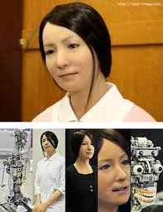
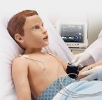
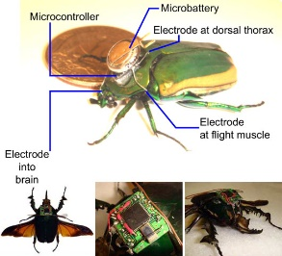
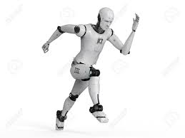
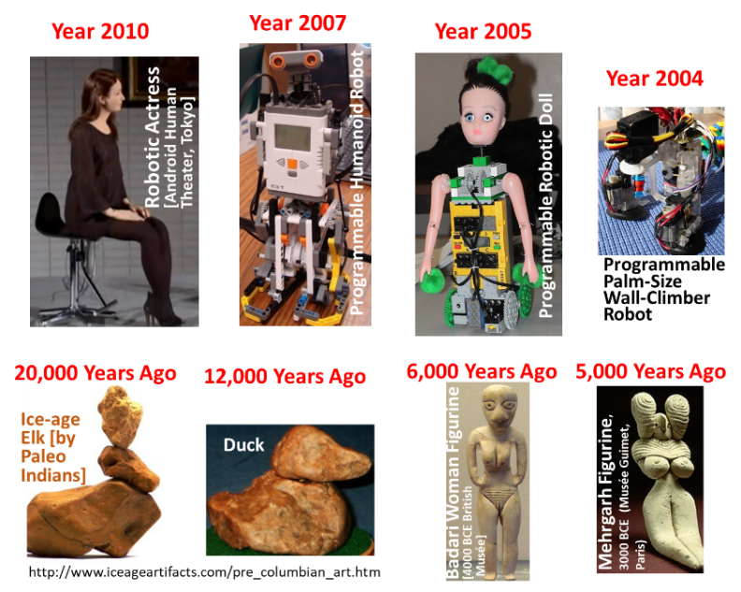
History of Technology
Year 2015
Year 2017
Year 2017
Year 2019
Pediatric Patient
Micro-controller
Battery
Electrode at dorsal thorax
Humanoid Robot
Robotic Nurse
Electrode in brain
Electrode at flight muscle
Remote Controlled Beetle
MSU-USA
Notes:
The technology development dates back 20,000 years. A robotic doll and a wall-climbing robot were developed by my group. Worth noting (a) robotic actress, nurses, patients, and (b) remote controlled beetles.

Slide 4

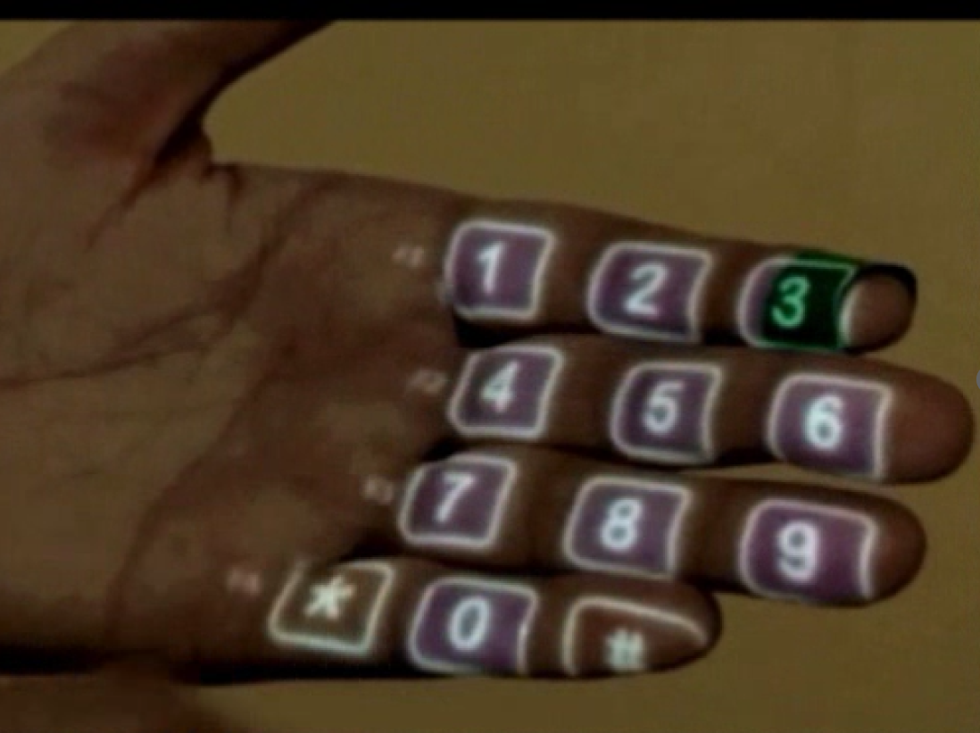
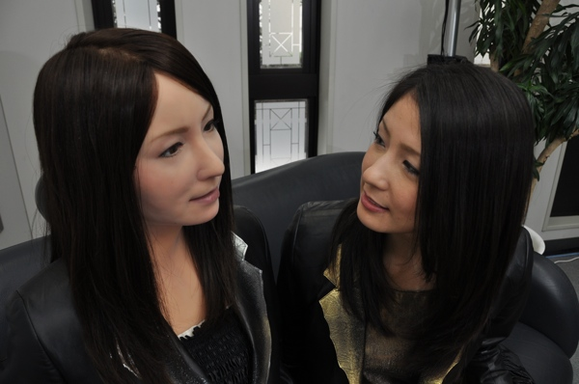
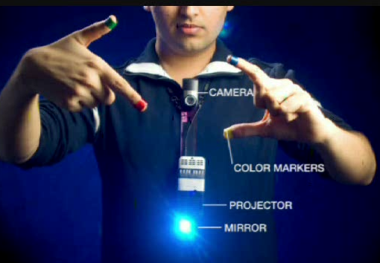
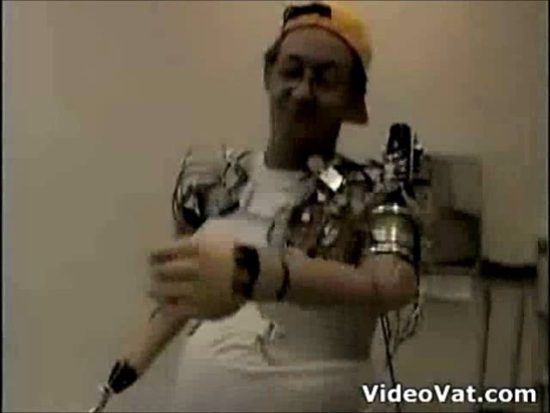
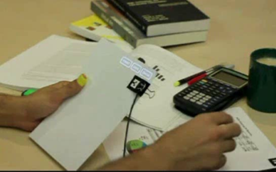
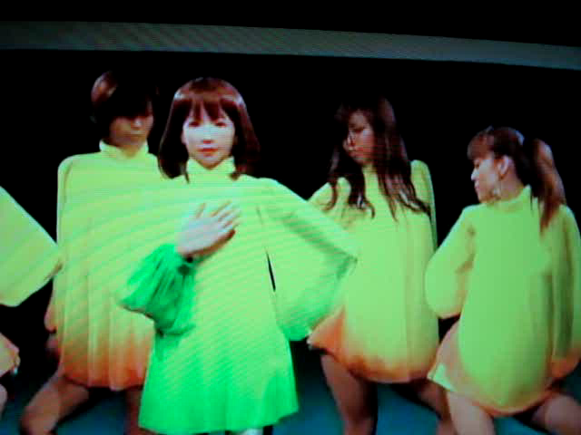
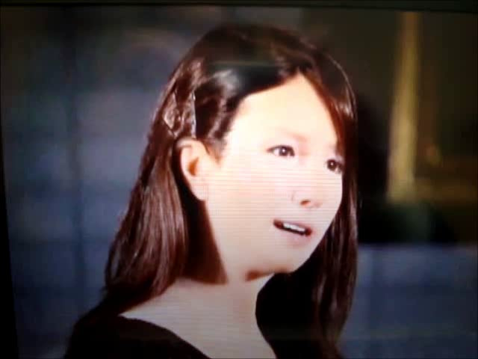
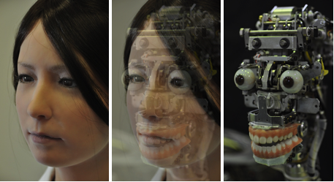
New Technologies
How does it work?
Dial phone number on your hand!!
Gesture Language
Wearable Wireless System
Think to move robotic hand
Assemble videos Using Your Finger!!
Robotic Theatre Actress in Tokyeo
How is it made?
Notes:
Examples of very creative technologies developed by others. It is important to show new exciting technologies to K-16 learner.

Slide 5
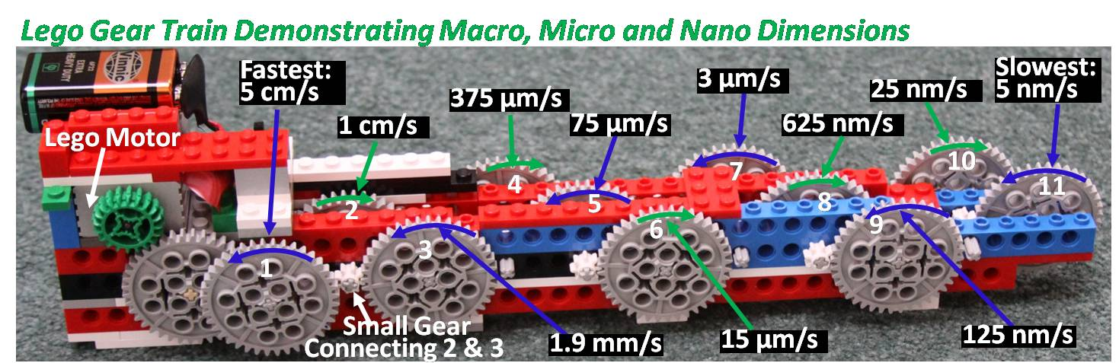
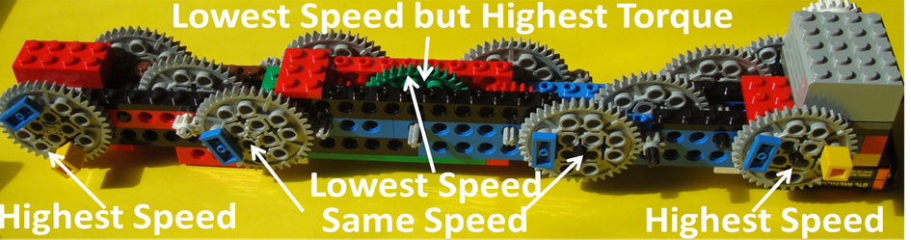
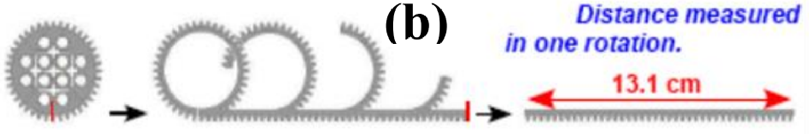
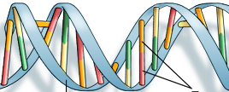
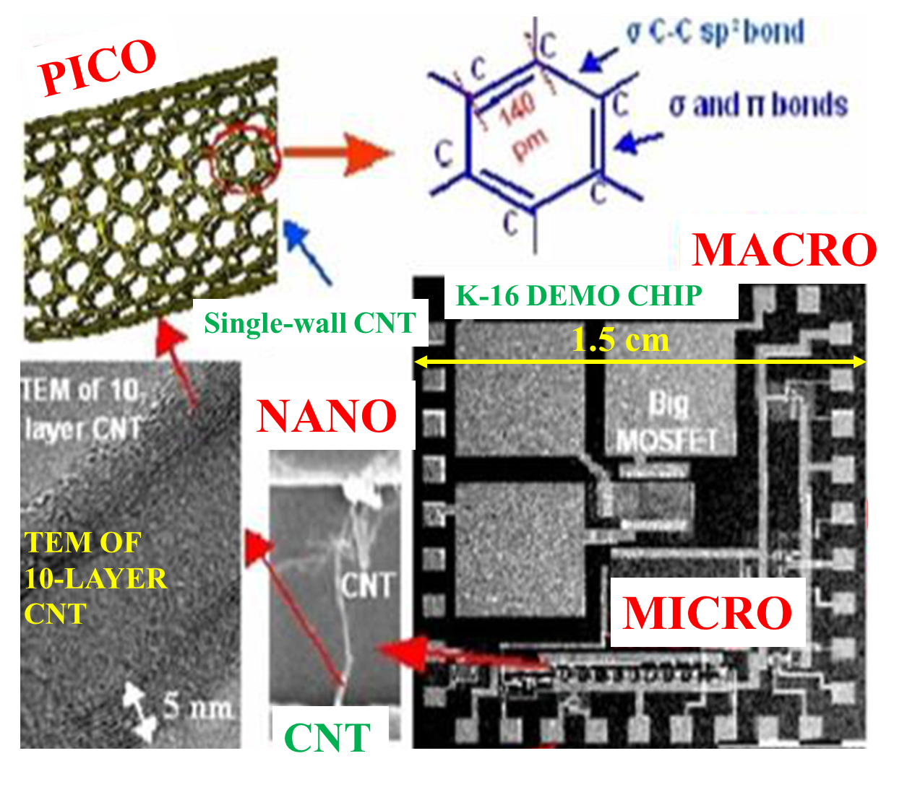
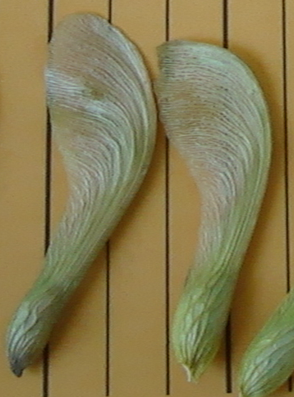
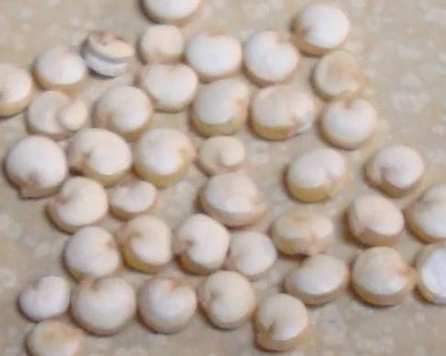
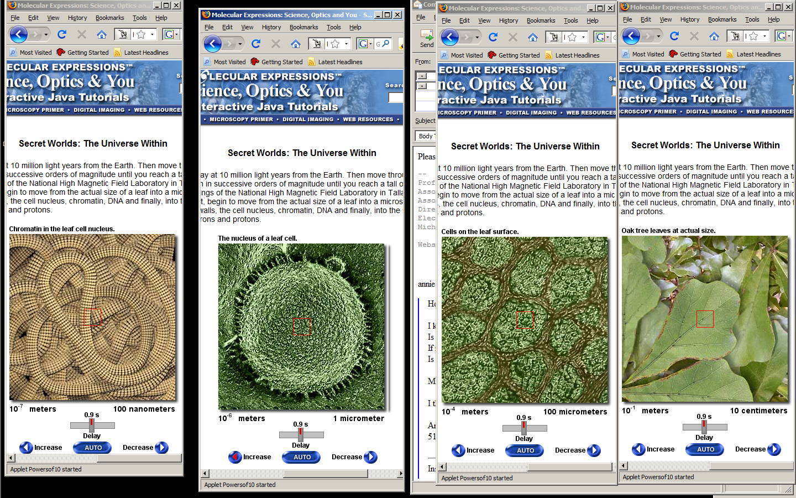
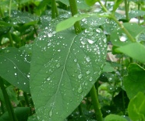
EXPLAIN MACRO, MICRO, NANO, PICO & FEMTO
The gear 11 takes 301 days to complete one revolution; & gear 10 takes 60.2 days for one revolution
3.6 nm
Z
Quinoa Grains (Contain 8 Amino Acids)
100 nm
2 nm
Lansing to New York
Base Pairs
Chromatin in a Cell
340 pm
Moon's Orbit
Particles Causing Static Charge
10⁹
m
10⁶
10³
m
10⁰
10⁻³
m
10⁻⁶
10⁻⁹
m
10⁻¹²
10⁻¹⁵
m
Gm
Mm
km
meter
mm
μm
nm
pm
fm
K-16 Test Chip
Satellite Height; 3.6x10⁷ m
Definition of Nano:
Sizes < 100 nm:
Physical Properties Change
New Science Needed to Explain
Cell Nucleus in a Leave
1 Meter = 1000 Millimeters
1 mm = 1000 Micrometers
1 µm = 1000 Nanometers
1 nm = 1000 Picometers
1 pm = 1000 Femtometers
Leaves
1 µm
http://micro.magnet.fsu.edu/primer/java/scienceopticsu/powersof10/
Notes:
Examples of explanations of dimensions and a creative geartrain using LEGOS. A challenging question by Conrad, a 2nd grader from Okemos Elementary School. Unique K-16 Test-chip suggested by Okemos High School teachers.

Slide 6
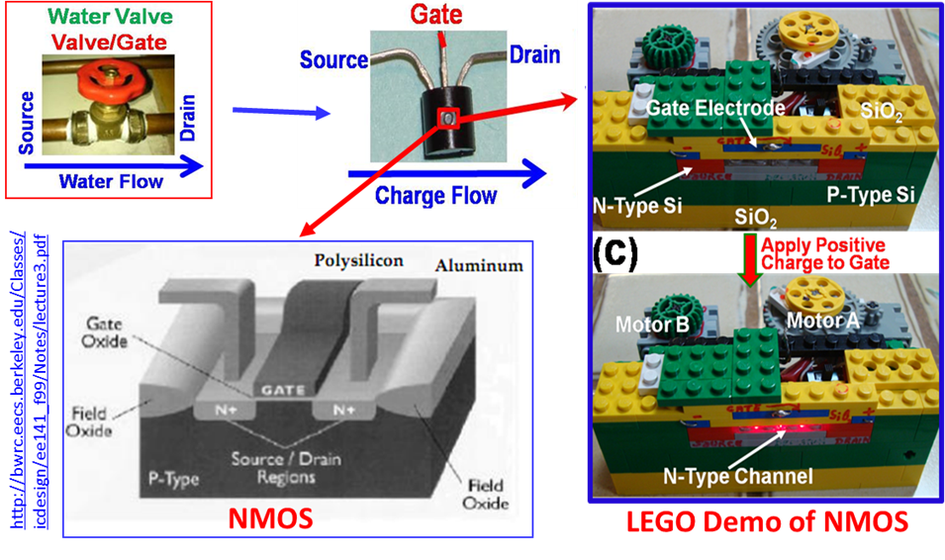
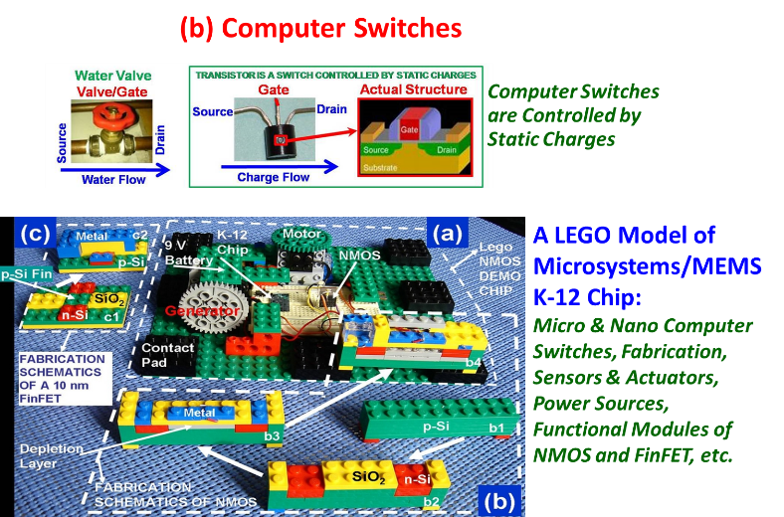
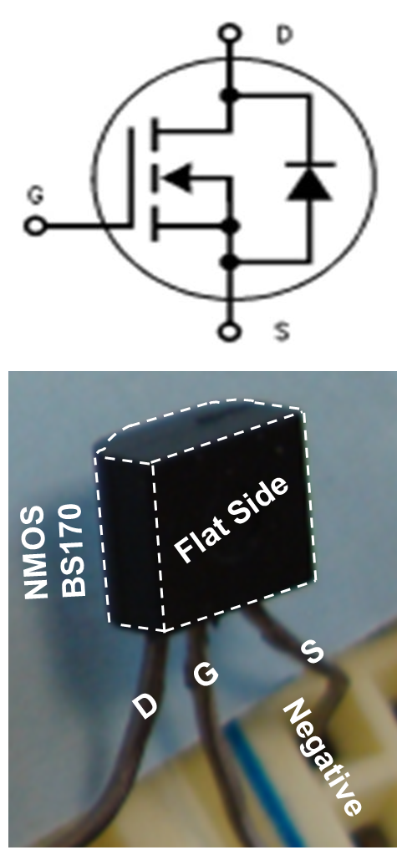
Computer switch demos and a Testchip using LEGOs
Notes:
Examples of Computer Switches and a Test-chip using LEGOS are unique and creative.

Slide 7
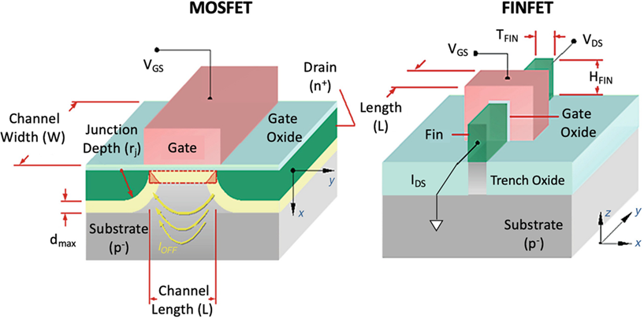
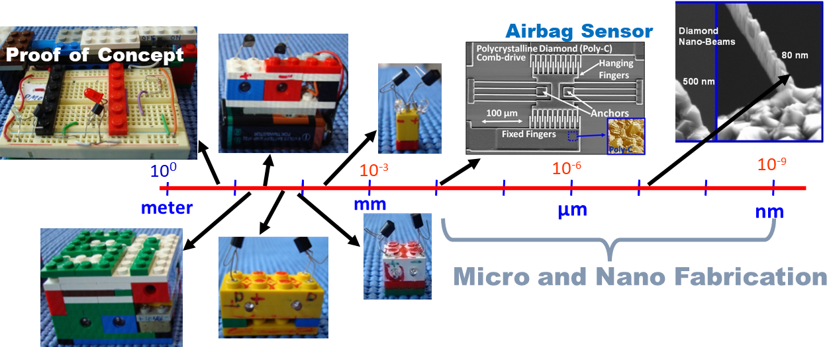
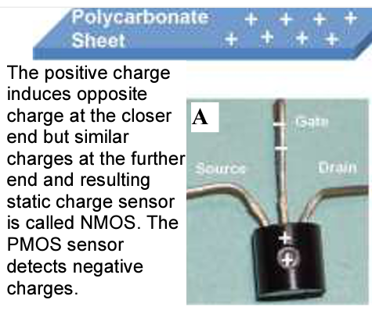
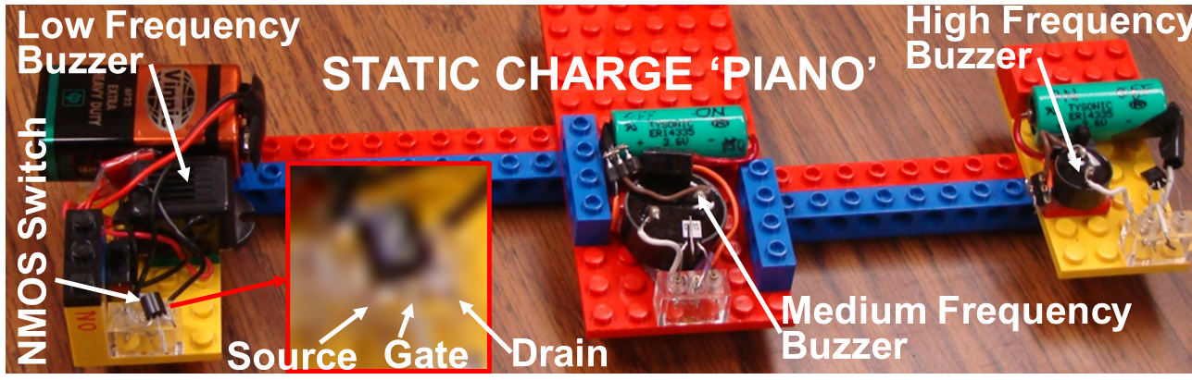
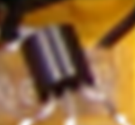
MINIATURIZATION OF SENSORS & MEMS (Micro Electro Mechanical System)
MOSFET
FINFET
Static Charge Sensors Made by Dean Aslam
Fabricated by Dean Aslam’s Doctoral Students
Notes:
Here are examples of FET (Field Effect Transistors); MOSFET and FINFET, and a real MOSFET switchable by static charges. Micro and Nano Fab technologies using diamond.

Slide 8
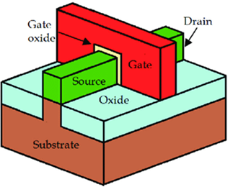
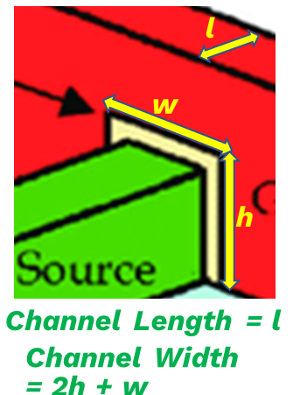
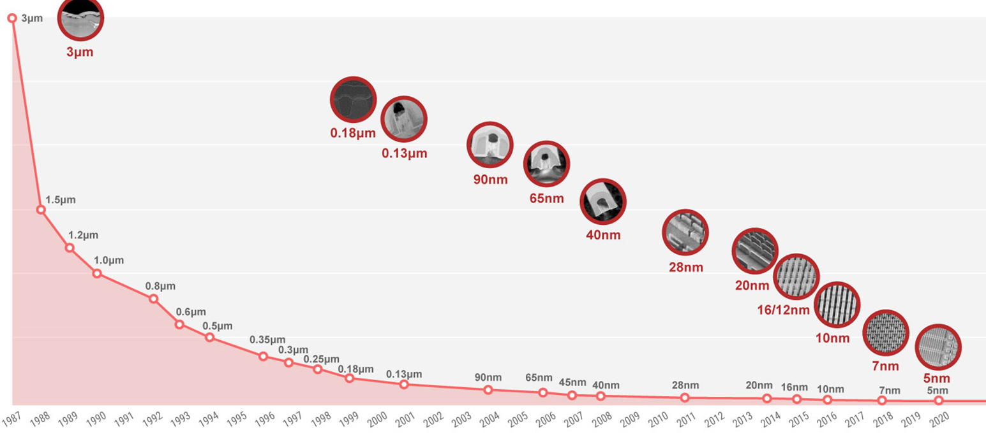
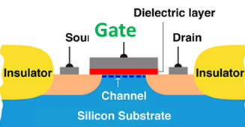
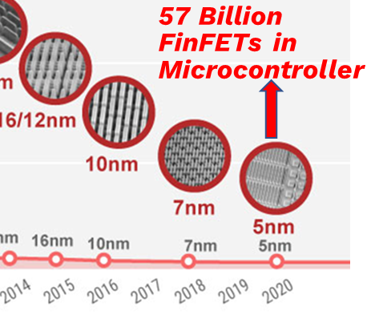
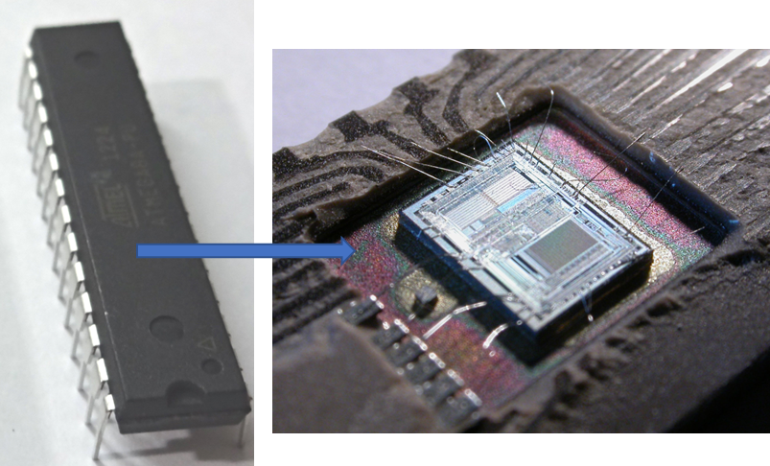
Dean Aslam’s Doctoral Thesis at RWTH, Germany: Fabricated 10 µm MOSFETs
FinFET
MOSFET
57 Billion FinFETs in a Microcontroller
Microcontroller is a Single Chip Computer
Human Brain has 86 Billion Neurons
Notes:
Miniaturization of MOSFETs and FinFETS. Interestingly, 57 Billion FinFETs in a Microcontroller as compared to 86 Billion Neurons in Human Brain!

Slide 9
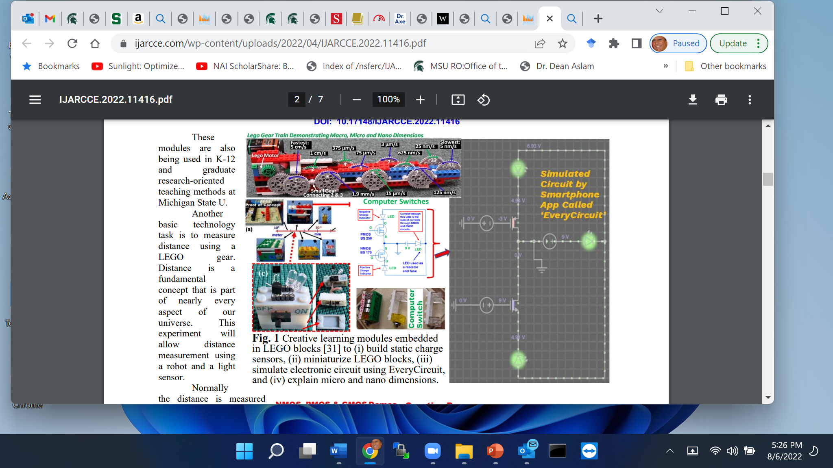
EveryCircuit App: Circuit Simulation Using Android or iPhone
EveryCircuit App: Circuit Simulation Using Android or iPhone
3D Print MOS Sensors
https://ijarcce.com/wp-content/uploads/2022/04/IJARCCE.2022.11416.pdf

Slide 10
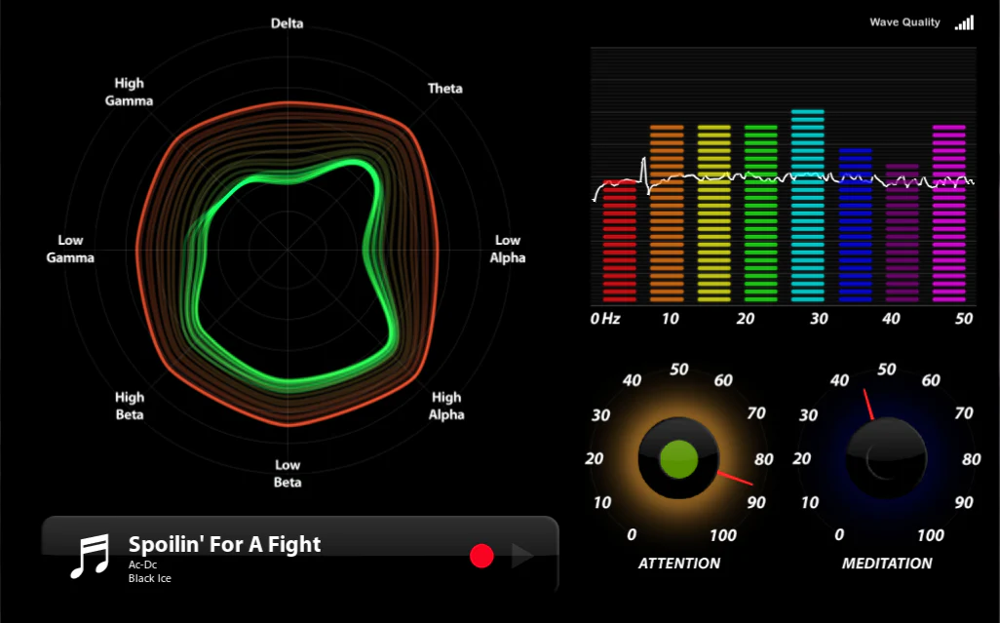
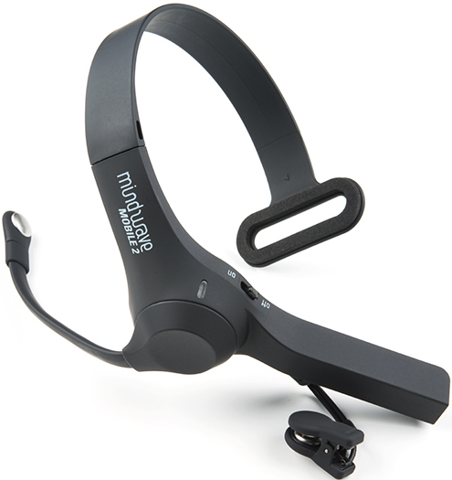
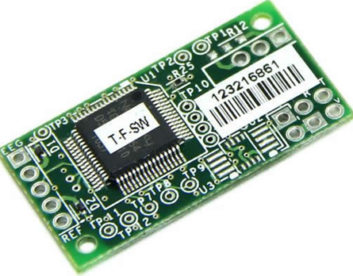
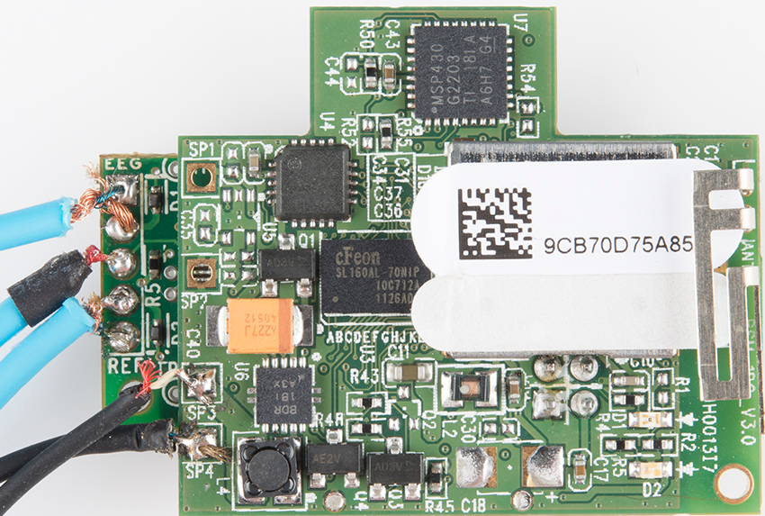
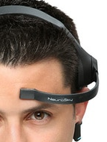
BRAIN SIGNALS; EEG (Electroencephalogram): Raw Signal, Delta, Theta, Alpha, Beta &
Gamma Waves, Attention & Meditation Levels
Anxiety, Depression, ADD, ADHD,
Empathy, etc., Algorithms
MINDWAVE MOBILE 2
TGAM Board
Self-Study of Psychological/Other Health Problems
WHY Self-Study?

Slide 11
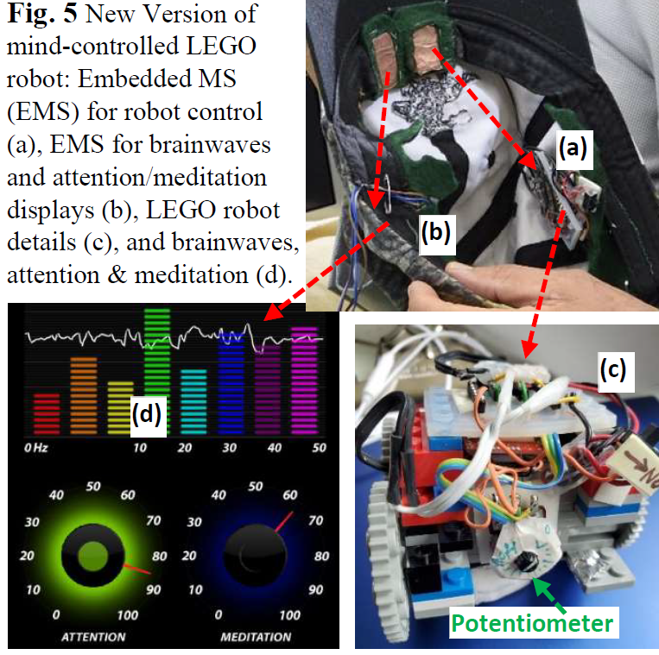

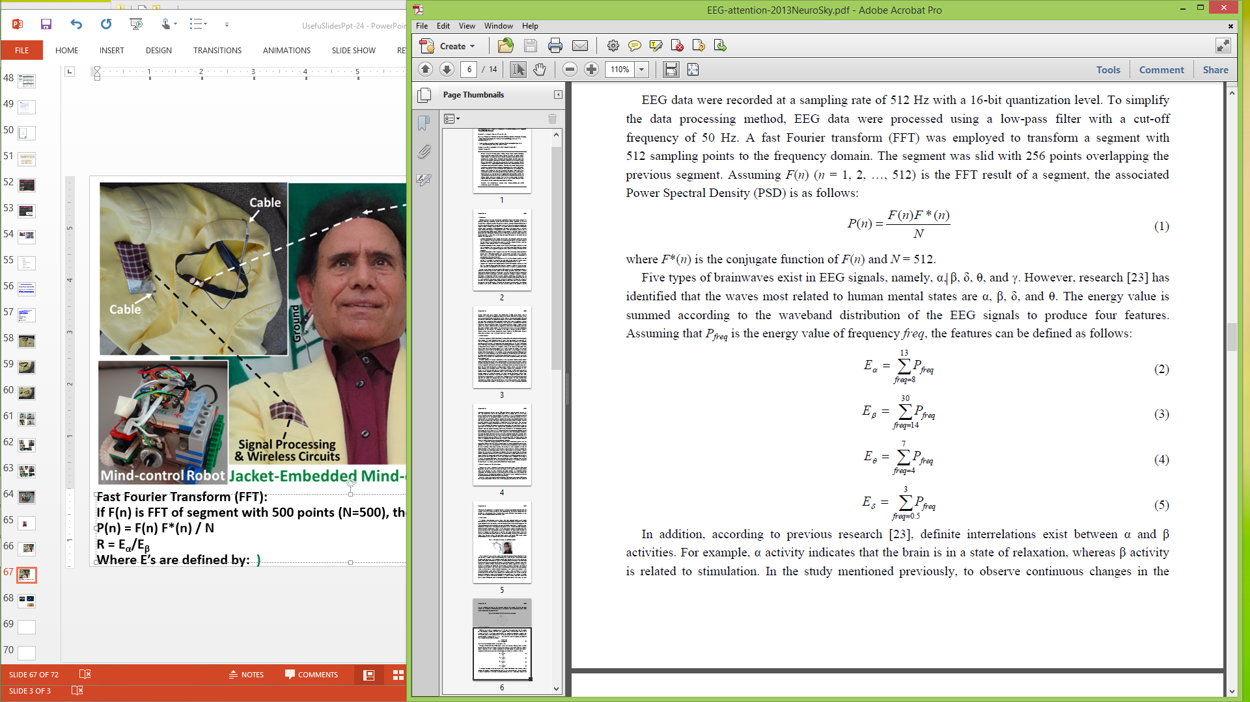
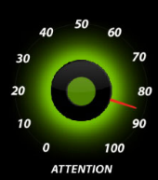
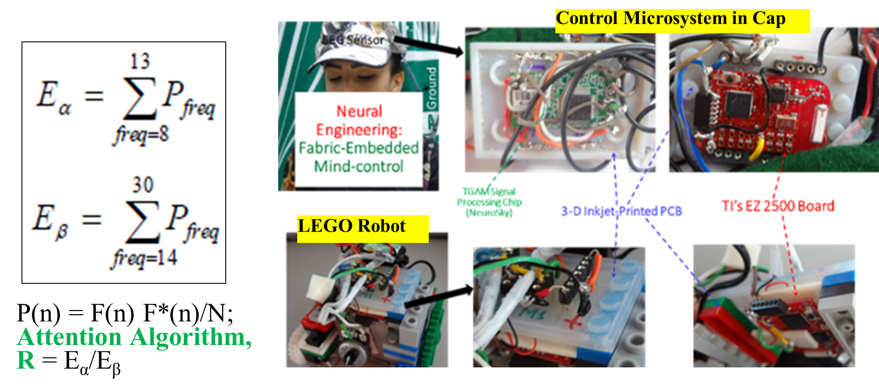
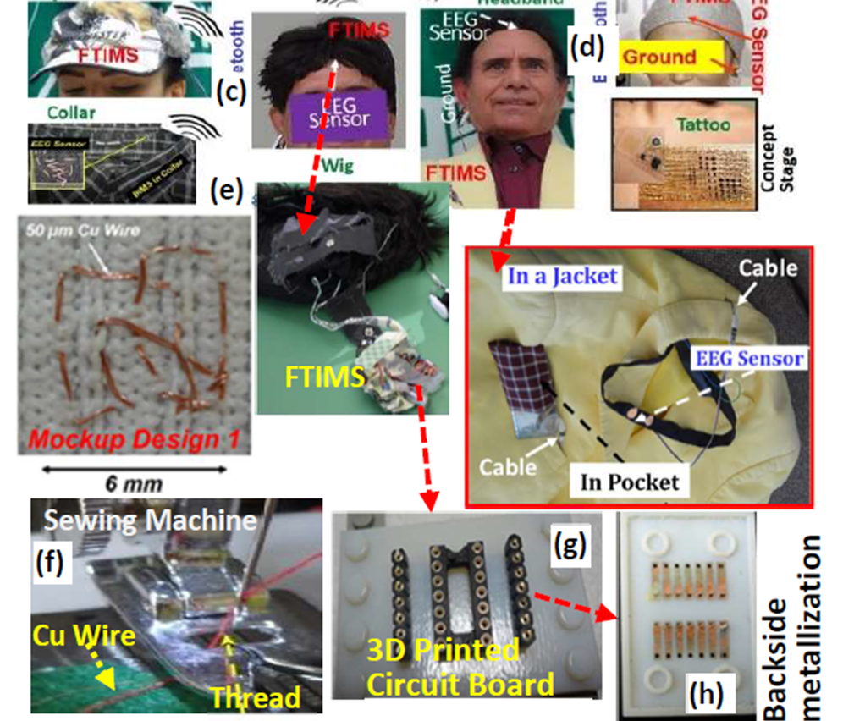
Latest Versions of Mind-controlled Robot and 8/16 Sensor OpenBCI System
  PRELIMINARY STUDY: Anxiety-controlled LEGO Robot; In anxiety, attention and meditation levels are low. AA (Anxiety Algorithm) = Attention x Meditation; lower the AA value higher the anxiety
Attention Level:
R = E_{α}/E_{β}

Slide 12
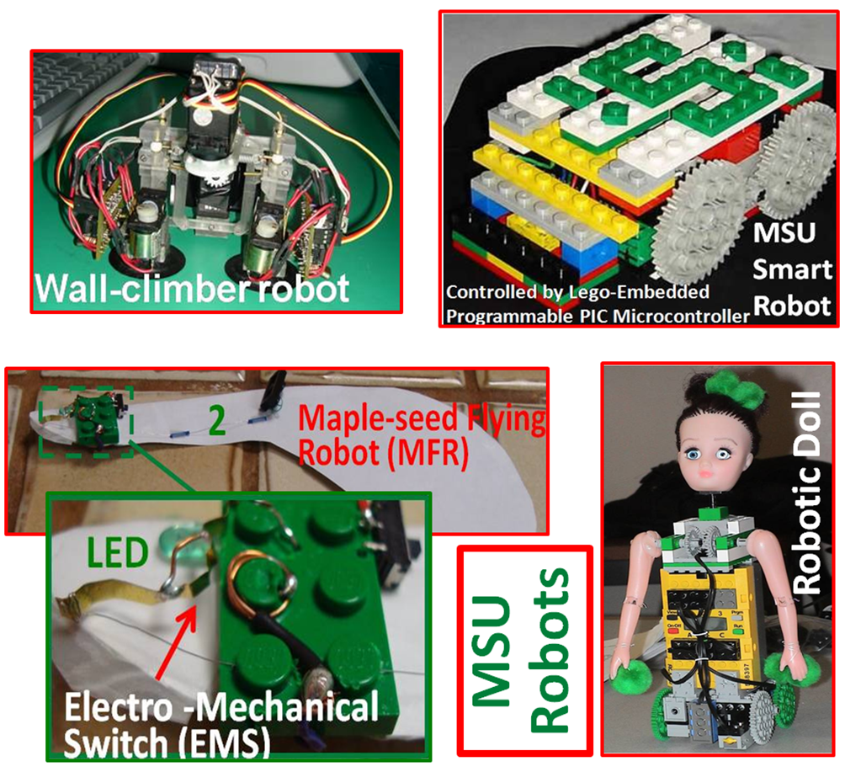


Functionalized Nanobricks with Embedded Intelligence (FNEI) Functionalized Bricks with Embedded Intelligence (FBEI)
Creative FBEI & FNEI For Research-Oriented Provocative STEM and Workforce Learning
https://ijarcce.com/wp-content/uploads/2020/06/IJARCCE.2020.9605.pdf;
Notes:
A large number developed. See this paper for details.

Slide 13


DESIGN, FABRICATION AND TESTING OF LEGO V-D GRAAF GENERATORS (Designed, Built & Tested by Dean Aslam)
https://ijarcce.com/wp-content/uploads/2021/06/IJARCCE.2021.10601.pdf
Notes:
Design Fabrication and Testing LEGO based VDG.

Slide 14








Maple-Seed Robotic Fliers
Initial Test
Microfabricated
Monitor the Environment; Detect Viruses?
(Original Idea by Dean Aslam in 2012)
Now: A joint project guided by Profs. Xiaogan Liang (UM) and Dean Aslam (MSU)
Notes:
Maple-Seed Flyer Project at UM and MSU.

Slide 15





ROBOTICS & NANOTECHNOLOGY CAMPS/WORKSHOPS: 2002 - 2015
KNOWLEDGE FLOW?
www.egr.msu.edu/~aslam
aslam@msu.edu
A School Teacher
January 2023: RESTART OF ROBOTICS & NANOTECHNOLOGY CAMPS/WORKSHOPS FOR SCHOOLS, COLLEGES, OTHER NATIONALLY AND INTERNATIONAL ORGANIZATIONS; contact deanaslam@gmail.com
A 2nd Grader Builds & Programs a Card-Sorter Robot
Advanced Projects
DEMOS & QUESTIONS
ROBOTICS & NANO CAMPS/WORKSHOPS
Smartphone Controlled LEGO Robot, NMOS & PMOS Demos,
Notes:
Summer Camps, restart camps, advanced projects

