Slide 1



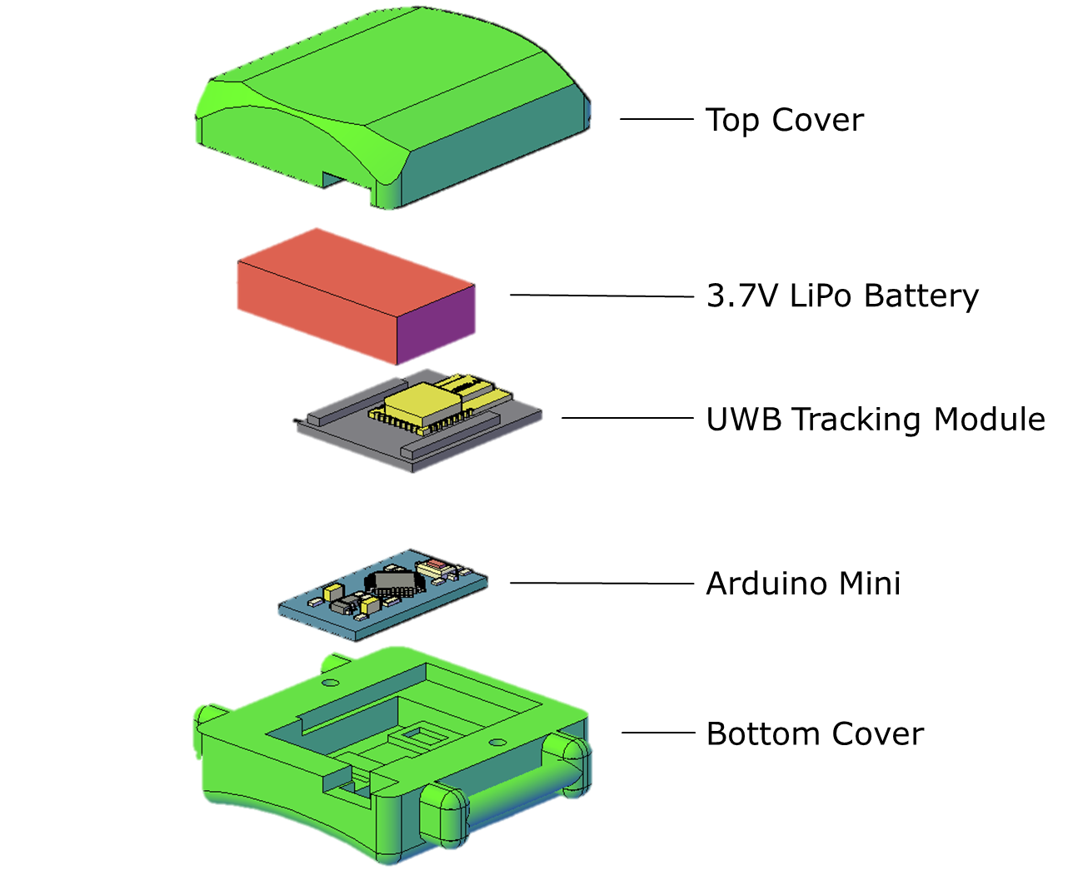
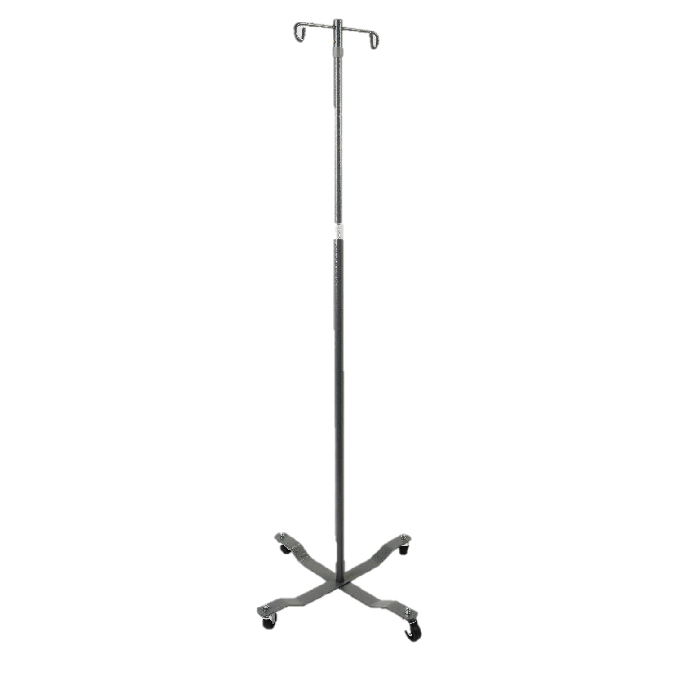
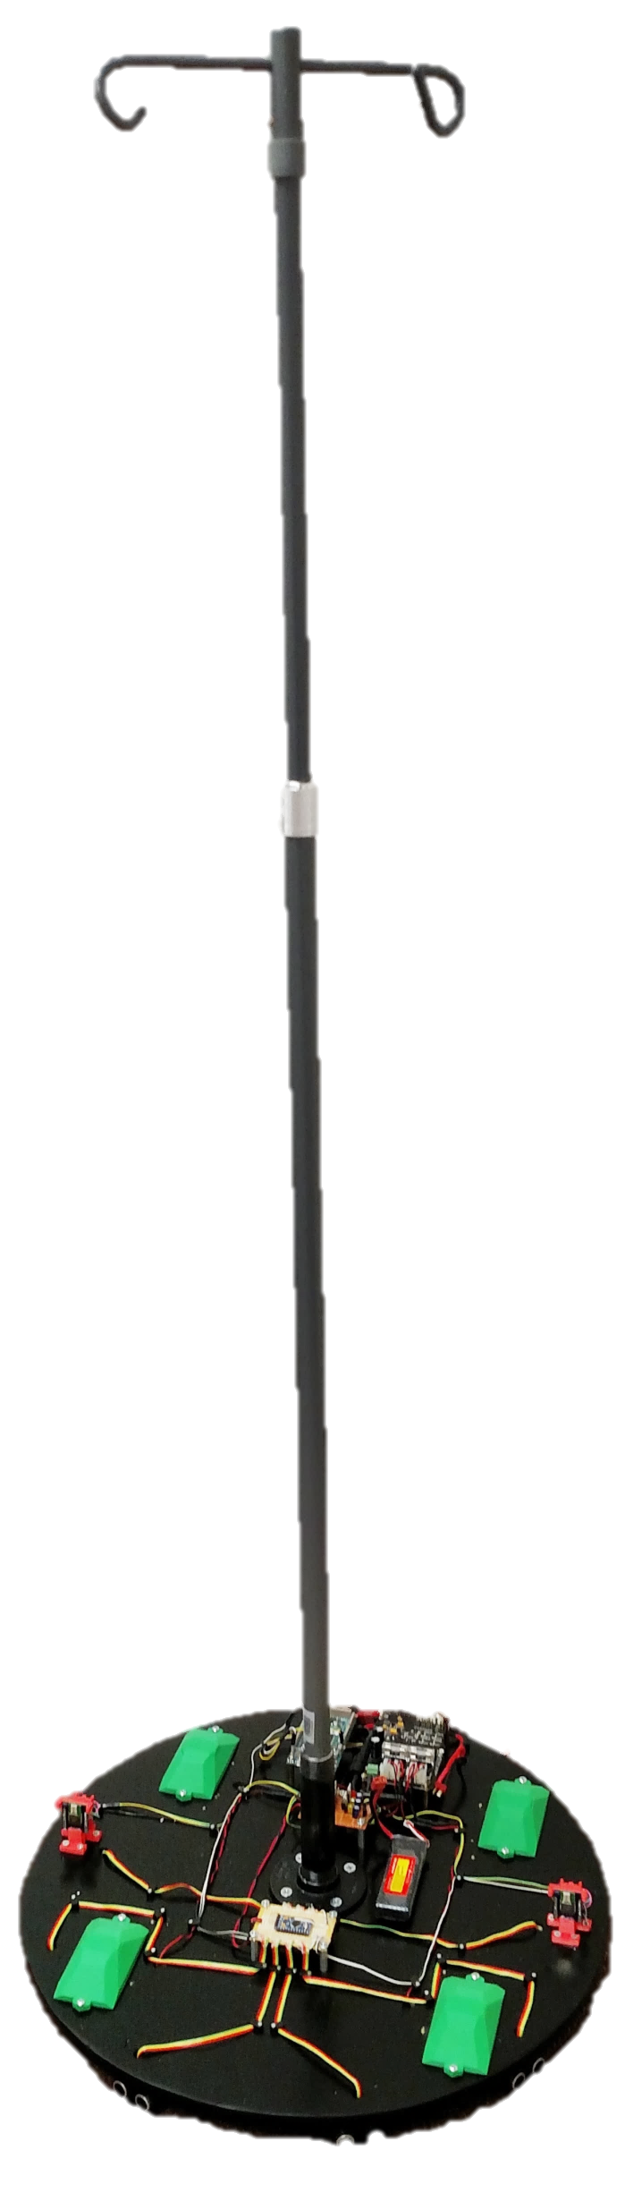
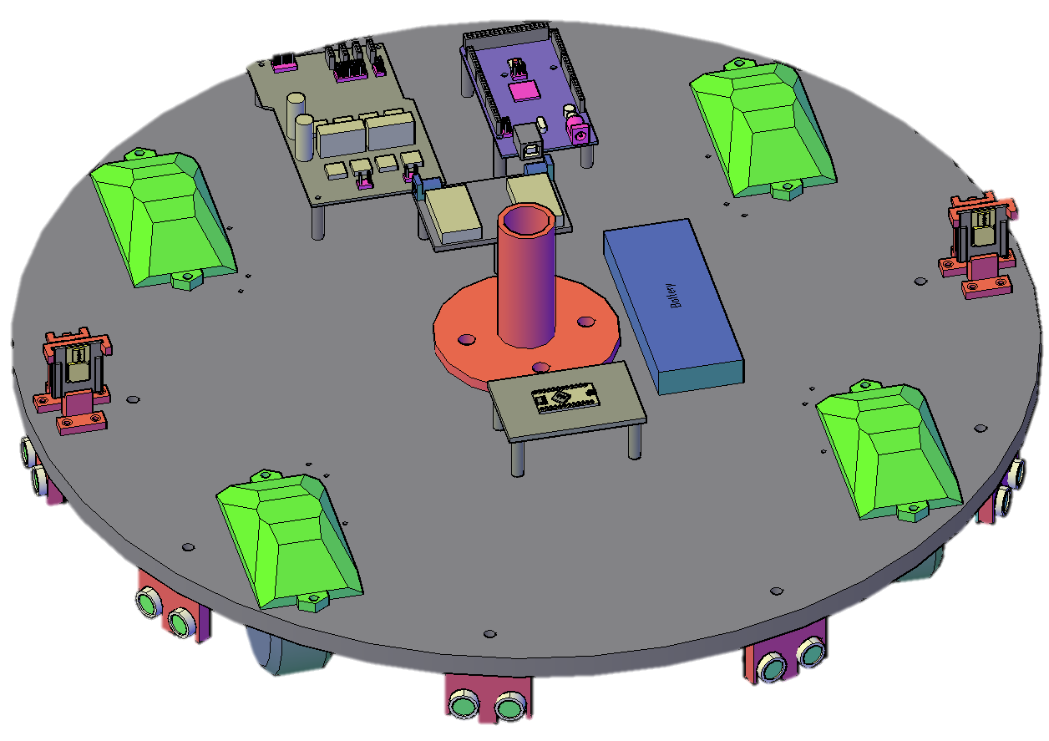
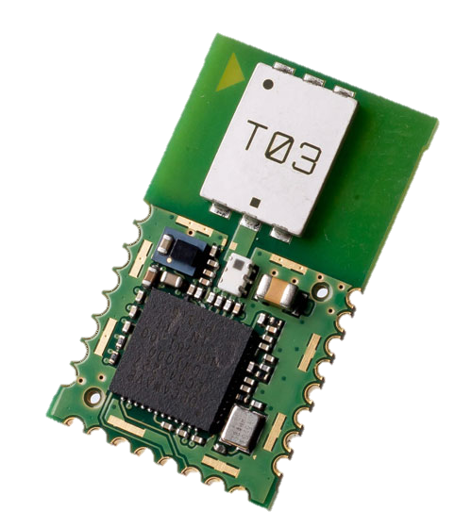
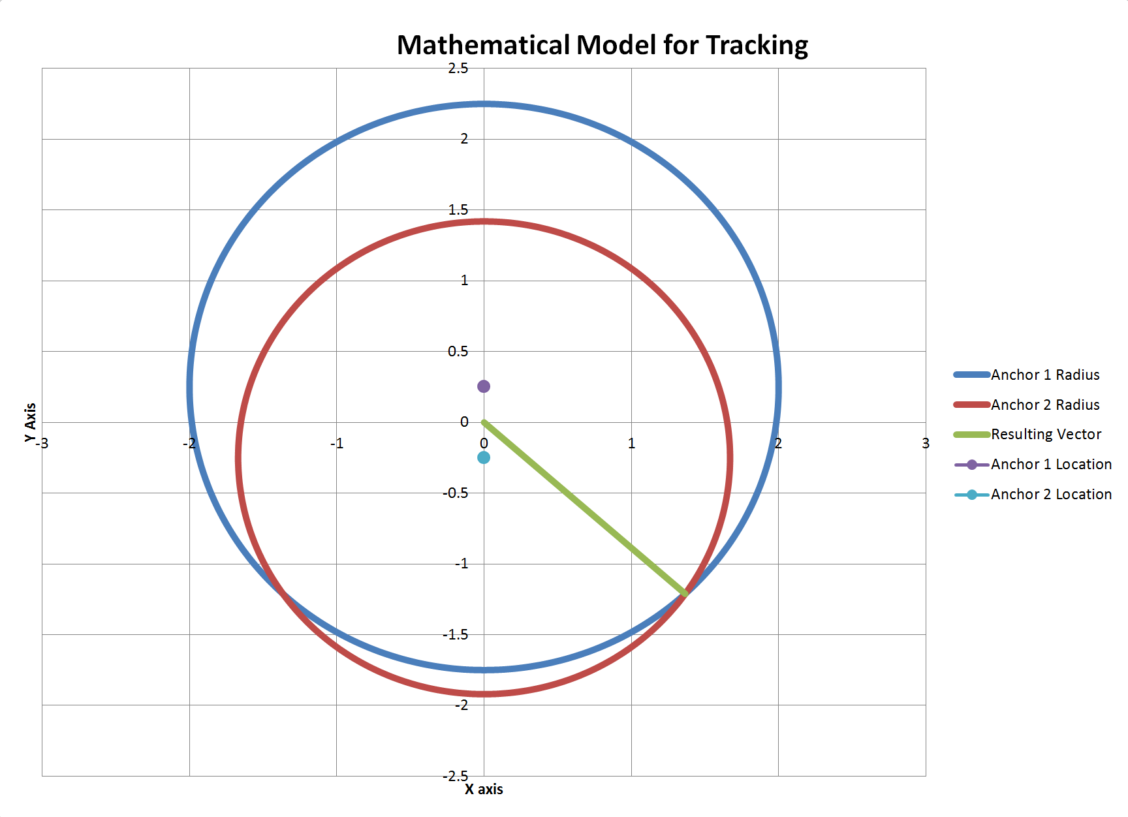
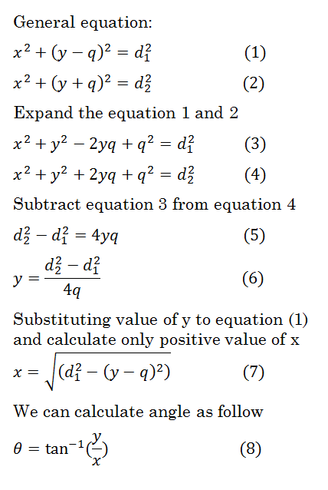
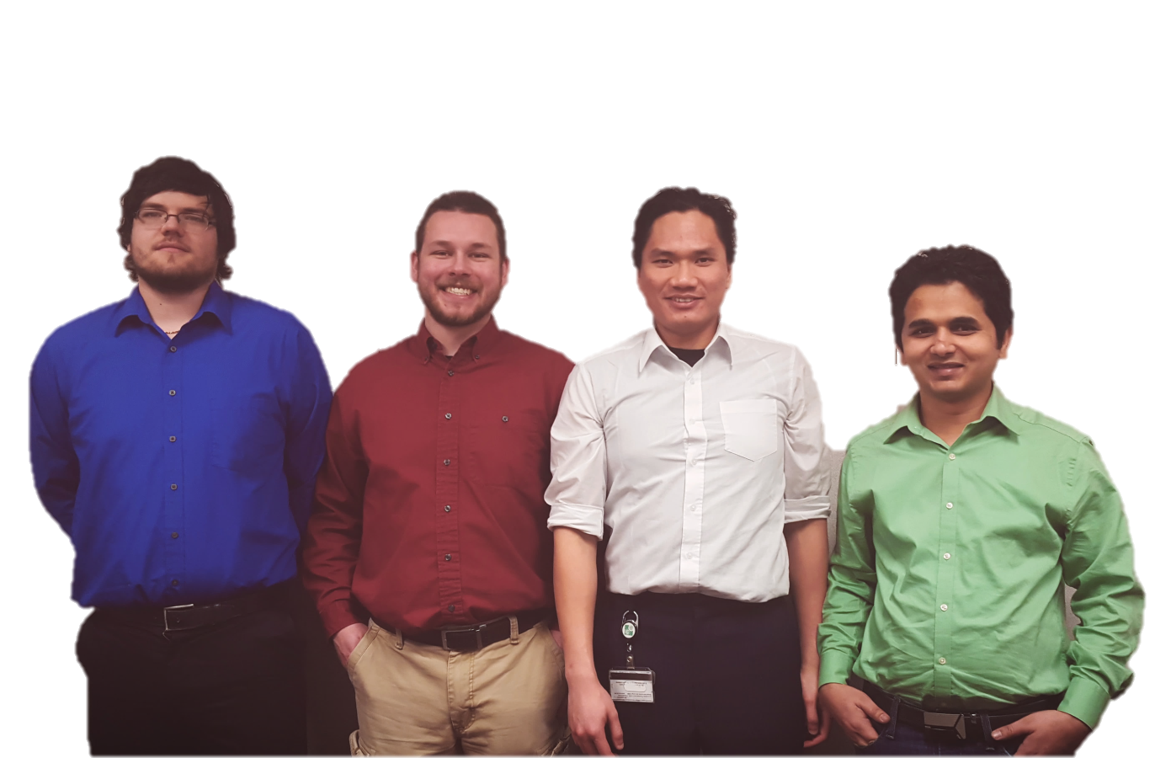

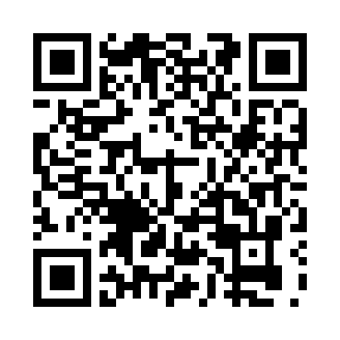
ECE-480 : Senior Design
IV Assistant Robot
● Bhim Khanal ● Brandon Hart ● Lam Nguyen ● Vincent Zickefoose
Background
Results
An area of potential improvement in the day-to-day operations of hospitals is the method by which intravenous (IV) therapy is currently administered. The
Design
The robot successfully follows the patient with an accuracy within 10cm, executes maneuvers like turning around corners, zero-radius turns, backing up,
Using two ultra wideband modules mounted on the base (below) and one in a wristband (right), both distance and angle can be wirelessly calculated using a simplified version of trilateration
typical IV pole(right) is unstable and difficult to move, especially for weakened, disabled, or otherwise incapacitated patients. This causes a potentially hazardous situation where patients must either struggle to move the pole, potentially tripping and falling, or must move with the help of a healthcare professional, which is inhibitive to both the patient's independence as well as the health care personnel's time and efforts
Our aim was to replace
this traditional IV pole with an autonomous robot capable of following the patient giving them
freedom of
mobility and
privacy
and going through doorways. The battery life is around one to two hours, and it can carry the pole and an IV bag while following the patient
Tracking
Wristband
Final Cost
Hercules Skeleton Bot Kit | 159.99
Tracking Modules | 75.75
Controllers | 79.95
5000 mAh Battery | 32.99
IV Pole | 24.73
3D Printed Parts | 26.00
Misc. Connectors and Adapters | 32.45
Misc. Hardware and Parts | 75.68
TOTAL | $507.54
The robot also has an obstacle avoidance system that protects it from colliding with walls and other large objects, as well as a capacitive touch-to-stop system that halts the robot if a person touches the pole
Robotic Base
At any given point in space, there are always two points created from intersecting circular regions of the two anchors. These two points are vertically symmetrical around the y-axis therefore points occupy on the left side of the origin and was eliminated through logic in the controller
Ultra Wideband
Module
Sponsor: MSU ECE Department Facilitator: Ramakrishna Mukkamala
Not exciting enough?
Scan to see
it in motion!

