Slide 1
Sensors and
Wireless Communication
Daniel Sun, Connor Grossman, Gao Xin, Hong Yi Shen, Daniel Gomez

Slide 2
Outline
LED
Sensors
Wireless Communication

Slide 3
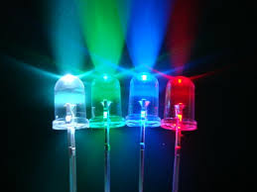
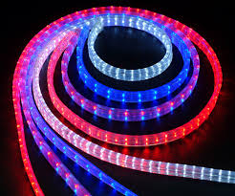
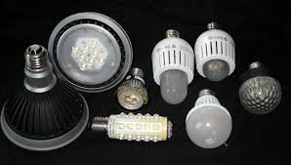
LED
Light-emitting-diode
Notes:
two-lead semiconductor light source.
One type of pn-junction diode.
The color of light is determined by the material that is used to make the semiconductor and the current runs through it.

Slide 4
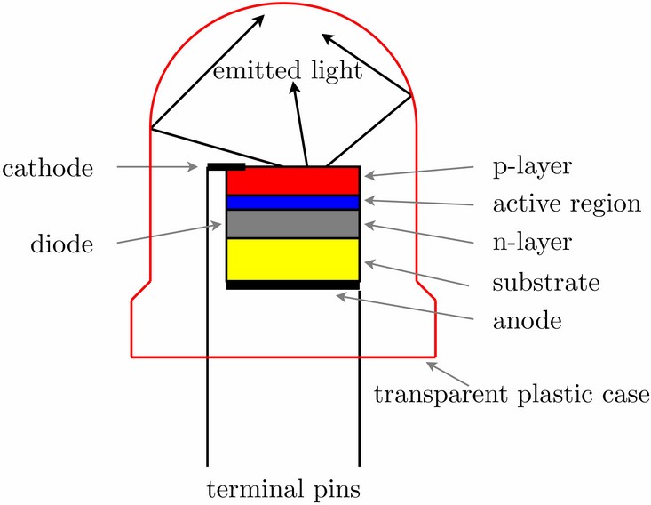
How does LED work?
Movement of electricity
Electrons recombination
Releasing energy
Electromagnetic radiation
Notes:
Creates light by using the movement of electricity along the path of its semiconductor.
When a suitable voltage is applied to the leads, electrons recombine with electron holes in the device and releasing energy in the form of photons.
When electrons stream through the semiconductor, electromagnetic radiation will be generated, and some of the electromagnetic radiation takes the form of visible light that human eye can see.

Slide 5
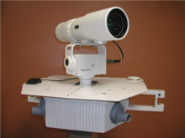
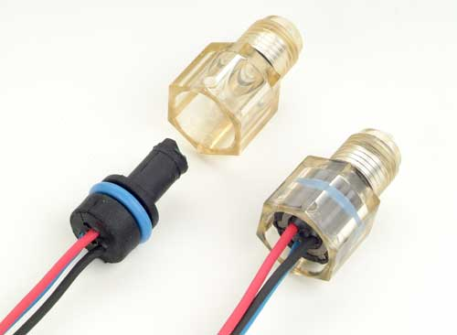
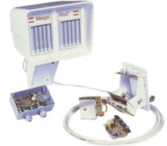
Electro-Optical Sensor
Light is turned into readable data
  the quantity of light is what is being measured
The sensor consist of an optical sensor, a light source, measuring device and an electric trigger
  electric trigger in our case is a microcontroller
Common uses
  Lamps
  position sensors
  speed sensors

Slide 6
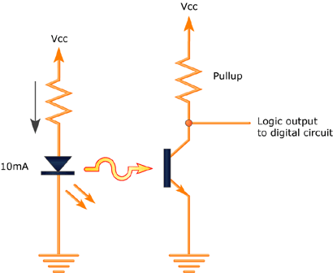
How it Works
Optical sensor
  phototransistor base current changes by the intensity of light. The modified current then changes the logic value
Light source
  LED is usually light source
  CTR (current transfer ratio)
    fixed current through the LED is crucial this determines the value of the pull up resistor
Electronic trigger
  microcontroller can serves as a measuring device
  Microcontroller monitors the current through the pull up resistor
  current values will trigger a logic 0 or 1

Slide 7
To Implement or Not?
extrinsic vs. intrinsic
On the bottom and top of the dispenser cup is where the LED and phototransistor are placed
Microcontroller will monitor current through the pull-up resistor
Detergent/fabric softener/bleach will affect the intensity of light received by the phototransistor
  this new intensity of light must significantly change the base current of the transistor
Pros
  can give very accurate logic highs and lows
  inexpensive
  easy to implement
Cons
  the current and resistors values need to be very specific
  LED brightness will need to be strong to get a very specific current
  failed LED will cause the system to fail

Slide 8
Chemiresistor
Metal Oxide | Vapours
Chromium Titanium Oxide | H₂S
Gallium Oxide | O₂, CO
Indium Oxide | O₃
Molybdenum Oxide | NH₃
Tin Oxide | Reducing Gases
Tungsten Oxide | NO₂
Zinc Oxide | hydrocarbons, O₂
Measures Chemical Material
  changes to electrical resistance
Most Common Chemiresistor
  refer to Table 1
First commercialized 1970
  detected carbon monoxide
Table 1: Metal Oxide Materials and purposes
Notes:
Another sensor that we looked into is the Chemiresistor. The chemiresistor is relatively new to the world of sensors. It was first commercialized in 1970 and mostly used as a gas sensor as we can see from Table 1.From table 1 we also see the different type of materials that chemiresistors can be made out of and the purposes of these materials. These are the vapours that they are going to sense or they have purposes such as reducing gases. The easy way of describing how chemiresistors work is that the vapor would change the electrical resistance material on chemiresistors and that will lead to the material that chemiresistors has senses then it will produce an electrical response for further usage.

Slide 9
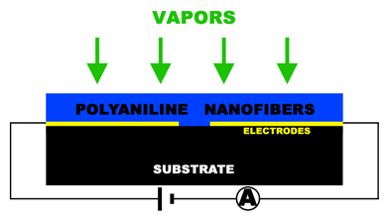
Chemiresistor Operations
Molecules adsorbed on surface
  creates electrical resistance
  modulate the change in resistance
Resistance change proportional to pressure
Converts concentration of chemicals into measurable electrical signal
Different Materials create different sensitivity
Notes:
This is the operation of the chemiresistor. First the Vapors are adsorbed on to the surface which creates a electrical resistance. Due to the change in the electrical resistance, the chemiresistor modulates the change in the resistance and determine the material that is sensed.The way that resistance change is through the pressure that it takes from the vapour and the resistance is normally proportional to pressure. After it intakes the pressure and the resistance values, it converts them into measurable electrical signal and from there on, different materials would create different type of sensitivity, therefore, the user would know what type of material is currently present, and then the user can decide to do with the given data.

Slide 10
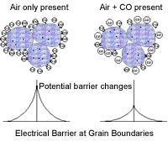
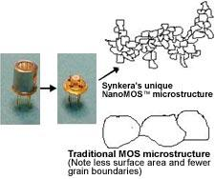
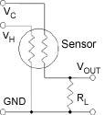
Chemiresistor Examples
Synkera Technologies
  Chemiresistors we have today
MOS Sensor Operating Principles:
• Gas adsorption on surface of the metal oxide changes electrical resistance.
• Reducing gas donates electrons and oxidizing gas "grabs" electrons.
• Change in resistance is a surface reaction and dependent upon the amount of surface area.
• Surface interactions occur at elevated temperatures.
Synkera NanoMOS™ sensors features/benefits
• Three unique sensor architectures:
• Planar sensors prepared via a thick film screen printing process
• Multilayer sensors
• MEMS sensors for low power and advanced operating modes
• Small size
• Improved sensitivity
• Low cost
• Fast Response
Operation of Planar and Multilayer MOS Sensors
• Sensor Resistance is a function of analyte concentration
• Log (resistance) is proportional to Log (concentration)
• Power required for heater operation of 100 mW to 1W.
Notes:
Here are some examples of the modern time chemiresistor examples. This is from synkera Technologies. As we can see the first one is Synkera Nanomos sensors, it has three unique architectures. all these structures are small in size and has improved sensitivity and has relatively low cost and a relatively fast response time. MOS sensor operating principles is the way it works and I’ve already talked about the general way of how it works in the previous slide. However Planar and Multilayer MOS sensors are different. The resistance is a function of concentration, and they are proportional to each other.

Slide 11
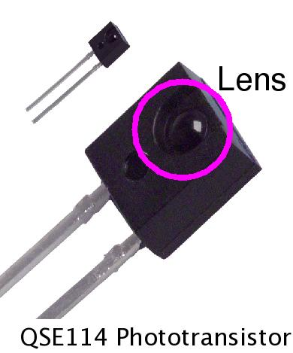
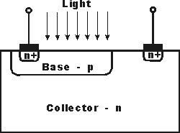
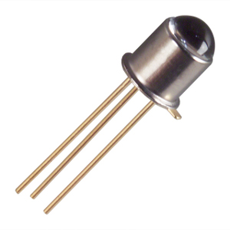
Phototransistors
A semiconductor Light Sensor
Larger base and collector areas than a normal Transistor, made by diffusion or ion implementation
Contains
  basic transistor with a transparent cover that has better sensitivity
Real Environment Uses
  reading finger positioning - touch screen
  monitoring paper positionings - printers/scanners
  Position Sensors
  remote controllers - audio visual equipments
Notes:
http://www.johnloomis.org/ece445/topics/egginc/pt_app.html
http://www.radio-electronics.com/info/data/semicond/phototransistor/photo_transistor.php
http://en.wikipedia.org/wiki/Photodiode
The last sensor that we are going to introduce is the Phototransistors. A phototransistor is a semiconductor light sensor. It has a larger base and collector areas than a normal transistor and the way that they do it is through diffusion or ion implementation. It contains a transistor with transparent cover so that it has a better sensitivity. The Real world uses are that reading finger position on cell phones, monitoring paper postioning such as scanners and printers. Remote Controllers such as gaming devices and such.

Slide 12
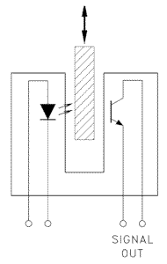
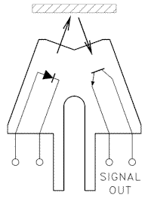
Operation Details
Operation
  light enters the base region
  electron pairs move due to electric field
    provides the base current
  electrons injected into emitter
Applications
  Optical Switch
    detecting objects when light source is blocked from detector
  Retro Sensor
    Senses reflection of object after light shines upon it
Why use Phototransistors?
  Low cost
  Available for Gains from 100 to over 100,000
  Moderately Fast Response times
  Available in many chip form
  Usable in many light sources, Most specifically ambient light sources
  Can be selected to have best fit in to your objective
Notes:
The way it works is that light enters the base region which causes hole electron pairs to be generated. Electron pairs will then move under the influence of the electrical field provided by the base current and causes the electrons to be injected into the emitter. Through the emitter the phototransistor than can sense what material is there due to the current flow and that’s how it detects what material is there and what to do with the material afterwards. Some real world applications include optical switch where as you can see from the picture. It detects the objects when the light source is blocked from the detector therefore sensing something is there because the light source has been blocked by an object. Another one would be the Retro sensor which senses the reflection of an object after light shines upon it. The reason that people would use phototransistors are that it is low cost, it has a wide variety of gains and it has a moderately fast response time. It’s available in many different forms and also usable in many light sources. It could specifically selected to meet a project's goal or need.

Slide 13
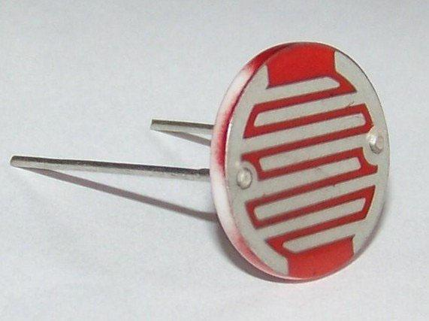

Photoresistor
Light-controlled variable resistor.
Photoconductivity
  The resistance of a photoresistor decreases with increasing incident light intensity.

Slide 14
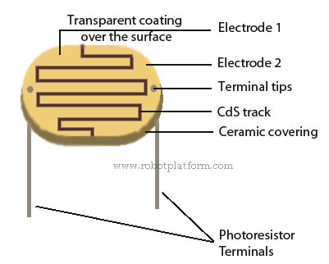
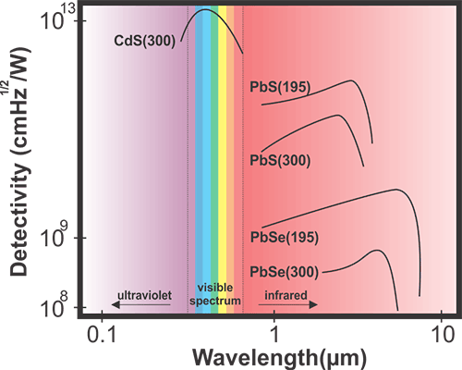
Cadmium Sulfide (CdS)
inorganic compound
intrinsic material (undoped)
Production of an electron hole pair
  CdS + hν → e⁻ + hole(+)
  this increase conductivity when irradiated with light because of free moving electrons
direct band gap of 2.4 eV
works best in the visible light range
peak sensitivity 560-600 nm

Slide 15
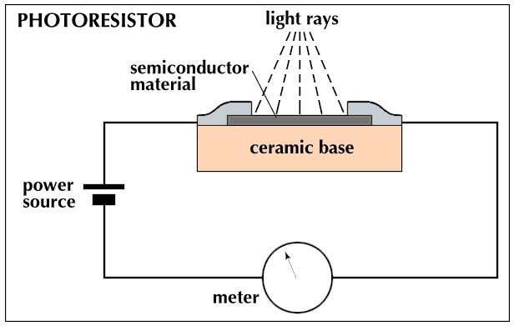
How does photoresistor work ?
Notes:
A photoresistor contains a thin film of semiconductor material, typically made of lead, calcium sulfides or cadmium sulfides, deposited over ceramic base.
When the semiconductor is exposed to light, photons from light will be absorbed by these materials and energy is transferred to electrons, which break up resulting in lower resistance and higher electrical conductivity.

Slide 16
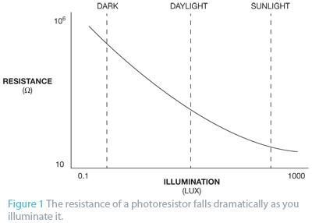
Applications of Photoresistor
Street lights, clock radios, alarm devices, night lights, outdoor clocks, solar street lamps, etc.
Use with small incandescent or neon lamp in guitar amplifiers

Slide 17
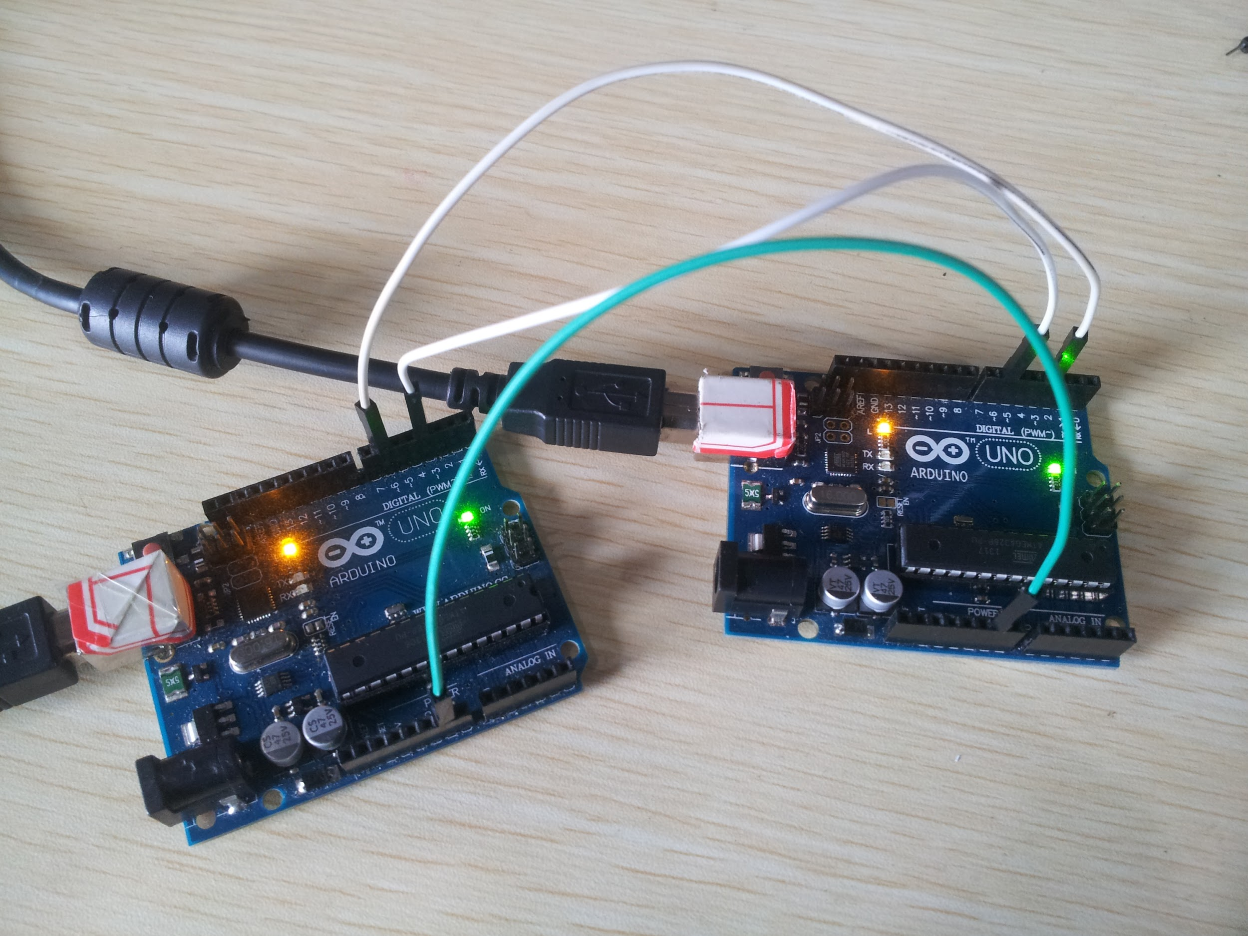

Data communication
Wire Communication
Wireless Communication
Date communication is very common nowadays, we use them everyday like remote control,short message etc.
Typically, there are two ways of Data communication: wire communication and wireless communication

Slide 18
Wireless communications
Wireless communication refers to the process of transferring information between two points, with no electric contact between them.
The most common type of wireless is RF communications.

Slide 19
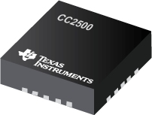
RF Transceivers
A transceiver is a device that comprise both a receiver and a transmitter. It is usually used for high speed data transmission.

Slide 20
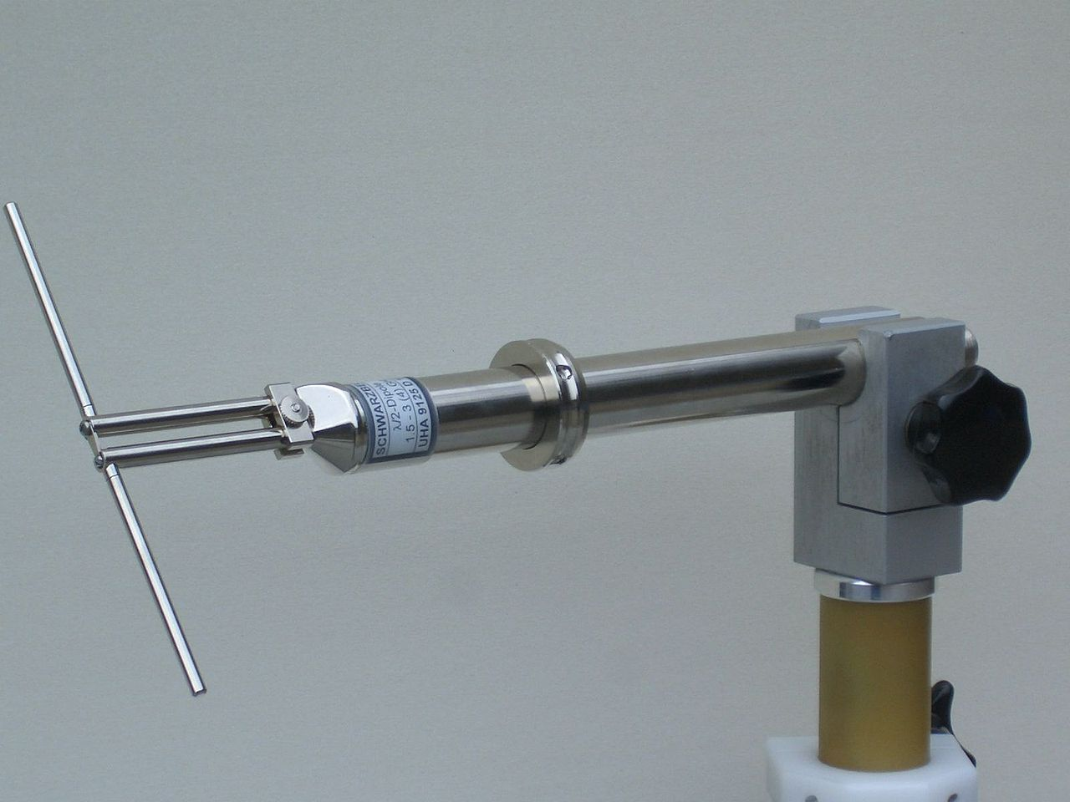
RF Antennas
Antennas are a necessary device for wireless communication, they convert electric power into radio waves and viceversa.

Slide 21

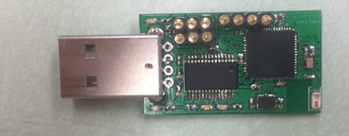
Computer Interfaces
USB ( Universal serial bus) provide the way of wire communication.
pros
convenient
common
reliable
microcontroller embedded with the USB port
USB (Universal Serial Bus) is the very common computer interface. It provide the way of wire communication. Most of computer have USB port now so it will be easy to use. It help to realize the data communication between device and computer.

Slide 22
Computer Interfaces
UART (Universal Asynchronous Receiver/Transmitter) is a piece of computer hardware that translates data between parallel and serial forms.

Slide 23
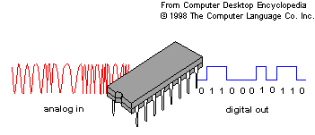
Analog-to-Digital Converter
AD converter ( Analog-to-Digital Converter)
Input: analog signal ( from sensors)
Output: Digital signal ( to microcontroller)
Sensors
Microcontroller
Some of sensors will provide the analog output, but the microcontroller will need digital signal.
Many of microcontroller has the Analog-to-Digital converter now. Normally it can convert the analog signal to digital signal in microseconds.

Slide 24
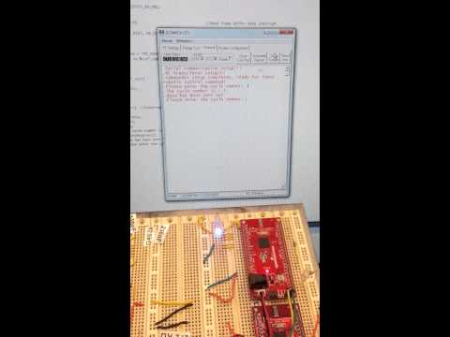
Data communication experiment

Slide 25
Data communication
USB port
ALU (computer)
microcontroller 1
Wireless communication
microcontroller 2
Dispenser Cup
AD converter
Sensors

Slide 26
Energy Transfer
To use energy more efficiently, energy transfer is one of very important part. The aim is to cost the less energy to provide the energy to the product continuously as needed
Light energy in room
Collect by solar panel
Store in button cell
Transfer to Micro-controller when needed

Slide 27
References
http://www.johnloomis.org/ece445/topics/egginc/pt_app.html
http://www.radio-electronics.com/info/data/semicond/phototransistor/photo_transistor.php
http://en.wikipedia.org/wiki/Photodiode
http://www.teccogroup.com/LED-Rope-light-p404.html
http://en.wikipedia.org/wiki/LED_lamp
http://naturescreationsinc.com/alternative-systems/led-lighting/
http://en.wikipedia.org/wiki/Analog-to-digital_converter
http://www.radio-electronics.com/info/data/resistor/ldr/light_dependent_resistor.php
http://en.wikipedia.org/wiki/Universal_asynchronous_receiver/transmitter
http://kids.britannica.com/comptons/art-53789/Photoresistor
http://www.edn.com/design/analog/4368794/Simple-night-light-uses-a-photoresistor-to-detect-dusk
http://www.education.rec.ri.cmu.edu/content/electronics/boe/light_sensor/1.html
http://nguyenmarysci4.tumblr.com/post/45739083253/what-the-led-how-it-does-it-work
“Electro-optical Senor” Wikipedia. Wikimedia Foundation Inc., 4 Feb. 2015. Web. 13 Mar. 2015.
“What is an Optical Sensor?” wiseGEEK. Conjecture Corperation, 12 Mar. 2015. Web. 13 Mar. 2015.
Ball, Stuart. “Exploring optical and magnetic sensors.” Embedded. 17 Jun. 2003. Web. 13 Mar. 2015.
“Cadmium Sulfide” Wikipedia. Wikimedia Foundation Inc., 22 Feb. 2015. Web. 24 Mar. 2015.

Slide 28

Questions?

