Slide 1
Dispenser Cup
ECE480 Senior Design Team 8
Daniel Sun, Gao Xin, Hong yi Shen, Connor Grossman, Daniel Gomez
Facilitator: Prof. Dean Aslam, Sponsor: Whirlpool
Notes:
Everyone 20s

Slide 2
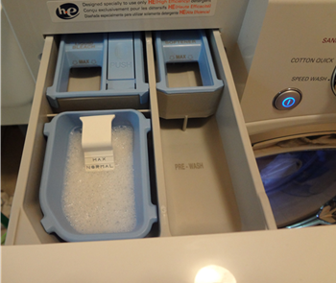
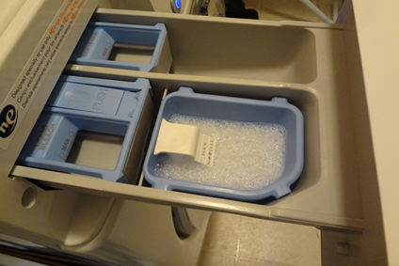
Dispenser Cups
Photos Provided By Dr. Aslam
Notes:
Daniel 15sec~~

Slide 3


Background Research
Whirlpool Corporation is one of the largest washing machine manufacturer.
The energy efficient and environmentally friendly are two important factor to sale of washing machine
Energy Star is an international standard for energy efficient consumer.
Notes:
Hongyi Shen

Slide 4

Executive Summary
Problem: Making the dispenser independant
Solution: Implementing a completely wireless system
Notes:
Connor Grossman, 40 secs

Slide 5
Customer Requirements
Independent power system for the dispenser cup
Wireless communication between the dispenser and the main part of the washer
Use photoresistor to detect the type of material (eg. powder or liquid)
Notes:
Gao Xin

Slide 6
Customer Requirements Cont.
To have the appliance control unit tell the dispenser which cups need to be filled and have it tell the user via LEDs
Dispenser is removeable and can be reassembled after cleaning
Notes:
Gao Xin

Slide 7
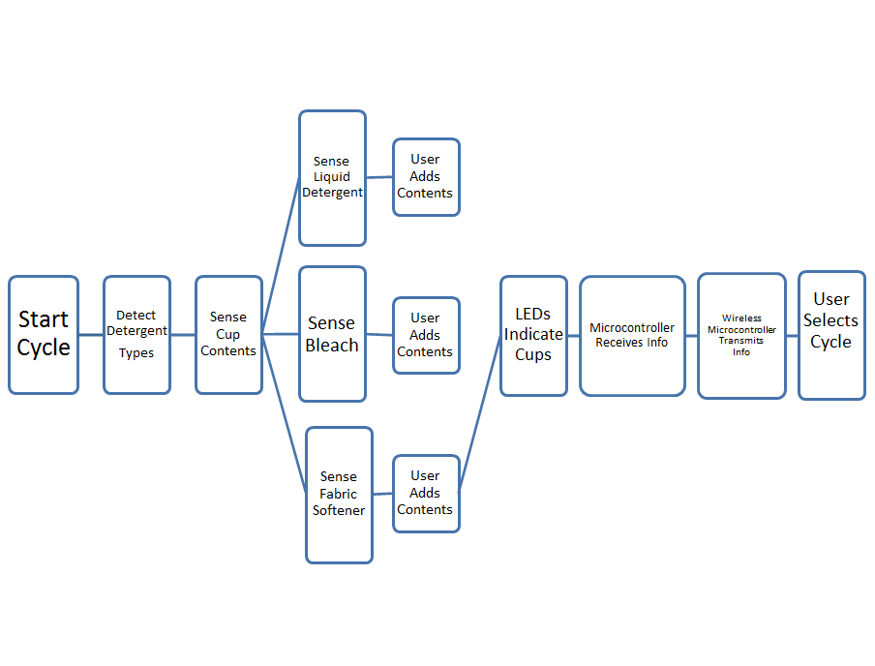
Fast Diagram
Notes:
Connor Grossman, 15 secs

Slide 8
Design Specifications
Wireless communication system
Solar cell independent power system for the dispenser
LED flashing Warning system
Independent dispenser cup that can be removed and cleaned
Notes:
Hongyi Shen

Slide 9
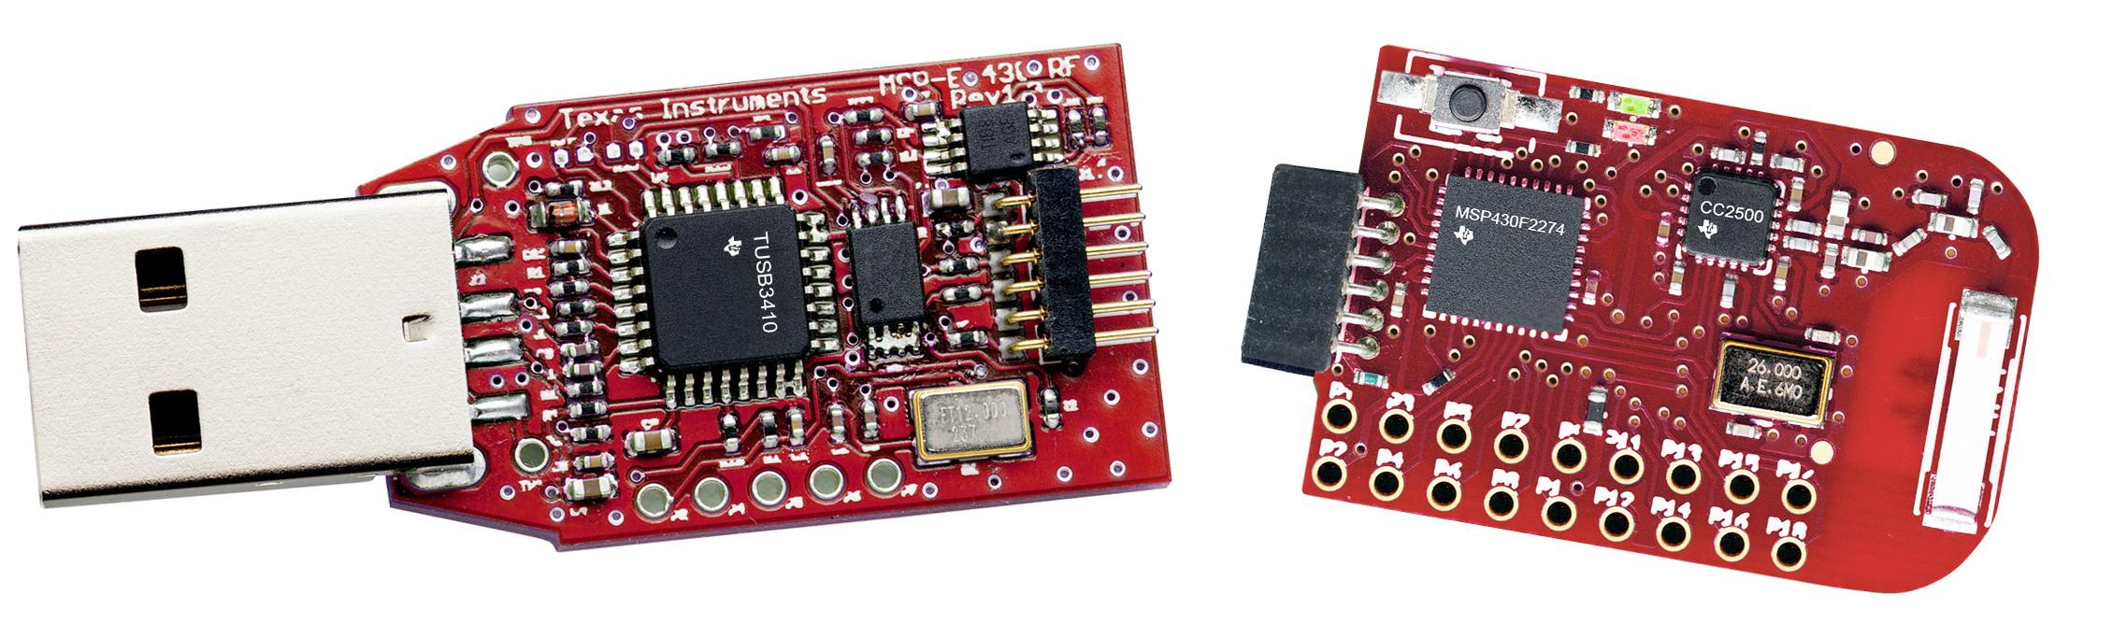
Wireless Controller Method One
TI Product: EZ430-RF2500
Cost: $120
Features: Low Power Transceiver, Programmer included.
Notes:
Daniel Sun
1 Minute

Slide 10
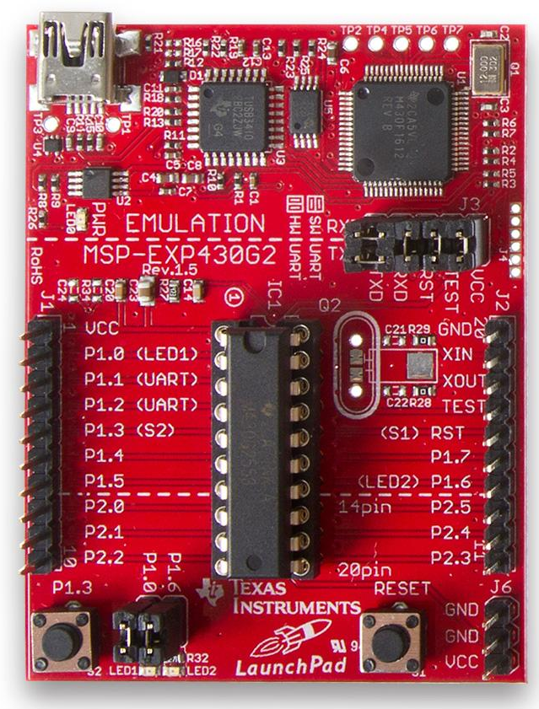
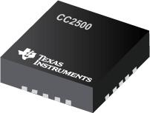
Wireless Controller Method Two
TI Product: MSP430-G2553
Cost: $3~
Features: Low Supply Voltage, Low Power Consumption.
TI Product: CC2500
cost: $4~
Features: Transceiver, low current consumption, high sensitivity.
Notes:
Daniel Sun
45 seconds

Slide 11
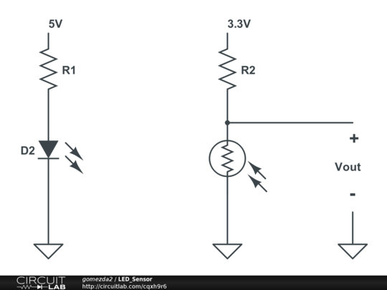
Sensor
LED Sensor
Red LED emits light
Photoresistor changes value depending on material
Output voltage is measured by the microcontroller
Depending on measured voltage material can be determined
Notes:
Daniel Gomez

Slide 12
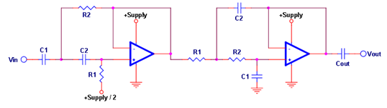
Proposed Design Cont.
Band Pass Filter
Ambient light issues
More accurate sensors
Notes:
Connor Grossman, 35 secs

Slide 13
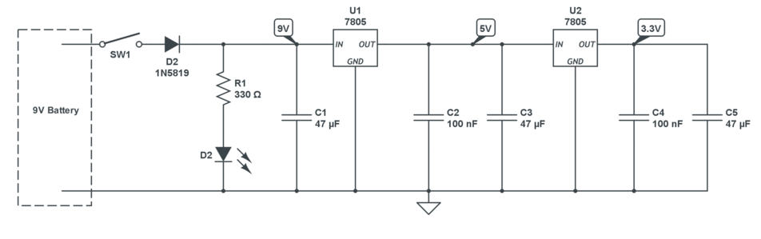
Power Supply
Notes:
Daniel Gomez

Slide 14
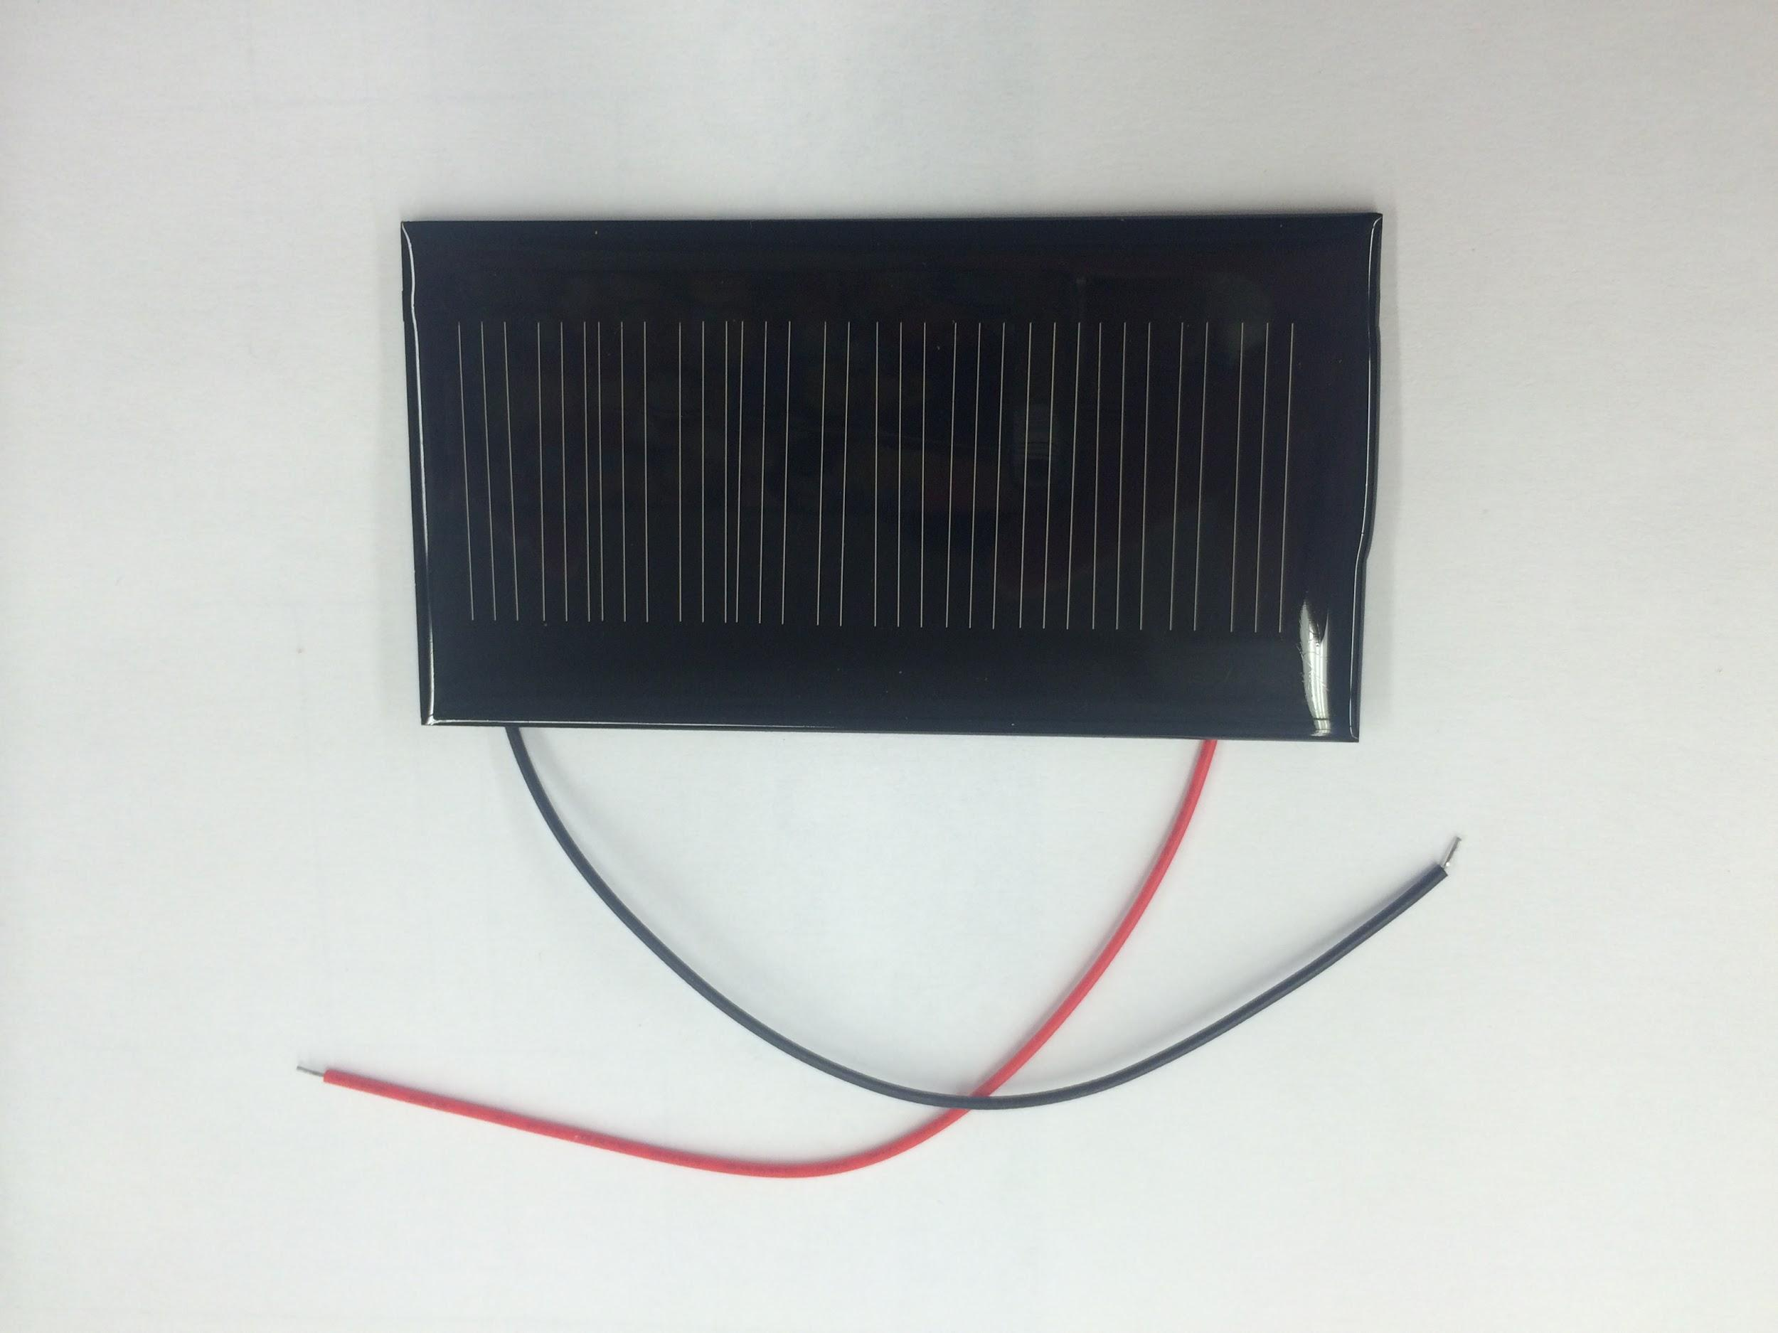
Solar Cell
Solar Cell that will be used to recharge the 9V battery used to power the entire system
Notes:
Daniel Gomez

Slide 15
Projected Plan Cost/Budget
Parts | Cost
20 piece of 50-100k ohm photoresistors | $4.22
9V Battery | $9.65
Solar Cell | $6.95
RGB LEDS | $9.95
Microcontroller | Varies
Detergent/Bleach/Softener | $40~
3D Model printing | Varies
 | Varies
Total

Slide 16
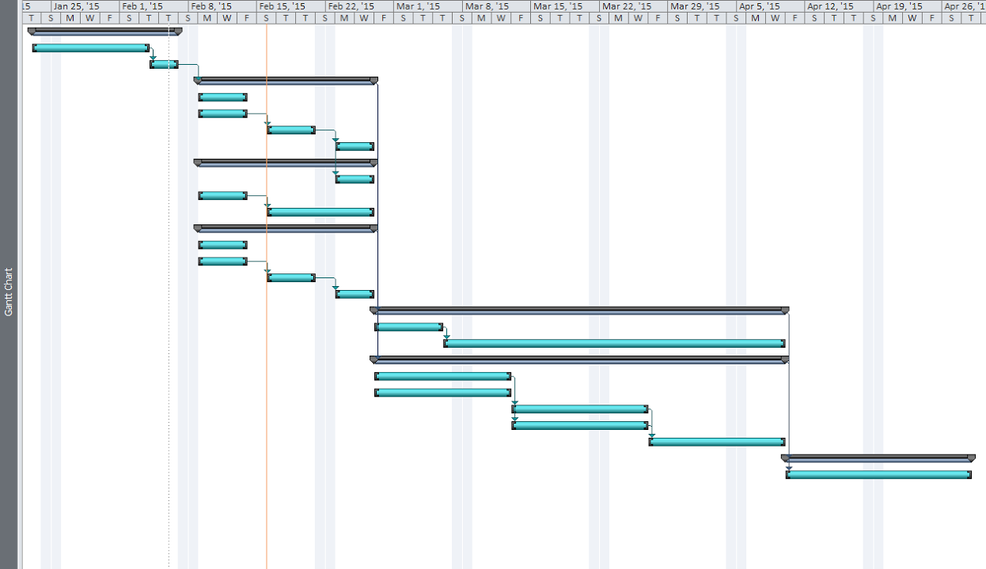
Gantt Chart
Refinement
Design
Prototype

Slide 17
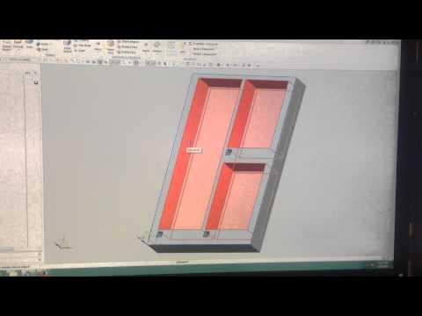
Proposed Design
First Layer
https://www.youtube.com/watch?v=-vuHKv-IN1I

Slide 18
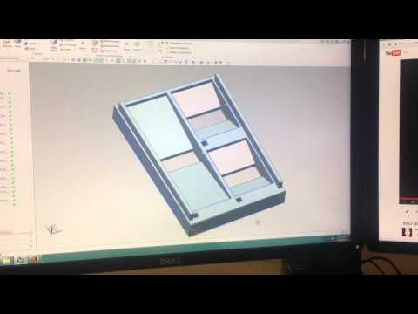
Proposed Design
Second Layer
https://www.youtube.com/watch?v=jSfQQ1IsYZs

Slide 19
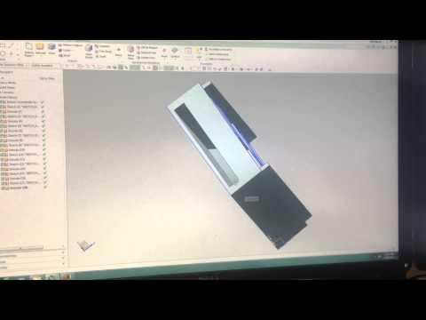
Proposed Design
Bottom Layer
https://www.youtube.com/watch?v=wNVwJLpacuM

Slide 20
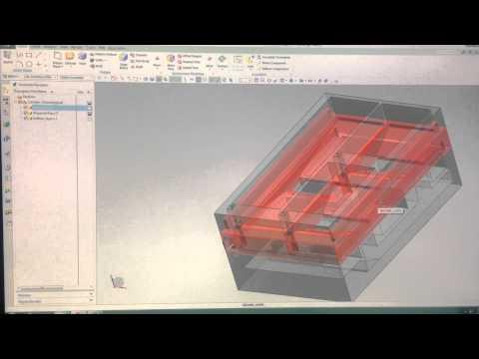
Proposed Design
Assembled 3-layer Dispenser Cup
https://www.youtube.com/watch?v=zzgmmQQ-HUw
Notes:
Gao, Daniel Sun

Slide 21
Special Thanks to
The Whirlpool Team
Dr. Dean Aslam (Faculty Advisor)
Brian, Gregg, and Roxanne (ECE shop)
ECE department for supplying labs and equipment.
Notes:
Daniel Sun
10 seconds~

Slide 22
Questions?
QUESTIONS?
Notes:
Everyone

