Slide 1
Team 7 Technical Presentation
RFID Technology
Notes:
Bingyang

Slide 2

Team Members
Trevor Emerick
Lauren Poole
Bingyang Wu
Jazmine Gaymon
Sponsor
Cliff Barnett
Facilitator
Nihar Mahapatra
Notes:
Bingyang

Slide 3
What is an RFID?
Radio-Frequency Identification
Small electronic devices
  Small chip
  Antenna
Up to 2,000 bytes of data
The overall use of RFID is increasing as it becomes cheaper to implement
Notes:
Bingyang
http://www.technovelgy.com/ct/Technology-Article.asp?ArtNum=1

Slide 4
What is NFC ?
Near Field Communication
Specialized subset within RFID
Branch of High Frequency RFID
Operates at the 13.56 MHz range
Ability to be a reader and tag
Peer-to-peer connections
Typically used for cellular devices
Notes:
Bingyang
http://blog.atlasrfidstore.com/rfid-vs-nfc

Slide 5
How does it work?
Three Components
  Scanning Antenna/ Reader (Current to EM. Waves)
  A Transponder/ Tag (EM. Waves to Current)
  Transceiver + Decoder (EPC)
These work together to create an RFID System
Notes:
Bingyang
http://www.technovelgy.com/ct/Technology-Article.asp?ArtNum=2
http://www.impinj.com/resources/about-rfid/how-do-rfid-systems-work/

Slide 6
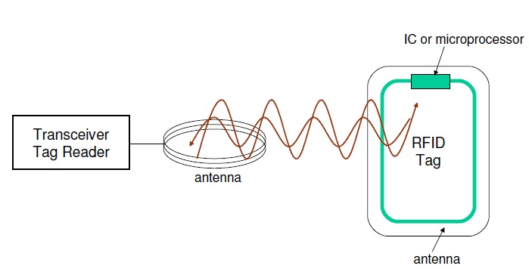
How does it work?
Notes:
Bingyang

Slide 7
System Design - Scanning Antenna
First part of the overall reading device
Obtains the tag value from the object it is attached to or implanted in
Vary in size depending on application and placement
Provides the RFID tag with power to operate
Notes:
Lauren

Slide 8
System Design (Cont.) - Transceiver
Second part of the overall reading device
Responsible for decoding the read RFID tag
Verifying whether it is a valid
Receives the broadcasted information from the transponder
Notes:
Lauren

Slide 9
System Design (Cont.) - Tags
Made of a microchip and antenna that communicates with the reader
Active Tags
  Have own power source
  Provide faster reading
  Further range of detection
  Shorter life Span
Notes:
Lauren

Slide 10
System Design - Tags (Cont.)
Passive Tags
  Do not require batteries
  Longer life span (virtually unlimited)
Field Programmable
  Value can be programmed into the chip and changed as needed
Notes:
Lauren

Slide 11
System Design - Tags (Cont.)
Cards are similar in size to a credit card
  Includes credit cards, company identification cards, Enhanced Licenses, or gate access cards
Useful where other barcodes are not
  Doesn’t need to be on the objects surface
  ~100 ms or less read time
  Can read multiple tags at a time

Slide 12
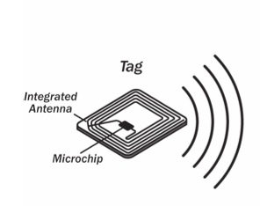
System Design - Tags (Cont.)
Notes:
Lauren

Slide 13
Applications
Credit Cards
Toll Roads (I-Pass/E-ZPass)
Access Control
Hotels
Inventory Tracking & Security
Notes:
Jazmine

Slide 14
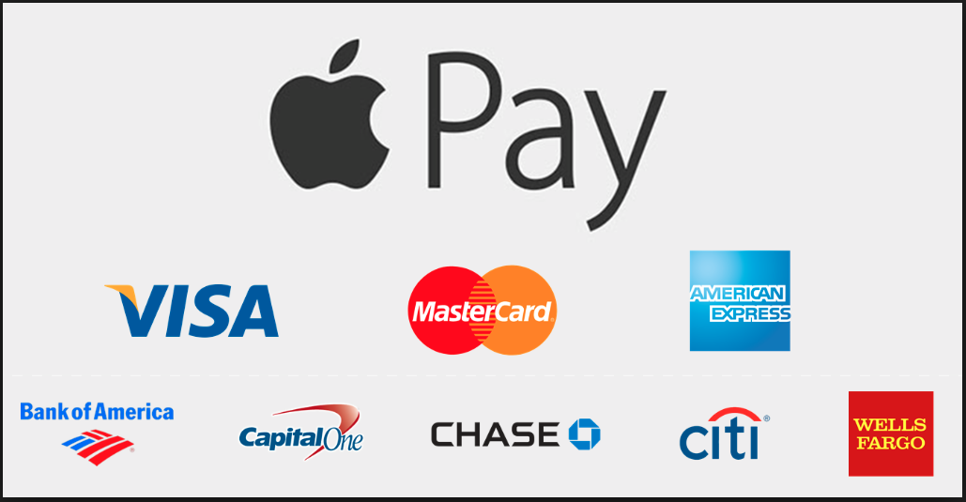
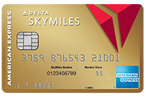
Credit Cards
“Smart Card”
On the go
Versatile
  One Device
    Reads Multiple Cards
    Accepts Many Carriers
Notes:
Jazmine

Slide 15
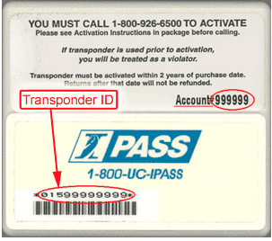
Toll Roads
FasTrak
Smoother Traffic Flow
Cheaper for the business - less operators
Improved fuel efficiency
  No stopping
  No starting from a stopped position and getting back up to the traveling speed
Notes:
Jazmine
https://www.thetollroads.com/assets/objects/207/6_15_06_LeCG_Toll_Road_Study.pdf

Slide 16
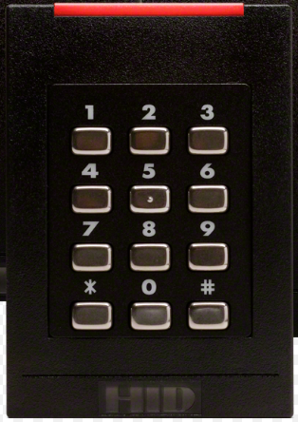
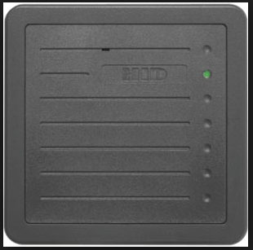
Access Control
Typically seen around campus
  Buildings
  Parking Lots
Possible Requirements
  Valid Credentials - Major, Department, Job Status
  Time of the day - Business Hours/Nights
Notes:
Jazmine

Slide 17
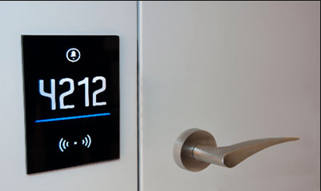
Hotels & Upscale Apartments
Reprogrammable
Harder to lose
Less Maintenance
Trace lock activity
Customer Experience
Notes:
Jazmine

Slide 18
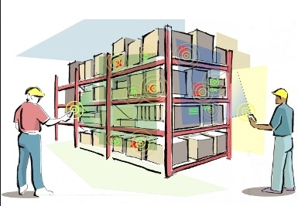
Inventory Tracking & Security
Prevent over or under stocking
Tagging High Risk items with RFID tags
  Security - Prevent Thefts
  RF Tag - Simpler, All the same
  Libraries, Stores, etc
Quality Control
  Able to locate items with a short shelf life “remotely” or at a further distance
  RFID - Complex
Notes:
Trevor
https://www.nibusinessinfo.co.uk/content/using-rfid-inventory-control-stock-security-and-quality-management

Slide 19
RFID Companies
HID
  Used widely on campus from readers for gated lots, and doors to rfid tags that come with university vehicles.
Matrix Systems
  Produces card readers and the servers that manage these devices
Notes:
Trevor

Slide 20
Shortcomings of RFID Technology
Standards are not well set
  Implemented using different manufactures that use their own RFID technology and processes
    i.e. ExxonMobil’s SpeedPass can only be used at ExxonMobil, If a fast food restaurant wants to use it, they would have to purchase it from Speedway
Notes:
Trevor

Slide 21
Shortcomings of RFID Technology
Not well protected, can be skimmed very easily by unauthorized personnel
High-gain antennas can read these tags from further away
  Concern for consumers
Ability to be jammed by energy from WiFi or mobile devices at the right frequency (Interference)
Notes:
Trevor

Slide 22
Questions?
Notes:
Trevor

