Slide 1

Team #9: Video Recording Tool for Car Infotainment and Navigation Systems
MEMBERS:
Shengzhe Gao
Radhika Somayya
Xinye Ji
Kun Zhang
Yan Gong
Jianying Tang

Slide 2

Introduction
What is FFMPEG? Why do we need it?
Using FFMPEG to record in different video formats
FFMPEG is an open source video recording package available on Windows, Linux, and OS X
Very powerful terminal based recording tool
FFMPEG requires this kind of syntax in a shell command:
ffmpeg [input options] -i “input_name” [output options] “output_file_name”

Slide 3
Input Sources
FFMPEG can use a suite of input commands. It can convert to and from any supported video/audio codec, as well as stream from live feeds, which is what our example is going to be in this presentation
-f :this option is typically not needed for file conversion. However for streaming tools, such as x11grab (a linux screen grabbing tool) and video4linux2 (a webcam streaming tool), -f is needed to specify these streaming tools
x11grab is a separate linux tool that ffmpeg uses to record the screen. Additionally, this changes the “input_name” of the command to simply a coordinate, which points to the upper left corner of what part of the screen wants to be recorded.
Example: -f x11grab -video_size 1024x768 -i :0,0
video4linux2 is another linux tool that allows you to grab the video screen from any recorded camera. input_name becomes /dev/video0 (if you only have one camera plug in, if there are more cameras)
Example -f video4linux2 -i /dev/video0

Slide 4
Video Settings
-r : determines what the frame rate for either input or output. This is measured in units of frames per second. For example -r 20 would mean 20 frames per second.
-vcodec or -c:v : allows you to set the video codec. H264, avi, and various mpeg formats are all supported. For example: -vcodec avi
-acodec or -c:a : allows you to set the audio codec. Supported formats include AAC, FLAC, and various modes of mp3. For example: -acodec, libfaac
-video_size: it controls the video resolution. This is done typically by pixel values. For example, -video_size 1920x1080 would be HD resolution.

Slide 5
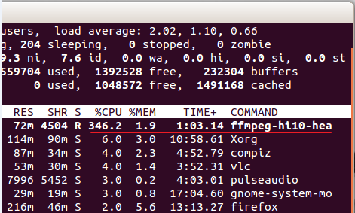
Video Codecs
Computational Complexity
  Heavily Encoded Video Formats: ex. H264
  Degrading of video quality
File Size
  Detail of raw video
  Data storage space

Slide 6

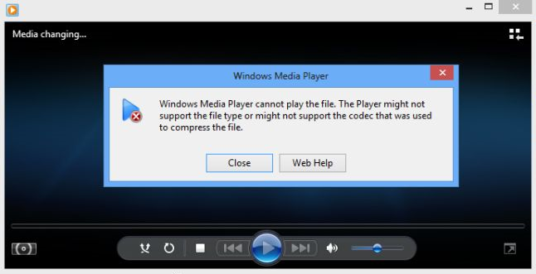
Video Codecs (cont.)
Playability
  Obscure formats are efficient & have better quality
  Less popular formats have compatibility issues (ex. MKV files for Windows Media Player)

Slide 7
Output
FFMPEG outputs typically are video or audio files. There are certain settings that pertain to them.
y: This indicator states that the output file can overwrite an older file of the same name.
t: This indicates how long the video should be. t is stated in seconds. -t 60 would cause the video to run for one minute.
q:v: Indicates the video quality ranging from 1-31. 1 would be the highest indicator, and 31 would be the lowest.
Output file names can also help ffmpeg derive the output codec.
For example, having the output be called output.mpg would cause ffmpeg to record in mpeg-1

Slide 8
Filters
FFMPEG also allows the user to apply filters to video
Allows users to edit videos on the fly via terminal
More interesting feature: ability to tile four video streams into one
-filter_complex: This is an example construction for a complex filter, which tiles four video inputs and compiles them into one 480p video.
  nullsrc=size=640x480 [base];
  [0:v] setpts=PTS-STARTPTS, scale=320x240 [upperleft];
  [1:v] setpts=PTS-STARTPTS, scale=320x240 [upperright];
  [2:v] setpts=PTS-STARTPTS, scale=320x240 [lowerleft];
  [3:v] setpts=PTS-STARTPTS, scale=320x240 [lowerright];
  [base][upperleft] overlay=shortest=1 [tmp1];
  [tmp1][upperright] overlay=shortest=1:x=320[tmp2];
  [tmp2][lowerleft] overlay=shortest=1:y=240[tmp3];
  [tmp3][lowerright] overlay=shortest=1:x=320:y=240"

Slide 9
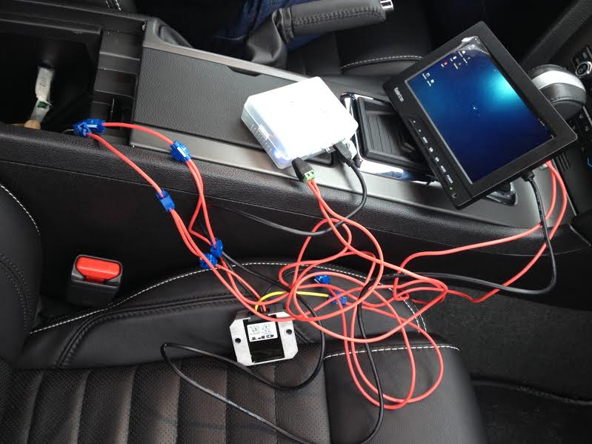
Questions?

