Slide 1

Team #9: Video Recording Tool for Car Infotainment and Navigation Systems
Members: Shengzhe Gao, Radhika Somayya, Xinye Ji, Kun Zhang, Yan Gong, Jianying Tang

Slide 2
Background
Build a video recording tool for a vehicle’s infotainment and navigation system
Four cameras – one display
  Center stacked
  Instrument cluster
  Front view of road
  Right side view of road
Display
  6-7 inches
  HDMI port
  GPS location
  Time stamp
  Clear enough to read street signs
DVR
  Start/stop recording
    switch
  Record one minute segments
  Store video onto USB drive
  Notification on when to change flash drive

Slide 3
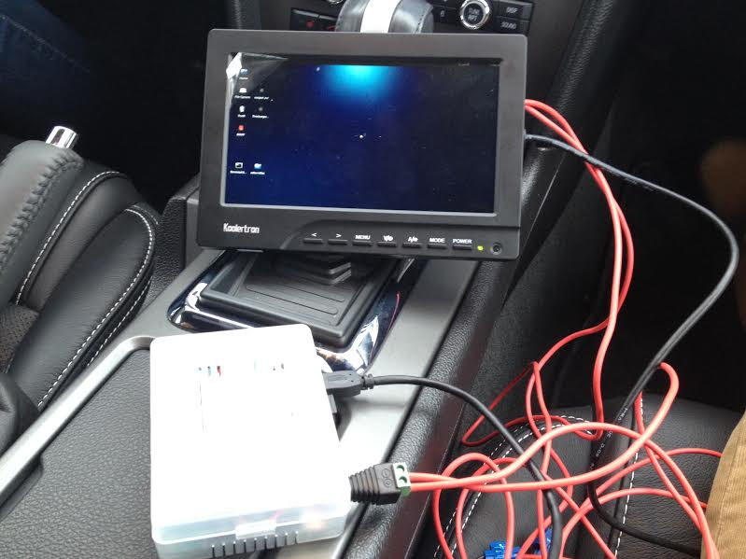
Background (cont.)

Slide 4
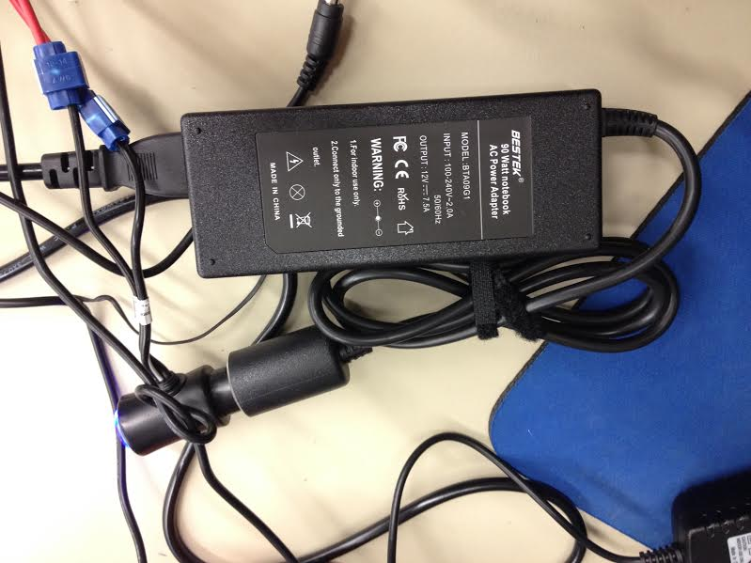
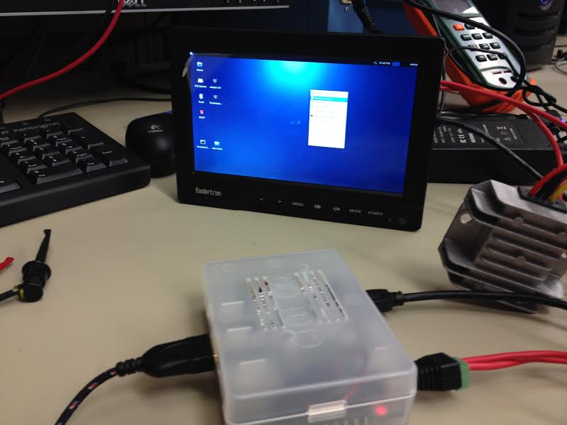
Specifications
Hardware
  Add a color screen with HDMI port to display the four views of the camera
  Design a power supply to run all components from the 12V vehicle battery

Slide 5
Specifications (cont.)
Software
  Add true DVR (always recording in background)
  Add a user HMI for the screen
    Video file name
    Current state (recording/processing/idle)
    % of memory remaining
  Four video streams merged concurrently
  Add feature to view each camera image on display (to position cameras)
  Screen should show when device is ready for use
  Improved video quality
  Zero bugs or system lockup/resets

Slide 6
Hardware
DC to DC converter
  Screen – 12V 2A
  Odroid – 5V 4A
  5.55mm * 2.1mm adapter
  Step down converter to transfer 12V to 5V

Slide 7
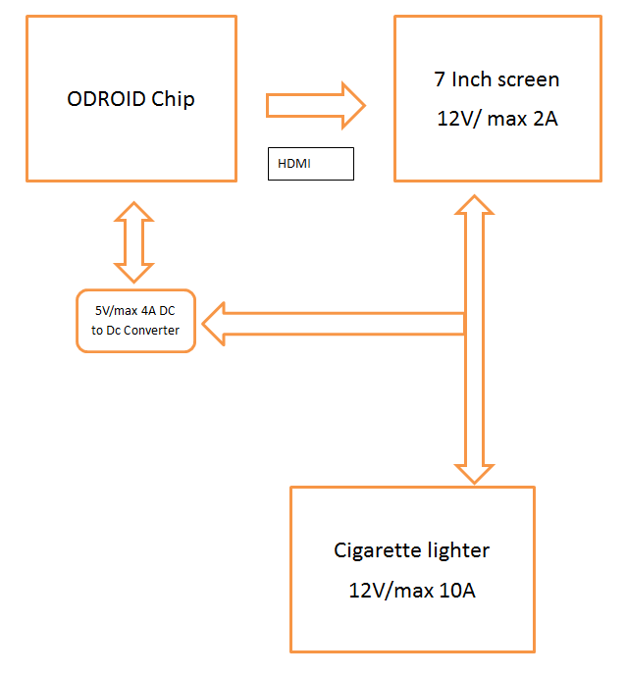
Hardware (cont.)

Slide 8
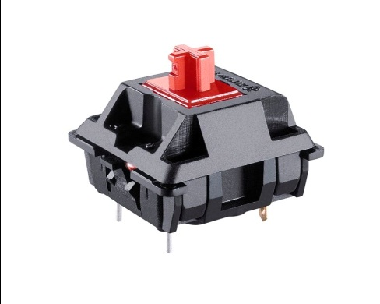
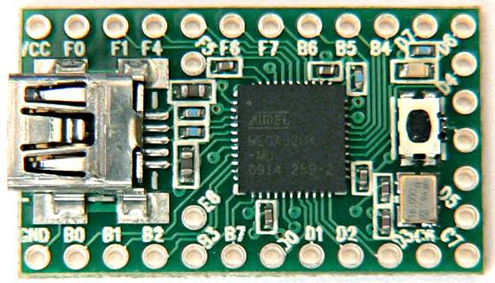
Hardware (cont.)
Four buttons switch
Teensy USB development board
Cherry mechanical key switch
Teensy is with the header pins to plug directly into a solder less breadboard.

Slide 9
Software
Broadcasting a live view of each camera onto each corner of the screen
Recording the screen using open source Linux software (FFMPEG)
More computationally friendly
Multiple threads on Odroid
  1 thread – running live views
  2 threads – screen capture
  1 thread – concatenating video

Slide 10
Software (DVR Function)
DVR function
  Record last 5 minutes of film
  FFMPEG
Implementation of DVR
  Recording 1-minute segments (FFMPEG)
  Script concatenates last five 1-minute segments
  Store on USB drive

Slide 11
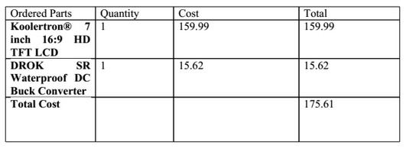
Budget

Slide 12
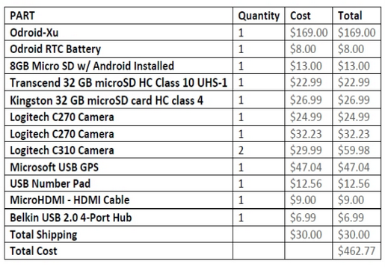
Budget (from past team)

Slide 13
Problems
Power supply
  Last team supplied whole system with 2 input powers
Software
Data storage
  Correctly store video clips into USB drive
Add display
Hardware and software compatability

Slide 14
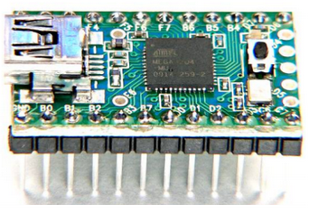
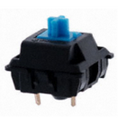
Improvements
Hardware
  Teensy USB microcontrollers and Cheery MX blue switch button
  Modify the switches system:
    output functions can implement the following:
      Recording
      Start/stop
      Store the memory and output the video files into memory stick.
  Combine Odroid chip with screen into a simple box container
    Box will be 3D printed
      simplify all the wiring and connections
    Four cameras, GPS, key switch, USB storage, and power-converter will remain in original position

Slide 15
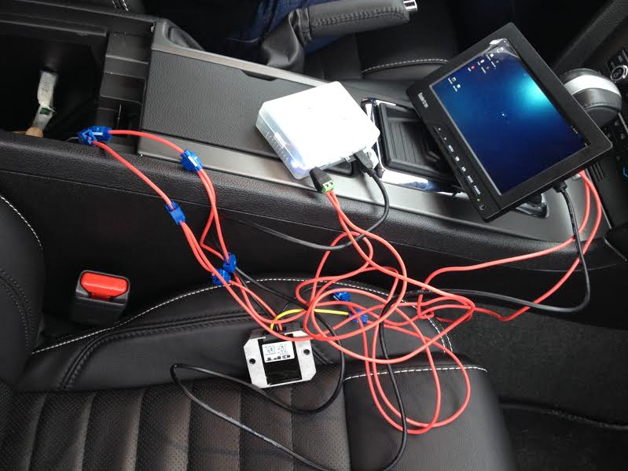
Improvements (cont.)

Slide 16
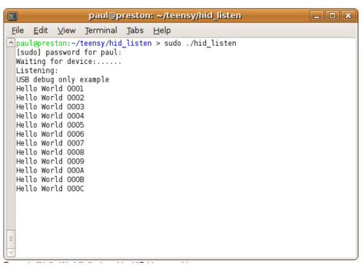
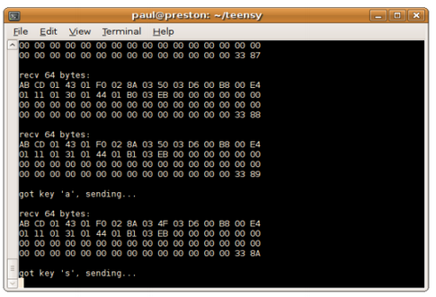
Improvements (cont.)
Software
  True DVR
    Displays the saved minutes/seconds
    GPS location on display
  C-Programming on microcontroller of switches
    Input of analog switches can be converted into digital switches
  Develop a user HMI for screen
    Show video file name, current state recoding/processing/idle, percentage of memory remaining

Slide 17
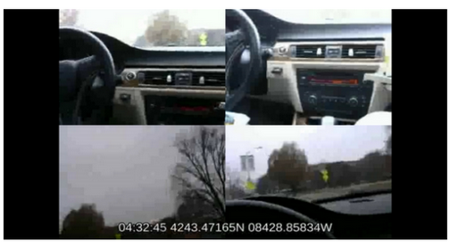
Questions?

