Slide 1


MSU Solar Team
Battery Management System
Team 7
Matt Gilbert-Eyres, Albert Ware
Gerald Saumier, Auez Ryskhanov
Michael Burch
Facilitator
Dr. Bingsen Wang

Slide 2
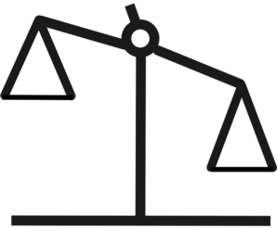
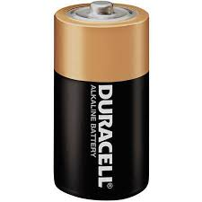
Battery Balancing
Batteries can have small differences in capacitance
Differences will cause problems when batteries are connected in series
Protects the system by balancing the cells to compensate for the differences.

Slide 3
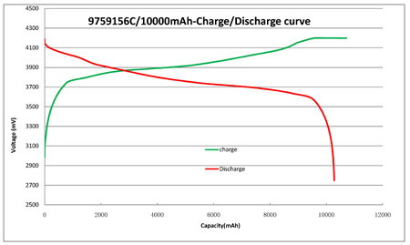
Battery Charge and Discharge
Voltage increases quickly at the start of charging
Voltage decreases quickly at the end of charge life
Battery balancing important at theses times

Slide 4
Why Battery Balancing?
Increases Battery Life
  With imbalance individual cell voltages will drift apart over time
  With imbalance capacity of total system decreases
Two kinds of Balancing:
Passive
Fixed Shunt
Controlled Shunt
Active
Boost Converter
Switched Capacitor
Single Switched Capacitor
Double Tiered Capacitor
Single-inductor method
Multi-inductor method
Single-Windings Transformer
Multi-Windings Transformer

Slide 5
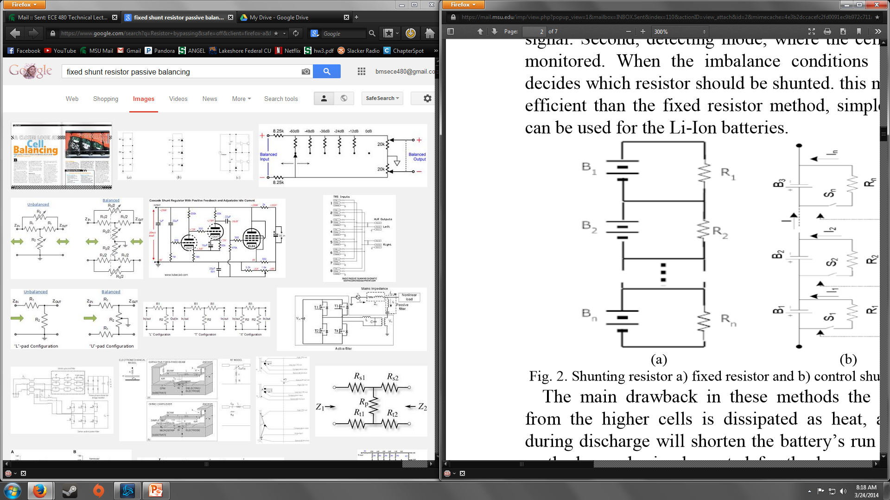
Passive Balancing
Fixed Shunting Resistor
Continuously bypassing current
Resistor Scaling
Varies to limit cell voltage
Works on Lead-acid and Nickel based
Pros:
Simplicity
Low Cost
Robust
Cons:
Energy Continuously Dissipated
Creates Heat

Slide 6
Passive Balancing
Controlled Shunting Resistor
Two Modes
  Continuous
  Detecting
Controlled by relay/switches
Works on Li-Ion
Pros:
Simplicity
Low Cost
Reliable
Cons:
Energy is Dissipated
Creates Heat

Slide 7
Passive Balancing
Overall Shunting Resistor
Easy to use and implement
Reliable
Can shorten battery run time
Wastes Energy

Slide 8
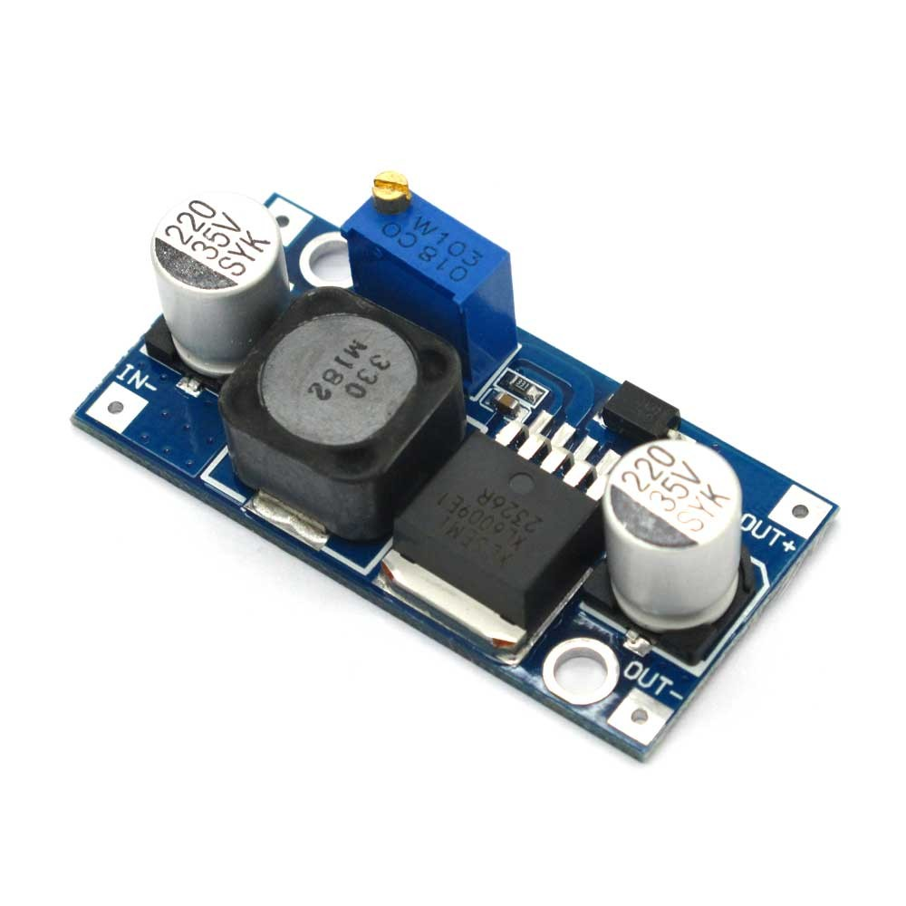
Active Balancing
Boost Converter Cell Balancing
Uses boost converter to transfer excess energy from highest cell to lowest cell
Requires
  Voltage sensors
  Controller
  Switches

Slide 9
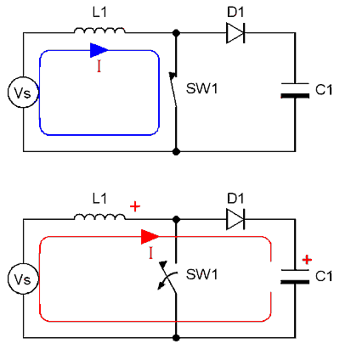
Active Balancing
Boost Converter
Boost input voltage to desired voltage
Uses duty to cycle to control output voltage
Equation
Vo= (1/1-D)*Vin

Slide 10
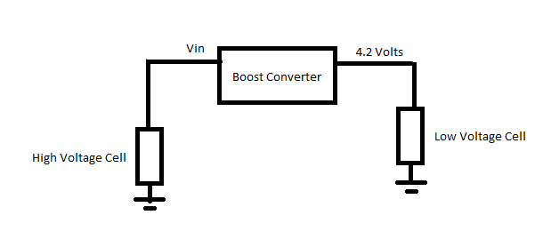
Active Balancing
Boost Converter Cell Balancing cont.
Lithium Ion batteries charge at 4.2 v
Boost converter must output constant 4.2

Slide 11
Active Balancing
Capacitive Balancing
What is capacitive balancing?
  It is a method utilizes capacitors as an external storage unit that allows higher charged batteries to transfer energy to lower charged batteries.
  This cycle of charging and discharging capacitors allows for all the batteries to operate at the same voltage.

Slide 12
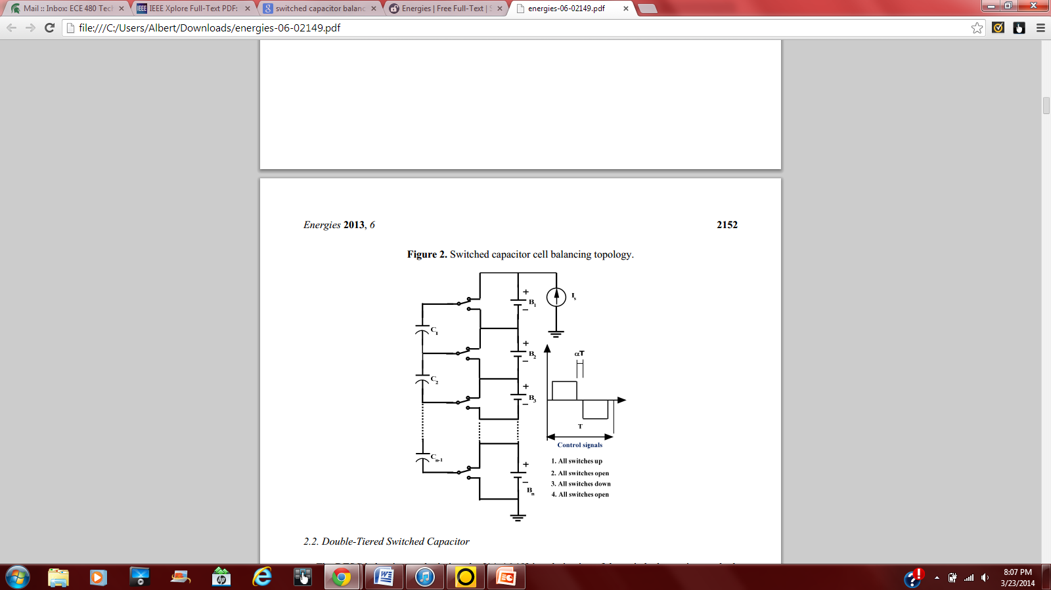
Active Balancing
Switched Capacitor
This method shuttles the energy from the high charged batteries to the lower charged batteries, but all batteries are not connected together.
Pros:
  Easier to implement
  Charges and discharges efficiently
Cons:
  Higher cost than resistor systems
  Not the quickest system

Slide 13
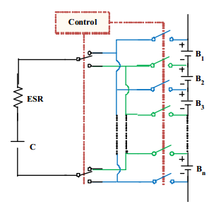
Active Balancing
Single Switched Capacitor
Similar to the other system but it only uses one capacitor for balancing.
Pro:
  Requires less number of switch compared to the switched capacitor method (batteries >5)
Con:
  Switching logic is more complex

Slide 14
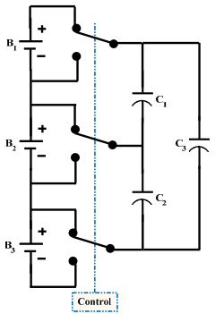
Active Balancing
Double Tiered Capacitor
Same functions as the other systems, but another capacitor is added to improve linkage amongst the batteries.
Pros:
  Balancing time is cut by more than half
  Charges and discharges efficiently
Con:
  More capacitors required

Slide 15
INDUCTOR/TRANSFORMER BALANCING METHODS
Single-inductor method
Multi-inductor method
Single-Windings Transformer
Multi-Windings Transformer

Slide 16
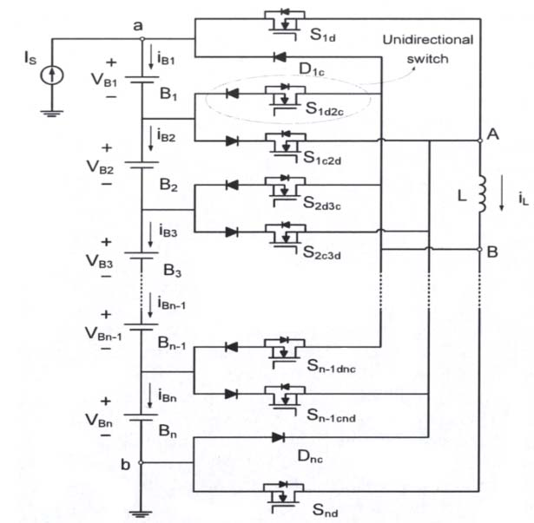
Active Balancing
Single-inductor method
Use one inductor
Control system senses the voltage
Duty cycle 50%
High current destroys transistors

Slide 17
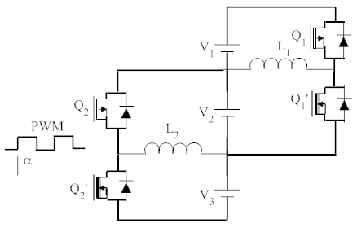
Active Balancing
Multi-inductor method
Uses n-1 inductors
Control system senses the voltage
Applies PWM to transfer the energy
Takes long time for transferring the energy

Slide 18
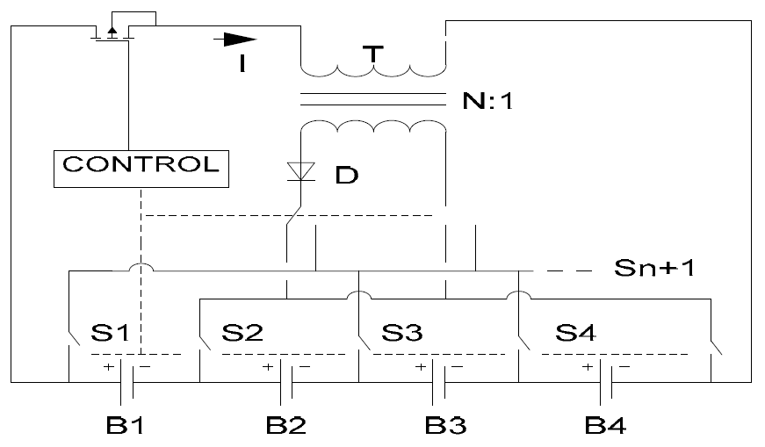
Active Balancing
Single-Windings Transformer
Pack to-cell topology
  Uses one transformer
  Transfers whole energy to the week cell
Cell-to-pack topology
  Uses one transformer
  Transfers energy from the high energy cell

Slide 19
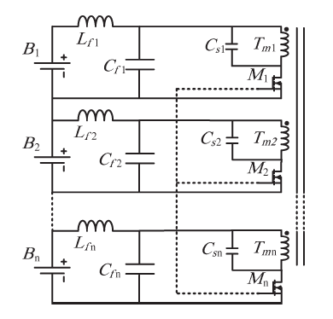
Active Balancing
Multi-Windings Transformer
Uses multi-winding transformer
Group of cells can exchange the energy
Really hard to make a transformer with big number of windings

Slide 20
Source
http://www.mdpi.com/1996-1073/6/4/2149

