Slide 1


MSU Solar Team
Battery Management System
Team 7
Matt Gilbert-Eyres, Albert Ware
Gerald Saumier, Auez Ryskhanov
Michael Burch
Facilitator
Dr. Bingsen Wang

Slide 2

Table of Contents
What Is A Battery Management System
Cell Protection
Communication
Design
Budget
Status/Goals

Slide 3
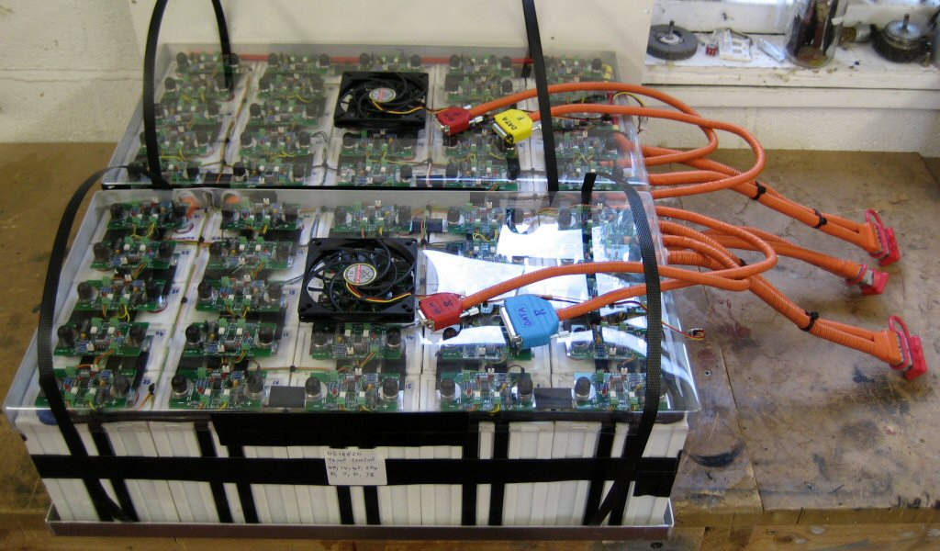
What Is A Battery Management System?
Electronically controlled system that manages rechargeable battery cells.
Four Functions
  Cell Protection
  Cell Balancing
  State of Charge
  Communication

Slide 4
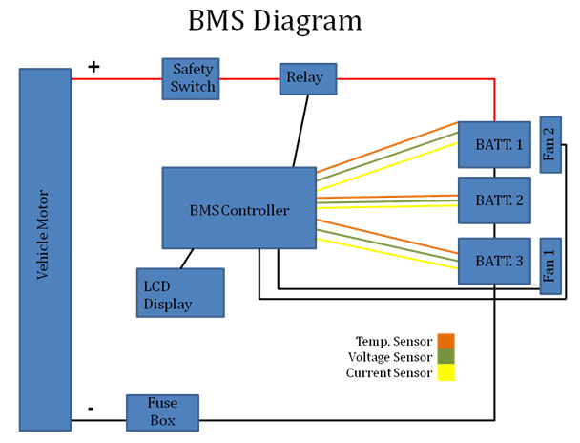
Design Layout
General layout of the system and it features

Slide 5
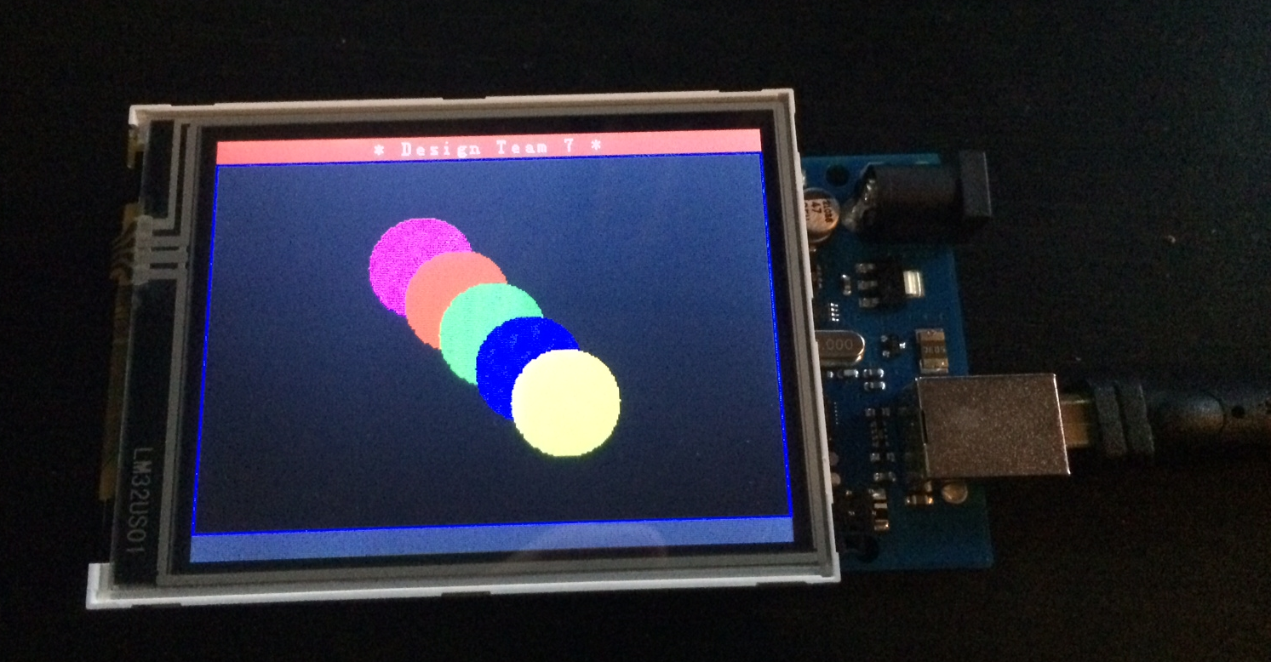
Communication Requirements
Communication Board
  8 analog inputs
  4 analog outputs
Display Screen
  Compatible with chosen board
  Possible touch screen for input to system
Sensors
  4 voltage sensors
  1 current sensor
  3 temperature sensors

Slide 6
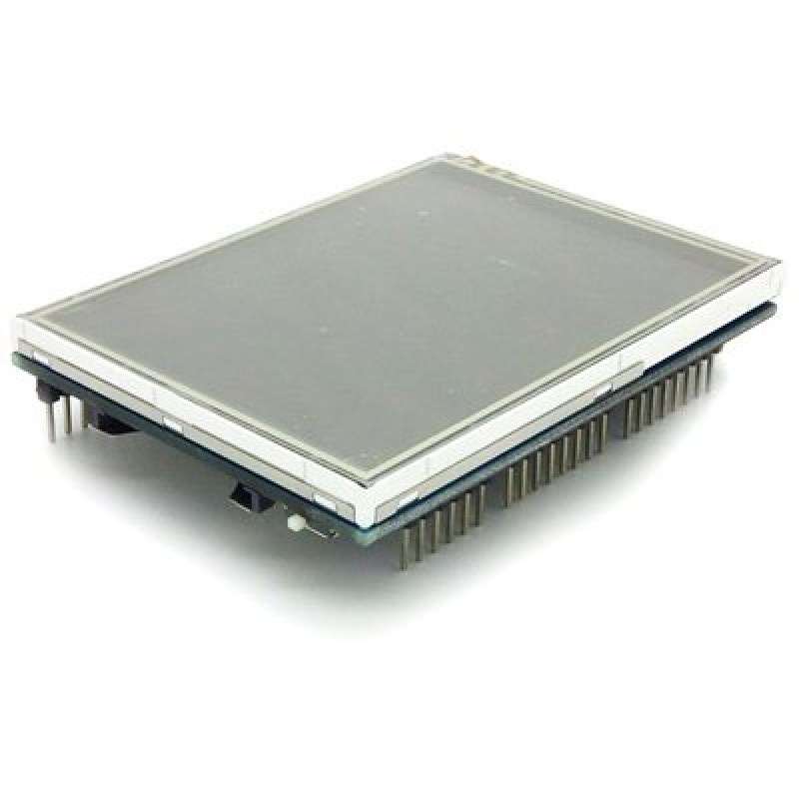
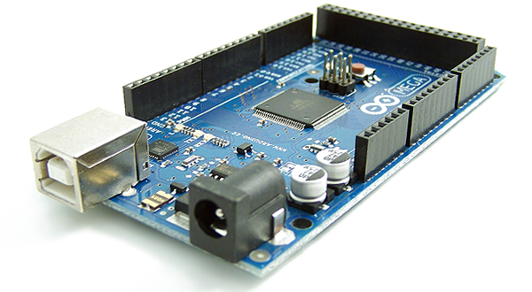
Communication Board & LCD Screen
Arduino Mega 2560 R3
LCD Touch Screen
16 Analog Inputs
16 MHz Clock Speed
256 KB Flash Memory
ATmega2560 Microcontroller
3.2” LCD Touch Screen
5V Operation Voltage

Slide 7
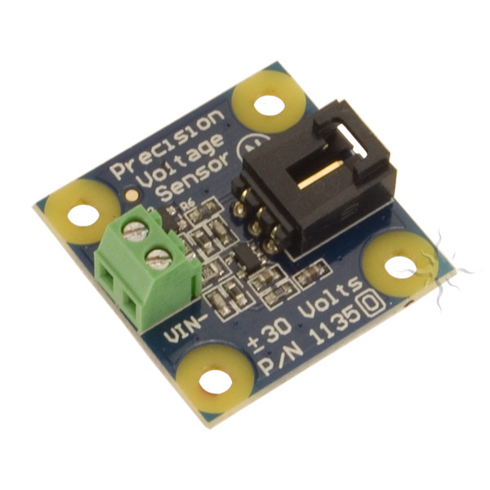
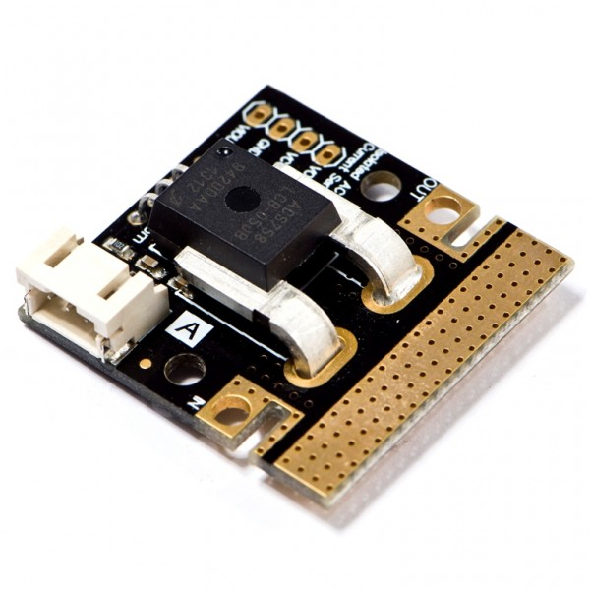
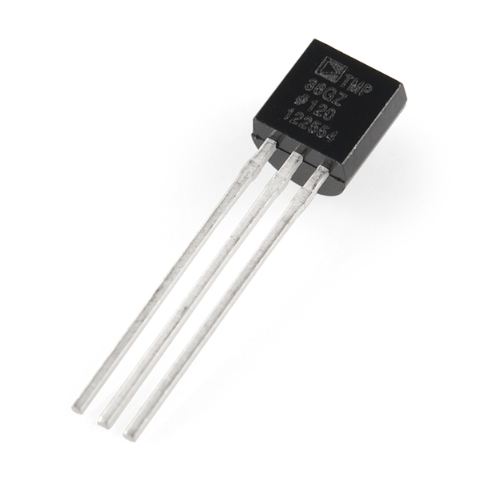
Cell Protection: Sensors
Voltage Sensor (4)
  0.02445-25V input voltage detection range
  0.00489V voltage analog resolution
  Reduces voltage 5x for input to Arduino
Current Sensor (1)
  AC/DC compatible
  Hall Effect
  -50A to 50A current range
Temperature Sensor (3)
  Thermistor Based
  Approx. -40º C to 125º C range

Slide 8
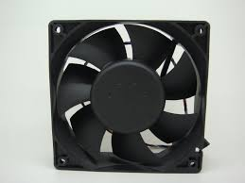
Cell Protection: Cooling System
2 Fans to cool down the batteries
1 Fan to cool down the Arduino board

Slide 9


Battery Balancing
Protects the system by balancing the cells to compensate for the differences.
Increase efficiently of system and life of battery
Team currently use passive balancing
Implementation of active balancing

Slide 10
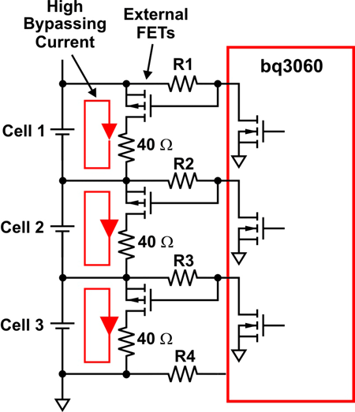
Passive Balancing
Higher voltage batteries are connected to resistors to lower voltage (balance the cells).
High Losses
Easy to use

Slide 11
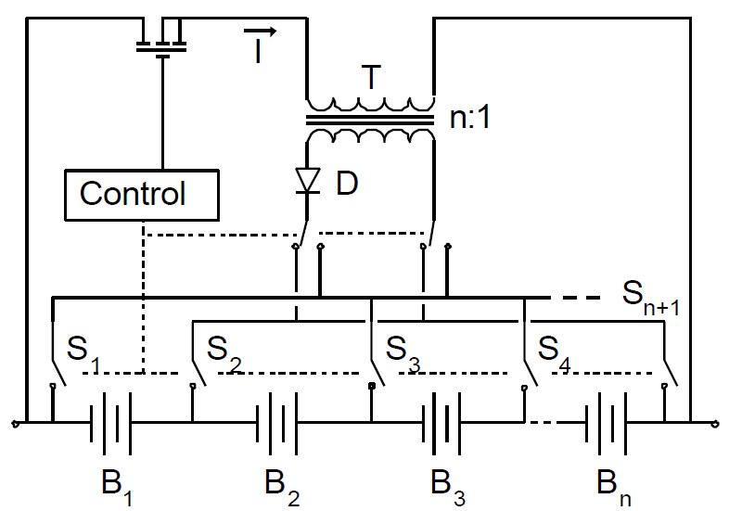
Active Balancing
Move charge from a higher voltage cell to one with the lower charge.

Slide 12
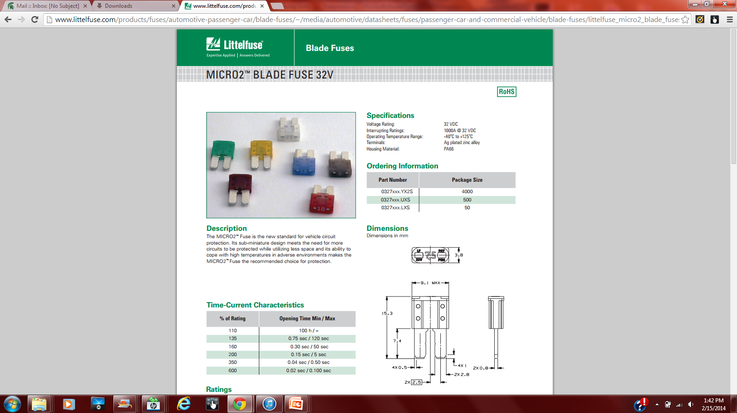
System Fusing
Fuse type: 10Amp 32 Volt Micro2 Fuse by Littelfuse.
Purpose for fusing the system is to ensure wires and the system are protected in a over current situation.

Slide 13
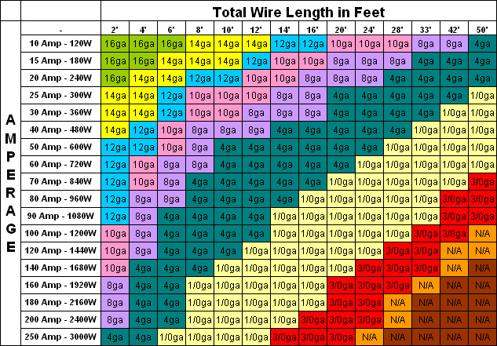
System Wiring
Wire size was based on current and voltage requirements.
For our project we will be using 18 gauge wiring (.82mm^2)

Slide 14
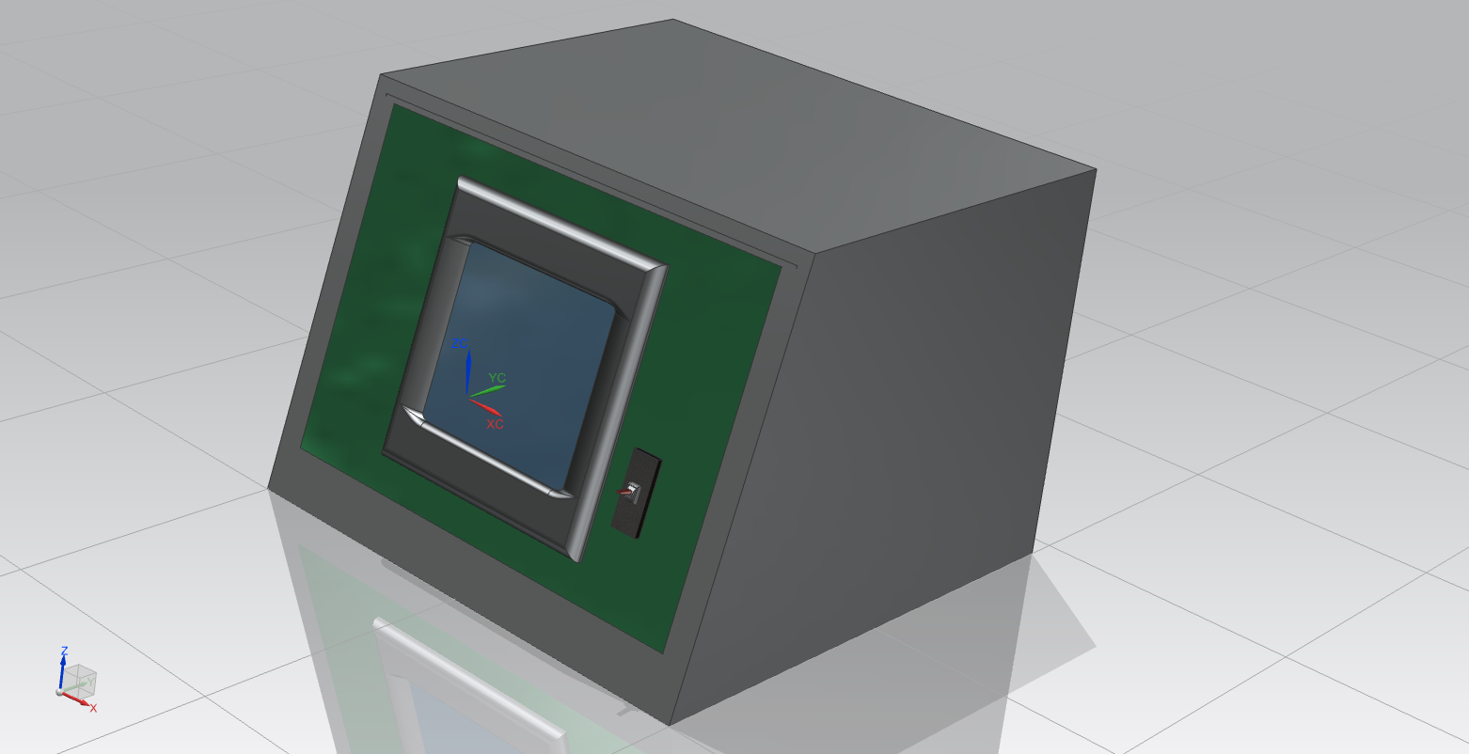
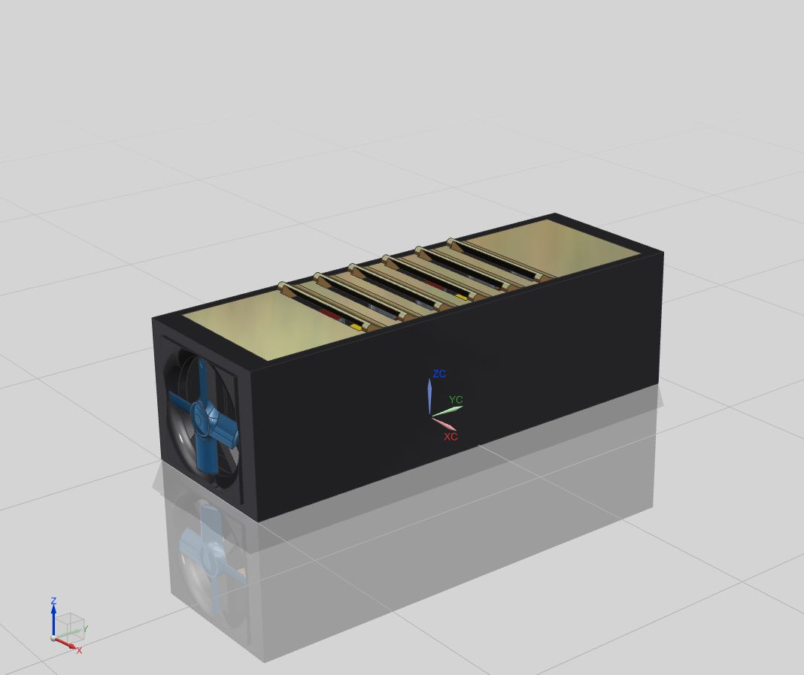
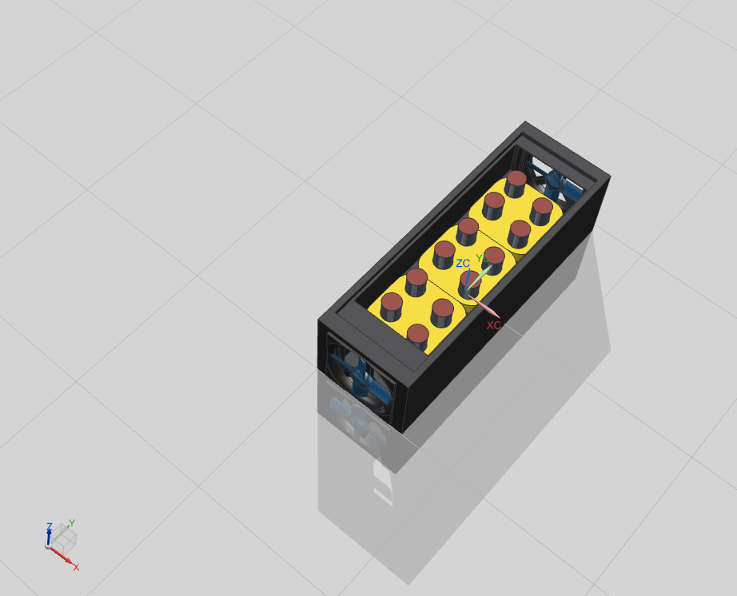
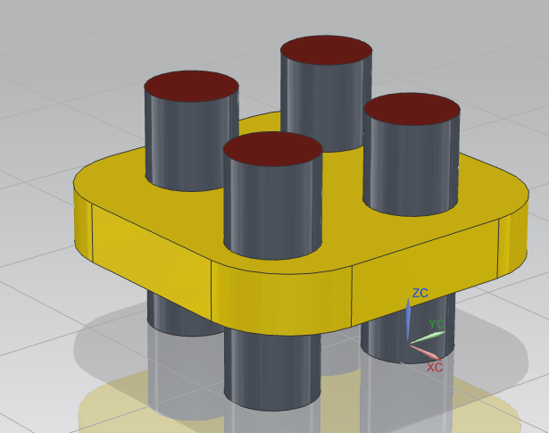
Packaging
Figure1: BMS Housing
Figure2: Battery Box
Figure3: Battery Holder

Slide 15


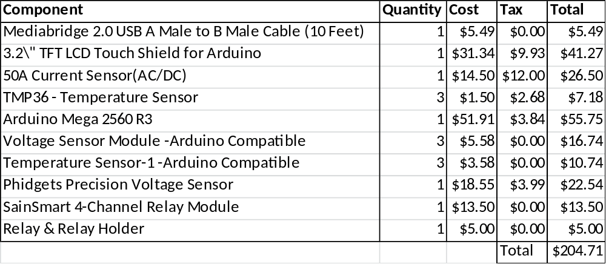
Budget

Slide 16
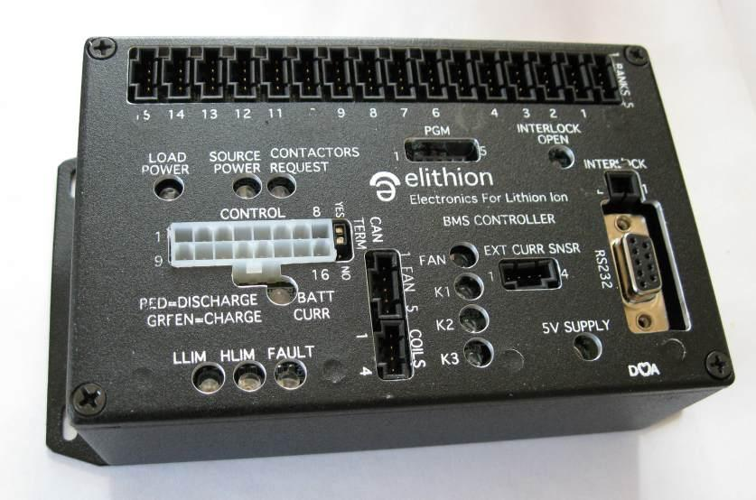
Motivation
Elithion Lithiumate Pro
  Balancing
  Charge Control
  Price

Slide 17
Status/Goals
Design aspect is complete
Currently waiting for Parts
Going into the design/prototyping phase
Looking forward to the balancing mechanism

Slide 18

Thank You
Questions?

