Slide 1


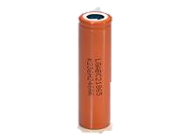
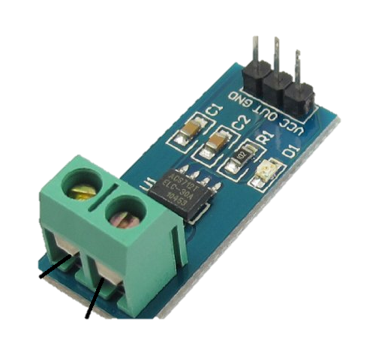
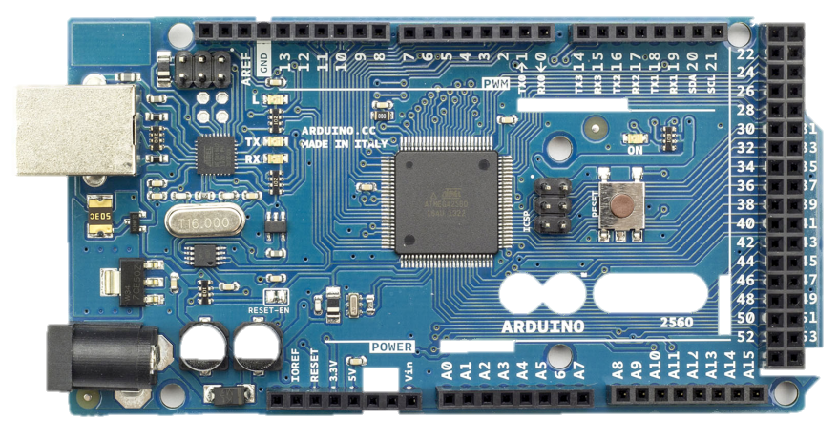
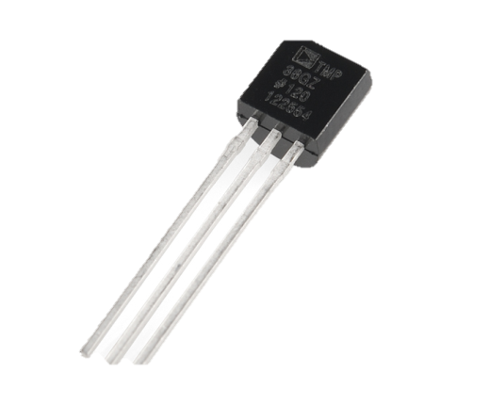
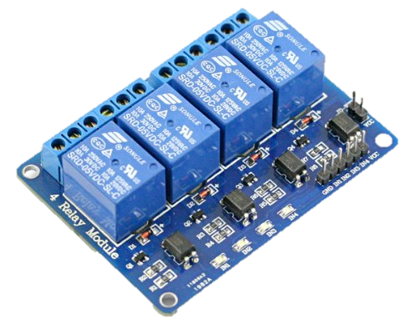
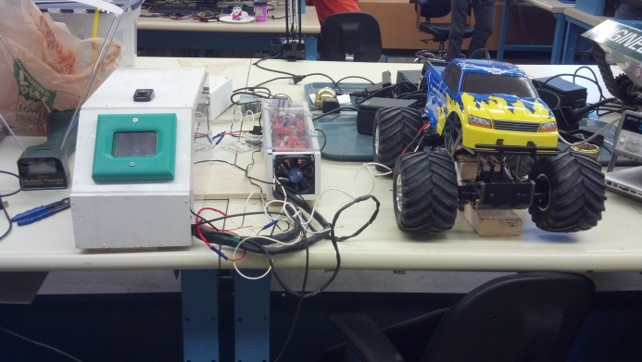
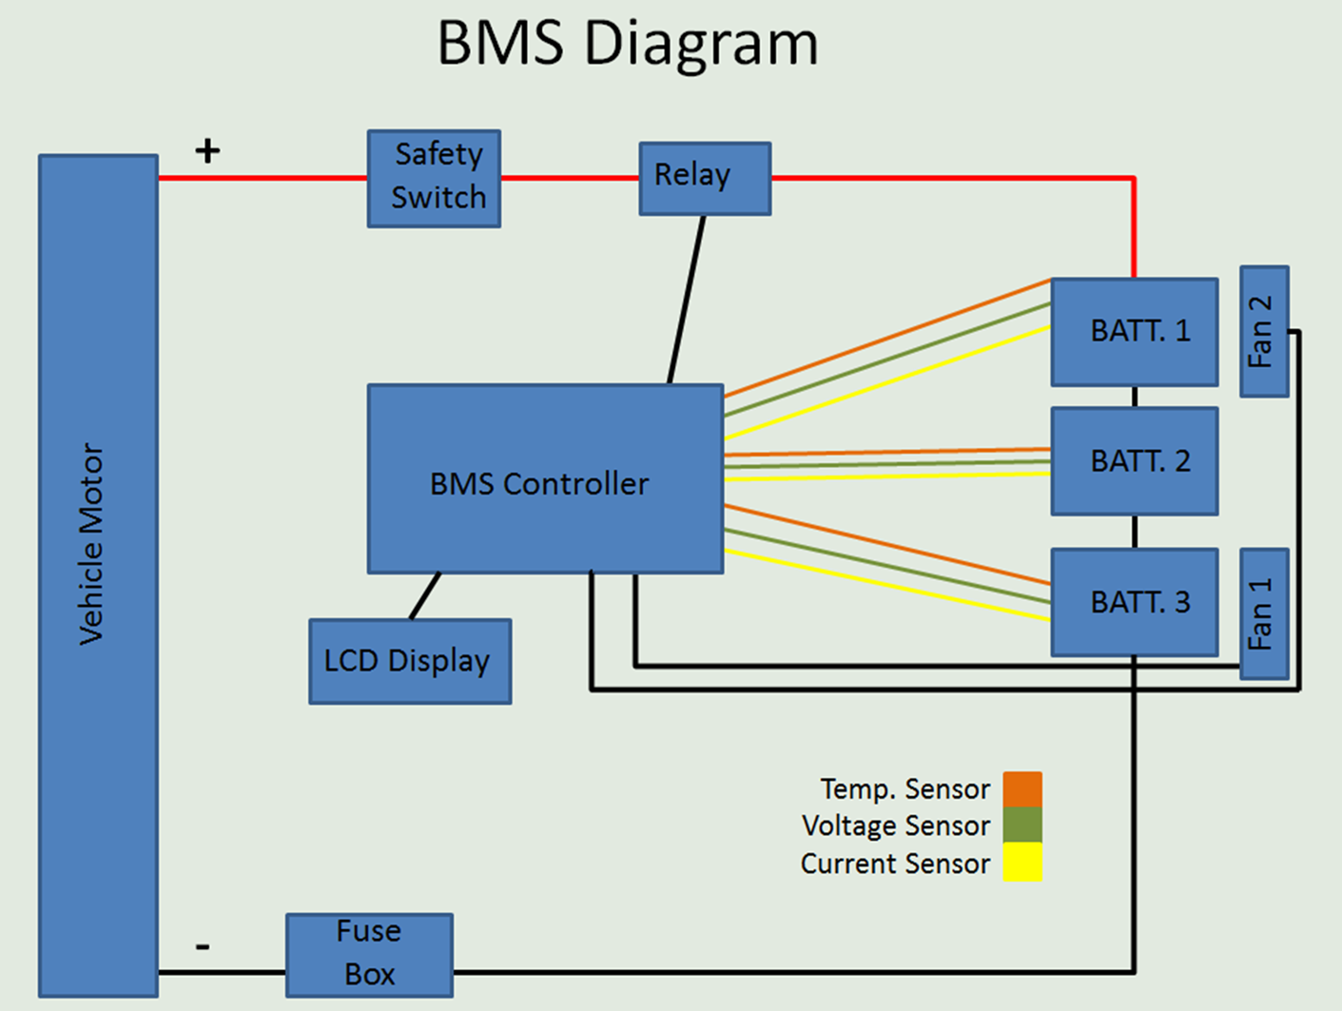
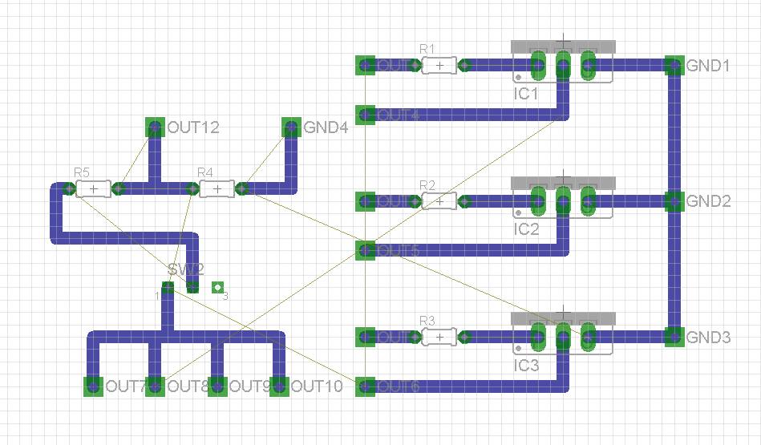






Battery Management System
Abstract
Final Design
Testing and Results
The Michigan State Solar Car Team recently switched
from lead-acid batteries to lithium-ion batteries. Lithium-ion batteries have a better power to weight ratio compared to lead-acid making them ideal for racing. The switch from lead-acid to Lithium ion posed a problem for the Solar Car Team. Lithium ion batteries require a complex battery management system. The knowledge and understanding of such a system was unknown to the Solar Car Team.
The team was able to build a battery management system. The system was able to monitor the battery cells and take preventative action to protect the batteries when necessary. In addition to meeting the requirements, the final design incorporated additional features such as active cooling, visual and audio warning system, 3d printed LCD holder and implementation of battery balancing.
Voltage Sensor Data
Battery Cell | Voltage Sensor Voltage | Multimeter Voltage | % Error
1 | 3.779 | 3.780 | .026
2 | 3.782 | 3.786 | .13
3 | 3.782 | 3.781 | .026
Current Sensor Data
Input current | Power Analyzer Reading | Current Sensor Reading | % Error
0 A | 0 A | 0 A | 0%
10 mA | 10 mA | 10.05 mA | .5%
50 mA | 50 mA | 50.12 mA | .24%
1 A | 1.003 A | 1.009 A | .598%
1.5 A | 1.506 A | 1.511 A | .332%
Objectives
Our main objective is to build a small-scale battery management system. Our project will provide a development platform that can be used to test different battery management methods before implementation on the main car.
Final Design
Emergency protocols went into effect when over current, temperature or voltage was detected. The response time was within msec of detection.
Requirements
Budget
Detect the following events
  Over voltage
  Under voltage
  Over current
  Over temperature
Display the following
  Cell voltage
  System current
Take action to prevent damage to the system
The team had a $500 budget to build the battery management system. The table below shows that our final product.
Products | Cost
Electrical Components | $224.90
Controller | $55.75
Mechanical Parts | $22.91
Total | $303.56
Trigger Circuit for Balancing System
The Team
Dr. Binseng Wang
MSU Facilitator
Matt Gilbert-Eyres
Electrical Engineer
Gerald Saumier
Computer Engineer
Albert Ware
Electrical Engineer
Auez Ryskhanov
Electrical Engineer
Mike Buch
Electrical Engineer

