Slide 1


Facilitator
Dr. John Deller
Sponsor
Resource Center for Persons with Disabilities (RCPD)
Project Liaison
Stephen Blosser
Aditya Mathew
Design Team 6
Nicholas Blackledge
Chunyang Chu
Matt Smania
Steven Le
Bowei Yu
Resource Center for Persons with Disabilities
Bluetooth Low Energy Beacon

Slide 2
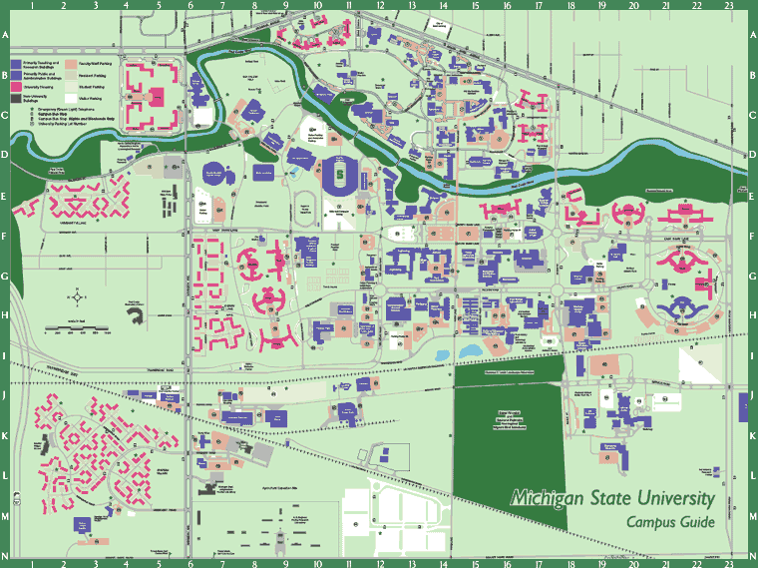
Introduction
Resource Center for Persons with Disabilities (RCPD)
  Help people with disabilities navigate campus

Slide 3
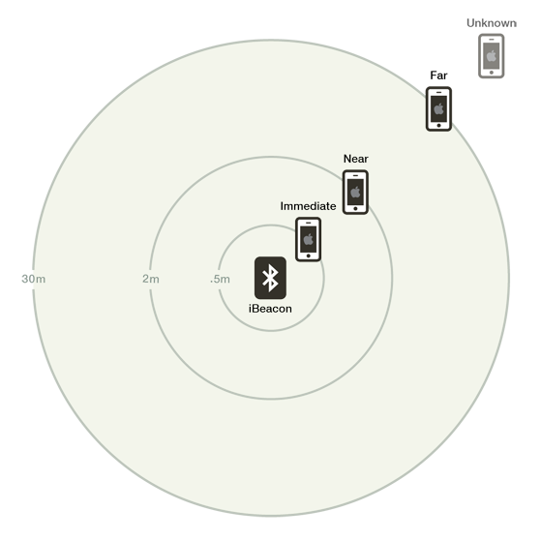
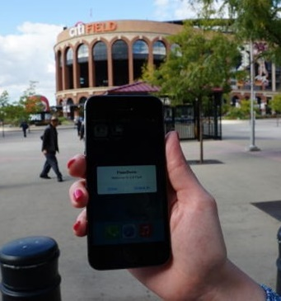
Bluetooth Low Energy Beacon
Place around buildings on campus
Navigation via smartphone
Low cost, low power solution

Slide 4
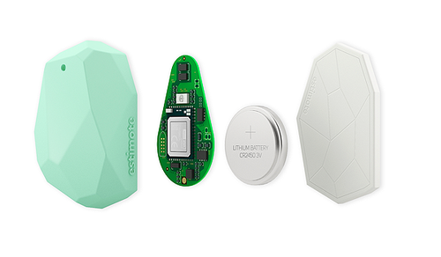
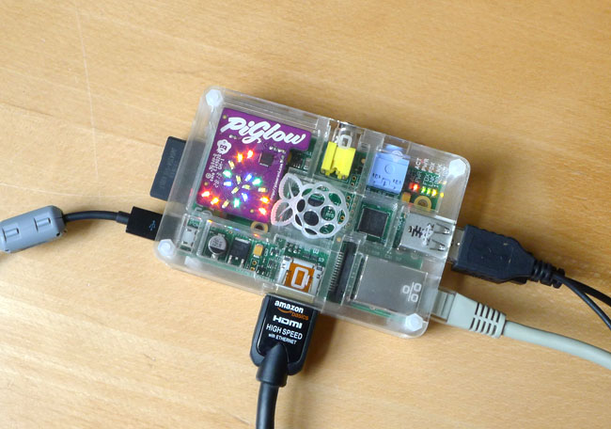
Beacons on the Market
Estimote Beacon
piBeacon

Slide 5

Design Objectives
  BLE beacon (Bluetooth version 4.0)
  Compatible with Apple’s iBeacon
  Less than $20 per beacon
  Tamper resistant
  Small size
  Develop iOS and Android
  applications

Slide 6
Conceptual Design
  Three possible designs
    TI cc2540 BLE chip
    Bluegiga BLE112 BLE module
    Nordic Semiconductor
    nRF8001 BLE chip
  All three designs meet objectives
    Support Bluetooth 4.0 standard
    Cheaper price, within $20

Slide 7
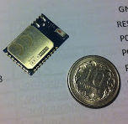
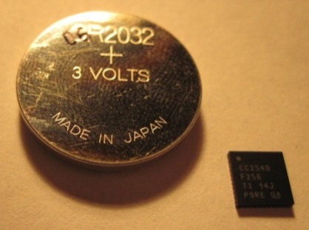
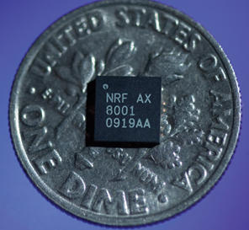

Conceptual Design Rankings
Chip design
Bluegiga
BLE112
TI cc2540 chip
Nordic nRF8001
Product size
Price $16 ≈$6 ≈$6
Security
Development 1 3 3
time(weeks)

Slide 8
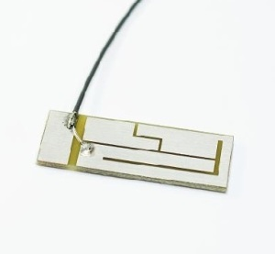
Solution
  TI cc2540
    Bluegiga BLE112 development board
  PCB antenna
  Disable flashing via Bluetooth

Slide 9
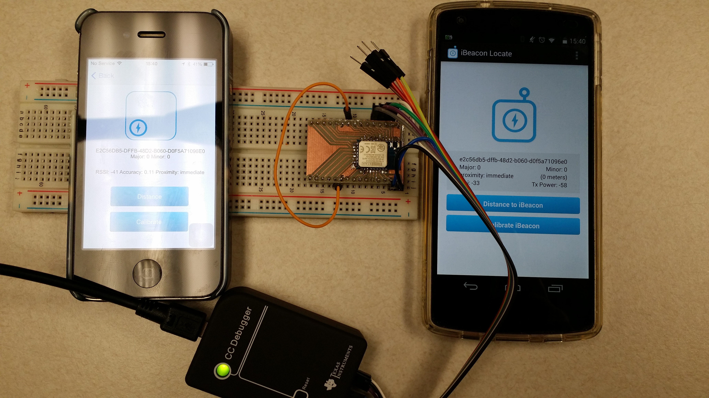
Current Progress

Slide 10
Next Steps
  Firmware development
  PCB layout
  Mobile application
  Testing

Slide 11
Budget
Item | Estimated Cost
Bluetooth Low Energy Chips (TI CC2540, BLE 112) | $60
Other electrical components | $70
Programming / Debug tools | $100
Demonstration beacons | $50
Shipping | $50
Total | $330
Budget Table

Slide 12
Questions?

