Slide 1
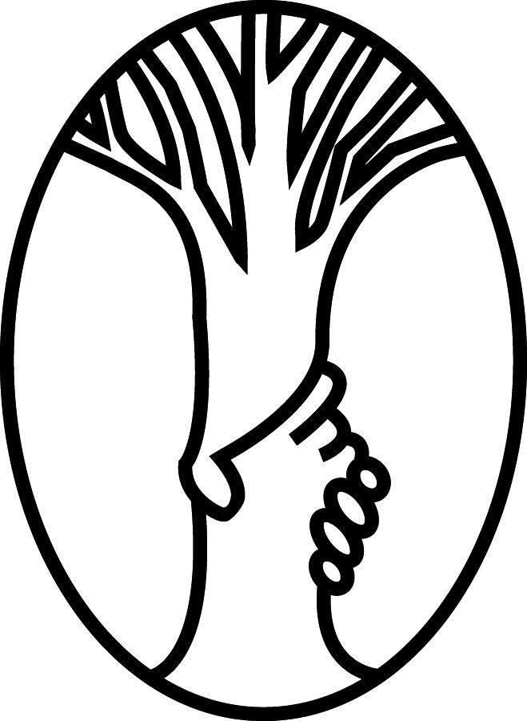

Facilitator
Dr. John Deller
Sponsor
Resource Center for Persons with Disabilities (RCPD)
Project Liaison
Stephen Blosser
Aditya Mathew
Design Team 6
Nicholas Blackledge
Chunyang Chu
Matt Smania
Steven Le
Bowei Yu
Bluetooth Low Energy Beacon

Slide 2
Introduction
MSU Campus
  538 buildings
  8.125 square miles
Resource Center for Persons with Disabilities (RCPD)
  Help people with disabilities navigate campus

Slide 3
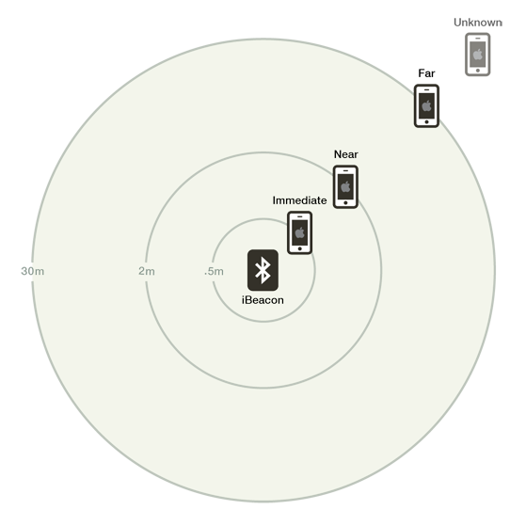
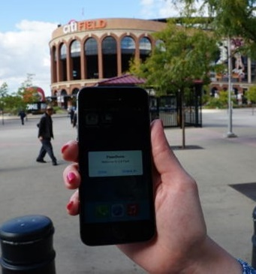
Bluetooth Low Energy Beacon
Place around buildings on campus
Navigation via smartphone
Low cost, low power solution

Slide 4
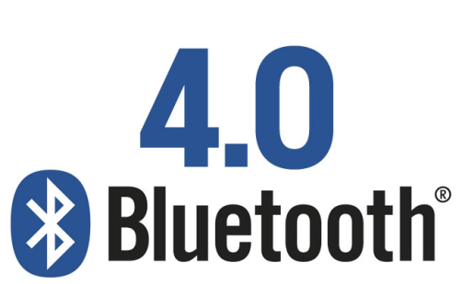
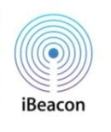
Background
  Low Power Bluetooth Devices
    Broadcast a packet 20 milliseconds to 10 seconds
    2.4-2.4835 GHz frequency
  Beacon Information
    UUID
    Major Number
    Minor Number

Slide 5
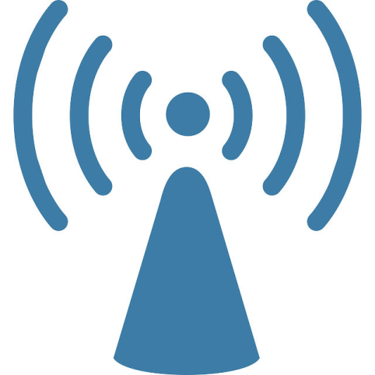
Design Specifications
  BLE beacon (Bluetooth version 4.0)
  Compatible with Apple’s iBeacon
  Less than $20 per beacon
  Tamper resistant

Slide 6
Demonstration

Slide 7
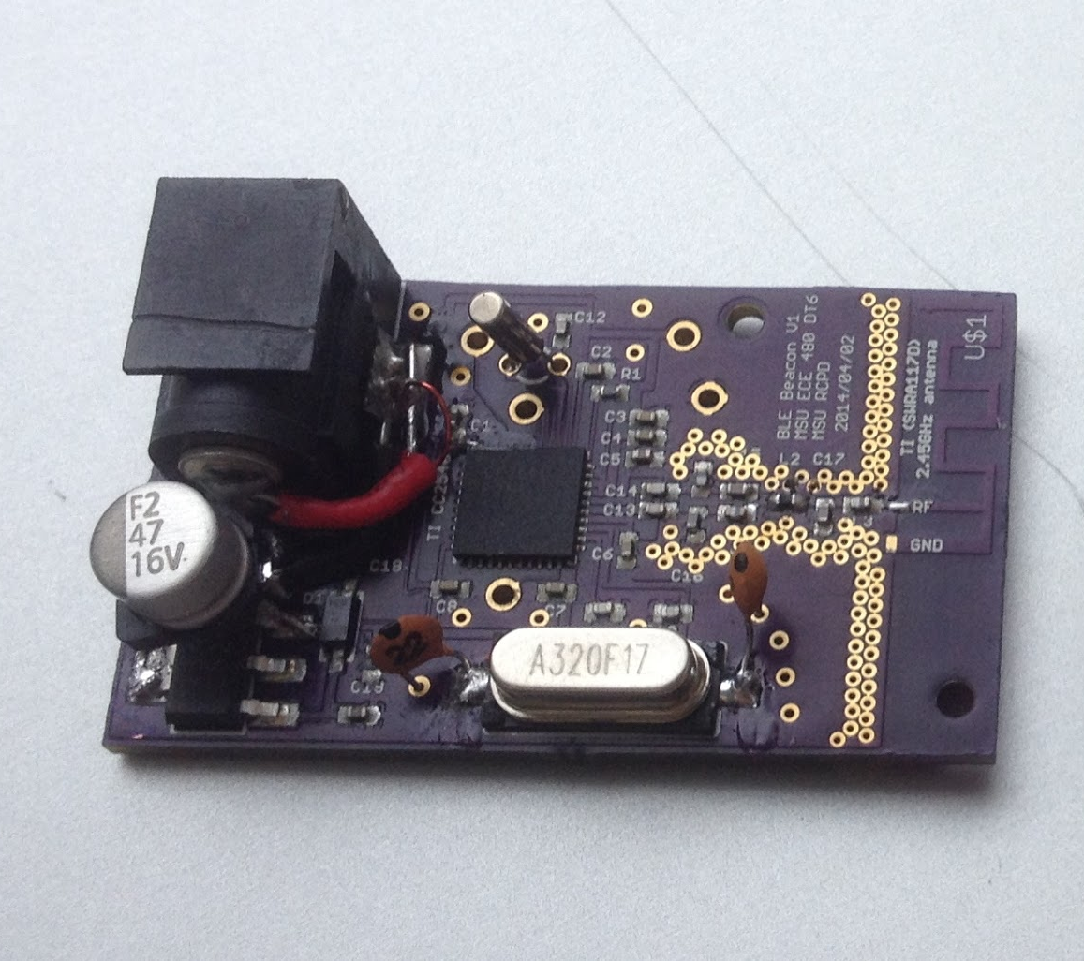
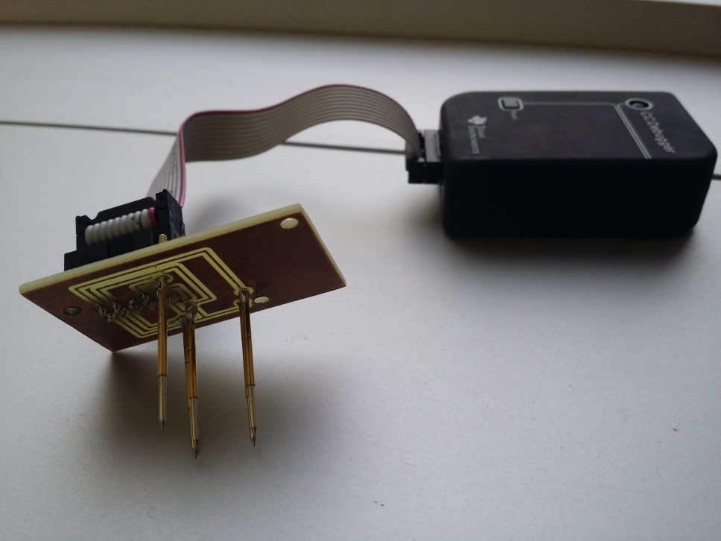
Final Design
  Based on TI cc2540
  1x2 inches in size
  Total Cost roughly $10
  Programming header to prevent tampering

Slide 8
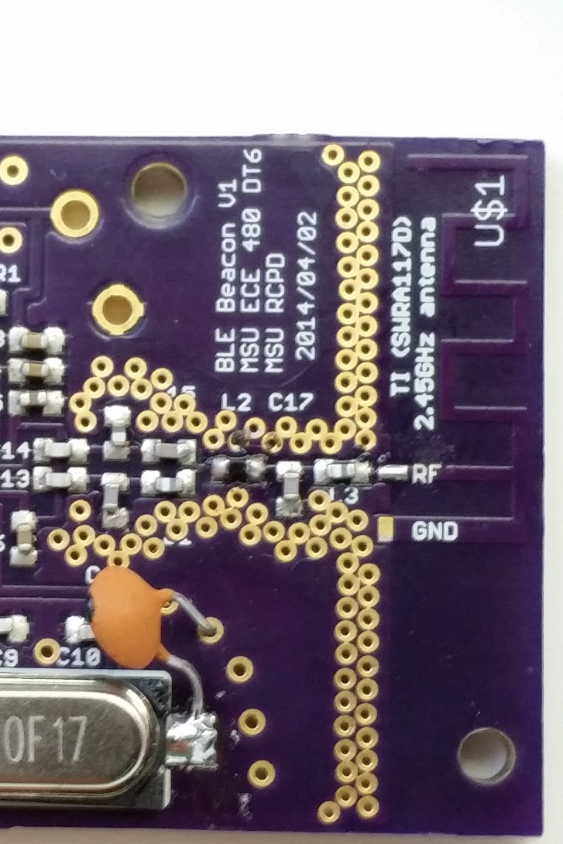
RF Design
    PCB antenna
    Via stitching
    Solid Ground
    Plane

Slide 9
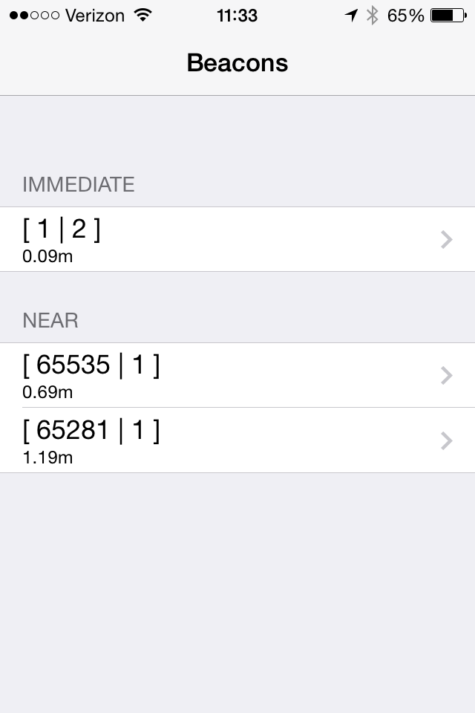
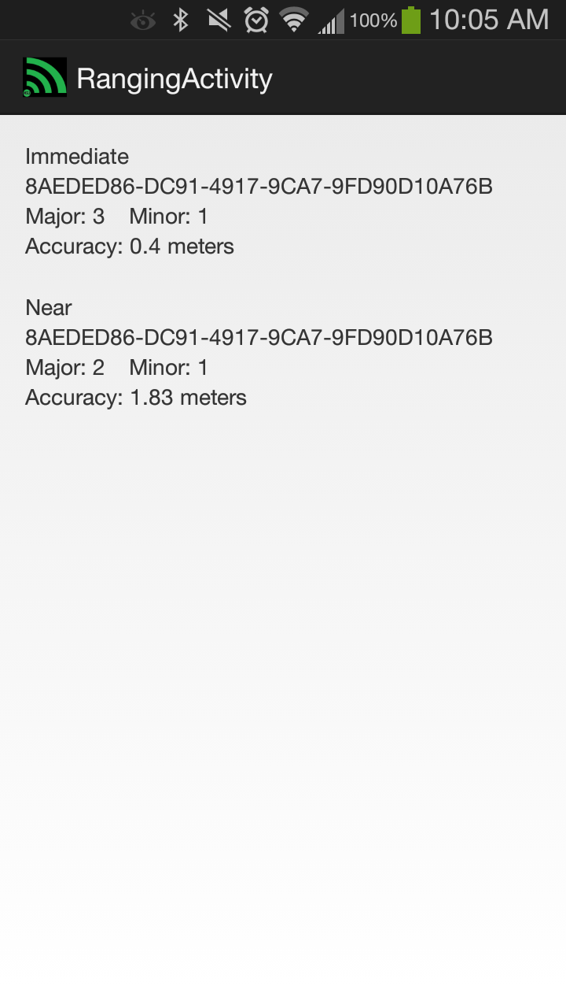
Software Design
  Android
    Radius Networks
  iOS

Slide 10
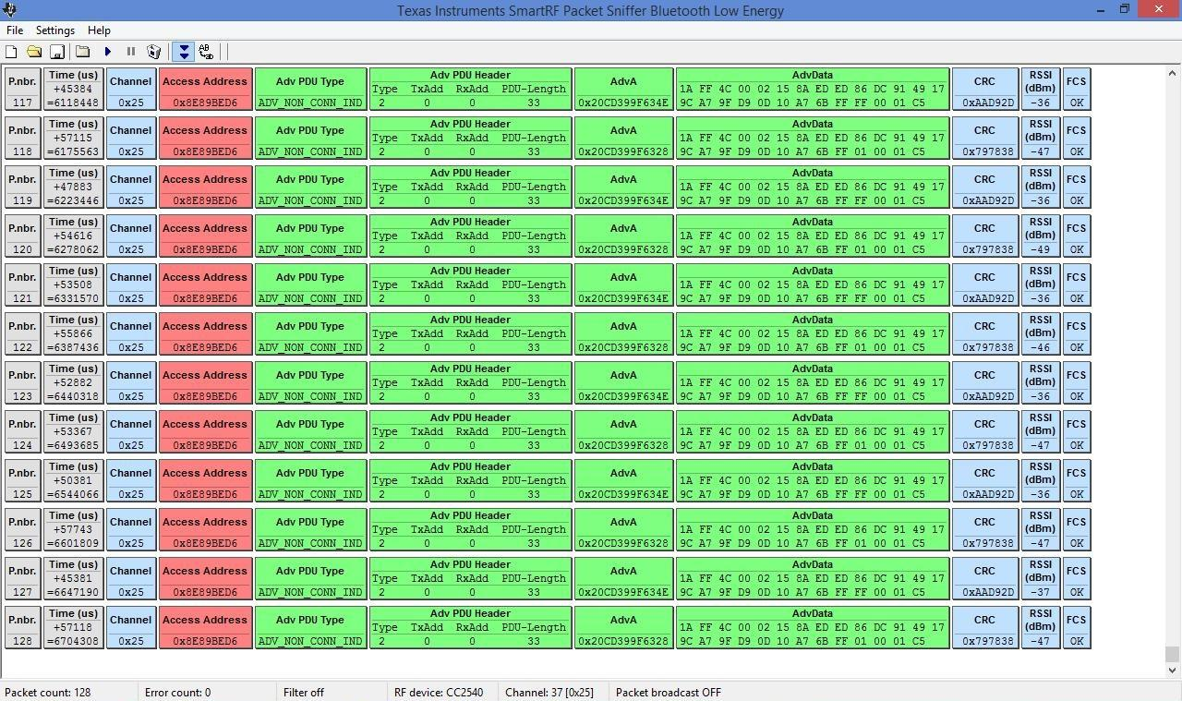
Test Results
    Packet Capture

Slide 11
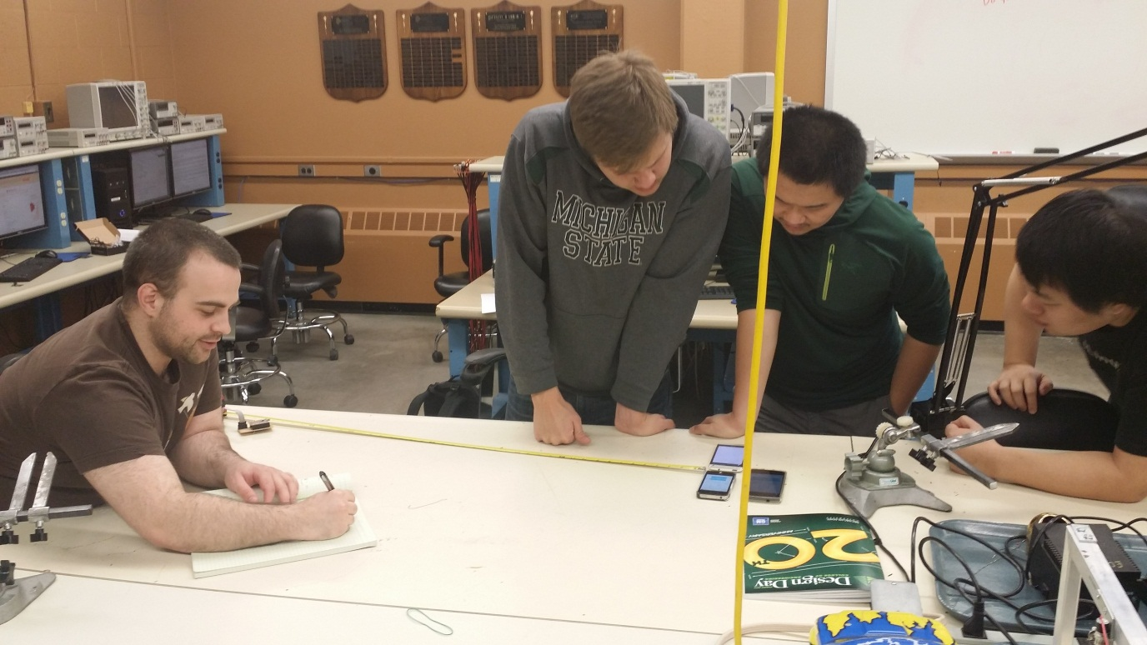
Test Results
  Connectivity Test
  Maximum Range Test

Slide 12
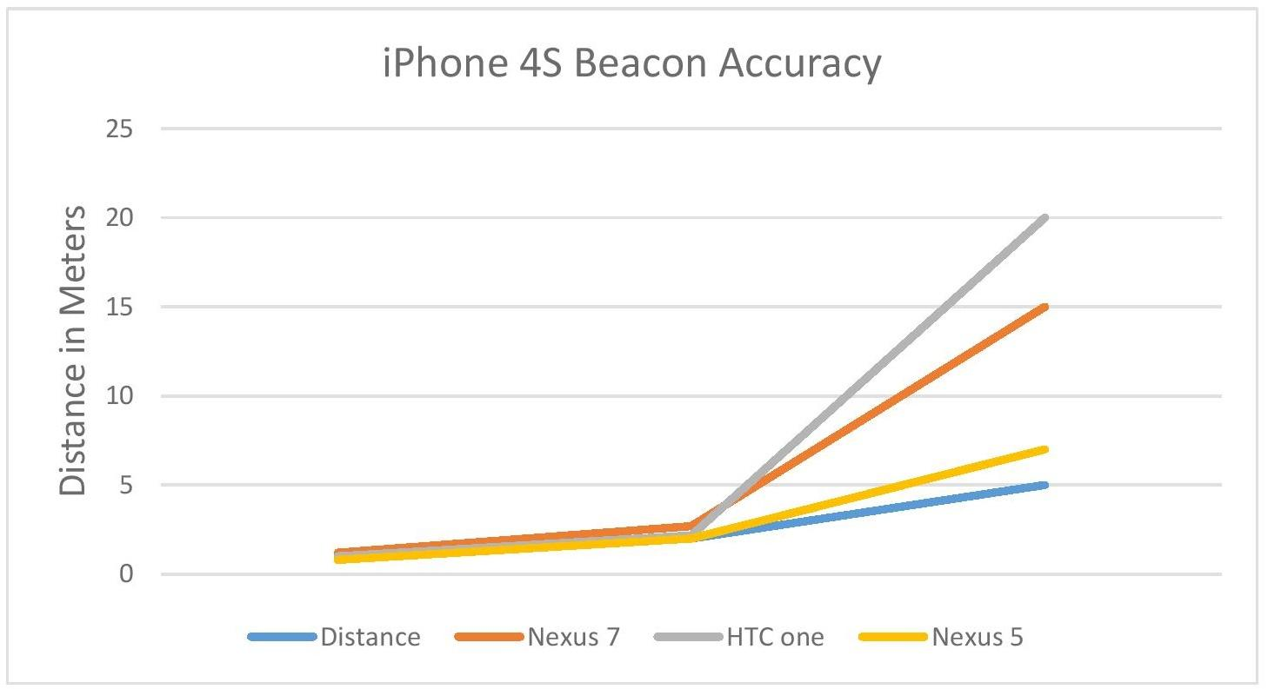
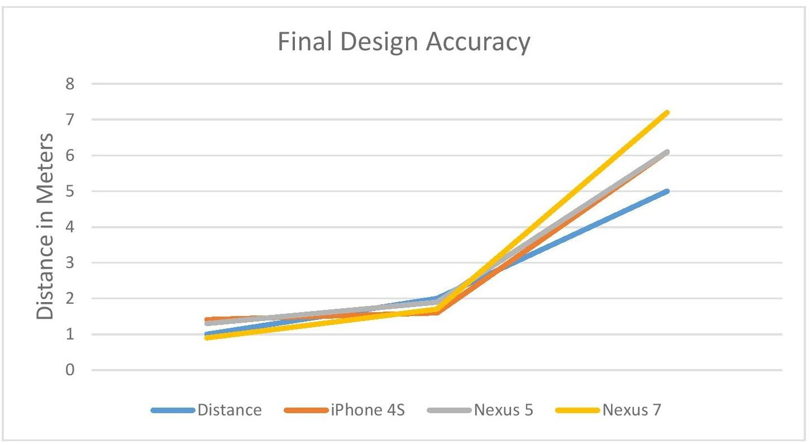
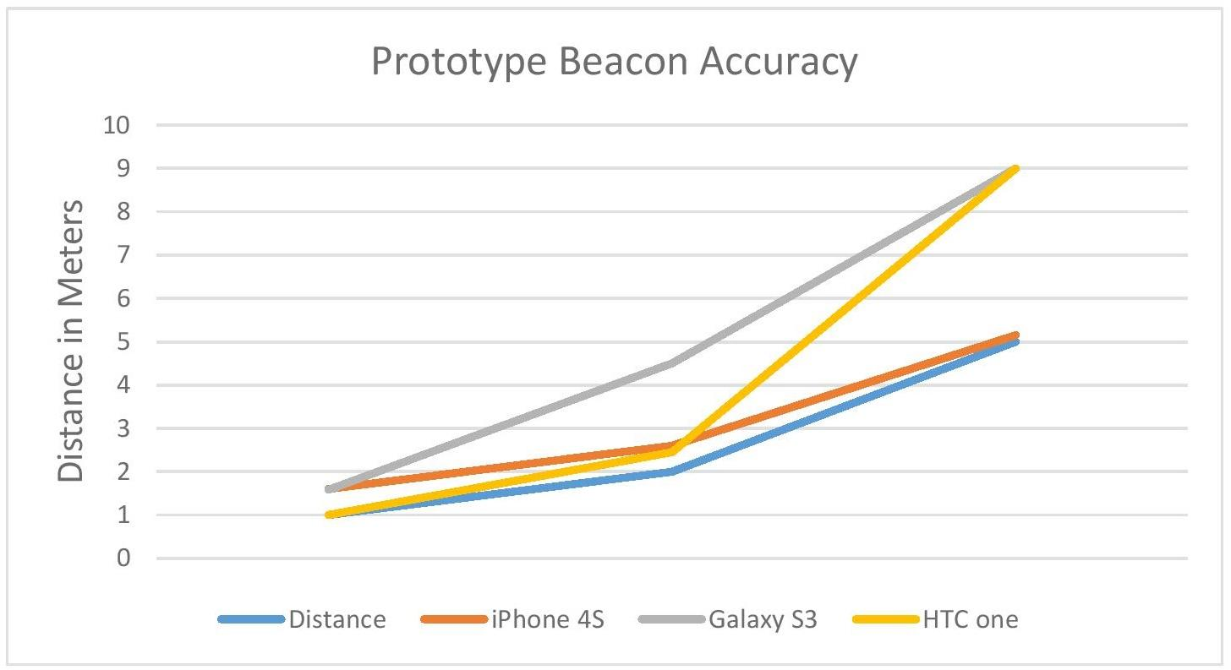
Test Results
  Distance Accuracy Test

Slide 13
Future Design Improvements
  Hardware
    Revise PCB layout
      - Capacitors
      - DC jack
    Battery Powered
  Software
    Implement Database
    Improve Android Distance Measurement
  *picture of current PCB layout*

Slide 14
Questions?

