Slide 1
Survey of Current Braille Technologies
Team5
Steven Chao
Kodai Ishikawa
Daniel Olbrys
Terry Pharaon
Michael Wang

Slide 2
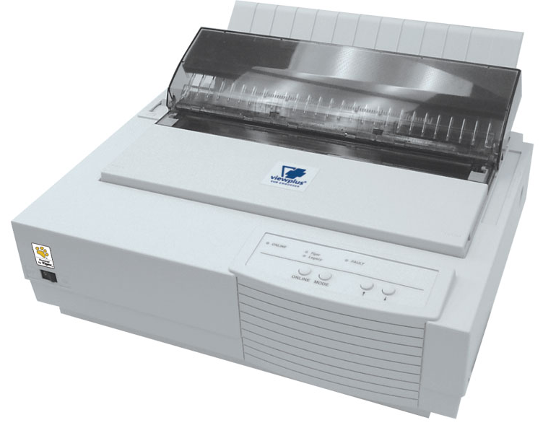
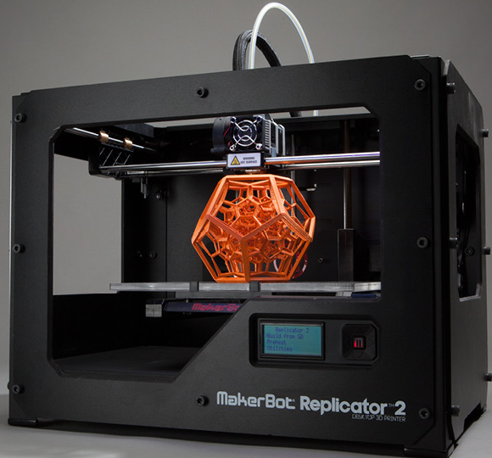
Current Braille Display technology
Various braille display technologies in the market:
Non – Refreshable
Printers
  Embossed paper braille
  3D printing technology

Slide 3
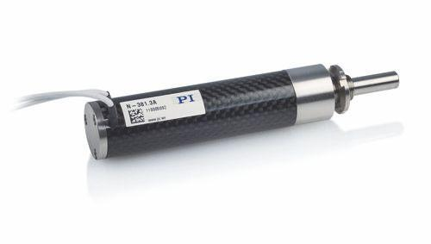
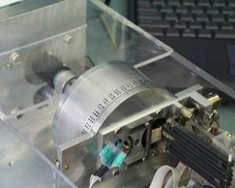
Current Braille Display technology
Various braille display technologies in the market:
Refreshable
Piezo actuators
  Electrical energy to linear motion
Wheel
  Utilizes three electromagnets to adjust dot position

Slide 4
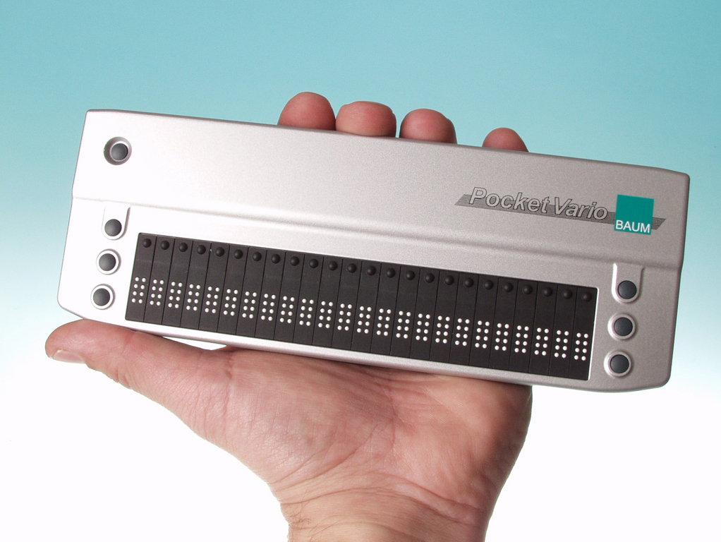
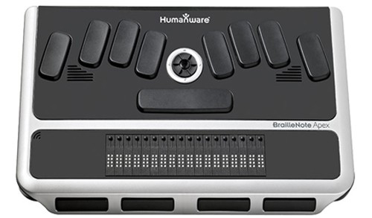
Braille Displays
Braille Cells
Cursor Router Keys
Navigation Buttons
Perkins Style Keyboard
Scroll Wheel

Slide 5
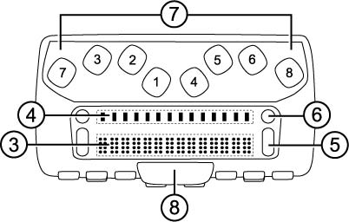
Braille Displays
Features (Standalone)
  Word Processor
  Book Reader
  Web Browser and E-Mail
Apex BT 32 - $5495
Perkins Style Keyboard
  Dots 1:6
  Enter, Backspace, Spacebar

Slide 6
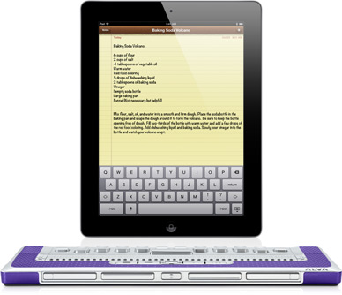
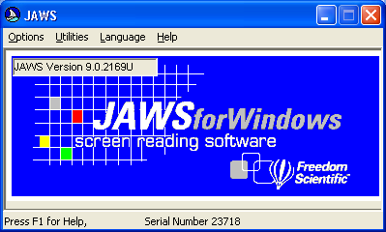
Braille Display Software
Braille Displays for iOS
  Software Built-in
  Bluetooth
  VoiceOver
JAWS Screen Reading Software
  Keyboard Shortcuts
  Displays active window/menu

Slide 7
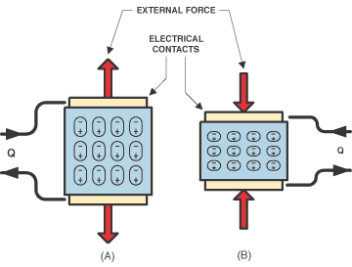
Introduction to Piezoelectricity
Mechanical Stress generates a voltage
Linear relationship
Inverse relationship

Slide 8
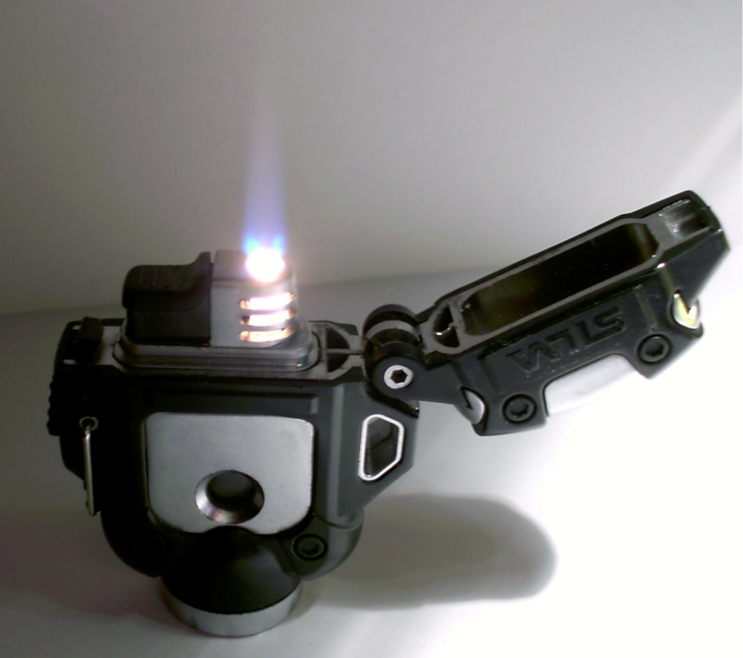
Piezoelectric Applications
High voltage and power sources
Sensors
Motors
Actuators

Slide 9
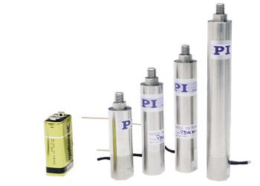
Piezo actuators
Applying voltage to piezoelectric causes deformation
High resolution, µm scale
Relatively short distance, not very effective for all uses

Slide 10
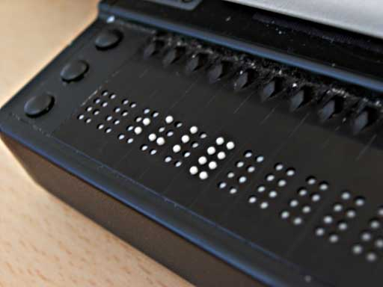
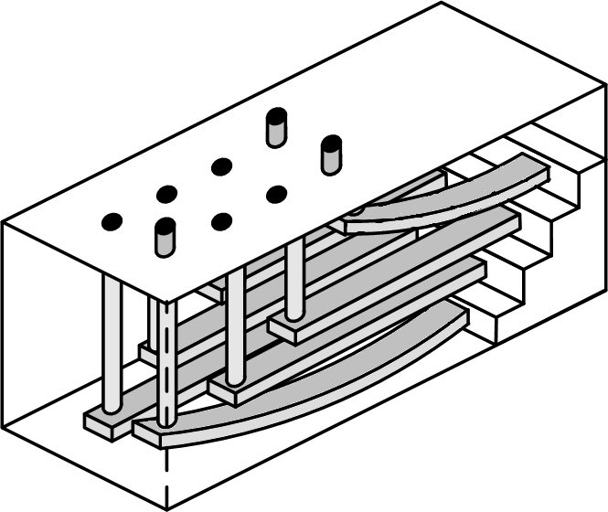
Refreshable Braille Display
A device that displays a line of Braille characters, generally 40-80 cells
Each dot is operated by a single piezo-crystal connected to a lever
Crystal expansion is small but powerful
This allows the display to output text files

Slide 11
Analysis of Piezo-Displays
High Cost ($1000 - $5000)
Individual pin cost is about $4
Virtually instantaneous refresh speed
Very high functionality
However, the high cost leaves a great deal of room for improvement

Slide 12
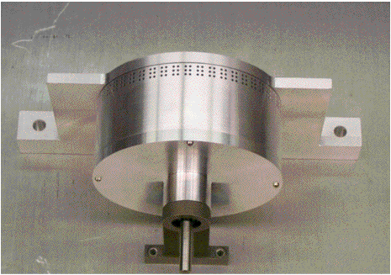
Rotating-Wheel Based Refreshable Braille Display
Developed by National Institute of Standards and Technology (NIST)
Inverted method of operation
Utilizes three electromagnets to adjust dot position
Wheel is spun by small motor (adjustable speed)
Still in R&D phase, no commercial products yet (but patents exist)
http://academic.uprm.edu/pcaceres/Undergrad/PaperlessBraille/id18.htm

Slide 13
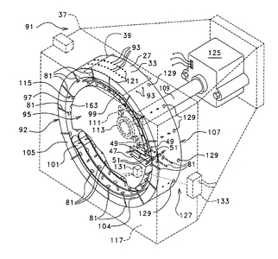
Rotating-Wheel Advantages
Expected to reduce cost by factor of more than 10x
Relatively small footprint (approx. CD player sized)
Mechanically very simple (robust)
Fast refresh rate (reset after completing one revolution)
http://www.google.it/patents/US20020045151

Slide 14
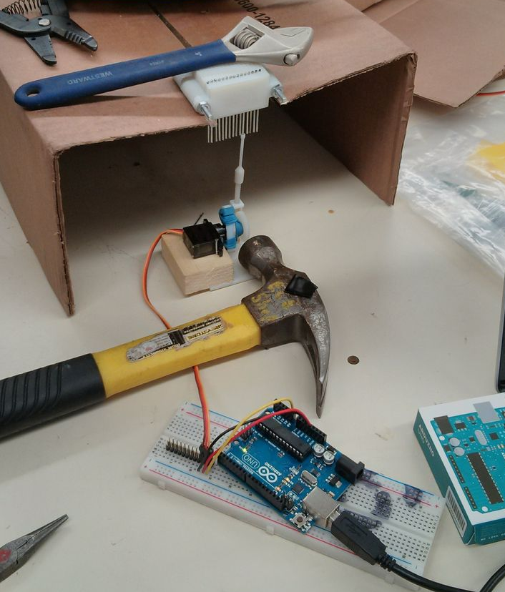
Future Display technology
Non-available in the market:
Our Design
  3D Refreshable Tactile Display
Possible Improvements
  Fast, more accurate, more durable and cheap.

Slide 15


Questions?

