Slide 1


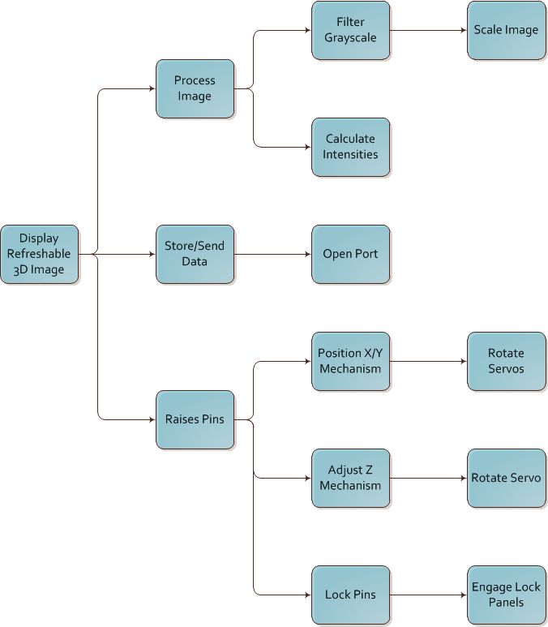
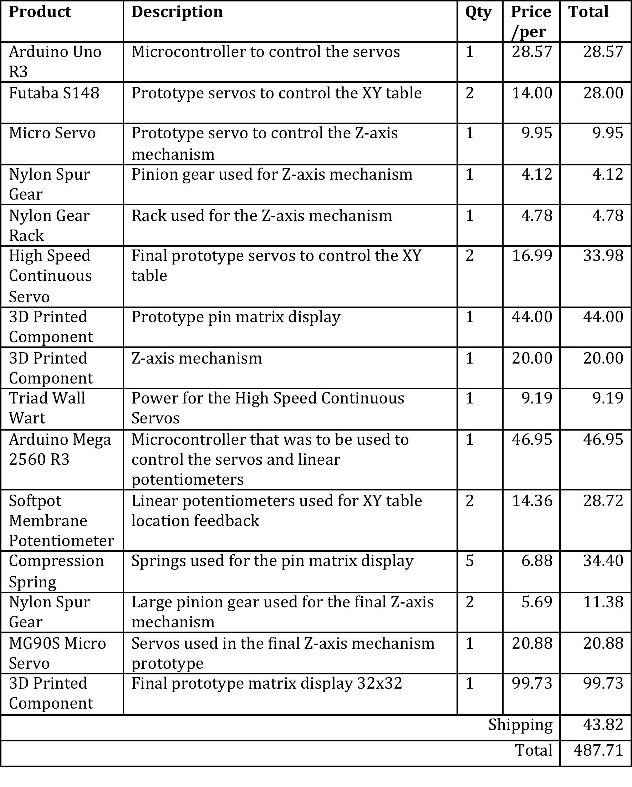
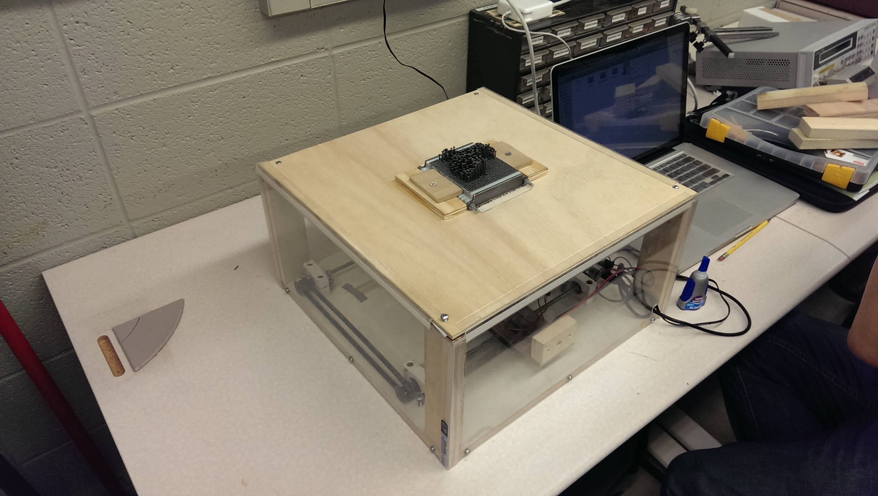
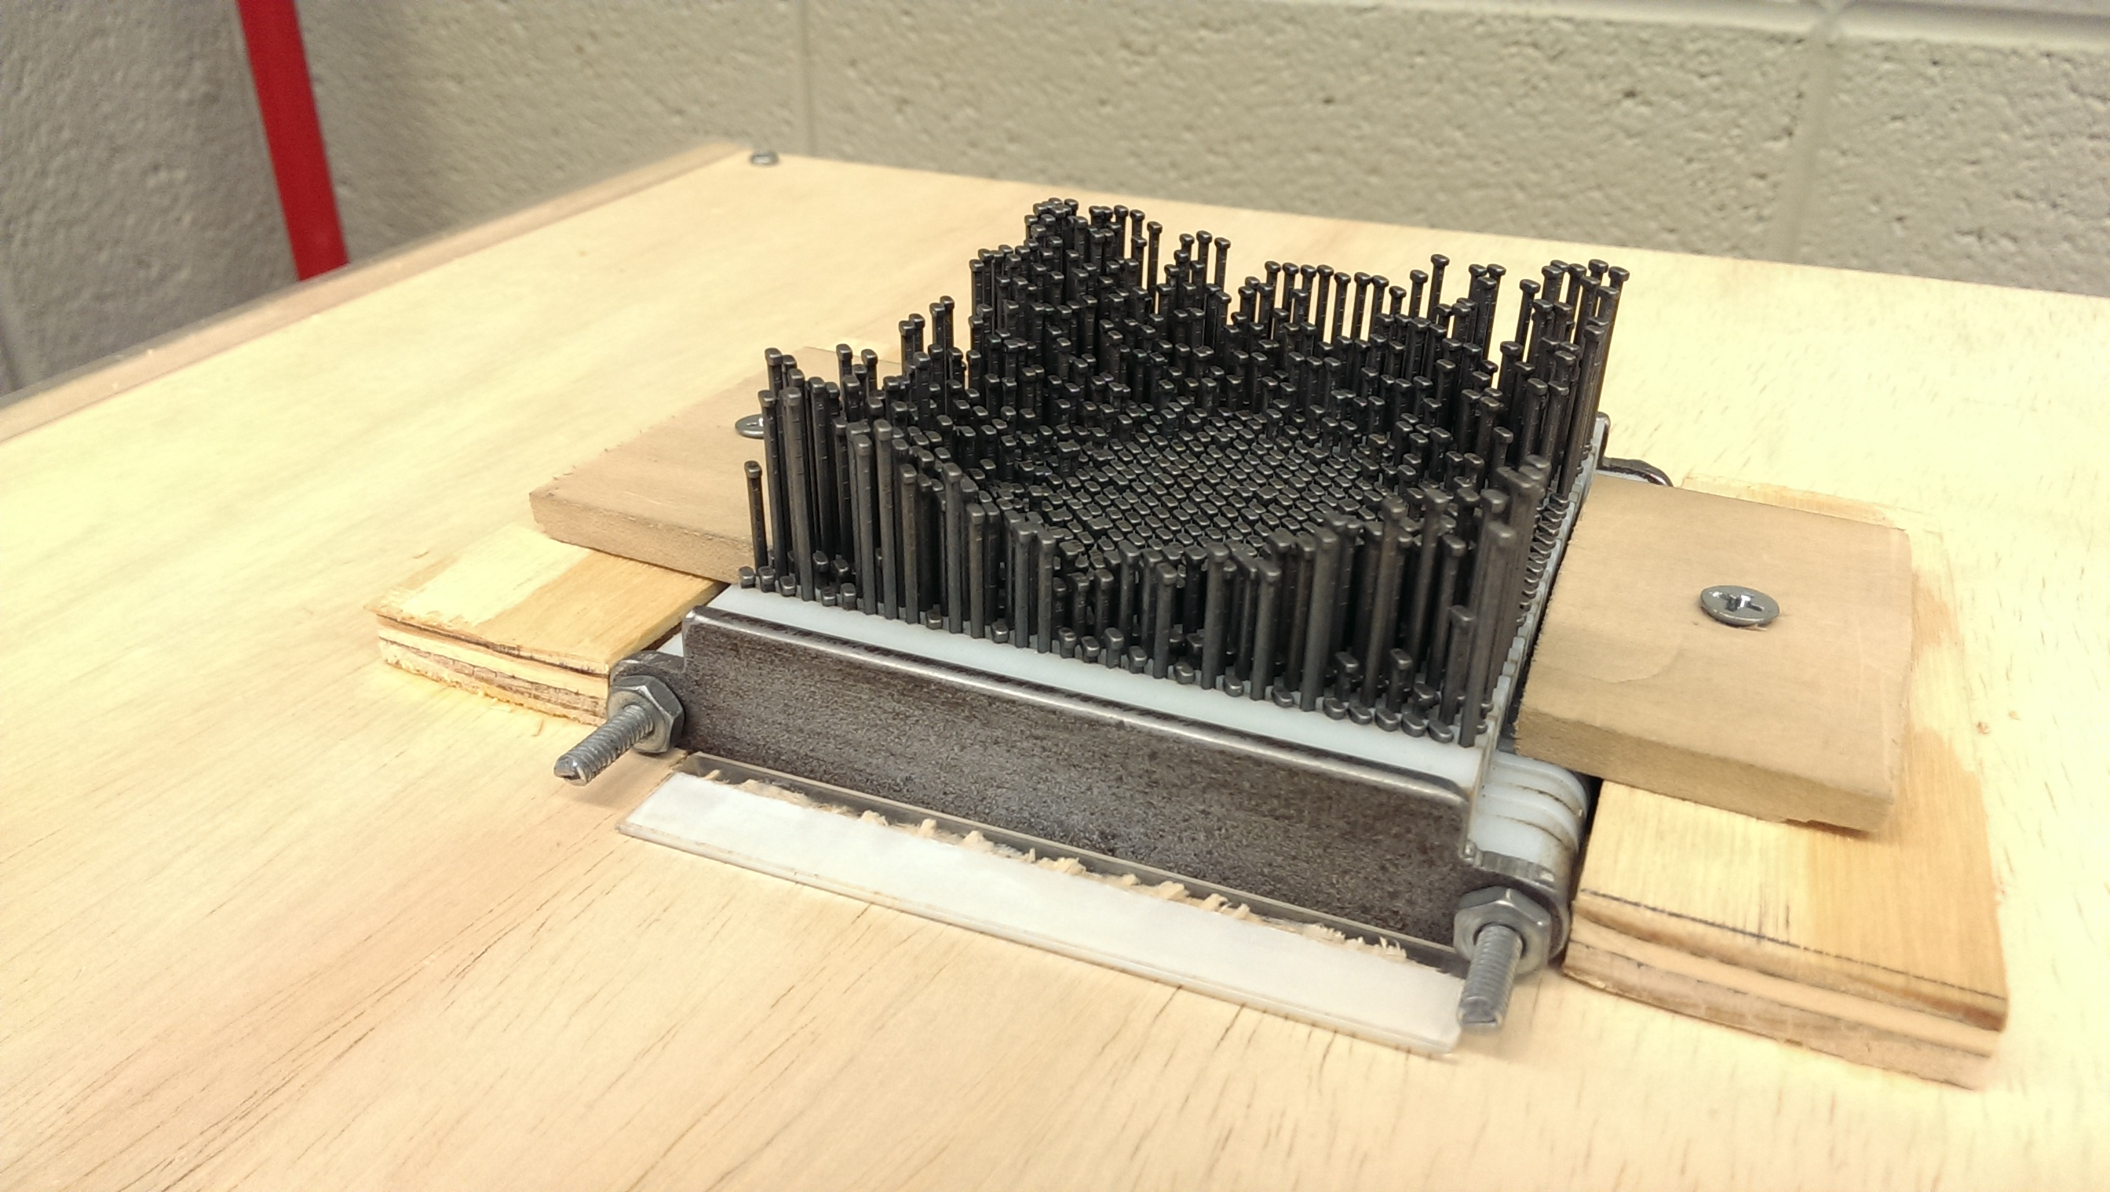
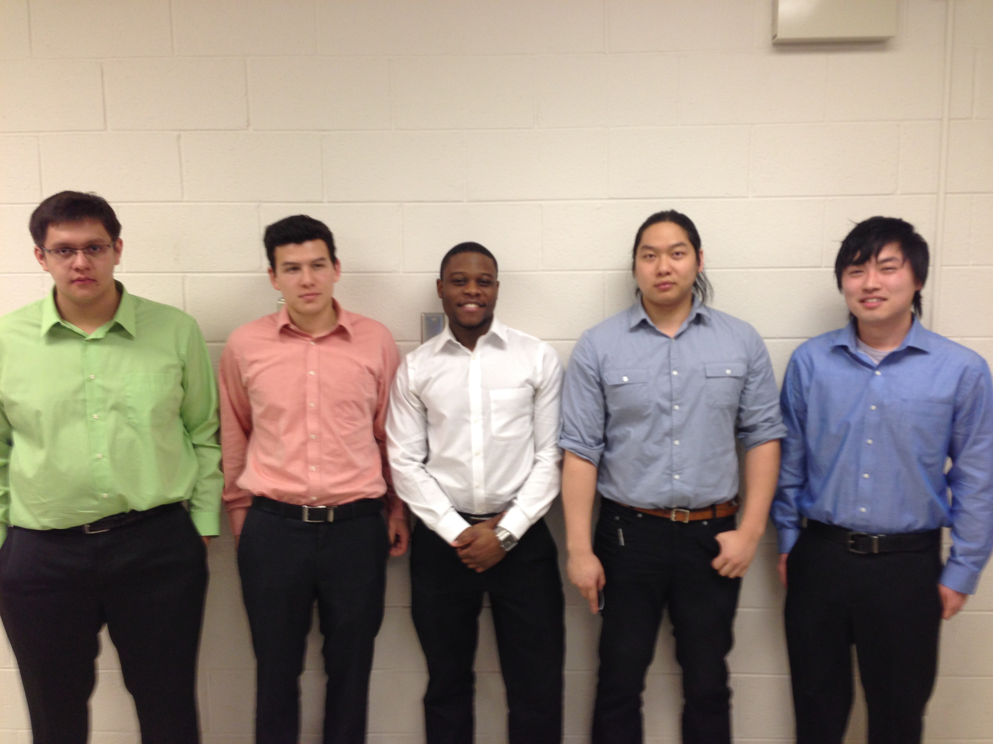
Refreshable 3D Braille Display
Sponsors: MSU Resource Center for People with Disabilities
Dr. Satish Udpa
Facilitator: Dr. Tongtong Li
Introduction and Background
Design Concept
Budget Analysis
In an age of forever increasing digitization, issues arise with equalizing opportunities for the blind. Despite the fact that Universities have been pushing for the adoption of new technologies, blind students may be left behind other students. The current crop of commercially available solutions to mitigate this issue fall short of being practical, both from an accessibility and fiscal standpoint.
Team Five has constructed a device that utilizes a refreshable display to display tactile 3D images. The device is able to receive image files, analyze and process the image in terms of color intensity, and then output these results via a 3D pin matrix display, with color intensity determining the height of each pin. The refreshable nature of this device means that the device has numerous practical applications, with functionality that is currently unavailable in the marketplace. It is also far less costly than the use of non-refreshable technology.
Final Design
Design Requirements
Standard Braille spacing
Pin height: 1in (25.4mm) to 1.5in (38.1mm)
Voltage Requirement: 120V AC (Wall wart)
Resolution: 32x32 or greater
Rigid pin materials
Project Summary
The project was an overall success. We constructed a 3D tactile display that could display images and Braille. We were able to implement a working XY table, Z-axis pin raising mechanism, pin matrix display, and Arduino code. The team was able to work successfully together without any major disputes. We were able to apply our problem solving techniques we acquired at Michigan State University to solve difficult issues. The project was done on time and within the $500 budget. The semester was a continual learning process, and we were able to fulfill all of the learning objectives defined for the senior capstone class.
Technical Description
The 3D refreshable tactile display hardware sections can be broken down into three main sub-groups of efforts: Z-axis pin setter mechanism, X-Y axis table, and the pin-holder/display.
The Z-axis pin setter mechanism is composed of two rack and pinion arrangements driven by low cost 0-180 degree servomotors. The design is scalable and is able to parallelize multiple operations by utilizing multiple servomotors.
The X-Y table is a lead-screw design that specializes in accuracy due to the large number of turns required to advance the platform. There are two lead-screws that drive the X-axis for stability and are driven in parallel by a belt and frictionless ball bearings. The Y-axis is another lead-screw that is mounted on the X-axis and supports the Z-axis pin setting mechanism.
The pin matrix display is made from 3D printed plastic components. The plastic layers hold 1024 individual pins by friction, which holds them up as they are set and prevents them from falling as the pin setter is adjusted and moved. Small springs are placed in between the layers to help equalize the tension on the pins. Once the image is completed, the display can be tightened to lock the image.
Results and Discussion
Our final design managed to complete the 32x32 “pixel” image in about a half an hour, with few errors. In order to improve the functionality of the final design, we adjusted the tightness of the locking grid, to decrease the number of pins that slipped back down to the low setting.
Since our design was a proof of concept, we believe that it was successful, showing that a refreshable tactile display actually can be implemented cheaply. If we wanted to increase the size of the display, it could be done by simply designing for a larger grid of pins. Increasing the speed of the refresh rate could also be accomplished by simply increasing the number of Z-axis pin-raising mechanisms. Improving the robustness of the design could be achieved by using higher quality components (e.g. metal), but at the price of a higher total cost.
Our design offers a cost-effective alternative to 3-D printing plastic models for use in the education of the blind.
Project Sponsors
Satish Udpa – East Lansing, MI
Stephen Blosser – East Lansing, MI
Design Team 5
From left to right: Daniel Olbrys, Steven Chao,
Terry Pharaon, Michael Wang, Kodai Ishikawa

