Slide 1

Team 5
3D Braille Display
Sponsor: MSU Resource Center for Persons with Disabilities & Dr. Satish Udpa
Facilitator: Dr. Tongtong Li
Steven Chao
Kodai Ishikawa
Daniel Olbrys
Terry Pharaon
Michael Wang

Slide 2
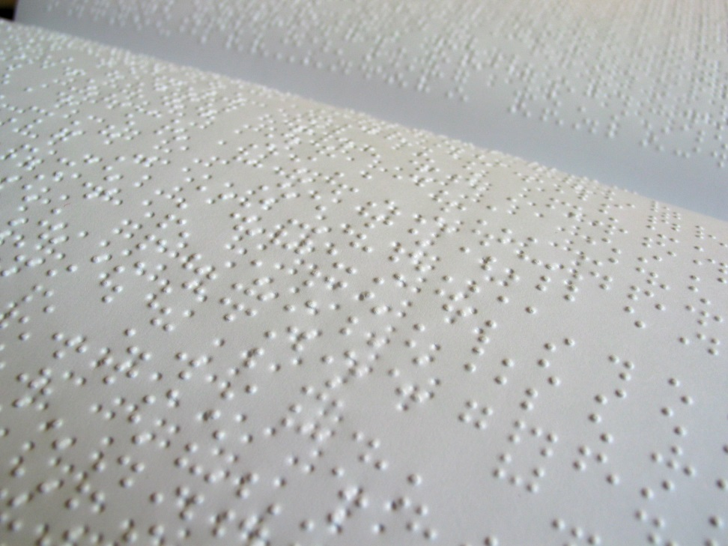
Background
Braille printers, 3D printed Braille, Braille displays
Currently, there are no refreshable 3D displays for the blind
Lack of resources for blind students
Some uses: 3D waveforms and curves, maps, pictures, etc.

Slide 3
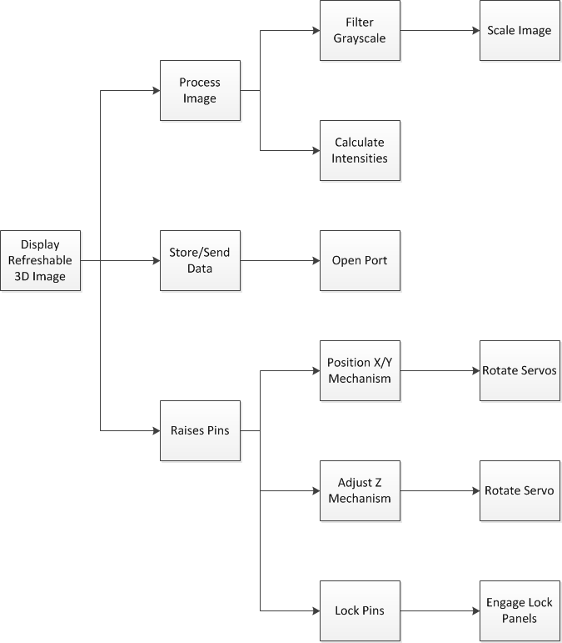
Problem Statement
Develop a system able to:
Receive image files
Process said images
Output results via pin matrix display

Slide 4
Design Specifications
Understanding design parameters
  Providing explicit information about the requirements of the products
  Why the design is built this way
Importance of design specification based on usage
  Most important to lease important design specification

Slide 5
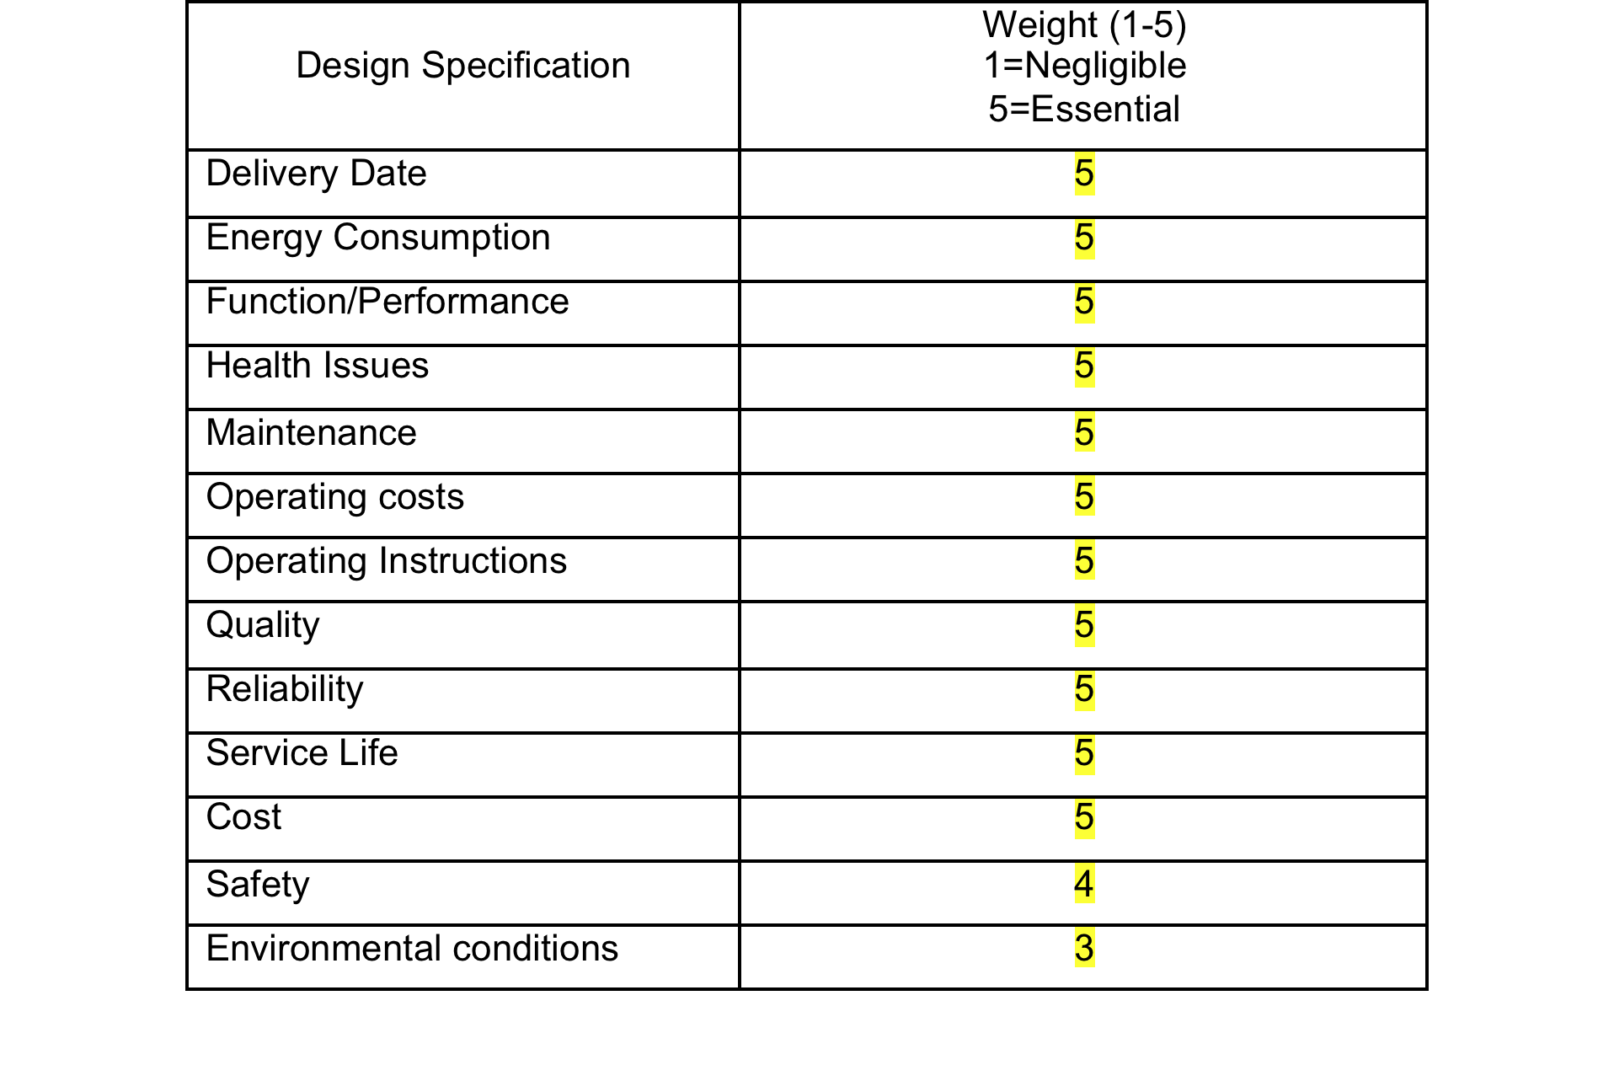
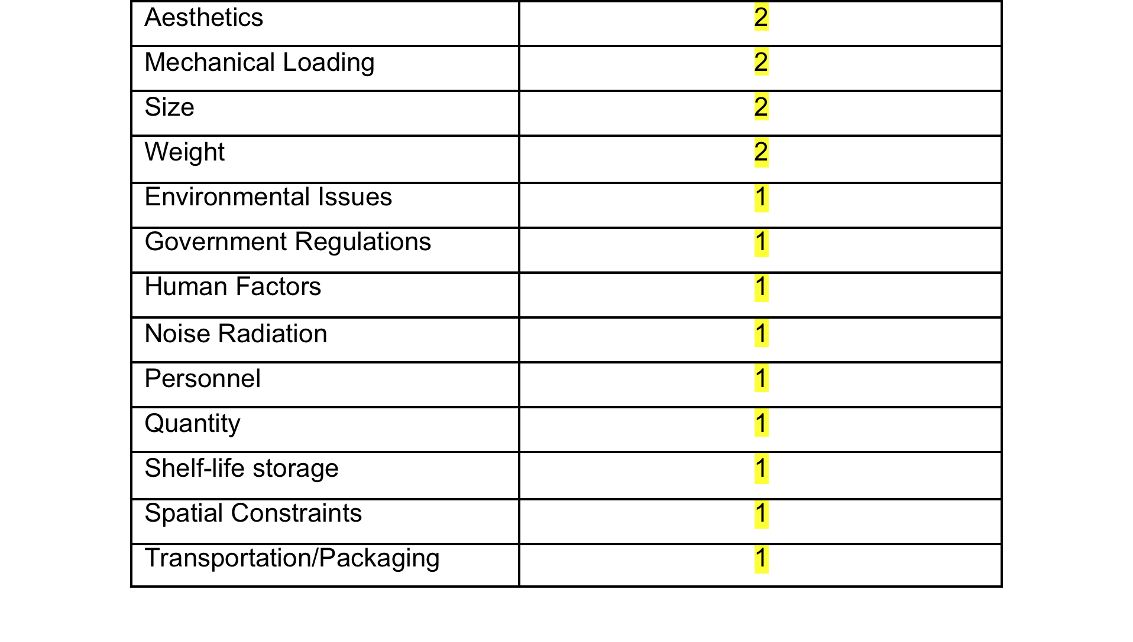
Design Specifications

Slide 6
Design Considerations: Pin Movement
Push Up:
  Initially set down (reset down)
  During pin setting, must maintain set height
  Must be locked into place during use
Pull Down:
  Initially set/reset up using springs
  Pulled down by attached wires
  Will maintain set height, provides resistance to touch, fast refresh rate
  Difficult to coordinate individual rod control, very complex, not very robust

Slide 7
Design Considerations: Pin Type
Smooth Rods
  Must maintain set height, and needs a locking mechanism for use
  Easier to design and manufacture, variable pin height
  Difficult to hold in place
Notched Rods
  Notches will allow easier locking, with the downside of quantifying pin heights
  More difficult to design, but more effective with locking mechanism

Slide 8
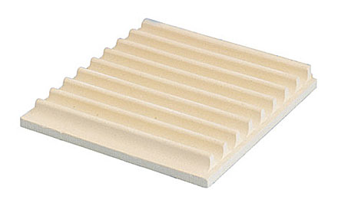
Design Considerations: Locking Mechanism
Sliding Plate
  Easier to implement, but necessitates uniform locking of pins
  More uniform distribution of locking resistance to each pin
External Compression
  Series of panels with pins interspaced
  Hard to implement, but allows a row-by-row locking of the pins

Slide 9
Design
Refreshable Display
  Z Axis pin mechanism
  X-Y Axes controlled by step motors, gears move pin mechanism into place to raise pin
Smooth pins
  Pins held in place via friction
  Max height of one inch
Controlled by Arduino
  Receives processed “image” over USB and begins pin setting routine

Slide 10
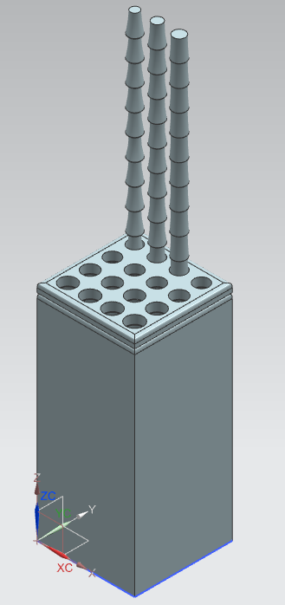
Current Progress
Small array – 4 x 4
Test different pin characteristics
  Material
  Shape
Single Pin actuator
  Step Motors

Slide 11
End Semester Goals
Large Array – 64 x 64 pins
  Big enough for entire hand
Parallel Operation – Multiple Pin Actuators
  Increase speed of image creation
More countable height levels
  Higher resolution
  More advanced images

Slide 12


Software
Convert image to grayscale
Resize image
Normalize image
Convert pixel intensity into a corresponding height
Send data to Arduino through serial USB

Slide 13
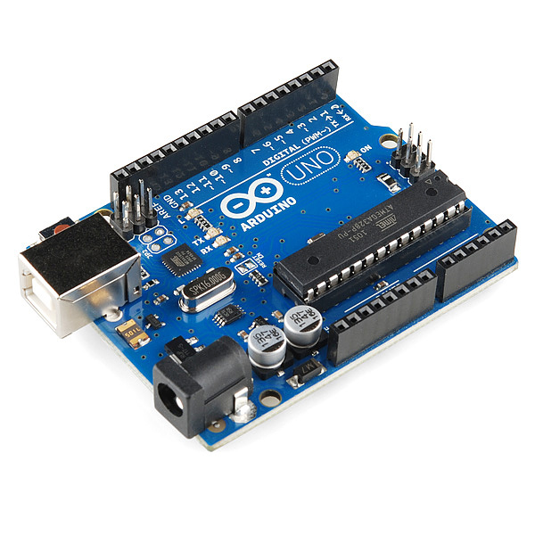
Budget
3D Printed Components - $150
Step Motors - $100
Gears/Track - $40
Arduino Uno R3 - $30
Metal Pins - $30
Approximate Total: $350

Slide 14
Questions?
Thank you for your time.

