Slide 1

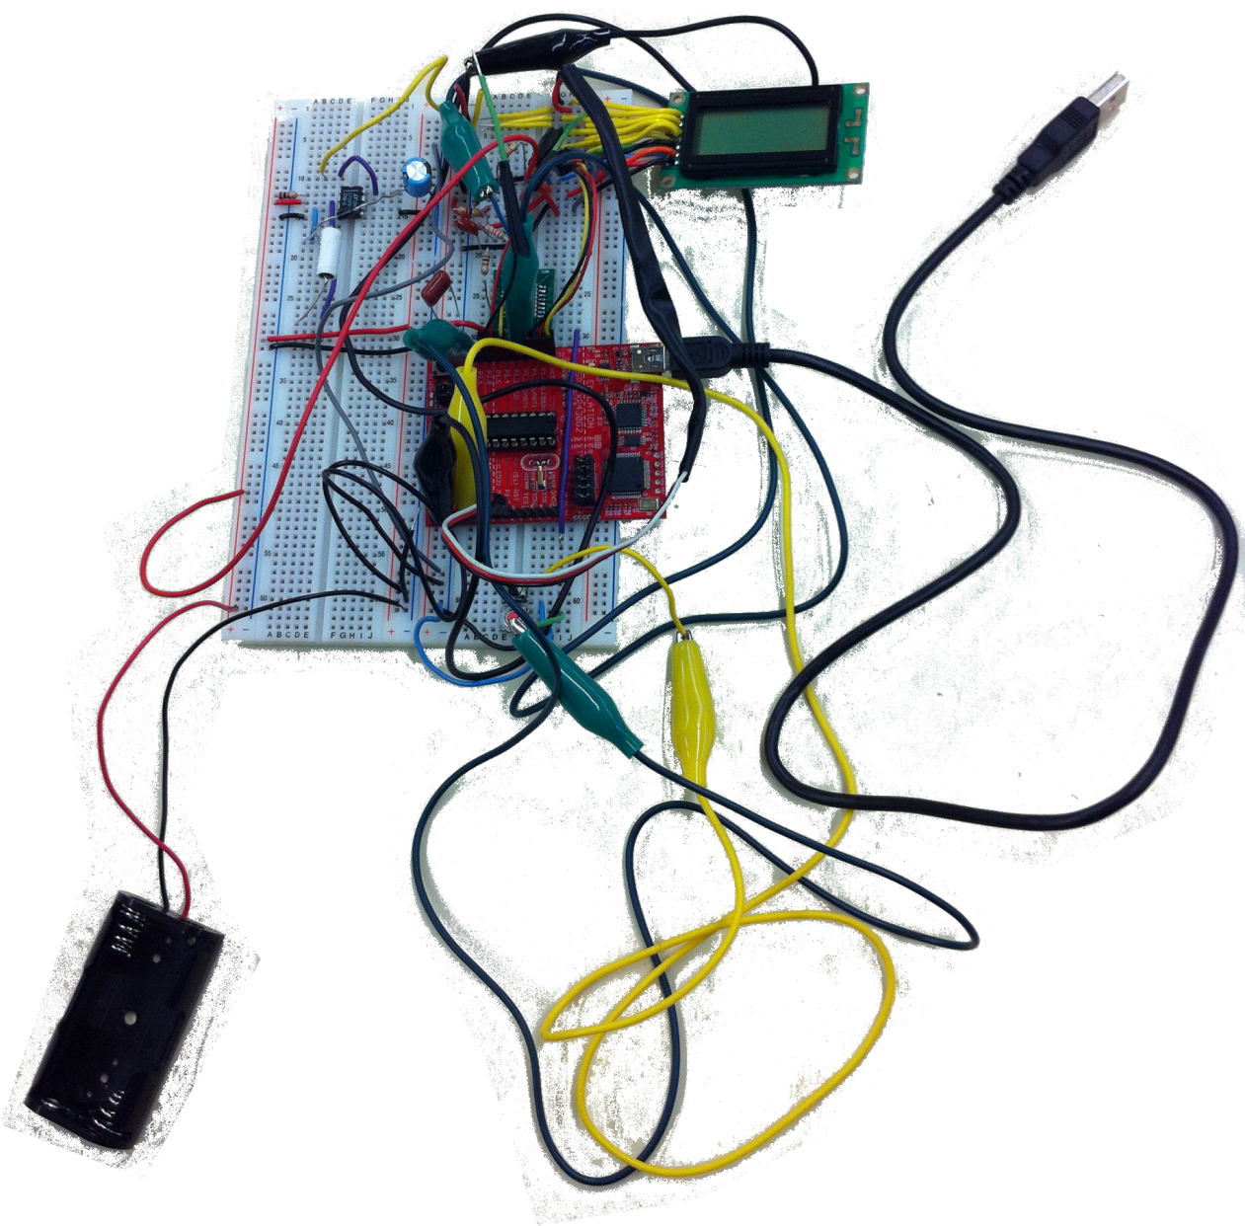
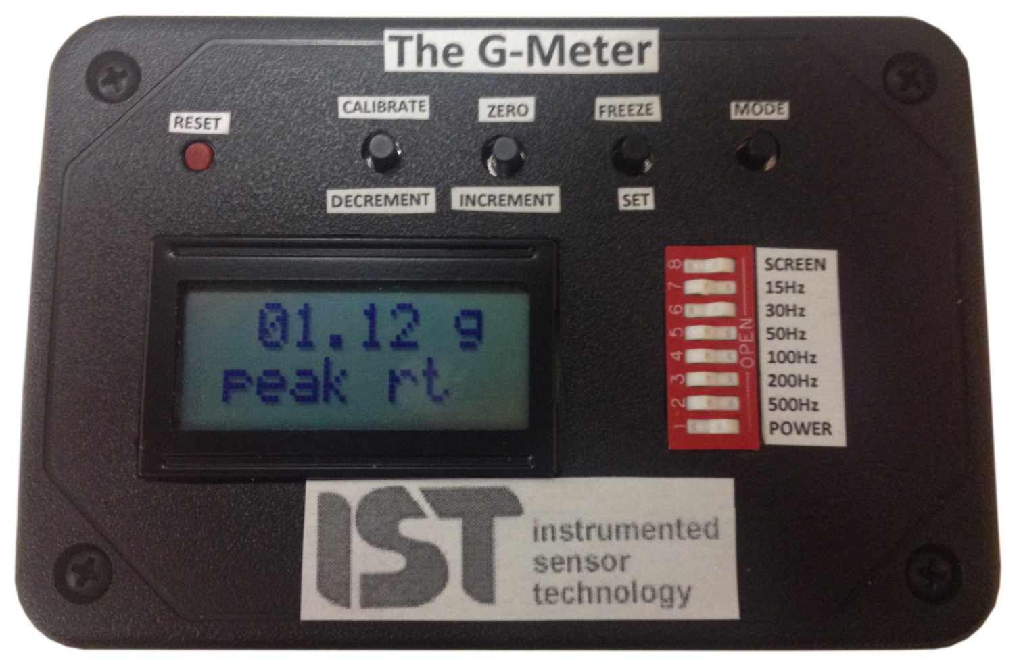
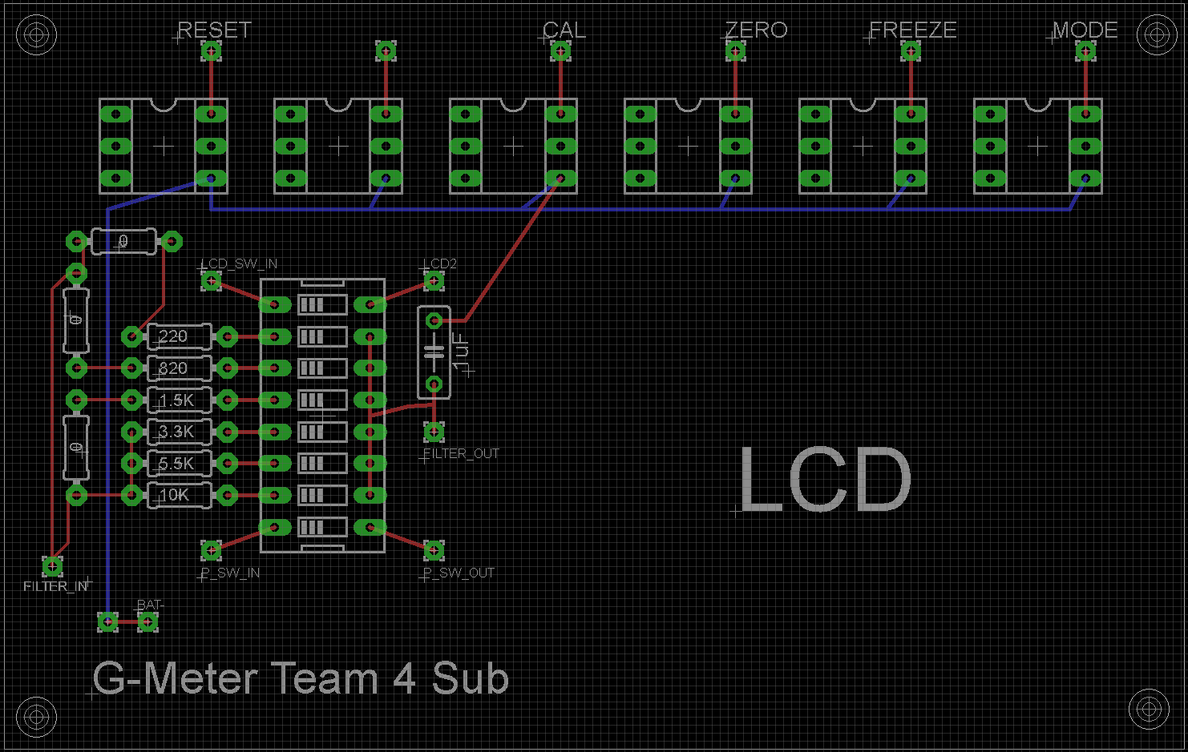
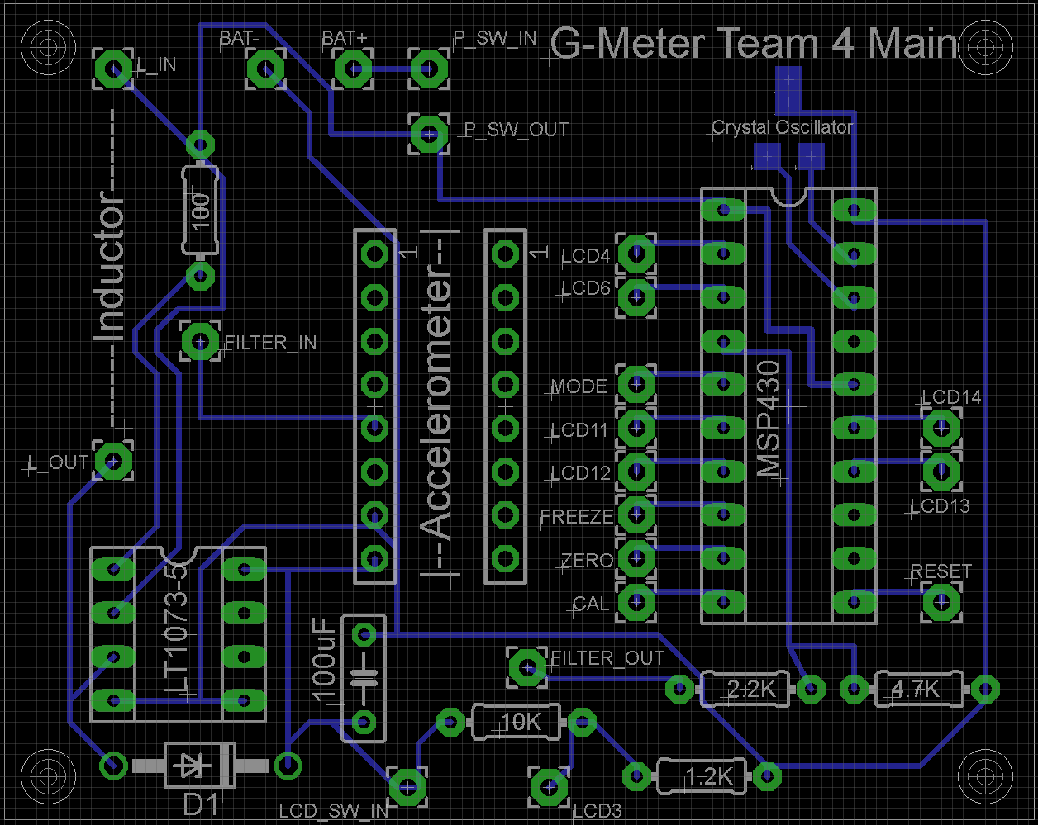
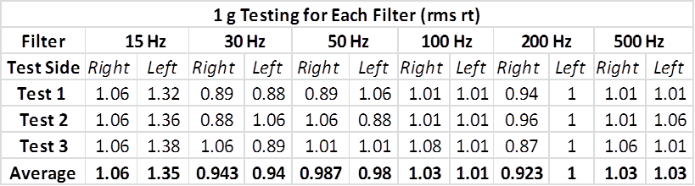
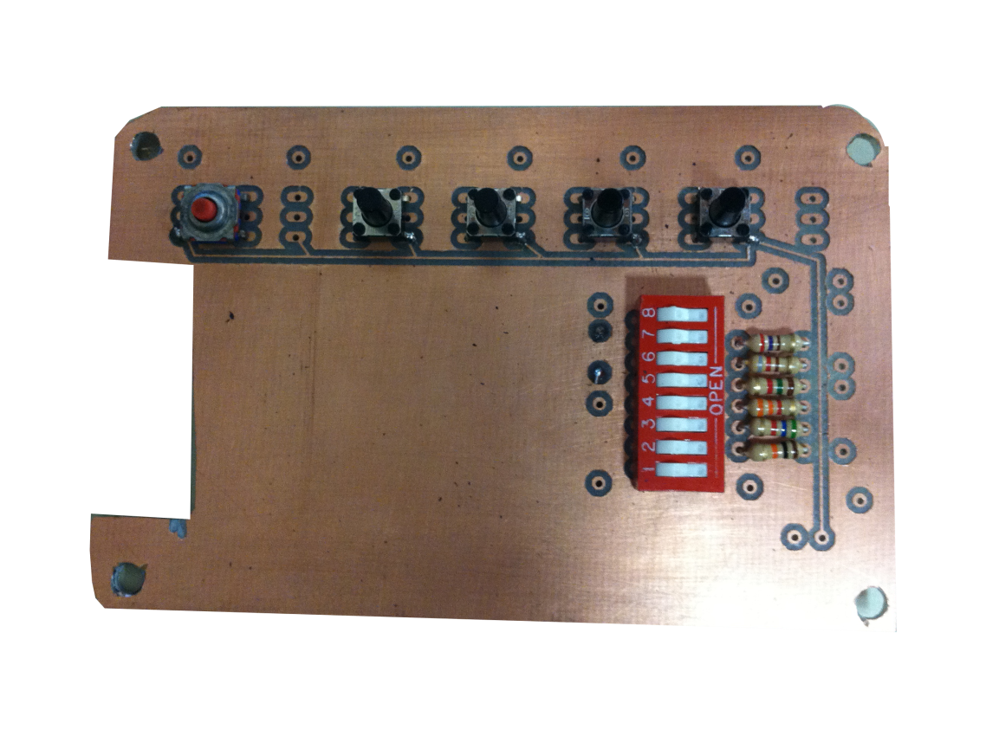
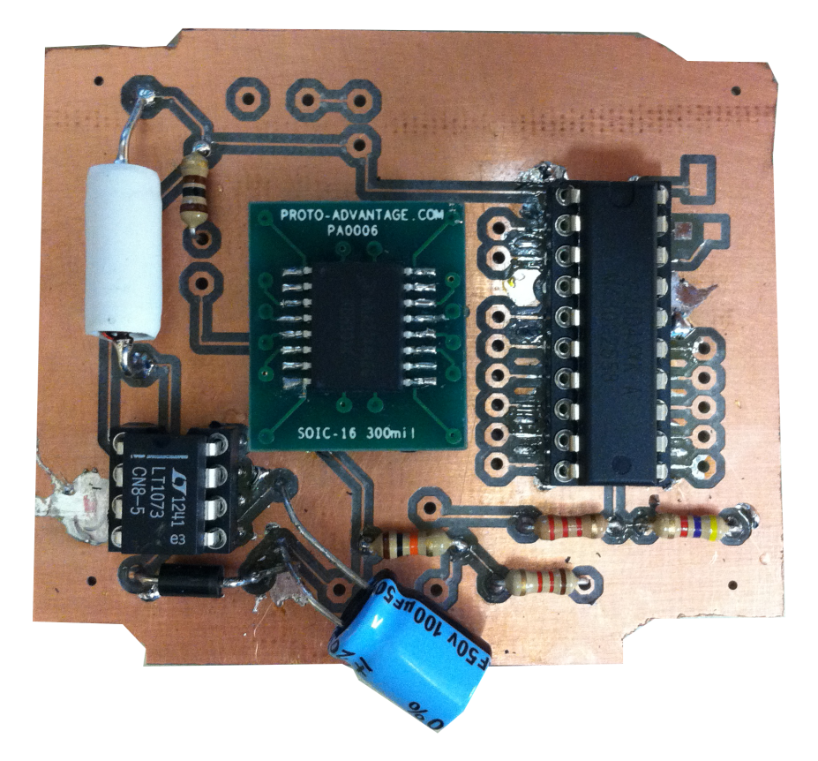


Real Time G-Meter with Peak/Hold
ECE480 Team 4: Karl Anderson, Shuhan Chen, Corey Fox, Eric-John Kohler, Tim Carroll, Dan Svoboda
Spring 2013
Abstract
Key Parameters
Hardware Design
The purpose of this project was to develop a portable G-Meter, roughly the size of a cell phone. Potential applications of the product include logging destructive acceleration during the shipment of a packages.
The on-board microcontroller is programmed to perform several important functions. It is capable
of recording peak acceleration events and logging the time at which they occurred. The meter
also features real-time RMS calculation and a set of six bandwidth filters to monitor acceleration within a specific frequency range.
Display and record peak g events and RMS readings. Must record time and date of occurrence.
30 days on 2 AA batteries
Selectable bandwidth filters
Initial Prototype
The first prototype was constructed in three separate modules on solderless protoboards.
EAGLE Schematic
The messy original circuit
was carefully documented
and recreated in EAGLE.
Block Diagram
Testing
This diagram represents a high-level view of the G-Meter. Each block was implemented by a member of the group.
The G-Meter is dynamically calibrated using the earth’s static gravitation (1G) as a reference.
The on board clock was measured, and deviates by less than a minute over a one month period.
Final Production
Two PCBs were created and populated with components. Inside the final enclosure, the PCBs are stacked along with the screen and battery pack.
Accelerometer
Bandwidth Filters
Control Buttons
DIP Switches
MSP430
Microcontroller
2x8 LCD
Software
Display Driver
Memory
Code on the MSP430 microcontroller:
Continuously reads acceleration and computes RMS values and peaks
Maintains a real time clock with time and date for peak log
Sends data to the screen through the display driver circuit
Utilizes interrupts and low power modes to reduce power consumption
Voltage Regulator
2 AA Batteries

Slide 2
Real Time G-Meter with Peak/Hold
ECE480 Team 4: Karl Anderson, Shuhan Chen, Corey Fox, Eric-John Kohler, Tim Carroll, Dan Svoboda
Spring 2013
Abstract
Key Parameters
Hardware Design
The purpose of this project was to develop a portable G-Meter, roughly the size of a cell phone. Potential applications of the product include logging destructive acceleration during the shipment of a packages.
The on-board microcontroller is programmed to perform several important functions. It is capable
of recording peak acceleration events and logging the time at which they occurred. The meter
also features real-time RMS calculation and a set of six bandwidth filters to monitor acceleration within a specific frequency range.
Display and record peak g events and RMS readings. Must record time and date of occurrence.
30 days on 2 AA batteries
Selectable bandwidth filters
Initial Prototype
The first prototype was constructed in three separate modules on solderless protoboards.
EAGLE Schematic
The messy original circuit
was carefully documented
and recreated in EAGLE.
Block Diagram
Testing
This diagram represents a high-level view of the G-Meter. Each block was implemented by a member of the group.
The G-Meter is dynamically calibrated using the earth’s static gravitation (1G) as a reference.
The on board clock was measured, and deviates by less than a minute over a one month period.
Final Production
Two PCBs were created and populated with components. Inside the final enclosure, the PCBs are stacked along with the screen and battery pack.
Accelerometer
Corey’s g testing data here?
Bandwidth Filters
Control Buttons
DIP Switches
MSP430
Microcontroller
2x8 LCD
Software
Display Driver
Memory
Code on the MSP430 microcontroller:
Continuously reads acceleration and computes RMS values and peaks
Maintains a real time clock with time and date for peak log
Sends data to the screen through the display driver circuit
Utilizes interrupts and low power modes to reduce power consumption
Voltage Regulator
2 AA Batteries

