Slide 1

ECE 480
Electrocardiogram Demonstration Board
Texas Instruments – Precision Analog
Design Team 3
Texas Instruments Contact: | Pete Semig
Facilitator: | Dr. Ramakrishna Mukkamala
Team Members: | Nate Kesto
 | Mike Mock
 | Justin Bohr
 | Chaoli Ang
 | Yuan Mei
 | Xie He

Slide 2
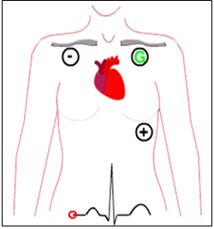
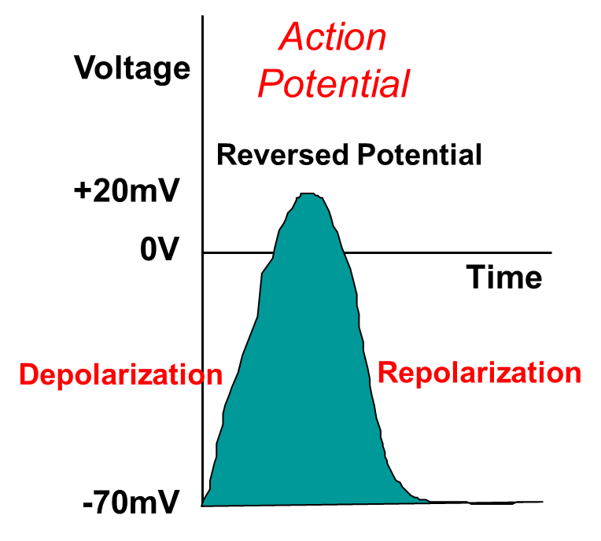
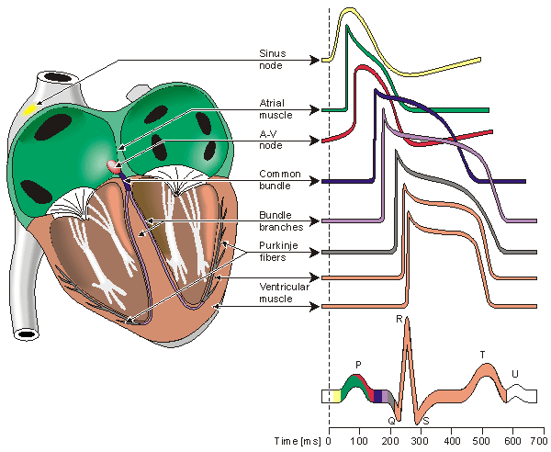
Background
Electrocardiogram (ECG or EKG)
  What is it?
  Methods of measurement (µV to mV)
  Biomedical Applications
Electrode Measurement
Biopotentials from Cardiac Cells
Superposition produces ECG signal
Notes:
What is it? Electrocardiogram measures electrical activity of the heart. This electrical activity is generated by biopotentials. Biopotentials are electrical potentials between living cells and thus when there is a disturbance between the cells an action potential is generated which produces action current. With the heart, action potentials are generated by the rhythmic contractions.
Electrocardiogram: Recording ECG signals through a non-invasive method is termed as Electrogradiogram and is done by placing three electrodes on the body. The positive electrode reference on the left side of the heart, negative on the right, and a ground reference.
Applications: Main applications are human medical and animal medical fields, Dr.’s and vets can detect irregular or abnormal heart beats. ECG are also used extensively in research.
Outdated ECG Board: TI has an outdated ECG board that is inaccurate, large, and uses old chips.
Showcase to customers: Goal is to replace old board with a new more accurate and compact board that uses some of TI’s products in their current portfolio.

Slide 3
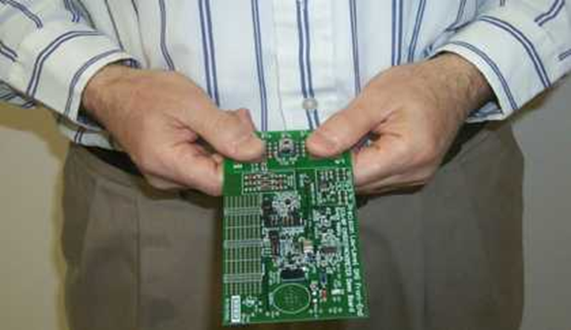
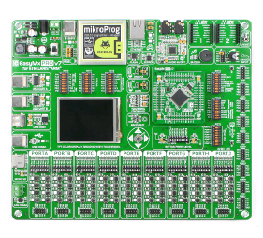
Background
Texas Instruments – Precision Analog
  Current ECG demo board
    Outdated components
    Large
  Desired Outcome
    Reliable and Accurate
    Small footprint
    Sturdy
    Populate with modern components
    Pair with Stellaris as oscilloscope
Texas Instrument’s Current ECG Board
Stellaris Microcontroller

Slide 4
Project Timeline
Phase 1: Design Analog Front End (AFE)
  Power Supply, Amplification, and Analog Filters
  Simulate designs in TINA-TI
  Lay out design on printed circuit board (PCB)
  Phase 2: Test PCB and Interface with Stellaris µC
    Test and compare with TINA simulations
  Integrate AFE PCB with Stellaris µC
  Design proto-type for finger measurements
Phase 3: Design Final Product
  Allow real time ECG measurement from fingers
  Develop algorithm for µC to detect diseases or beats/min

Slide 5
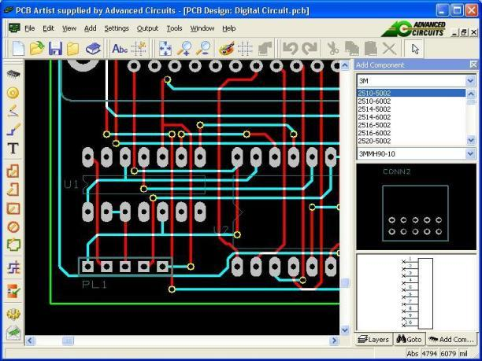
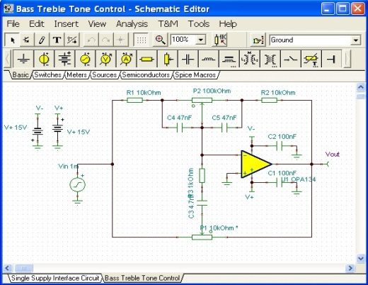
Tools and Resources
PCB Artist
  Pros
    Strong base of components library
    Schematic to PCB wizard
  Cons
    Limited to one supplier
TI Resources
  Stellaris µC and oscilloscope demo kit
  CardioSim II
  Tina TI
  INA333,OPA333,OPA233
PCB Artist Layout Design
TINA-TI Spice Simulation

Slide 6
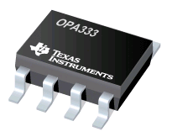
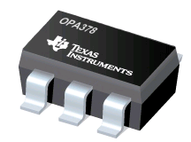
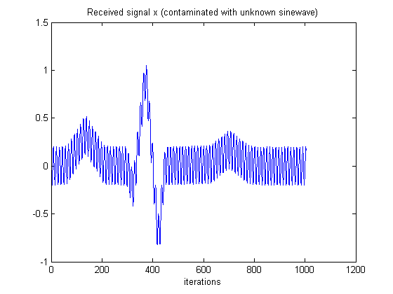
Design Considerations
Deliverable Goals
  Reliable final product
  Interchangeable Op-Amps
    SOT23-5 Platform Footprints
    Compare IC’s
  Low cost
  High ECG signal integrity
    High S/N ratio output
    Clean reference voltage signal
    Solid PCB design / layout
Two Interchangeable Op-Amps
ECG with low S/N ratio

Slide 7
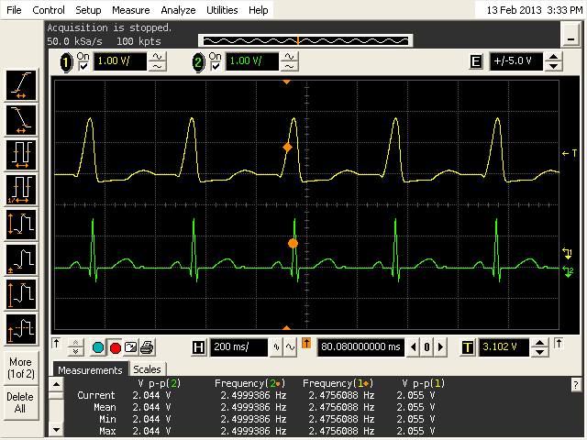
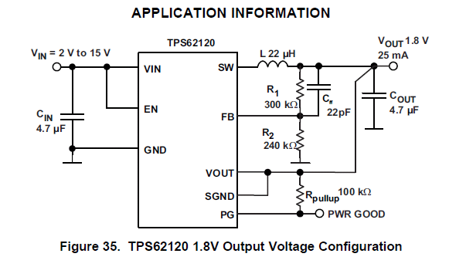
Design Considerations
ECG signal integrity
  Input Filtering (Pre & Post)
  INA333 Instrumentation Amplifier
    Linear Amplification
    Avoid saturation
    Bias for maximum signal swing
  Power Supply (Low Power)
    9V DC battery to 5V
    TPS62120 (Integrated Converter)
    2.5 Reference Voltage Noise (decrease)
Low Cost: $33 / 2-layer PCB
Agilent vs. CardioSim
TPS62120 Schematic

Slide 8
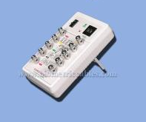
Design Solutions
9V Battery
Buck Converter
Divider and LPF
+5V
+2.5V
Servo Loop
Input Filtering
INA333
Post Filtering
Stellaris Oscilloscope
CardioSim II
RLD

Slide 9
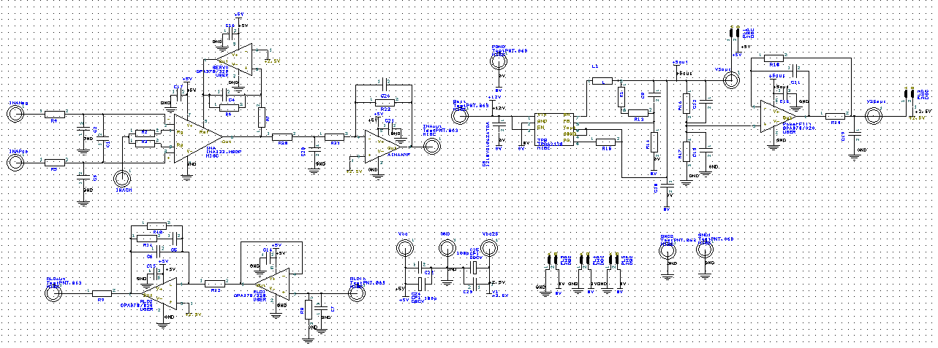
Design Solutions
Phase 1 Schematic

Slide 10
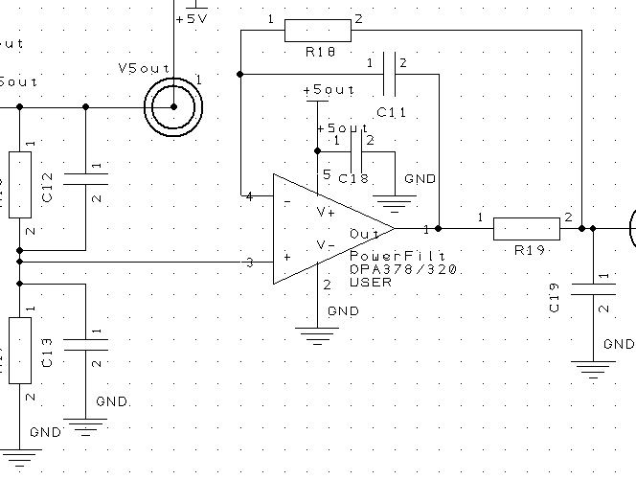
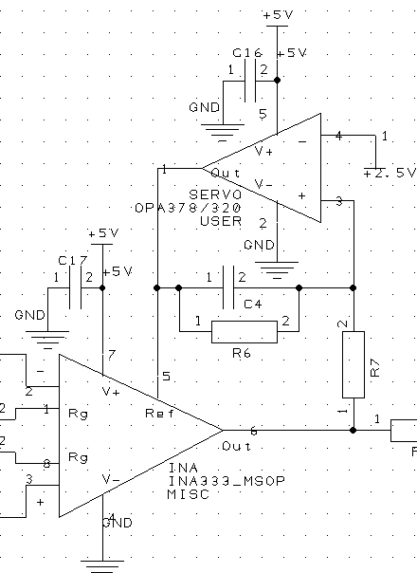
Design Solutions
Utilize both passive and active filters
Servo loop for INA to reduce LF wandering
Buffer LP filter for 2.5V supply (noise)
Low noise 2.5V bias reference
DC Servo Loop HP Filter

Slide 11
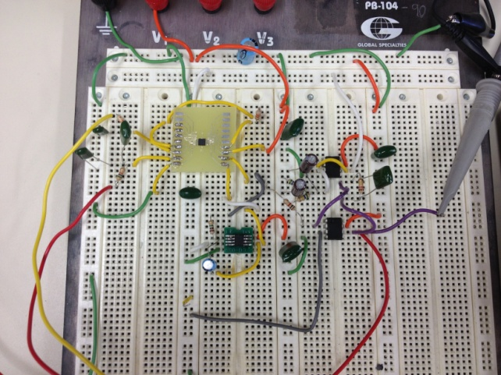
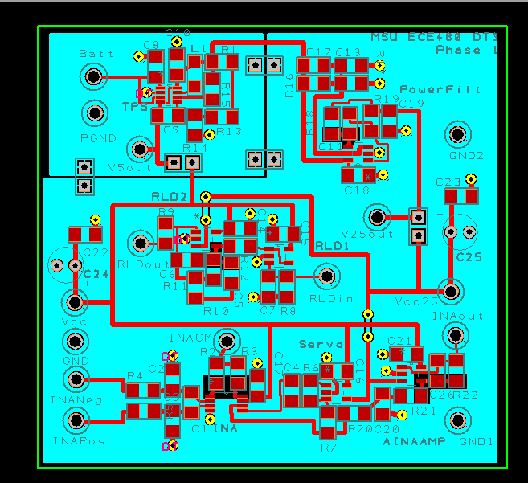
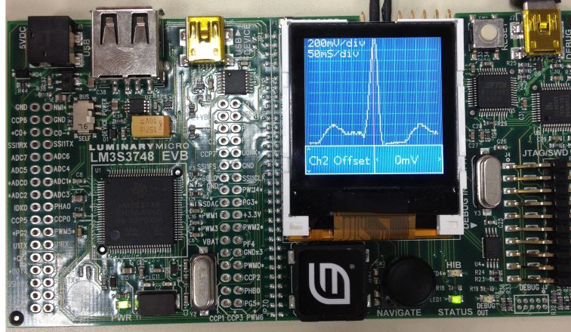
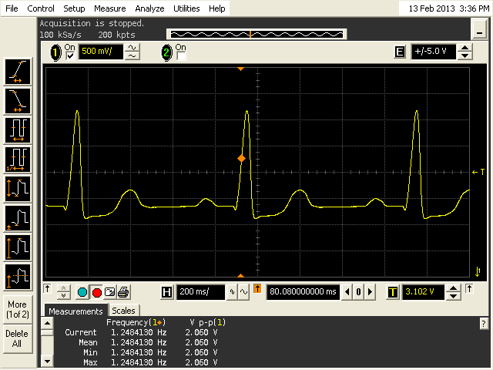
Project Progress
Phase 1: Tests on Proto-board
Phase 1: PCB Layout (2.5”x2.5”)
Phase 1: Output Signal (CardioSim)
Phase 2: Display Signal on Stellaris µC

Slide 12
Summary
Background
  ECG Measurements
  ECG demo board for TI
Project Timeline
  Three Phase Process
Tools and Resources
  TI TINA
  PCB Artist
Design Concern
  Budget, Reliability, Noise
Design Solutions
  Design, Simulation, Fabrication, Test
Notes:
We have talked about ECG, especially its purpose, signal from the heart;
For Design specification, we covered the Analog front end schematic. At same time, we introduce other components in the circuit to reduce the noise. Tools and environment, we used TI TINA to simulate and use PCB Artist to design layout

Slide 13
Questions?

