Slide 1


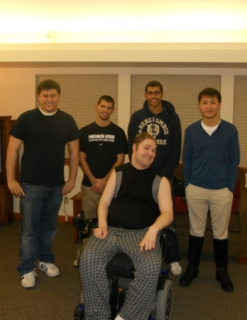
ECE 480 Design Team 3
Doug’s Kitchen Robot
Team Members
- Thomas Manner
- Ali Alsatarwah
- Ka Kei Yeung
- Daniel Phan
Team Facilitator
- Professor Lixin Dong

Slide 2
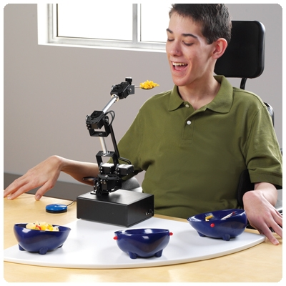
Background
Meal Buddy unit
- Most commercial robotic arms in the market, especially the automated modules, are capable of lifting only light payloads.
- Most of these commercial robotic arms are automatic and precision based.
- According to a pilot study conducted by the University of Central Florida, researchers found that most users, including quadriplegics, preferred manual controls and considered the automated designs “too easy and too automated.”[1].

Slide 3

Introduction
Project Objectives:
- Design and construct a robotic arm capable of handling heavy lifting, stirring, and other kitchen activities.
- Design a controller interface that is easily operated and accommodated for people with limited muscular movements.
- To assist Doug in lifting and moving items within the confines of his countertop, stove, and sink.

Slide 4
Customer Needs/Requirements
Capabilities of the Robotic arm
- Lift and carry a pot of water weighing 40lbs
- Variable Speed movements, but limited to a safe range
- Gripper and hooks for picking up kitchenware
- Rotating gripper to assist in stirring food on the stove
- Sensors for when Robotic arm reaches end of the track
Controller Interface
- Three joystick design
- Wireless communication
- Tall joystick for operation ease
- Programmed for Cartesian movement of Robotic arm

Slide 5
Customer Needs/Requirements (cont’d)
Miscellaneous Needs
- Designed for robustness and durability
- Easy to maintain
- Designed with easily replaceable circuitry and mechanical components.
- The controls should be programmable for future feature additions

Slide 6
Conceptual Designs
DESIGN CRITERION | Importance | Concept I Triple Joint Arm | Wall Mounted Cartesian Arm
 |  |  | Concept II (3 Axes) | Concept III (2 Axes 1 Rotation)
Aesthetic | 2 | 4 | 3 | 2
Coding Complexity | 2 | 2 | 5 | 4
Durability | 4 | 2 | 3 | 4
Flexibility and Orientation | 3 | 5 | 4 | 4
Payload | 4 | 2 | 5 | 5
Power Consumption | 4 | 3 | 2 | 4
Retractability | 4 | 4 | 2 | 5
Safety | 5 | 2 | 4 | 5
Size | 4 | 5 | 2 | 3
Sturdiness | 5 | 2 | 5 | 4
User Friendliness | 4 | 4 | 5 | 4
Upgradability | 2 | 2 | 5 | 4
 | Total: | 131 | 159 | 177

Slide 7
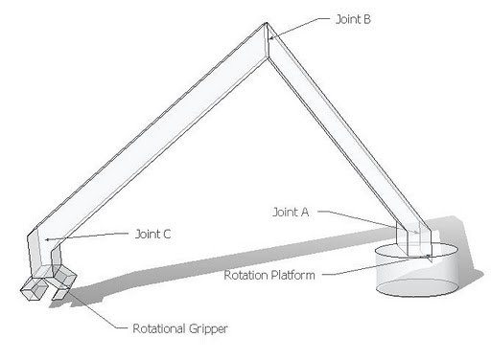
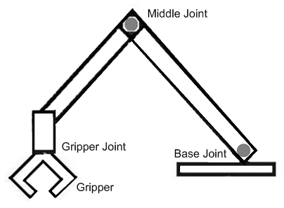
I. Triple Joint Arm
Flexibility
Coding complexity
Safety
Not Upgradable

Slide 8
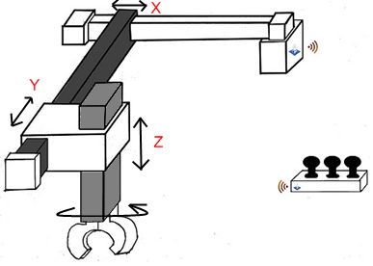
II. Wall Mounted Cartesian Robotic Arm
Simplest Coding
User Friendly
Expand into Bench Area
Gripper Power Consumption

Slide 9
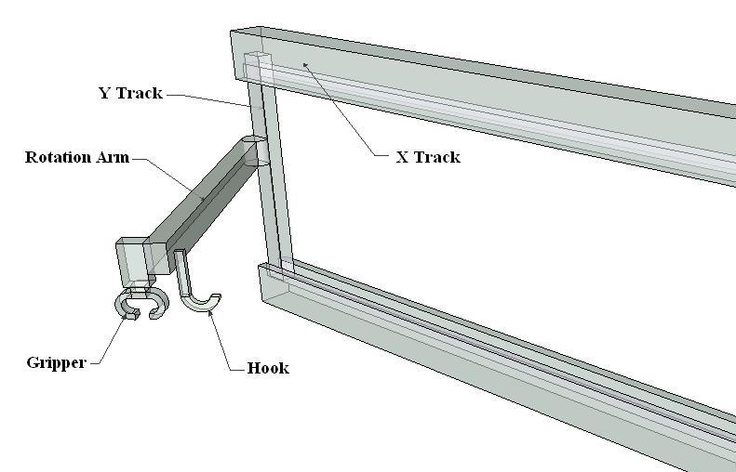
III. Cartesian Arm with Rotating Arm
Improved from Concept II
3/5 Motors Against Wall
Gripper – Light Load
Hooks – Heavy Load
Retractable
Gripper Rotational Motor

Slide 10
Budget
ffIit | Unit Price | Quantity | Item Total
Arduino Fio | $25 | 2 | $50
XBee Radio | $23 | 1 | $23
Linear Actuator (40” and 20”) | $130 | 2 | $260
Force Sensing Resistor | $5.00 | 2 | $10.00
Joysticks | $25 | 3 | $75
Miscellaneous Components | $40 | 1 | $40
Hitec Spline Metal Servo Horn | $3.25 | 1 | $3.25
Force Sensing Resistor | $5.00 | 2 | $10.00
Standard Servo | $17.99 | 2 | $35.98
Robot Hand | $17.89 | 1 | $17.89
USB cable | $9.01 | 2 | $9.01
Arm Rotor | $40 | 1 | $40
 |  | Total: | 574.31

Slide 11
Risk Analysis
Power Management
Operating Speed
Gripper type

Slide 12
Risk Analysis (cont’d)
Torque
Testing

Slide 13
Proposed Design Solution
The project must meet requirements for basic function set by the sponsor, without sacrificing safety.
  For the robotic arm, Figure 3 Concept III was chosen since 3 of the 5 motors are mounted near the wall. This will reduce the amount of torque on the overall system.
  Concerns involving the payload the gripper can hold was solved by adding hooks for heavier load applications.

Slide 14
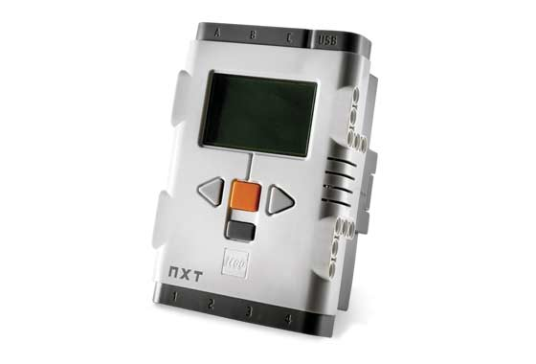
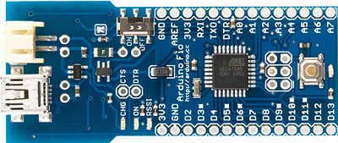
User Interface
Hardware Platform
  Lego
  Arduino
Controls
Output
  Pulse Width Modulation

Slide 15
Communication
Wired
  Simplicity
  Risks
Wireless
  Costs
  Convenience
  Technologies

Slide 16
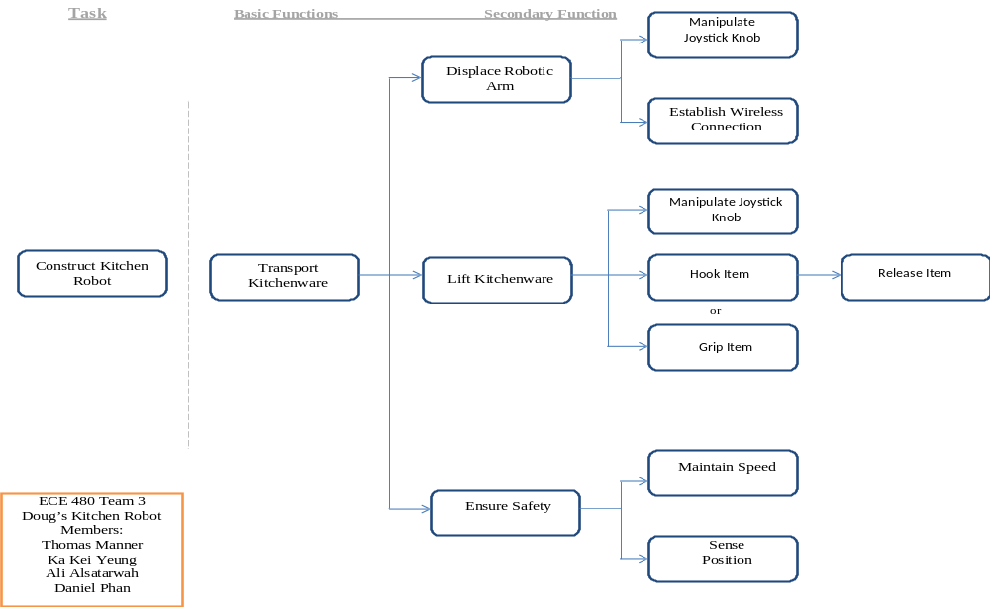
Fast Diagram
Questions?

