Slide 1
ECE 480 Design Team 3
Technical Lecture
Arduino Controller Design

Slide 2
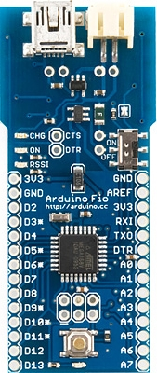
Overview
Arduino Fio and XBee Basics
Joystick Interface
Motor Control
Interrupt Sensor

Slide 3
Introduction
Based on Microprocessor ATmega328P
  3.3V
  8MHz
C/C++ Based
  http://arduino.cc/en/Reference/HomePage
14 Digital I/O
  6 PWM Available (8bit)
  analog Write() (2 bytes Duty Cycle)

Slide 4
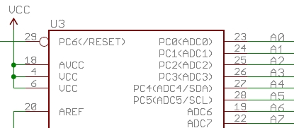
Introduction Continued
8 Analog Inputs
  10 bit Resolution
  Default Reference (Vcc)
  AREF (0-5V limit)
  analogReference(EXTERNAL)
32KB Flash Memory (Sketches)
  2KB for Bootloader

Slide 5

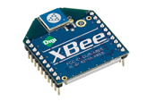
Connections
Wired
  Data (pins, header, solder)
  Power (Battery Connector)
  Charging (USB)
Wireless (2.4GHz)
  On-Board XBee Socket
  XBee to USB adaptor (Explorer)

Slide 6
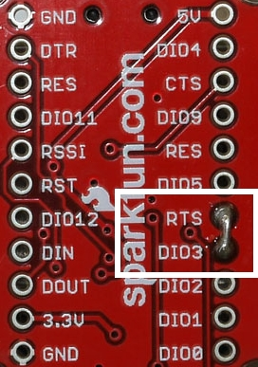
Wireless Programming
Preparation (for Explorer)
  Short RTS and D3
X-CTU Configuration (Windows)
  Connect
  Run X-CTU
  Set Computer Port (e.g. USB)
  Baudrate (57600, match uC)
  Modem Configuration…

Slide 7
Parameter | Programming Radio | Fio Radio
ID (PAN Hex) | IDENTICAL
BD (Microprocessor) | 6 for (Atmega328) | 6 for (Atmega328)
MY (Source) | (0000 to FFFF) | (0000 to FFFF)
DL (Destination) | FFFF (ALL) My Value (Speecific) | Programmer's MY value
D3 (Digital PIN 3) | 3 (DI) | 5 (DO HIGH)
IC (I/O Change Monitor) | 8 (i.e. 00001000 or D3) | not set
RR (Retries on Send) | 3 | not set
IA (Serial Interrupt) | FFFFFFFFFFFFFFFF (Immune) | 0xFFFF (Modify Allow)

Slide 8
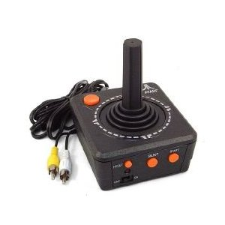

Digital Joystick Versus Analog Joystick
Joystick types
  Digital Joysticks
  Analog Joysticks

Slide 9
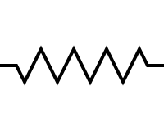
Interfacing the Analog Joystick to the Arduino Fio
The diagram:
A0 X
A1 Y
The functionality
3.3 v, VCC
10 bit input
GND

Slide 10
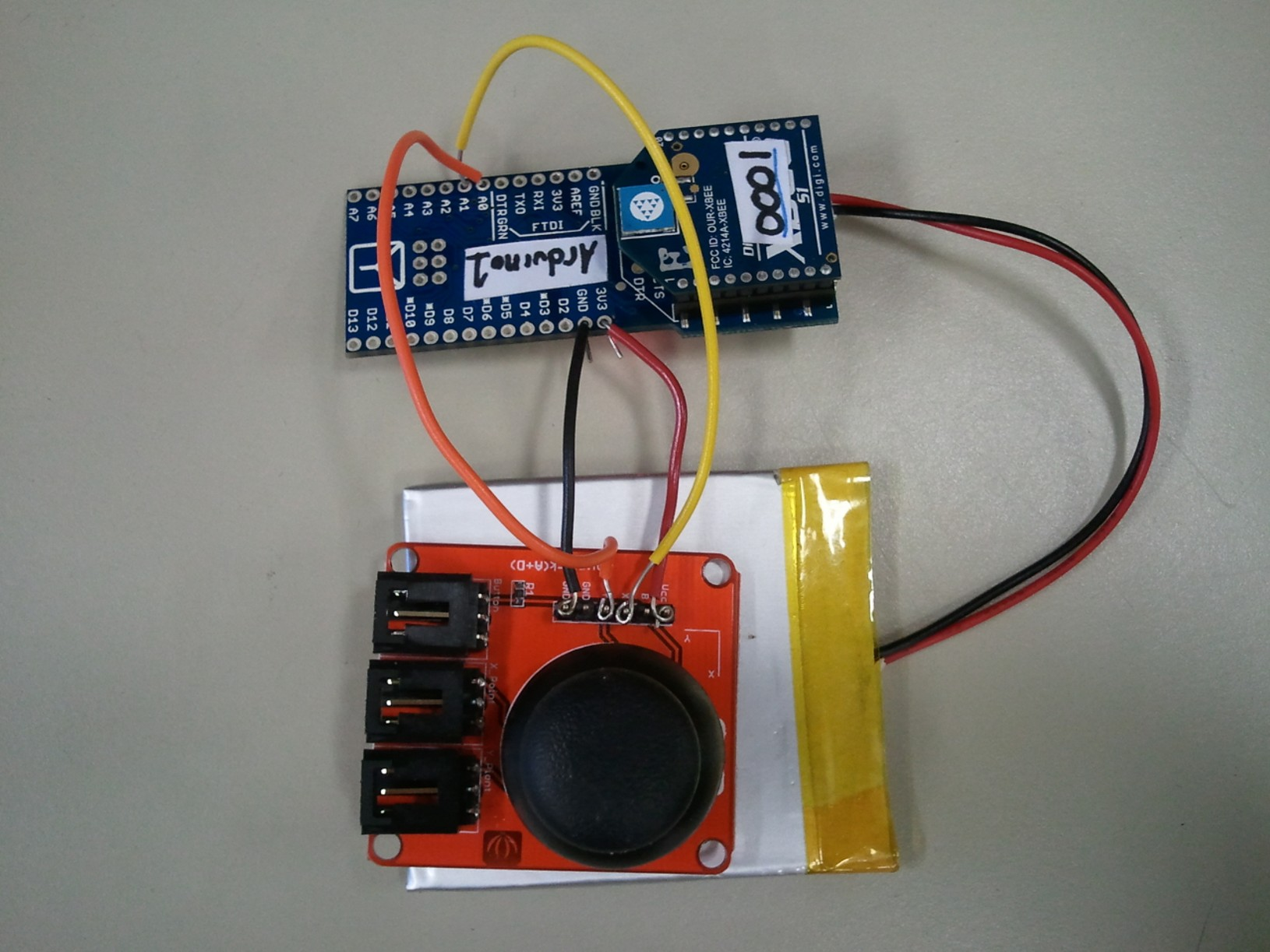
Generation of PWM signal
10 bit input /4 = (n*2^10)/(2^2)=(n*2^8)= PWM
  Code:
AnalogRead((10 bit input)/4) ( PWM 0-255, where 255 is 100% duty cycle)
AnalogWrite(pin#,direction) (0<=dir>=255)
AnalogWrite(pin#,PWM) (0<=dir>=255)

Slide 11
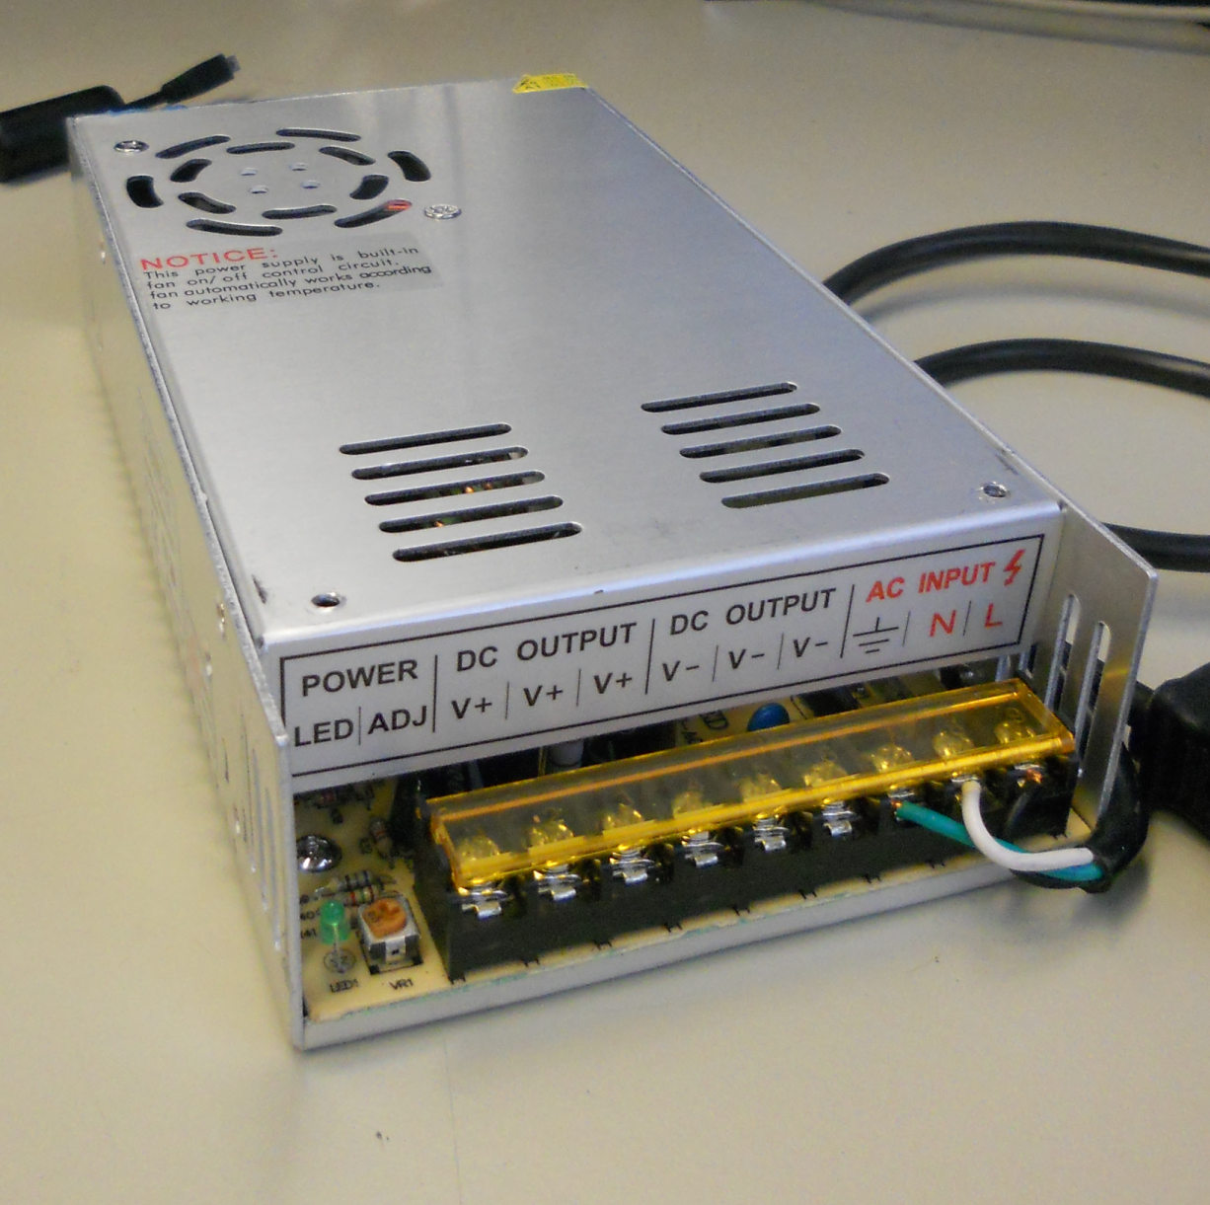
Power Supply
How to choose a power supply for driving Brushless DC motor
  AC-to-DC Power Supply
  Supply Voltage
  Parallel Connection of Motors
  Rated Supply Current
Mean Well 12V 29A Power Supply

Slide 12
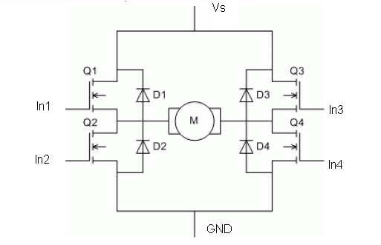
H-Bridge
How does an H-Bridge work?

Slide 13
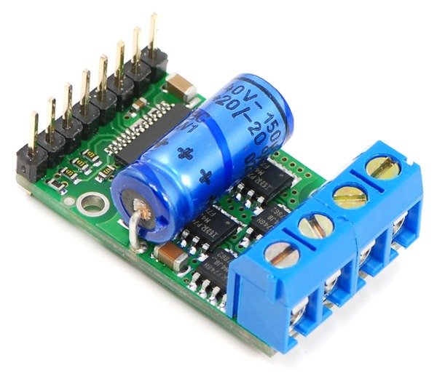
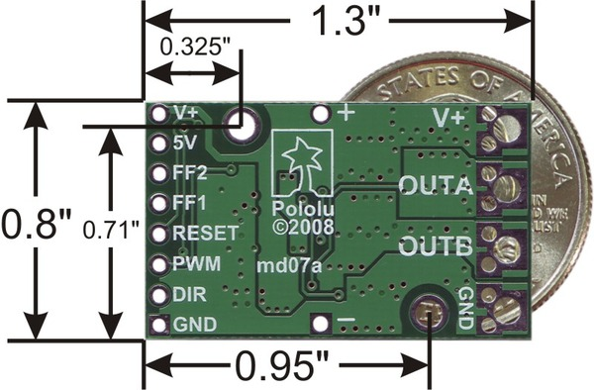
H-Bridge (Cont’d)
How do you pick an H-Bridge motor driver?
  Voltage rating
  Current rating
Pololu 18V 15A Motor Driver

Slide 14
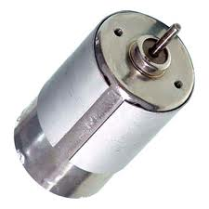
Brushless DC Motor Feedback
Position
  Rotation count
Speed
  Rotations
  Time
Direction
  Second sensor

Slide 15
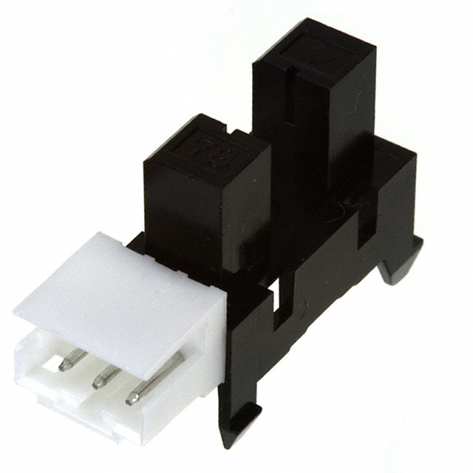
Calculating Position - Simple
Rotations counting
  Photo Interrupter
    “Optical Chopper”
Pulses per rotation
  Gear ratio
Single sensor
  Direction ambiguous
Arduino
  attachInterrupt(pin,ISR,EDGE);

Slide 16
Position Calculation - Robust
Second Photo Interrupter
  Sensor placement
  Sensor reading
Direction
  Edge Detection
Arduino
  digitalRead(pin);
1
2
1
2

Slide 17
Speed Calculation
Timing
  Change between pulses
Angular Velocity
  Two sensors
Arduino
  millis() : dTime = millis() – currentTime;
  Rpm = 1/spokeCount * 1/dTime * 1/3600;

Slide 18
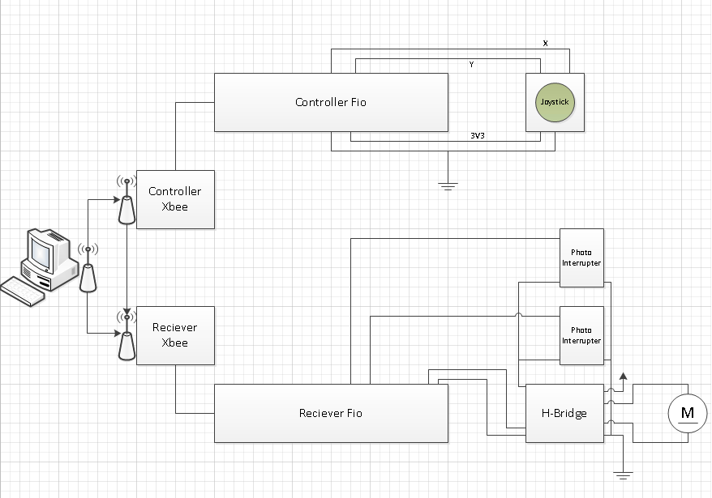
Summary

Slide 19
Questions?

