Slide 1


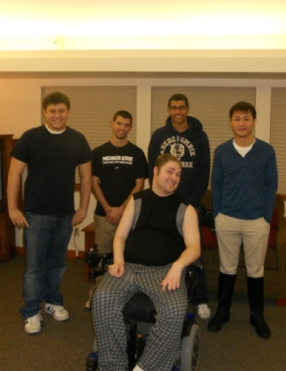
ECE 480 Design Team 3
Doug’s Kitchen Robot
Team Members
- Thomas Manner
- Ali Alsatarwah
- Ka Kei Yeung
- Daniel Phan
Team Facilitator
- Professor Lixin Dong

Slide 2

Introduction
Project Objectives:
  Design Wall Mounted Robotic Unit for Doug
  Lifting and transporting kitchenware and other items across the kitchen workplace
  Design wireless controller interface
  Easy to operate for people with limited muscular movements.
  User friendly design, accessible to other disabilities

Slide 3
Design Goals
Capabilities of the Robotic unit
  Lift and carry a pot of water weighing 30lbs
  Variable speed movements, but limited to a safe range
  Gripper and hooks for picking up kitchenware
  Rotating gripper to assist in stirring food on the stove

Slide 4
Design Goals (Continued…)
Miscellaneous Goals
  Durability and Aesthetics
  Easy to Maintain
  Easily Replaceable Circuitry and Mechanical Components
  Controls Should Be Programmable For Future Upgrades

Slide 5
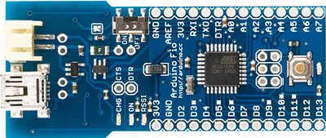
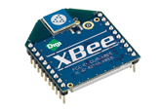
Design Specifications
Arduino Fio:
  Controller and Receiver
  Digital I/O (14)
  PWM (6), 10bits
Connection:
  XBee Radio
  1.2 GHz, PAN
  Programmable

Slide 6
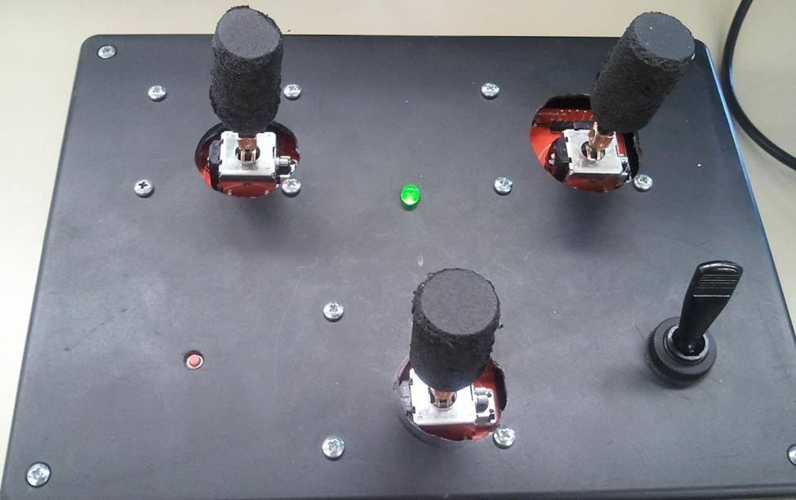
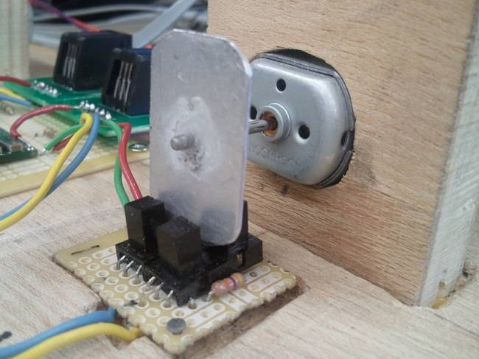
Controller Interface
  Three joystick Design (X, Y, Rotational Arm etc.)
  Wireless & Safety (cords)
  Modified Shafts
  Reset and On/Off buttons
Motors and Feedback
  High Power Motors (final)
  Photo Interrupter
  Feedback PWMs
  Interrupt & Position Value
  End Point Detection & Obstruction
1
2
1
2

Slide 7
Programming
  Arduino Sketches
  Open Source, C++ Based
  Read Analog from Joystick
  Send PWM Signal (speed) and Direction
  Sensor 1 – Interrupts
  Sensor 2 – Direction
  Updates Position
  Obstruction and End Points?

Slide 8
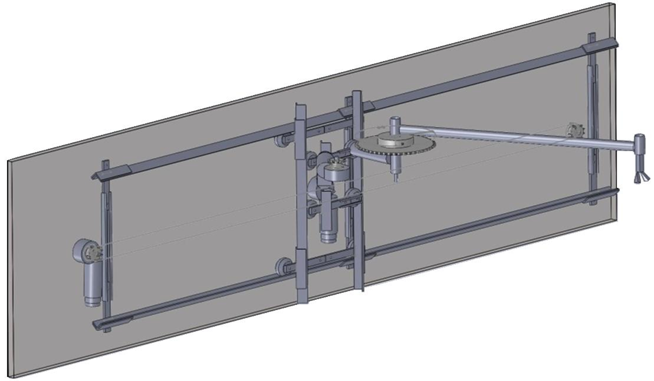
Mechanical Arm
Cylindrical Coordinates
  Conversion to Cartesian
Motor Configuration
  Tracks
  Rotation
  Mounting

Slide 9
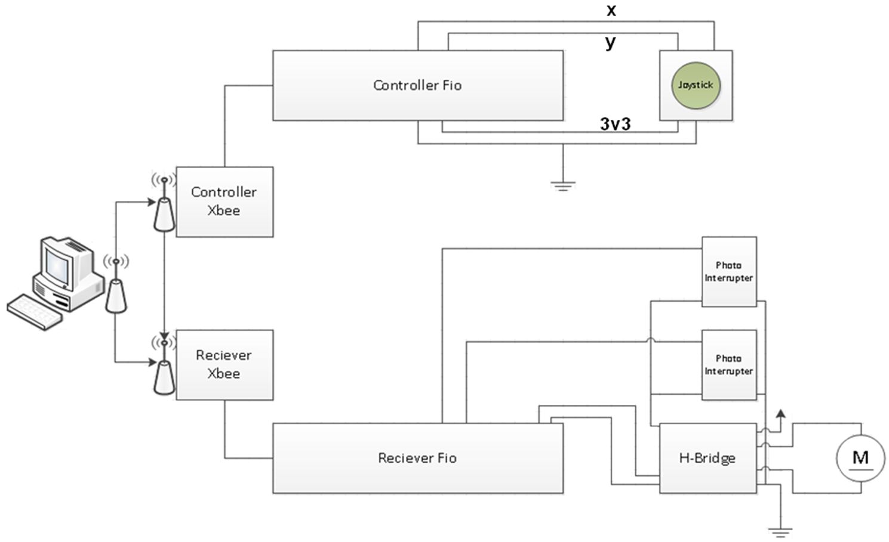
Electronics
Controller
  Arduino Fio Microcontroller
  XBee RF Radios
  Analog Joysticks
Motor Drivers
  H-Bridge Driver
  Power Supply

Slide 10
Suggestions for Future Improvement
Buy or customize new H-bridge motor drivers
Program the robotic arm to have Cartesian
movements
Use signals from sensing system to calculate
position, speed, and direction
Program some automated movements

Slide 11
Conclusion
Wireless Controller Interface
Mechanical Arm Design
Sensing System
Demonstration of Sensing System

