Slide 1




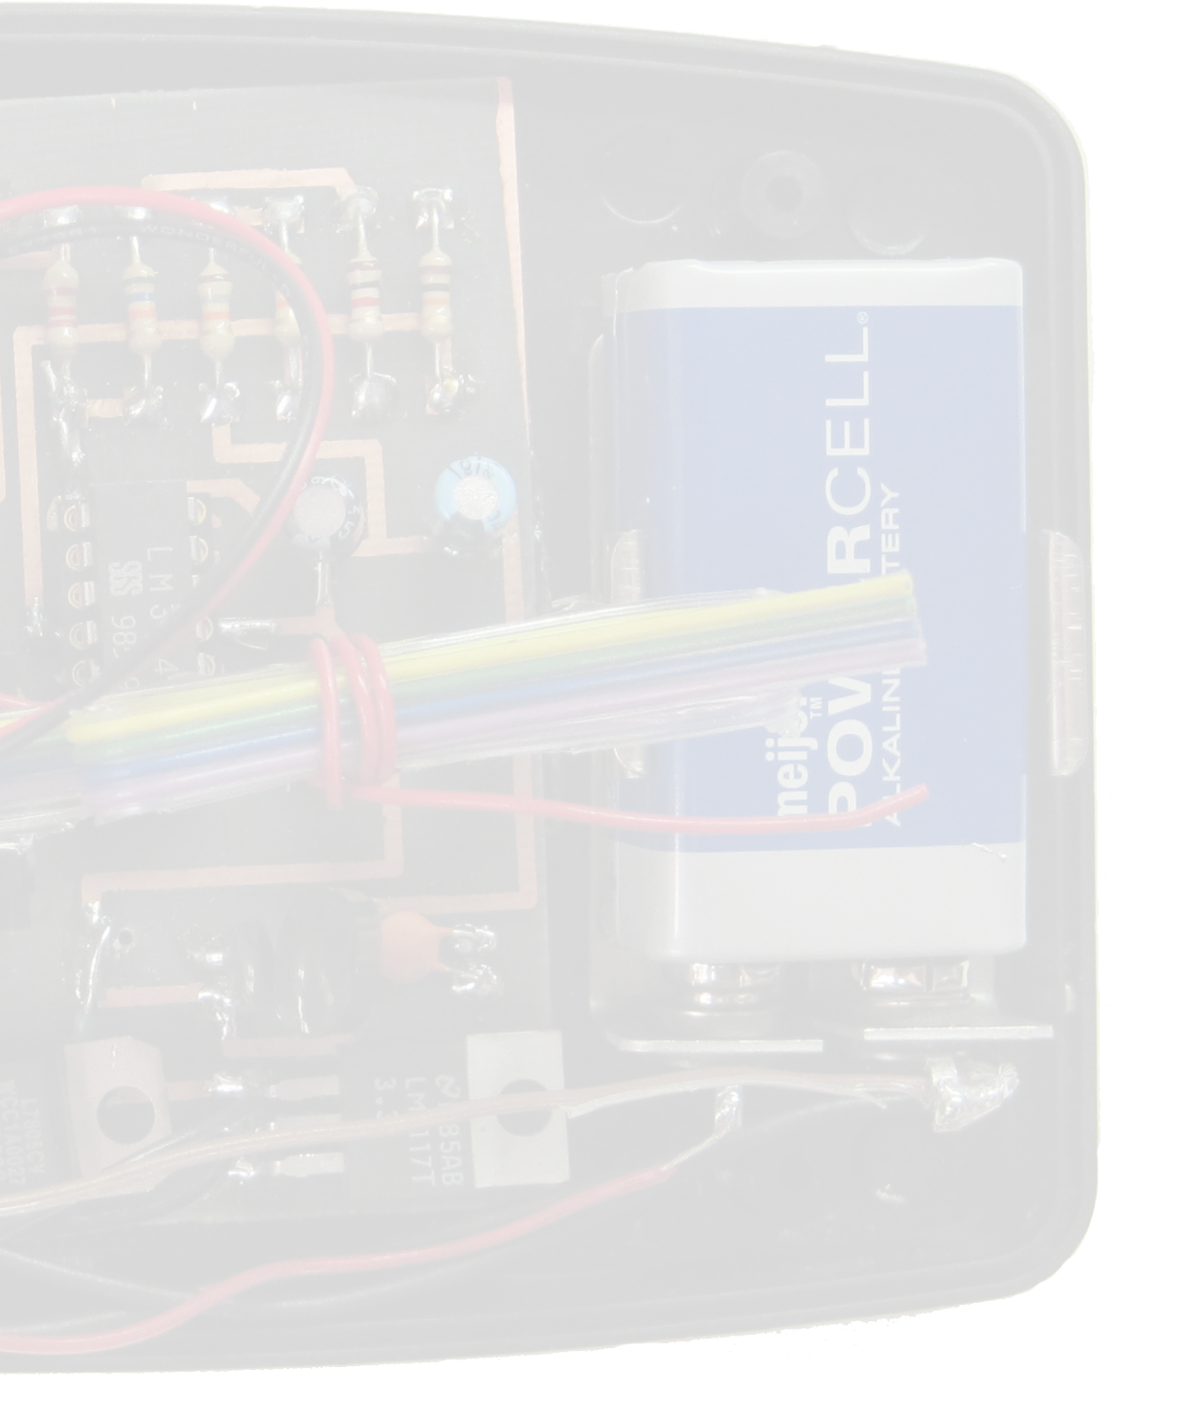
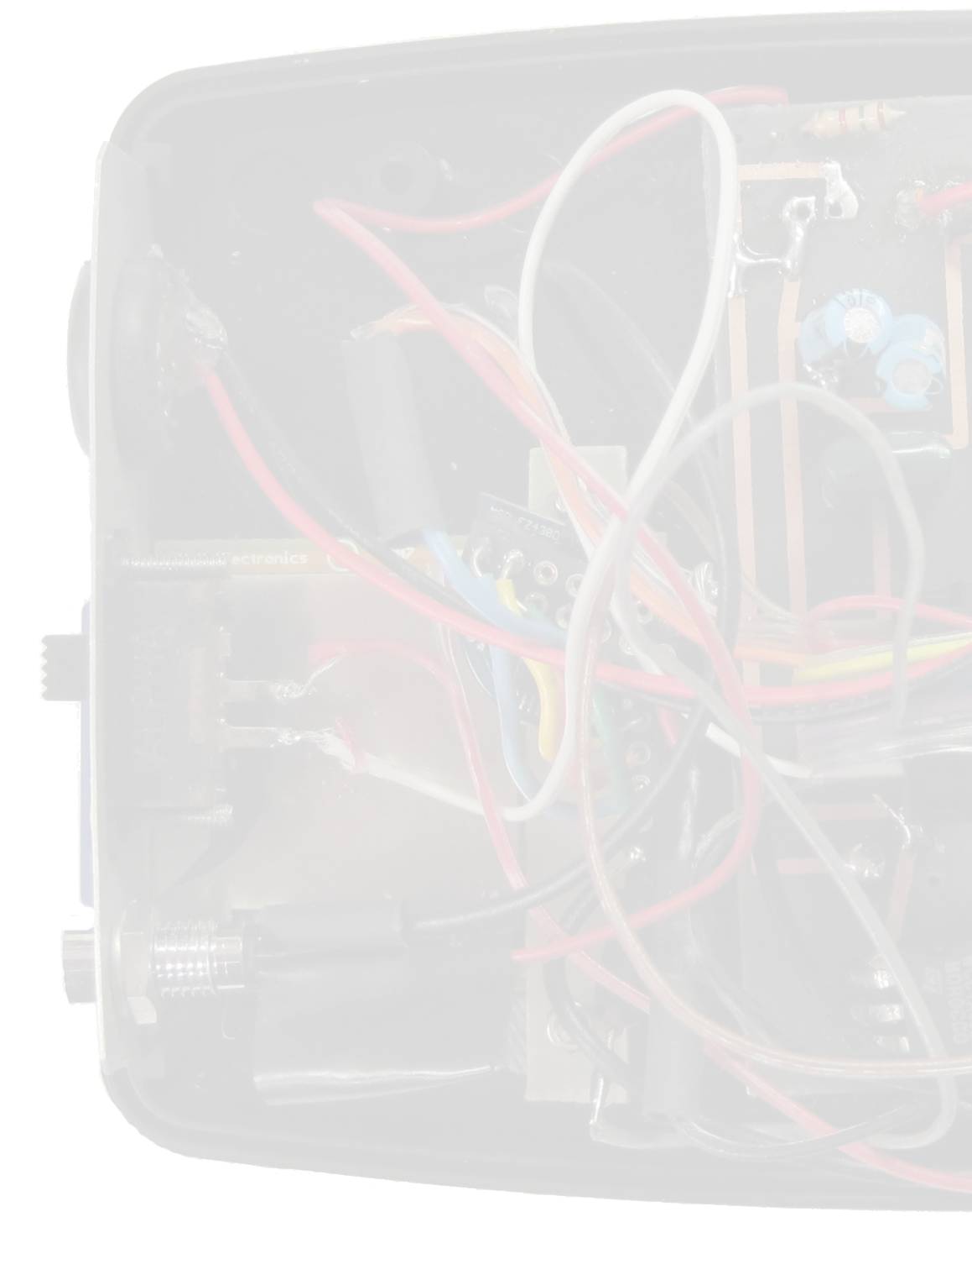


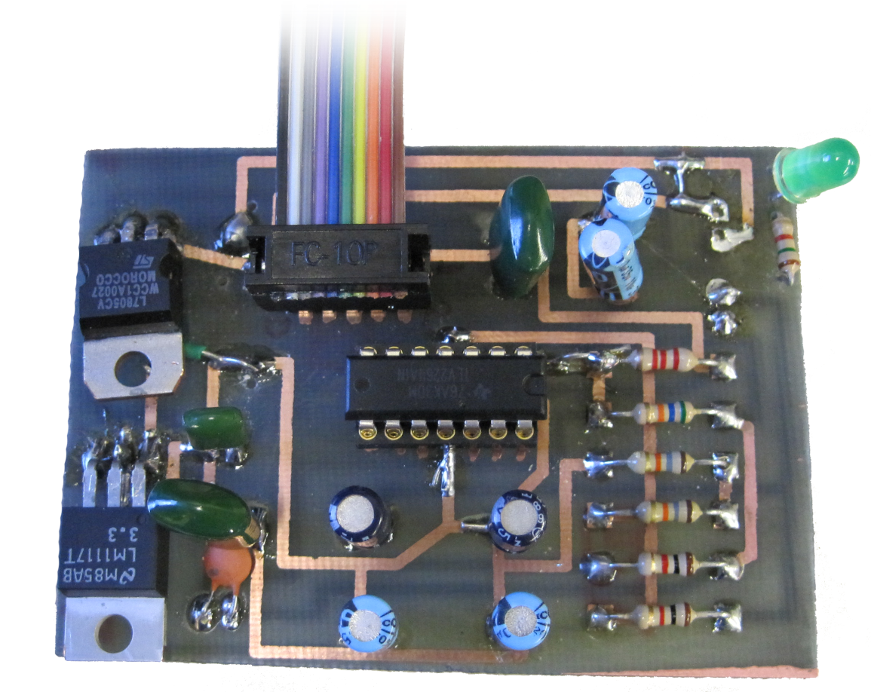
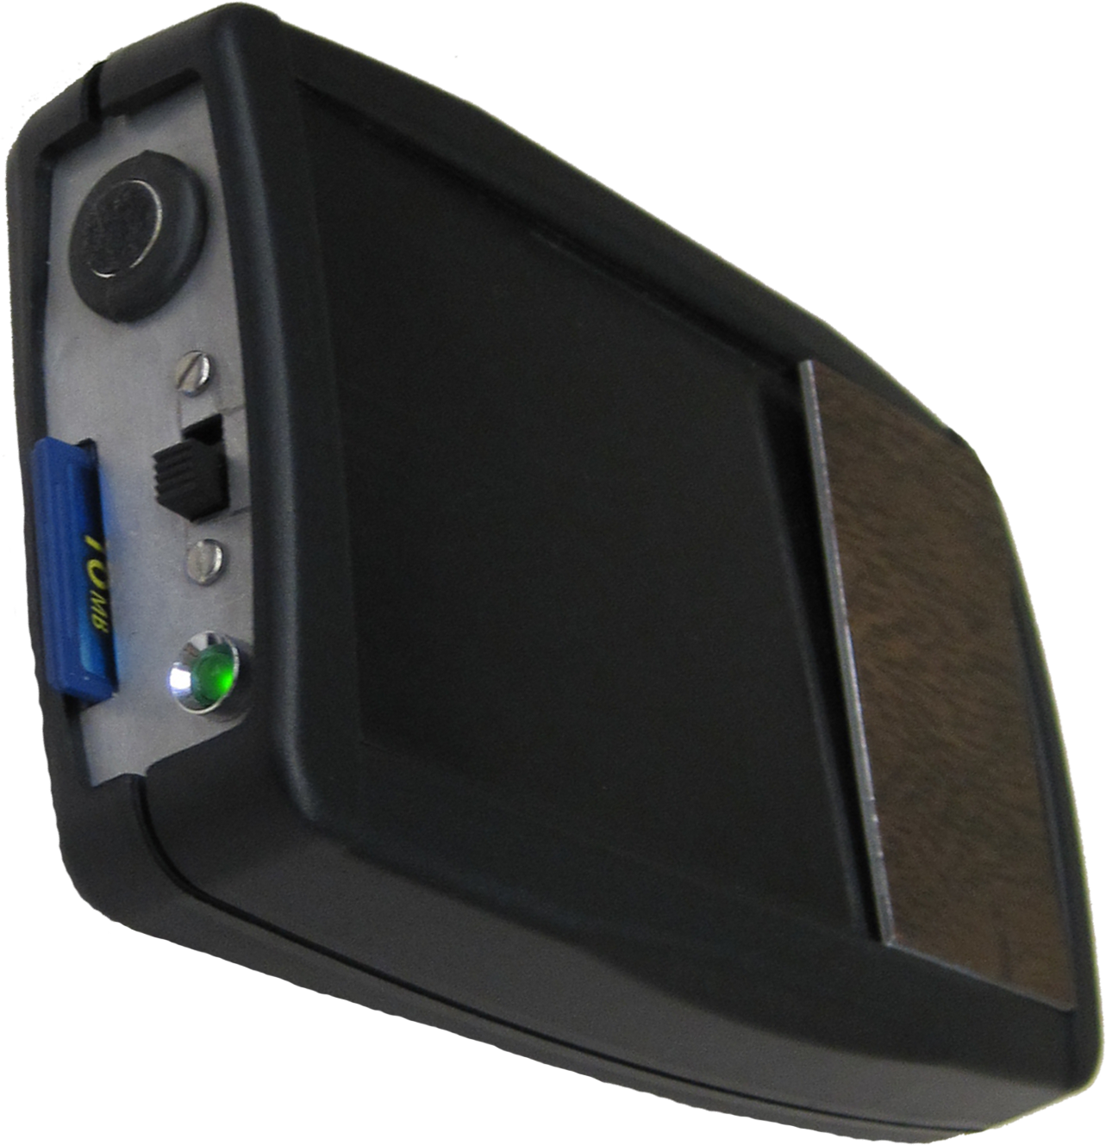
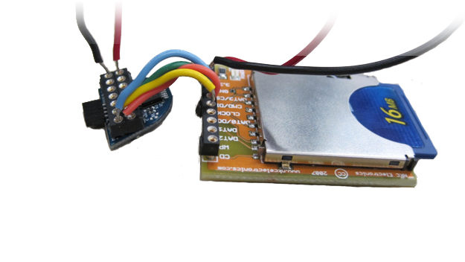
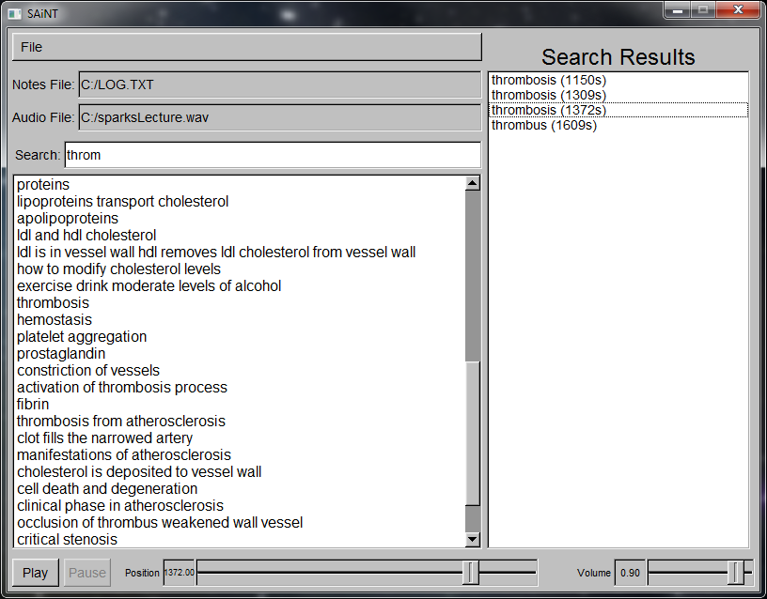
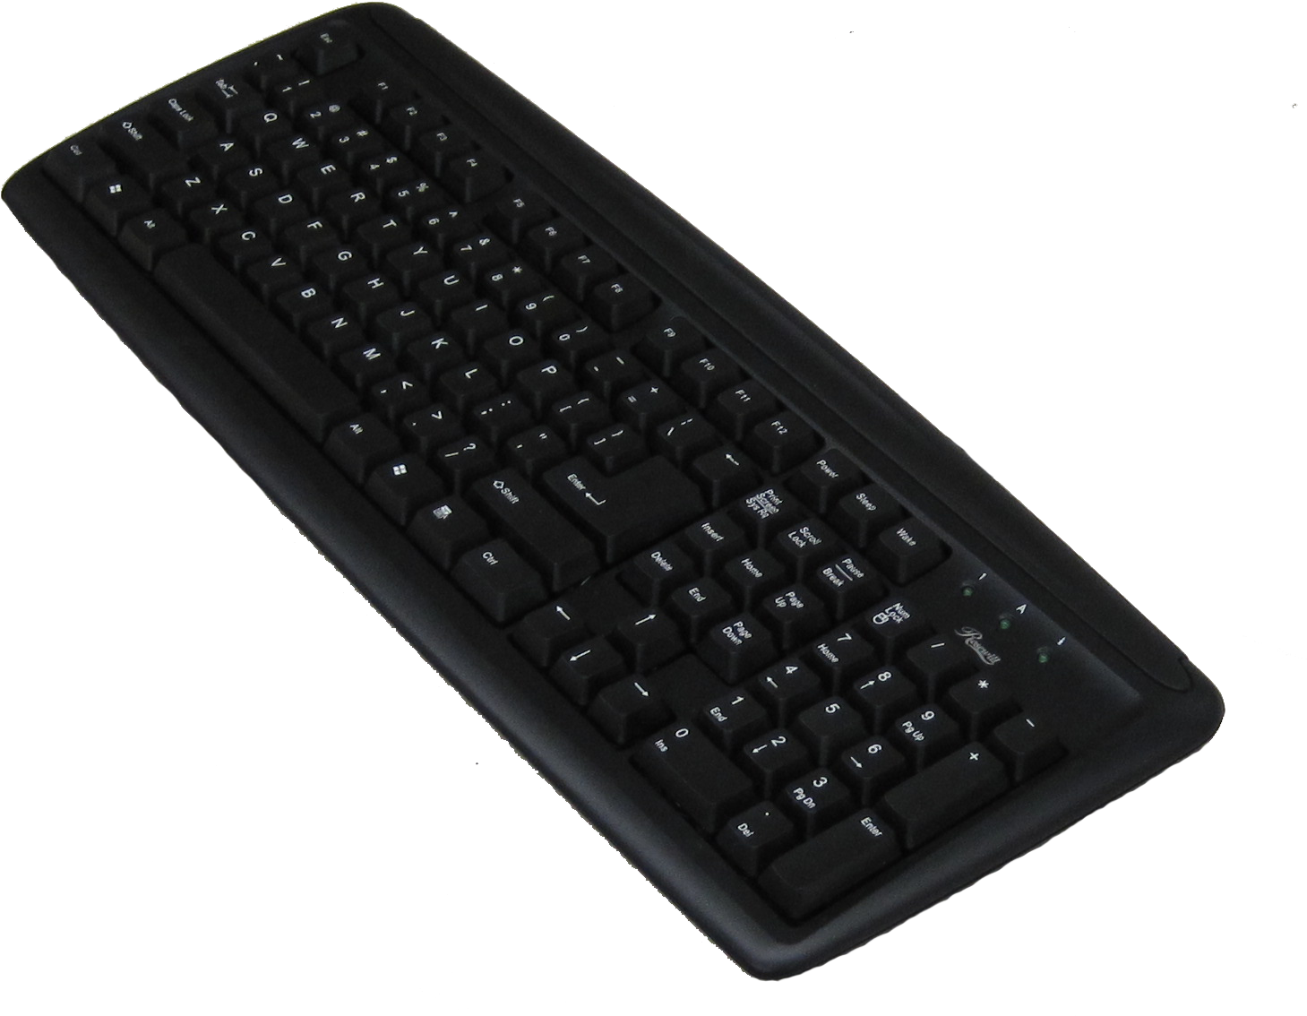
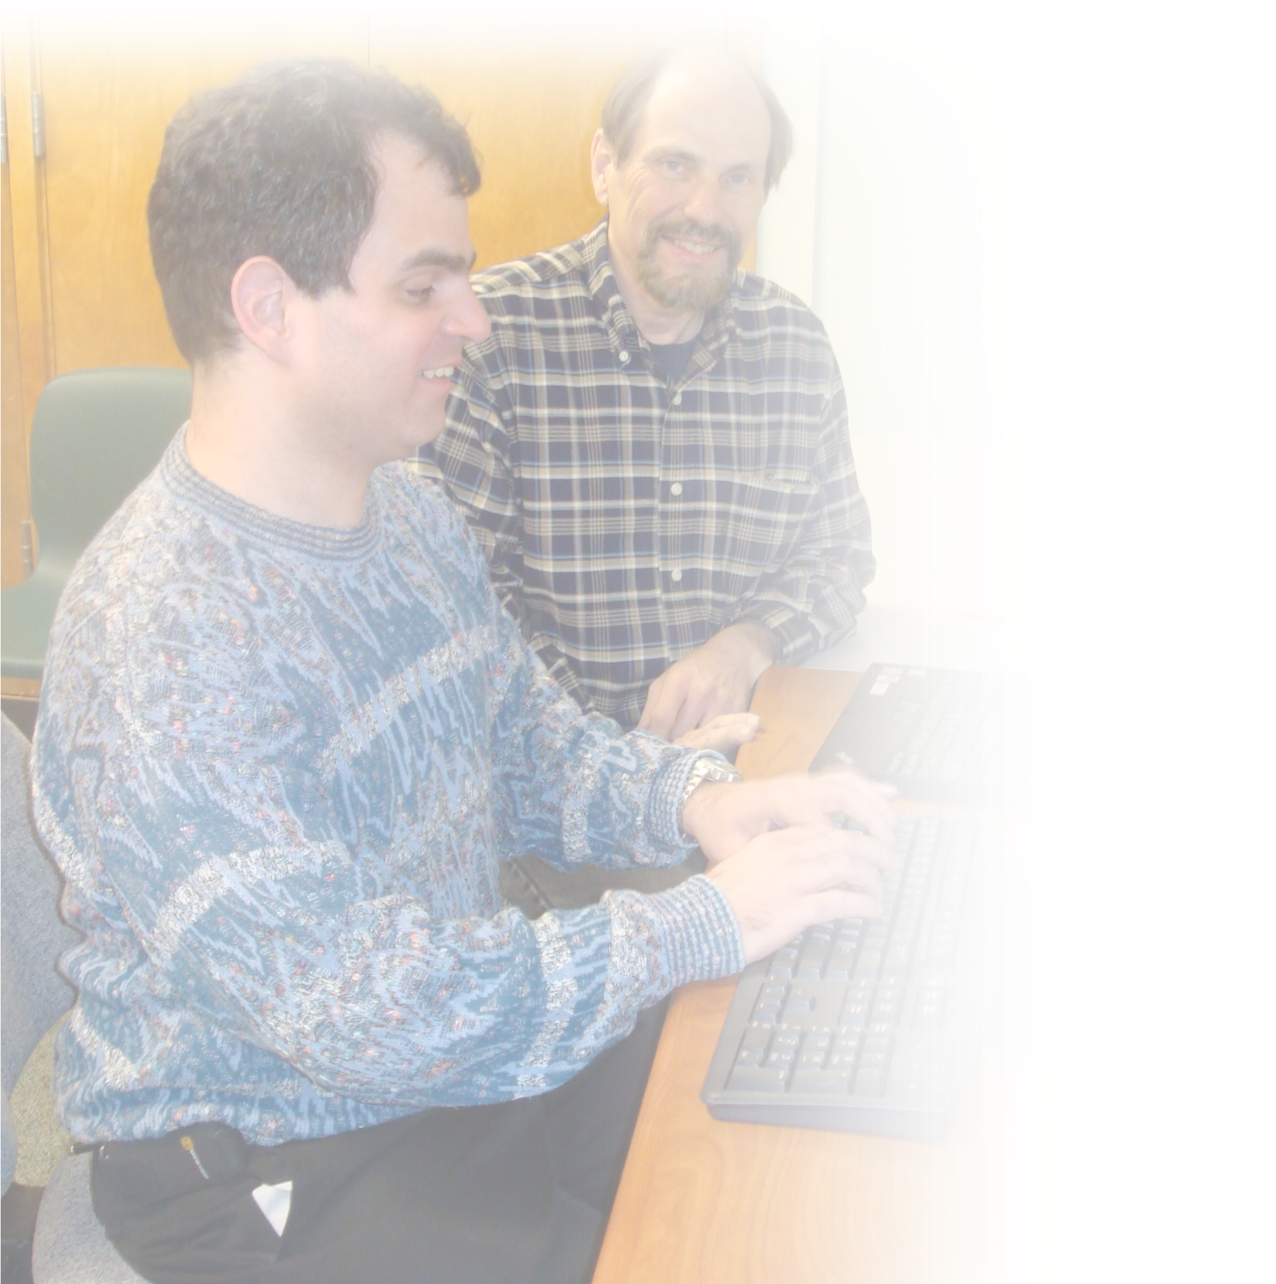
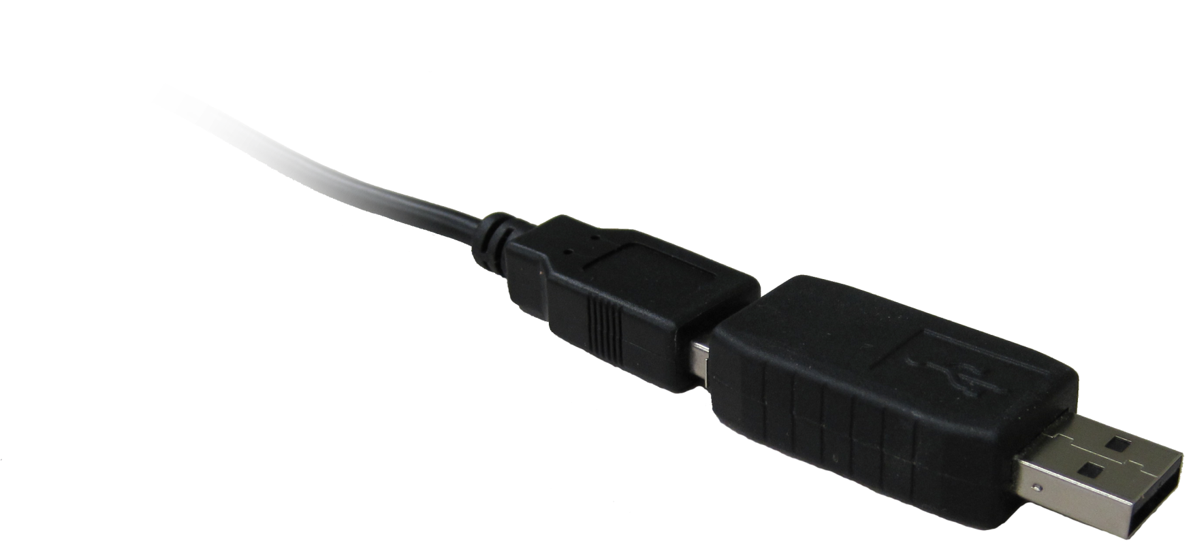





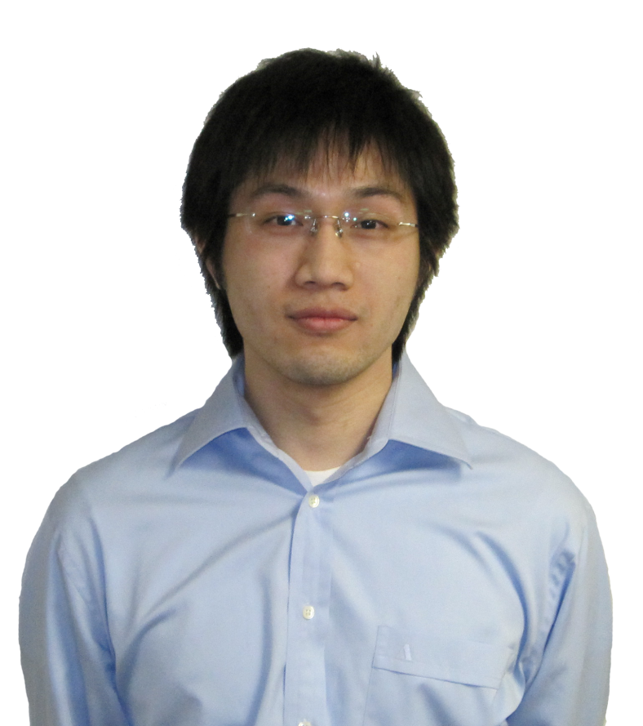

What is SAiNT?
SAiNT is a portable note taking device which was developed to assist the visually impaired with note taking during lectures and presentations. SAiNT will automatically synchronize typed notes to audio recordings and allow for quick playback and review of the recorded session.
How Does SAiNT Work?
SAiNT uses an effective combination of hardware and software to synchronize text to audio. With the SAiNT hardware, audio and keyboard keystrokes are recorded onto non-volatile memory devices. These files can be transferred to a computer where the SAiNT graphical user interface will allow you to search through your notes and playback the corresponding synchronized audio.
What were the design goals of SAiNT?
Audio Recording
The MSP430F2012 was the microcontroller used to handle the audio recording. The MSP430 was chosen because it consumes a very small amount of power, has an on board 10-bit analog to digital converter, and can be interfaced with SD cards. Our final audio recording circuit runs on a 9V battery and fits into a small enclosure as seen in the image on the left.
Hardware
-Low powered audio recording
-Capture and store USB keyboard input
-Save data to a non-volatile mass
Memory device
Software
-Create a graphical user interface to handle data
-Allow for searching of synchronized notes
-Quick and easy playback of audio recording from synchronized times
The Serial Peripheral Interface Bus (SPI) standard is used to store our recorded audio to a removable SD card.
Constraints
-Low cost
-Simple design and functionality to increase accessibility
-Minimal energy use for
longer recording sessions
-Small and light way for easy transportation
Our testing has shown that a even a small 16 MB SD card can store up to around 40 Minutes of digital audio.
Team 1 would like to give a special thanks to Al Puzzuoli for inspiring the SAiNT project.
Capturing Keyboard Input
SAiNT Utilizes a KeyLlama 2GB USB Keylogger to capture and store keyboard input. This device has two operation modes. In capture mode, the device will capture all keystrokes from a USB keyboard and inserts a corresponding timestamp. This was a critical feature to achieve text to audio synchronization.
Synchronization
The SAiNT graphical user interface is where the synchronization happens. The text file from the keylogger and the audio file from the SD card can
be loaded into the SAiNT user interface for review. This application allows you to view the notes, playback the audio recording, and search for specific words for instant position seeking.
Dean Aslam
Associate Professor
Stephen Blosser
RCPD Sponsor
Trieu Nguyen
Computer Engineer
Christopher Johnson
Electrical Engineer
Li-Shian Chen
Electrical Engineer
Huan Lin
Electrical Engineer

