Slide 1
Request for Proposal
(RFP)
In response to the RFP – the first step is to prepare a proposal
1. Review Customer Requirements and come up with candidate designs
2. Review advantages and risks of design, decide development tools ( hardware and software)
3. Life-cycle model for the project – systematic breakdown of project phases, etc.

Slide 2
Step 1
Understand needs of end user
  Design constraints
  Criteria for evaluating/ranking designs
  Feasible designs – ranking and trade-offs
Assess and Manage Risks
Develop models for systems, sensors, interfaces - subsystems
  sequential or parallel interconnected systems
Validation of models (input-output)

Slide 3
Step 2
Decide development strategy
  Top down, bottom up, combination
Development tools
  Software components,(compilers, libraries, support s/w)

Slide 4
Step 3
Project phases (concept, overall design, detailed design, coding development/ build and test)
  Project demos
  Identify deliverables
  Determine specification list and evaluate against original design specs ( iteratively develop a proposal that meets the customer needs)

Slide 5
Technical Section
Technical Section
  Identify customer needs (VOC Lecture)
    Understand the objectives, Meet with customer and Ask questions
  Constraints
    Generic - Standards, delivery date, quantity, safety, emi,
    Non-generic - environmental conditions, aesthetics, packaging, etc.
  Background
    Prior work and their shortcomings
  Design Specifications (meet with your customer/sponsor)
  Design parameters –
    Translate customer needs to design parameters
    Relevance of each parameter to design criteria that must be satisfied
Candidate Designs (more than 1 design)
  Evaluate/rank designs ( feasibility and decision matrices)
  Expected Outcomes
  Test plan – to demonstrate specs have been met

Slide 6
Project Management
Personnel
Tasks
Contribution of each team member
Resources needed/ procurement
Timeline
  Tasks, integration, reports, presentations, demonstrations
Gantt Charts – (rough draft for pre-proposal)

Slide 7
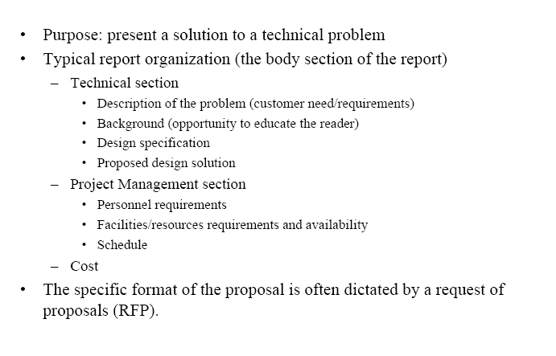
Full Proposal – Due Week 6

Slide 8
Proposal Format
No more than 15 typed pages
  Cover page
    Title, design team #, facilitator, Document type
    Design team members, date
  Executive summary
  TOC
  Introduction
  Background
  Objectives
  FAST Diagram
  Conceptual Designs, Ranking
  Proposed design
  Risk Analysis
  Project Management
  Budget
  References (plagiarism)
  Appendix

Slide 9
Questions

Slide 10
Technical Communications
Reports-
Pre-proposal
Full Proposal
Design Issues
  Interim Progress Reports - Status of project
  Final Report - Informs management/client of the final result , operating manual (use and trouble shooting)
  Application Notes-detailed description of the use of the product
Professional Self-Assessment
Oral Presentations

Slide 11
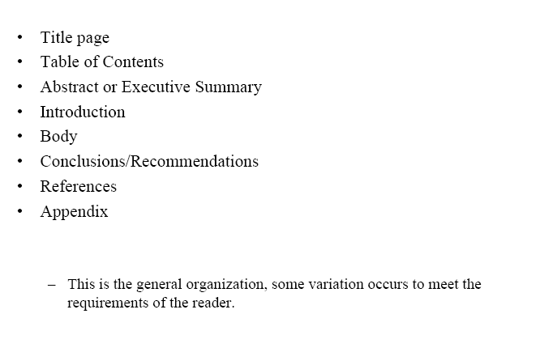
Formal Report Structure

