Slide 1
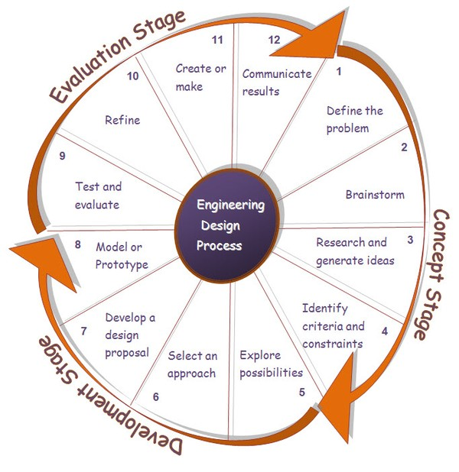
Engineering Design Process

Slide 2
Recommended Design Process
Define the problem. Voice of Customer (VoC)
Brainstorm ideas and research topic.
Develop engineering design specification.
  Mapping customers requirements to design specifications.
Feasibility study of possible designs. Selection Matrix.
Finalize Design Proposed Design Solution.
Plan the project schedule and execution.
Proposed design solution. Engineering Design Review.
Full Proposal

