Slide 1
ECE 480
Overview of the course
  Senior capstone design-
    learning more about engineering design,
    using what you have learned in previous courses,
    showing the you can learn new things on your own,
    showing you can complete a larger project in a team setting

Slide 2
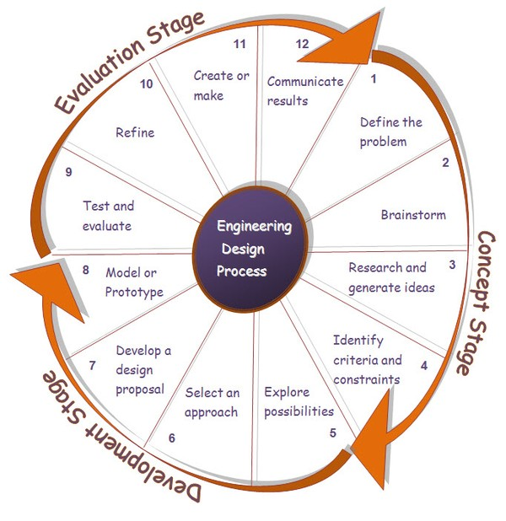
Engineering Design Process

Slide 3
Schedule
Week 1: Teams and projects are decided
Weeks 2-5: Project customer is consulted. Feasible solutions to the project are explored. And Engineering Design Review happens in week 5. A formal proposal is prepared and presented is presented in weeks 6-7.
Also in Weeks 1-5 a mini-project is done in the lab by individual student
Weeks 6-8: First prototype is built (breadboard level prototype)
Week 8: Your first prototype demo to instructors
Week 9 Spring Break
Weeks 10-15: Complete a final packaged prototype ready for customer use
Week 15: Final prototype demo to instructors
Week 16: Design Day- Present your final prototype to customer and judges

Slide 4
Schedule for Today
Photo release form (Also used for attendance today)
Labs begin this week
  Pick up lab kit at ECE shop starting today
  ECE 480 Lab: EB 2221 Door code: XXXXX (Open Lab except during scheduled lab times during first 5-6 weeks)
  Two important lab rules: Safety glasses required. No working alone in the lab.
Website location
  Schedule on the website
Syllabus

Slide 5
Projects
We plan to have 16-17 projects this semester
Project descriptions will go out early Wednesday by email.
Complete your project preference sheet by Wednesday at 5pm.
Prof. Udpa and myself will make all team assignments by class time Friday.

