Slide 1
Request for Proposal
(RFP)
In response to the RFP – the first step is to prepare a proposal
1. Review Customer Requirements and come up with candidate designs
2. Review advantages and risks of design, decide development tools ( hardware and software)
3. Life-cycle model for the project – systematic breakdown of project phases, etc.

Slide 2
Step 1
Understand needs of end user
  Design constraints
  Criteria for evaluating/ranking designs
  Feasible designs – ranking and trade-offs
Assess and Manage Risks
Develop models for systems, sensors, interfaces - subsystems
  sequential or parallel interconnected systems
Validation of models (input-output)

Slide 3
Step 2
Decide development strategy
  Top down, bottom up, combination
Development tools
  Software components,(compilers, libraries, support s/w)
  Labview

Slide 4
Step 3
Project phases (concept, overall design, detailed design, coding development/ build and test)
  Project demos
  Identify deliverables
  Feasibility matrix and decision matrix
  Determine specification list and evaluate against original design specs ( iteratively develop a proposal that meets the customer needs)

Slide 5
Pre- Proposal Requirements
Introduction
Technical Section
  Identify customer needs (objectives of the project)
  Formulate constraints - VOC
    Standards, delivery date, environmental conditions, emi, aesthetics, etc.
    Design Specifications
Background
  Prior work and their shortcomings
  Proposed design
  Explain design parameters with relevance to specs and criteria that must be satisfied
Candidate Designs (more than 1 design)
  Evaluate/rank designs
  Proposed design and Analysis
Cost Estimate - $500 ( Itemized and justified)

Slide 6
Full Proposal
Proposed Design solution
  Architectural Block diagram
  Hardware/software modules
  Sub-Tasks
  Expected outcomes
  Risk analysis
  Test plan - to demonstrate specs have been met

Slide 7
Project Management
Personnel
Tasks
Contribution of each team member
Resources needed/ procurement
Timeline
  Tasks, integration, reports, presentations, demonstrations
Gantt Charts – (rough draft for pre-proposal)

Slide 8
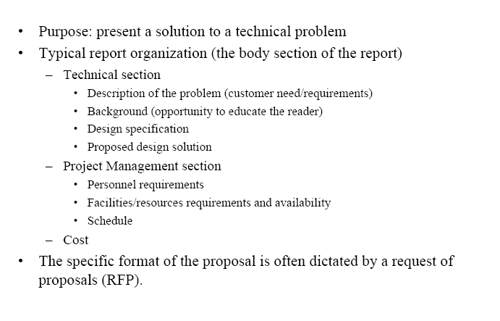
Proposal

Slide 9
Proposal Format
No more than 15 typed pages
  Cover page
    Title, design team #, facilitator, Document type
    Design team members, date
  Executive summary
  TOC
  Introduction
  Background
  Objectives
  FAST Diagram
  Conceptual Designs, Ranking
  Proposed design
  Risk Analysis
  Project Management
  Budget
  References (plagiarism)
  Appendix

Slide 10
Technical Communications
Reports-
Pre-proposal
Full Proposal
Design Issues
  Interim Progress Reports - Status of project
  Final Report - Informs management/client of the final result , operating manual (use and trouble shooting)
  Application Notes-detailed description of the use of the product
Professional Self-Assessment
Oral Presentations

Slide 11
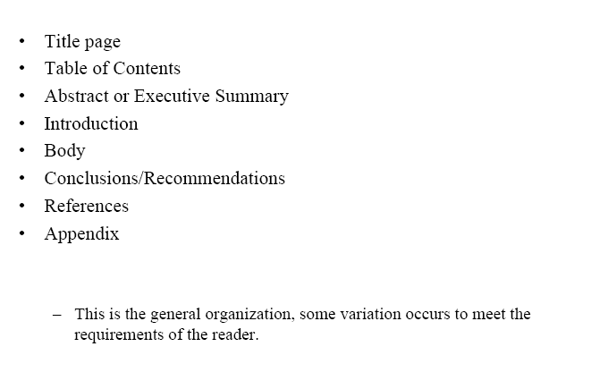
Formal Report Structure

