Slide 1

Early Warning System for Cloud Coverage
Design Team 7:
Nathan Vargo
Spencer Krug
Tianhang Sun
Qifan Wang
Liqing Yao

Slide 2
The Team
Nathan Vargo
  Electrical Engineer
  Presentation Prep
Spencer Krug
  Electrical Engineer
  Document Prep
Tianhang Sun
  Computer Engineer
  Manager
Qifan Wang
  Computer Engineer
  Web Design
• Liqing Yao
• Electrical Engineer
• Lab Coordinator

Slide 3
Agenda
Background Information and Problem
Initial Design Concepts
Obstacles
Proposed Design
Budget
Questions

Slide 4


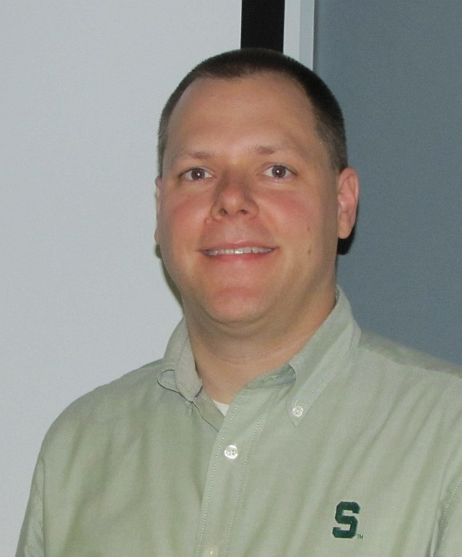
Background Information
• Sponsor
• MSU
• Wolfgang Bauer
• Department of Physics and Astronomy
• Nate Verhanovitz
• Department of IPF Power and Water
• Facilitator
• Nelson Sepulveda
• Department of Electrical and Computer Engineering
Nelson Sepulveda
Wolfgang Bauer
Nate Verhanovitz

Slide 5
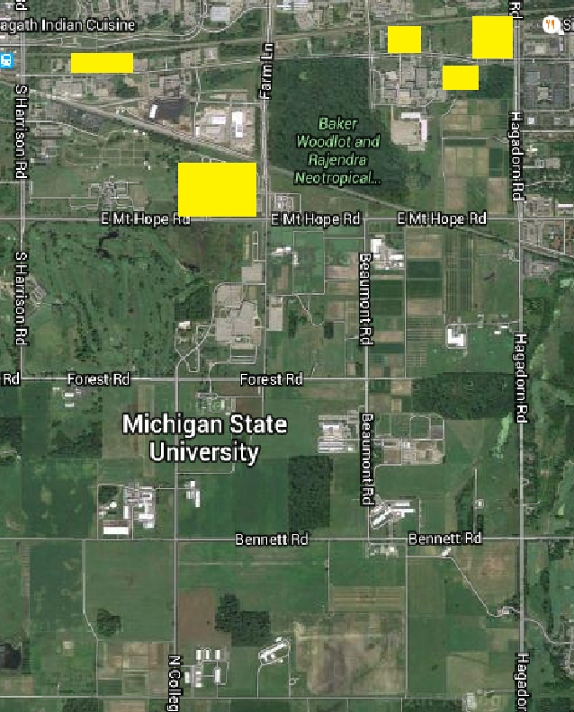
Background Information Continued
• MSU averages a peak power load of 65 MW
• Create own energy
• Reduce cost
• Going green
• MSU acquiring solar panels
• Solar panel power output 11-12MW

Slide 6
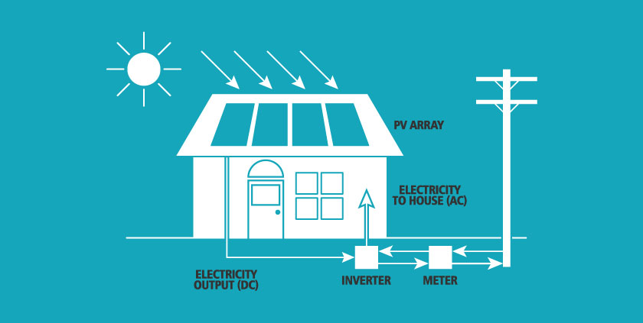
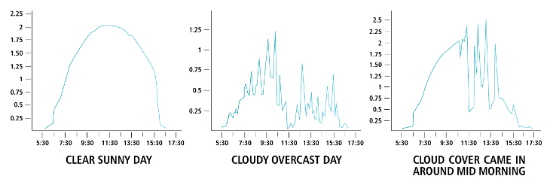
The Problem
• Solar power depends on the weather
• Cloud cover
• Clouds can quickly drop power output to 15%
• Backup Power Costs

Slide 7
What Does This Mean? - Deliverable Goal
• The design needs to track clouds
• The design needs to predicts future cloud coverage
• Backup generators need 1 min/MW
• Up to 10 min
• Distinguish clouds that will and will not cover MSU solar panels
• Distinguish between clouds and noise
• Airplanes, birds

Slide 8
Agenda
Background info and Problem
Initial Design Concepts
Obstacles
Proposed Design
Budget
Questions

Slide 9
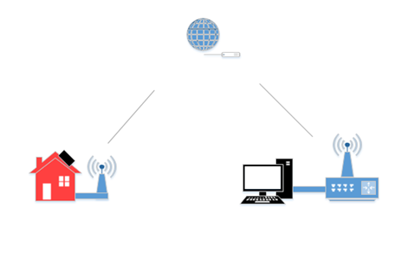
Initial Design Concepts
• Basic design requirements
• Distant sensors(10min range away from station)
• Wireless connection(cable cost a lot, analog sig might change through distance)
• Program and User Interface(data analysis)

Slide 10
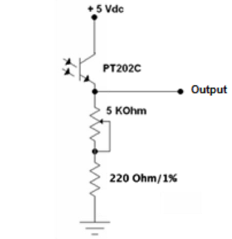
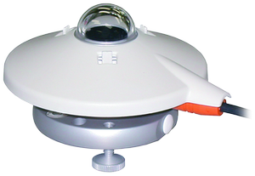
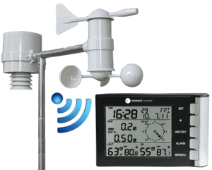
Sensor Types
• Built pyranometers(cheap, hard to implement)
• Commercial pyranometers(reasonable price, precise data reading, probably the best choice)
• Complete package pyranometers(too expensive, and only works with its own system)

Slide 11


Wireless Connection
• RF communication(FM, high power consumption)
• Wi-Fi in households(only issue is the permission of household)

Slide 12
Program and User Interface
• C++ // Most experienced, lots of classes taken in C++
• Matlab, R % Better for large-scale data analysis
% Not Industry standard
• Python ## Easier to use, good for data visualization
## Better in future industry scale analysis
## Lack of experience in creating large program

Slide 13
Agenda
Background info and Problem
Initial Design Concepts
Obstacles
Proposed Design
Budget
Questions

Slide 14

Obstacles
Experience
  Lack of the knowledge
  Have not detected solar irradiance change before
http://mysuperchargedlife.com/blog/wp-content/uploads/2013/02/mental-obstacles.jpg

Slide 15

Size and Shape of Clouds
Sensors may miss the small sized clouds
Shapes may cause error to the predictions
sensor
Movement
sensor
sensor
Movement
cloud
cloud
sensor

Slide 16

Direction and Speed of Cloud Movement
Random direction and speed
Hard to detect due to the random shapes
MSU
sensor
detected movement
sensor
cloud movement
MSU

Slide 17
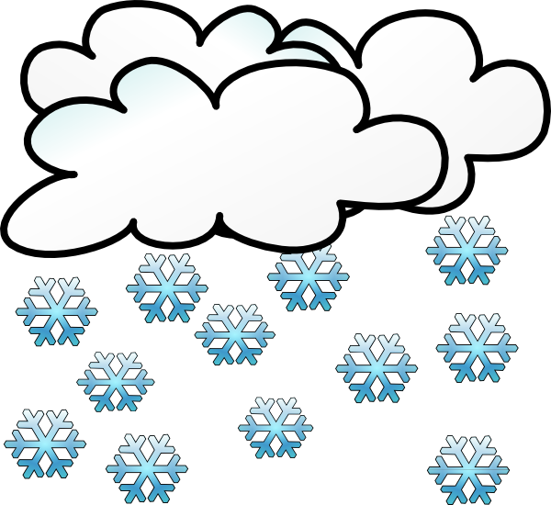
Seasonal Problems
Raining
  The water on top cause error
Snowing
  The snow will cover top and cause error
http://www.clker.com/cliparts/w/F/h/x/4/3/rain-cloud-md.png
http://www.clker.com/cliparts/7/P/f/u/5/e/snowing-hi.png

Slide 18
Sensor Location
Each sensor needs wifi access
Locate on volunteers’ house roof
The algorithm has to be suitable for random coordinates
sensor
sensor
sensor
sensor
MSU
sensor
sensor
sensor

Slide 19
Agenda
Background info and Problem
Initial Design Concepts
Obstacles
Proposed Design
Budget
Questions

Slide 20
Proposed Design
• Wireless sensor network using Wi-Fi
• C++ Programing Language
• Combination of Pyranometer and Light Sensor
• Test and Implementation Phase

Slide 21
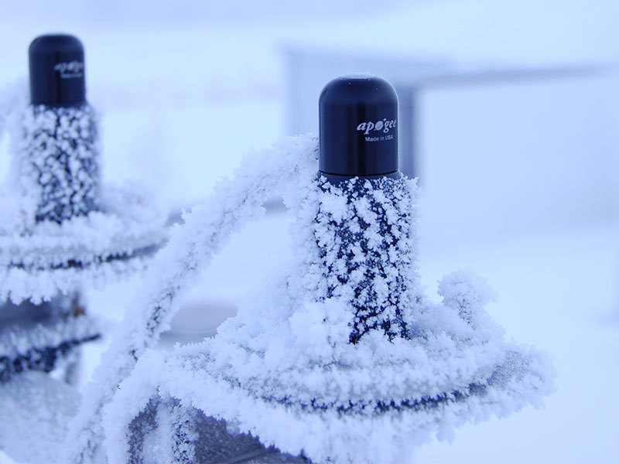
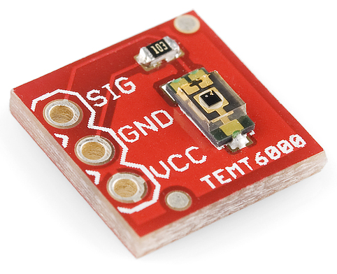
Proposed Sensor Type
• Pyranometer
• Apogee SP-230 All Weather Pyranometer
• Self Powered
• 12V DC Heater
• Analog Voltage Output
• 0.20mV per W/m²
• -40⁰ to 70⁰ C Operating Temperature
• $235
•Light Sensor
• Analog Voltage Output
• $5
Pyranometer
Light Sensor

Slide 22
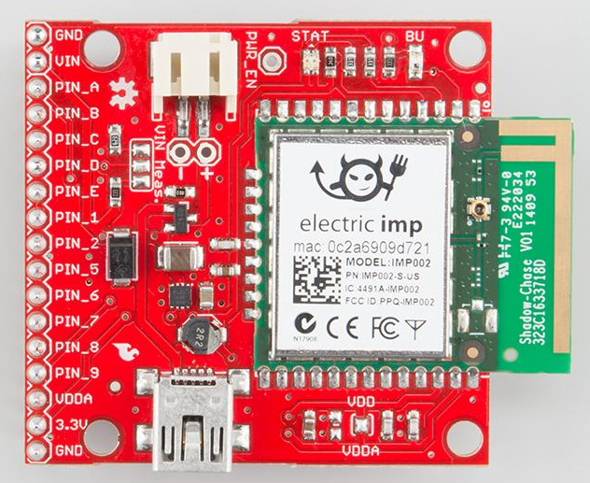
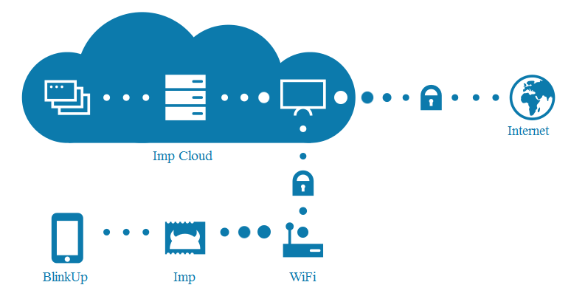
Proposed Wireless Communication
• Access to Wireless network at sensor location
• Use Wi-Fi to upload data to server
• Electric Imp002 Microcontroller
• Cost - $40
• Easy Wi-Fi setup
• Platform
• Easy to Use
• Cloud Access

Slide 23
Proposed Program and User Interface
• C++ Programming Language
• Experienced
• Experience in creating User Interface
• Microsoft Foundation Class
• User Interface
• Map of the MSU campus and solar panel location
• Load arbitrary number of sensors onto map
• Real time simulation of clouds
• Based on data series from remote sensor
• Algorithm to determine when the cloud will cover solar panels

Slide 24
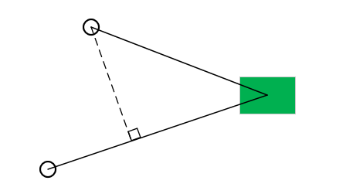
Detection Algorithm
Assumption
  Infinite large cloud -- don’t need to react to small clouds.
  Move in straight line, consistent speed -- difficult to predict, won’t change too much during the local area.
Implementation
  Based on speed towards MSU campus.
  Need data series from at least three sensors from one direction.

Slide 25
Agenda
Background info and Problem
Initial Design Concepts
Obstacles
Proposed Design
Budget
Questions

Slide 26
Budget
Budget will vary upon number of sensors implemented
Broken into two phases
  Test
  Total Project
Budget for Total Project
Budget for Test Phase
Part | Cost | Quantity
Test Phase | $130 | 1
Pyranometer | $235 | 10
Microcontroller | $40 | 9
Power Supply | $30 | 10
Total |  | $3140
Part | Cost | Quantity
Light Sensor | $5 | 10
Microcontroller | $40 | 2
Total |  | $130

Slide 27
Questions?

