Slide 1


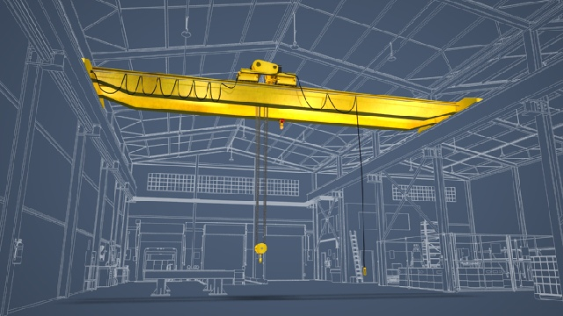

Cone of Safety around a Crane Hook
Presented by Team 5
Xue Cheng
Samuel Falabi
Charlie Nguyen
Richard Szink
Lanea Williamson

Slide 2
Team Roles
Richard
Szink
Charlie Nguyen
Xue Cheng
Lanea Williamson
Samuel Falabi
Project Management
Microcontroller research and programming
Documents Preparer
Power supply
Web Designer
Presentation
Sensor Research and safety cone design
Lab
Cost estimating and Purchasing
Alarm system
Alarm system
Sensor research and safety cone design
Simulation and Testing
Microcontroller programming
Overall design

Slide 3

Faculty
Dr. Hayder Radha
Professor and Associate Chair for Research
Study in coding and communications; image and video compression; image processing; multimedia communications over packet networks; video coding and communications over the Internet and wireless networks; modeling and analysis of the stochastic behavior of communication networks; wavelet, subband, and multiresolution coding

Slide 4

Sponsor
ArcelorMittal USA
-World’s leading steel and mining company
James Lang
-Coordinator, Finish and Coating

Slide 5

ArcelorMittal Company Background
World’s leading steel and mining company
Annual production capacity of 115 million tons and operating in 60 countries
Produce safe and sustainable steel
Provide conductive and a safe work environment for its employees

Slide 6
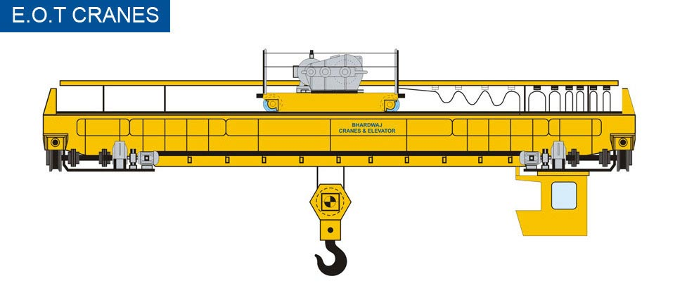
Crane Introduction
RC Overhead Cranes are used for transporting products and materials
Operated remotely by a Remote Control Crane Operator (RCCO)
Utilized to move tons of steel everyday

Slide 7
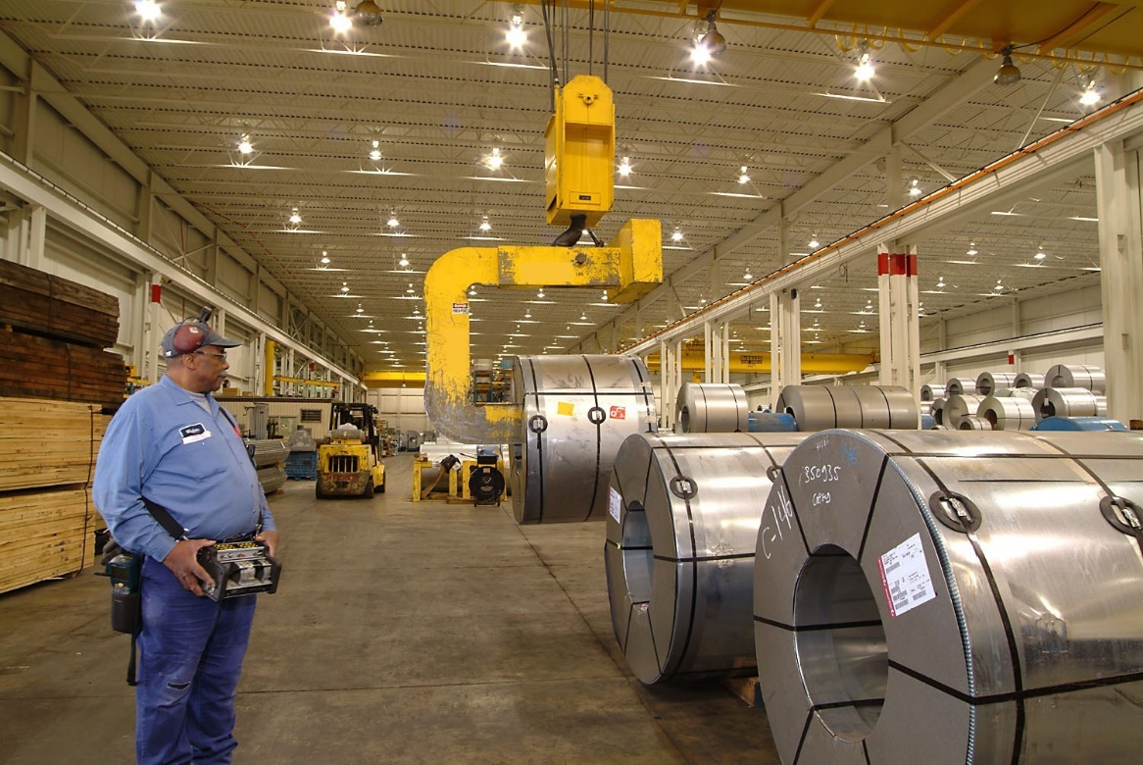
Safety Issues
Suspended steel coil loads hang from the overhead cranes and are potential safety risks to the operators.
Over fifty accidents have caused deaths in the past 15 years in the northwest Indiana Steel Industry.

Slide 8
Our Mission
The system will be able to detect any operator within a certain distance from a working crane.
The system will be turned on when the load is within 8ft above ground.
The system will sound an alarm and warn the operator when the operator is in the danger zone.
Data will be recorded so ArcelorMittal can constantly improve their safety measures and prevent future occurrences.

Slide 9
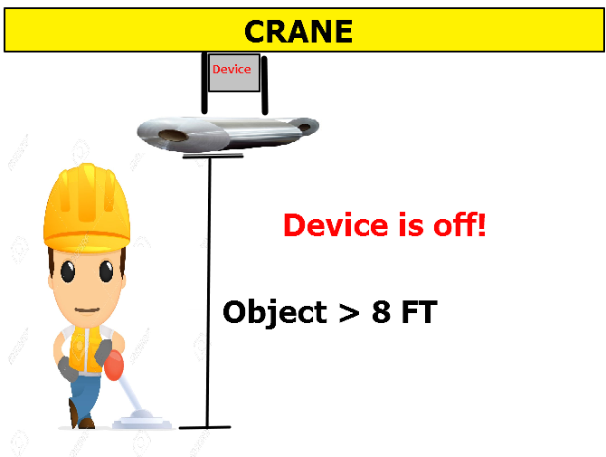
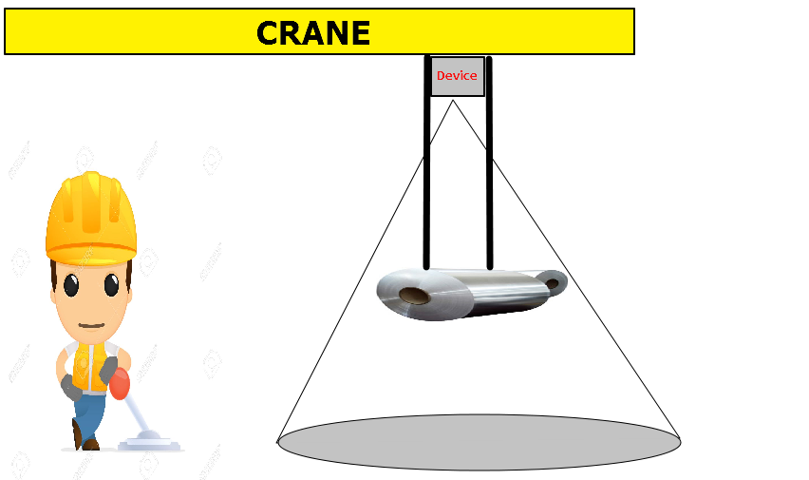
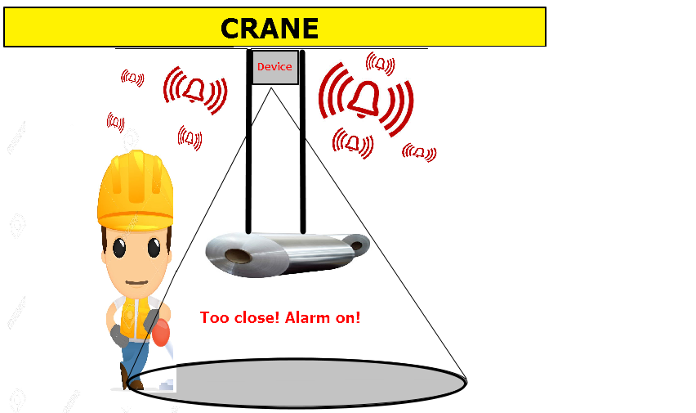
Design Schematic diagram

Slide 10

Research Techniques
What are the industry standards?
  Opportunity to advance field?
Has a similar project been completed before?
  What was the outcome?
What type of sensors would fulfill our needs?
What are our design constraints?
  How can we overcome them?

Slide 11
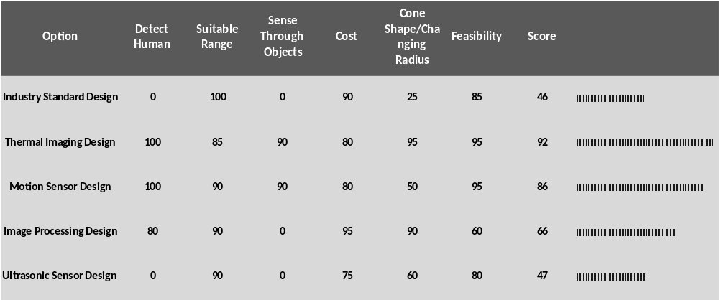
Ranking of Conceptual Designs

Slide 12

How do we build this?
Sensors
Alarm
Data Recording
Processing all the information

Slide 13
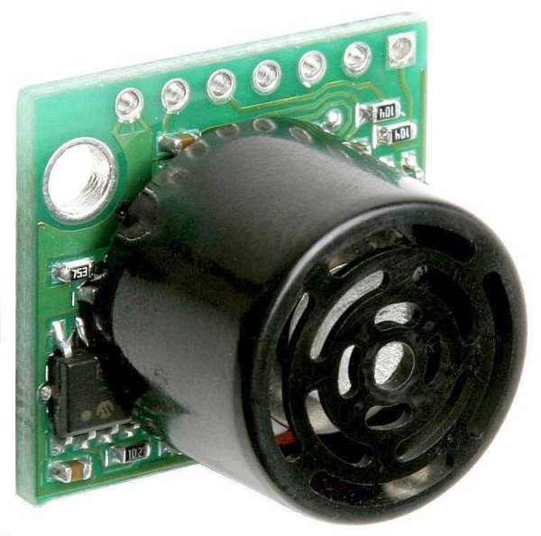
Detect Distance of the Load
Mount sensor on the trolley of crane
Use proximity sensor

Slide 14
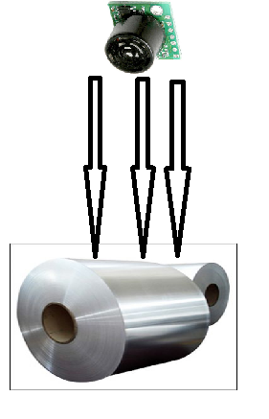
Proximity Sensor
Measures Distance
Uses Ultrasonic Sound
Detect the distance of the load, and only turn on the designed device when the top of the load is within 8ft above ground

Slide 15
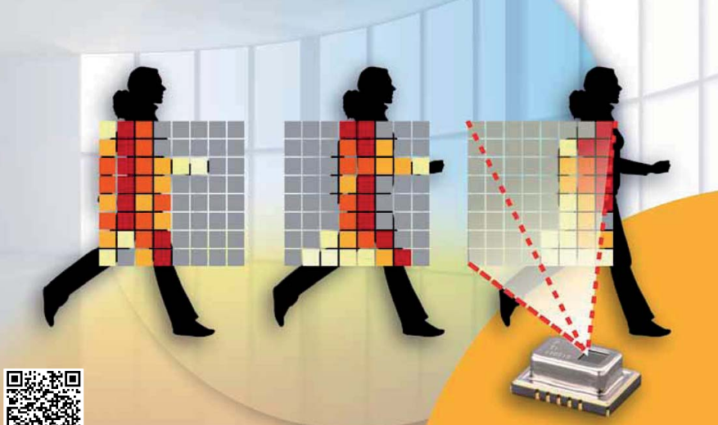
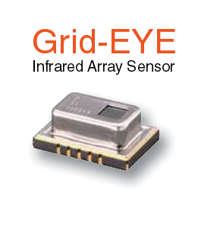
However…
Proximity Sensors can not easily detect humans
Thermal Sensors can!

Slide 16
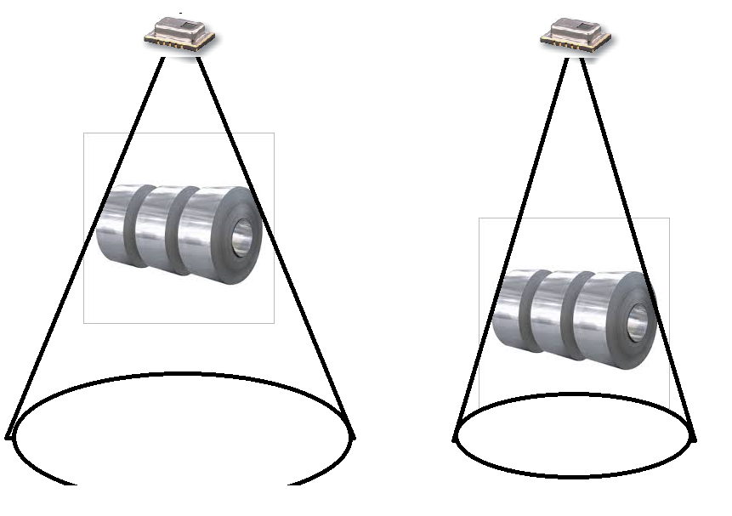
Adjusting size of Safety Cone
When the load gets closer to ground, we need to adjust the angle of sensor to shrink the safety cone

Slide 17
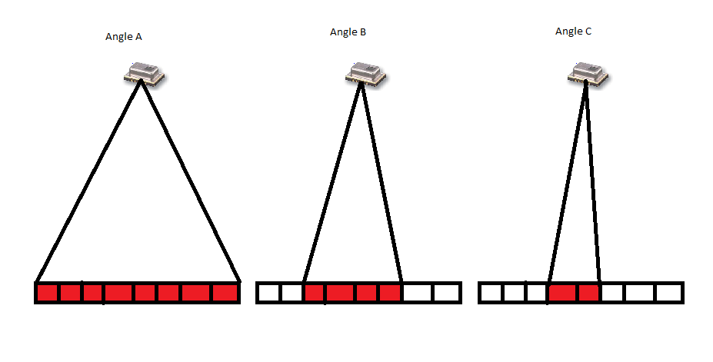



Selecting Thermal Angle
With thermal imaging sensor, we can select the range we need to measure. Therefore, we can adjust the safety cone with the height of the load.

Slide 18
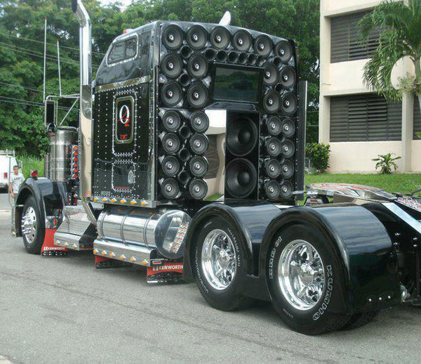
Alarm System
When a operator is detected within the danger zone, a signal will be sent to trigger the alarm system
We need to create a sound above 80 db

Slide 19
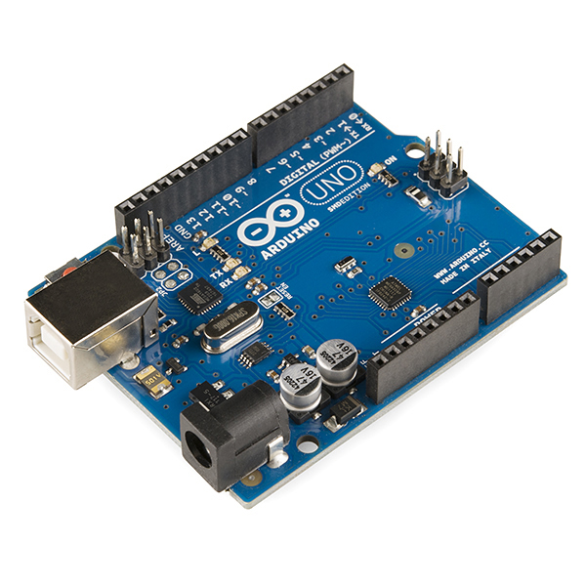
Microcontroller
Arduino
Cheap
Popular
Lots of Documentation

Slide 20
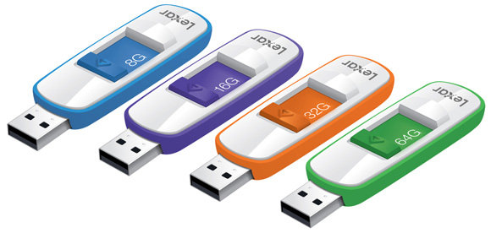
Data Recording
Used by ArcelarMittal to record near miss accidents
Written onto a flash drive

Slide 21
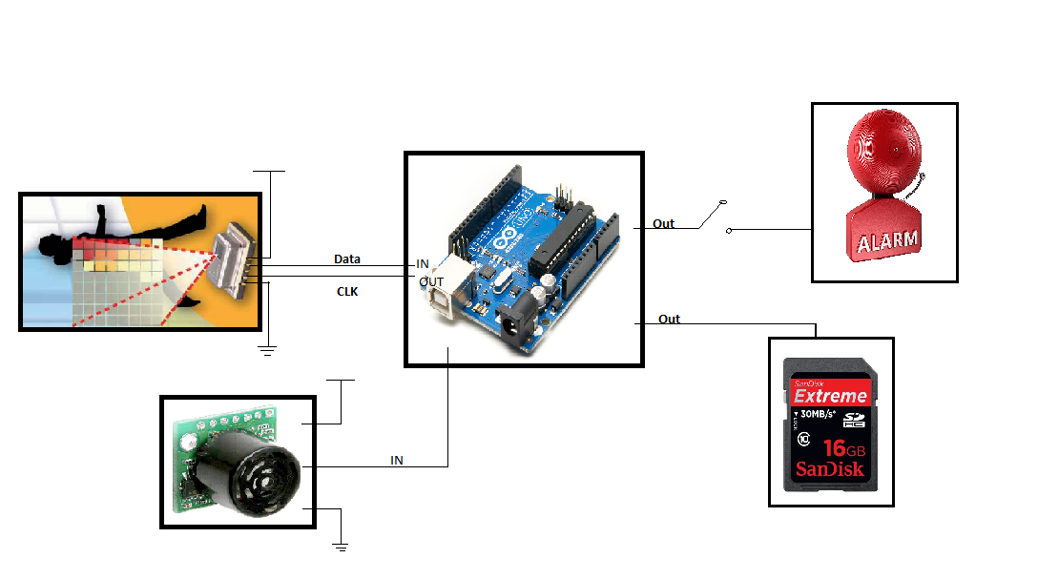
Overall Design

Slide 22
Design Constraints
Mounting
Alarm
Human Sensing - Temperature

Slide 23
Mounting
Bolted and not welded
Dust Prevention Box
Mounted to limit vibrations
Wiring Placement

Slide 24
Alarm
Mounting Location
Sound Frequency to alert the operator
Above 80 db

Slide 25
Human Sensing
Human’s Temperature is 98.6
Static Objects

Slide 26
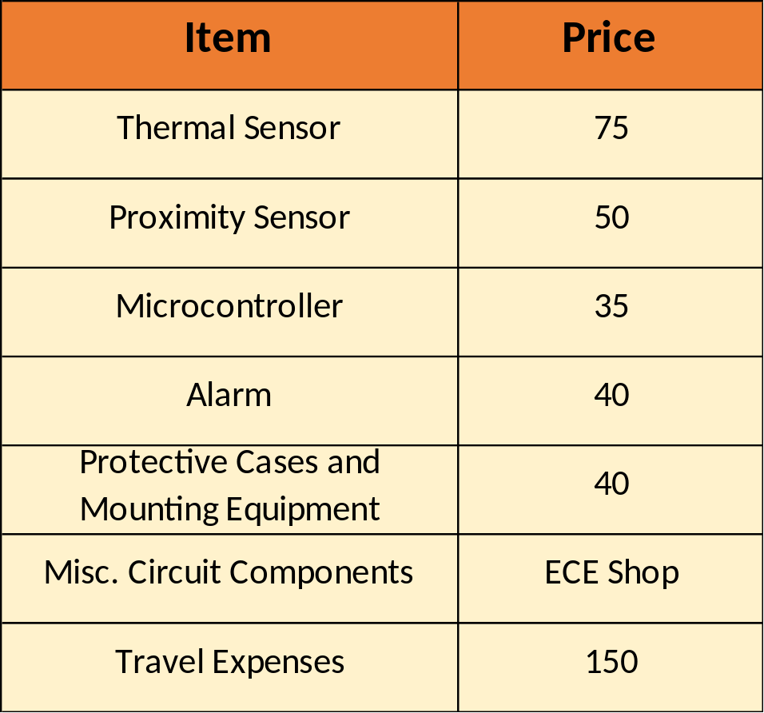
Budget
Total Budget
$500
Design Cost
-$240
Travel Expense
Remain
$110
-$150

Slide 27
Summary
Safety is top priority at ArcelorMittal
Using effective design techniques leads to best results
Opportunity for industry to use new methods to enhance safety
First recognizable project of its kind

Slide 28
Suggestions for Future Work
Purchase thermal sensor with a larger sensing matrix (cost )
Use Programmable Logic Controller instead of microcontroller
  Very few connections and easy to integrate.

Slide 29


Slide 30


Thank you!

