Slide 1
Incoming Power Grid Monitor
Team #3: James mccormick, zhihoug qian, Jacob jebb, victor Ezenwoko, alex lange
Facilitator: Dr. Aslam
Sponsor: Great lakes controls and Engineering

Slide 2





Project Management
Victor Ezenwoko
James McCormick
Zhihoug Qian
Alex Lange
Jacob Jebb
Notes:
Victor

Slide 3
Outline
Introduction
Design Specifications/Deliverables
Proposed Solution
Risks
Schedule
Budget
Conclusion
Notes:
James

Slide 4


Introduction
Importance: Troubleshooting power quality problems requires accurate measurements and analysis of power quality.
Goal: To develop a three-phase power monitoring system that can alert the user if any transient event occurs.
Sponsor
Great Lakes Controls & Engineering
Justin Walz
Facilitator
Dr. Dean Aslam
Notes:
Alex

Slide 5
Design Specifications
Run off 120 VAC wall outlet.
Measure voltages up to 600 V.
Measure current up to 100 Amps.
Memory to log data for 1 month
USB memory stick port
Internet capabilities to alert user via e-mail if any transient event occurs
User interface for control of system, data viewing.
Control of:
  Sampling rate
  Time clock
  Voltage transient reference
  Voltage % of transient
Monitor
  Current V, I and Power factor
  V, I and Power factor vs. Time graph
  Time of transient event
Notes:
zhihoug

Slide 6
Deliverables
Power monitoring system
Electrical Schematics
Software code utilized for data collection
Operator Manual
Notes:
Zhihoug

Slide 7
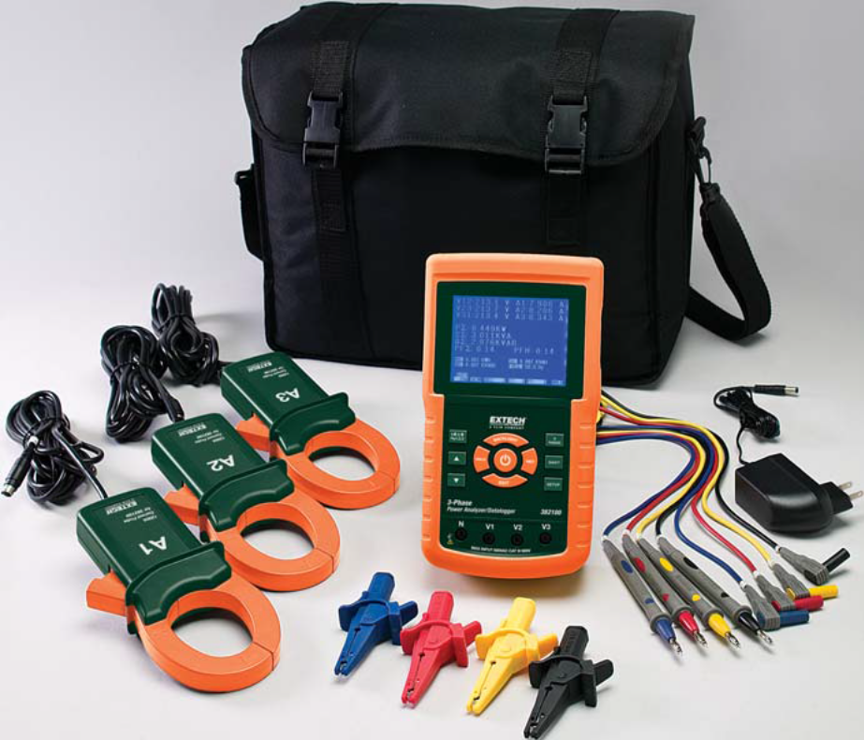
Background
Extech 3-Phase Power Analyzer
  Minimum sampling rate of 2 seconds
  Unable to detect transient data
  Lack of internet connectivity
Our goals are to improve on the shortcomings of this system, while maintaining the features our sponsor likes.
Notes:
Victor

Slide 8
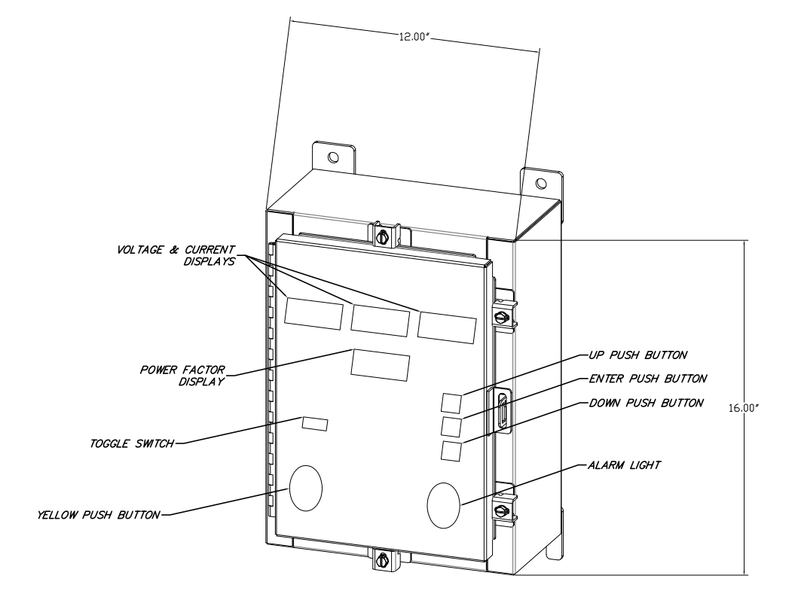
Proposed Solution
Voltage transformers in a separate box
Current clamps
Signal conversion
Programmable microcontroller with USB/Ethernet ports with expandable memory
Back-up battery power
LCD displays
Push buttons to change displays/input settings
Notes:
James

Slide 9
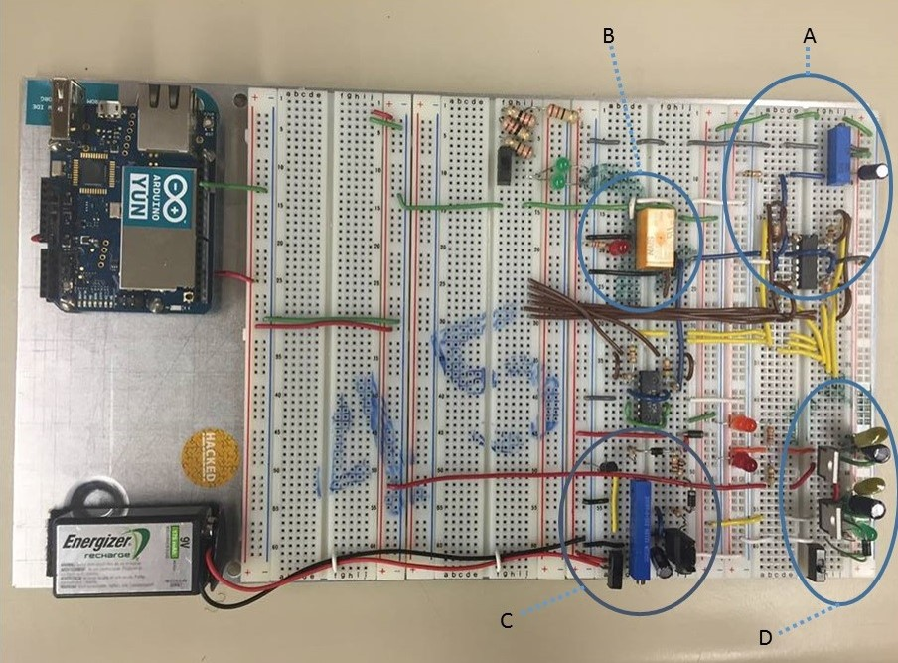
Hardware
Shown:
  Microcontroller
  Signal conversion circuit (A)
  Under voltage switch over circuit (B)
  Battery charger circuit (C)
  Input voltage/power circuit (D)
Proposed:
  Current clamps
  Voltage transformers
  LCD displays
  Enclosure
Notes:
James

Slide 10
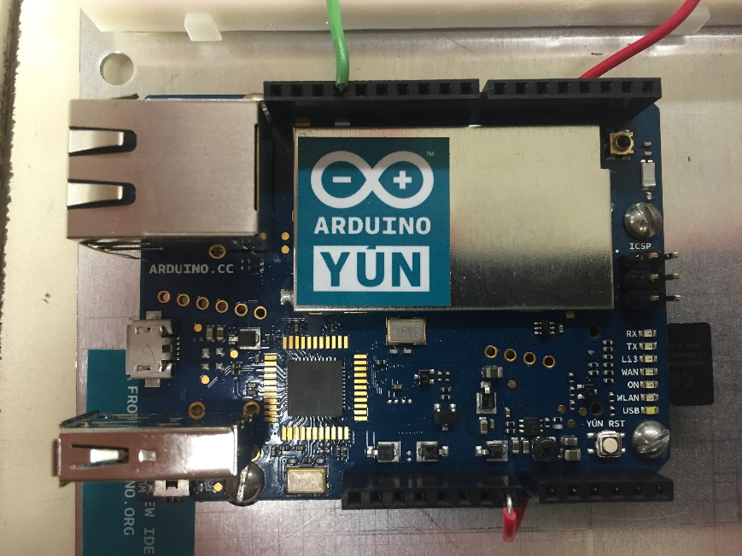
Software
Microcontroller: Arduino YÚN
  Familiarity
  Internet capability
Limitations
  Limited I/O on microcontroller
Overcoming Limitations
  Using I²C communication for LCDs
    Add module to LCD to give them different addresses
    Cuts down the number of I/O required for the four LCDs from 9 to 2
Notes:
Alex

Slide 11

Risk Analysis
High Voltage
Arch Flash
Component failure
Heat dissipation
Loss of power
Notes:
Jacob

Slide 12
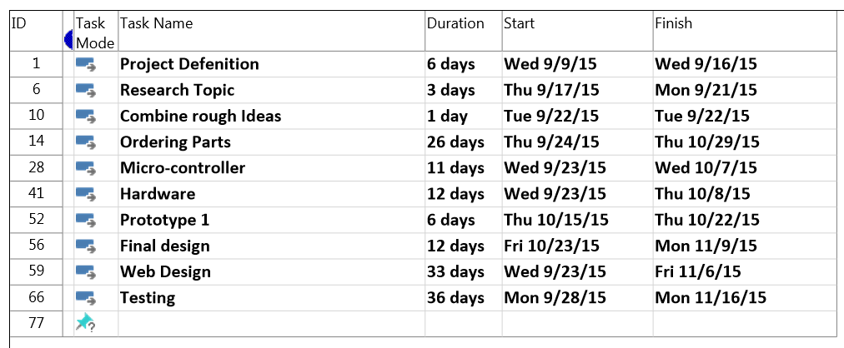
Gantt Chart
Notes:
James

Slide 13
Budget
Quantity | Item | Cost | Justification
2 | Arduino YÚN Microcontroller | $138.54 | Includes networking capabilities, need 2 to be able to test and program simultaneously.
4 | Basic 16x2 Character LCD - White on Black 5V | $39.80 | To display voltage and current for each phase, and the power factor.
4 | I2C Serial Interface Board Module LCD | $9.00 | Reduces the number of outputs used for the LCD displays.
1 | 64GB MicroSD Card | $35.99 | To save data from the microcontroller.
Notes:
Jacob

Slide 14
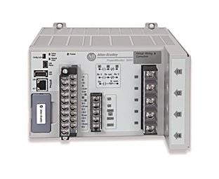
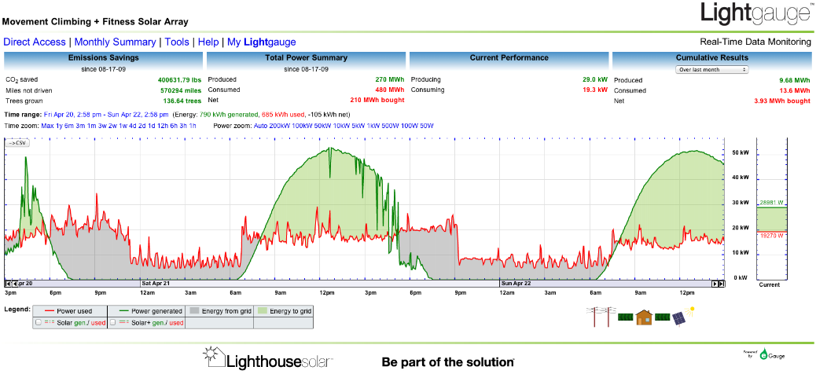
Future Designs
PLC
  Allen Bradley
HMI
Data logging software
Notes:
Jacob

Slide 15
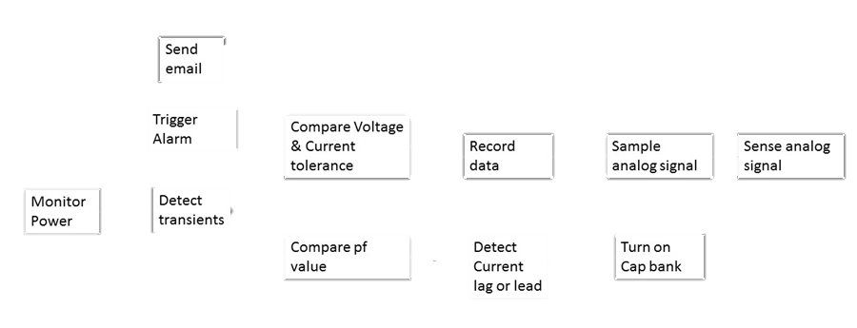
Conclusion
Notes:
Victor

Slide 16
Questions?

