Slide 1
Incoming Power Grid Monitor
James McCormick
Zhihoug Qian
Jacob Jebb
Victor Ezenwoko
Alex Lange
Design Day – Fall 2015
Team 3 – Incoming Power Grid Monitor – 12-11-15
Notes:
James

Slide 2
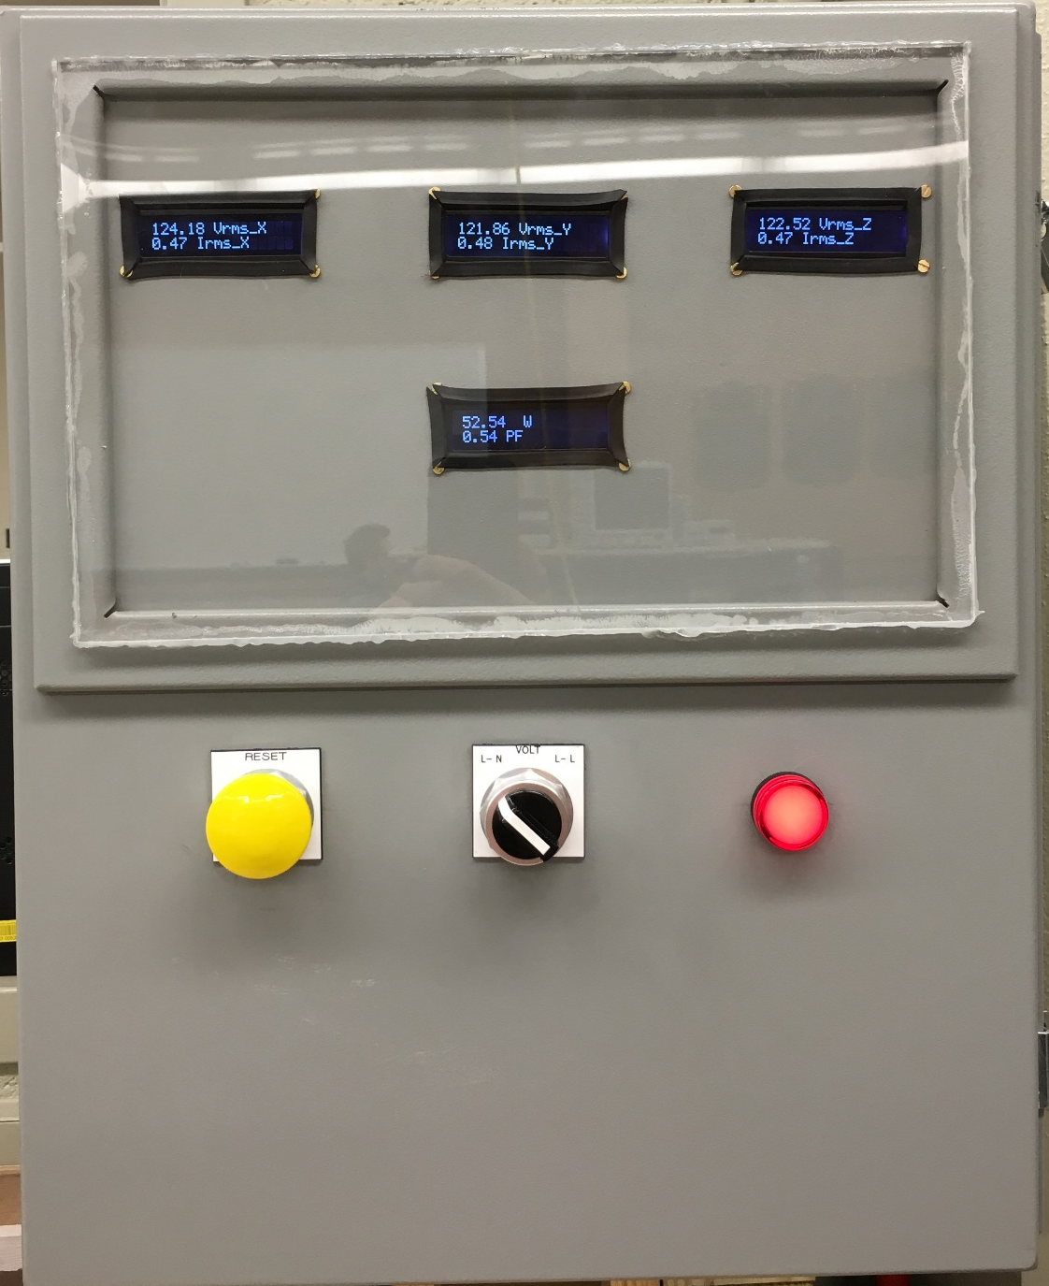
Outline
Introduction and Motivation
Design Specifications
Final Design
  Features
  Altered Parameters
  Bonuses
  Cost
Schematics and Manual
Future suggestions
Summary
Demonstration and questions
Team 3 – Incoming Power Grid Monitor – 12-11-15
Notes:
James

Slide 3


Introduction
Importance:
  Imbalance of three-phase voltages causes damage to three-phase machines
  Low power factor causes machines to operate inefficiently and increases Utility fees
  Troubleshooting power quality issues requires accurate measurements for analysis
Goal:
  Develop a three-phase power monitoring system that can be placed within a factory. The system must record data and alert the user if any transient events occur.
Facilitator:
Dr. Dean Aslam
Sponsor:
Great Lakes Controls & Engineering
Justin Walz & Bill Franson
Team 3 – Incoming Power Grid Monitor – 12-11-15
Notes:
Alex

Slide 4

Design Specifications
Requirements:
System must run off 120 VAC wall outlet
Ability to measure voltages up to 600 VAC
Ability to measure current up to 100 Amps
Memory to log data for 1 week
User interface for control of system and data viewing
USB memory stick port for removal of data
Internet capabilities to alert user via email if any transient event occurs
Deliverables according to the sponsor:
Power monitoring system
Wire clamps for voltage x4
Wire loops for current x3
Electrical Schematics
Operator manual
Software code utilized for data collection.
Team 3 – Incoming Power Grid Monitor – 12-11-15
Notes:
Victor

Slide 5
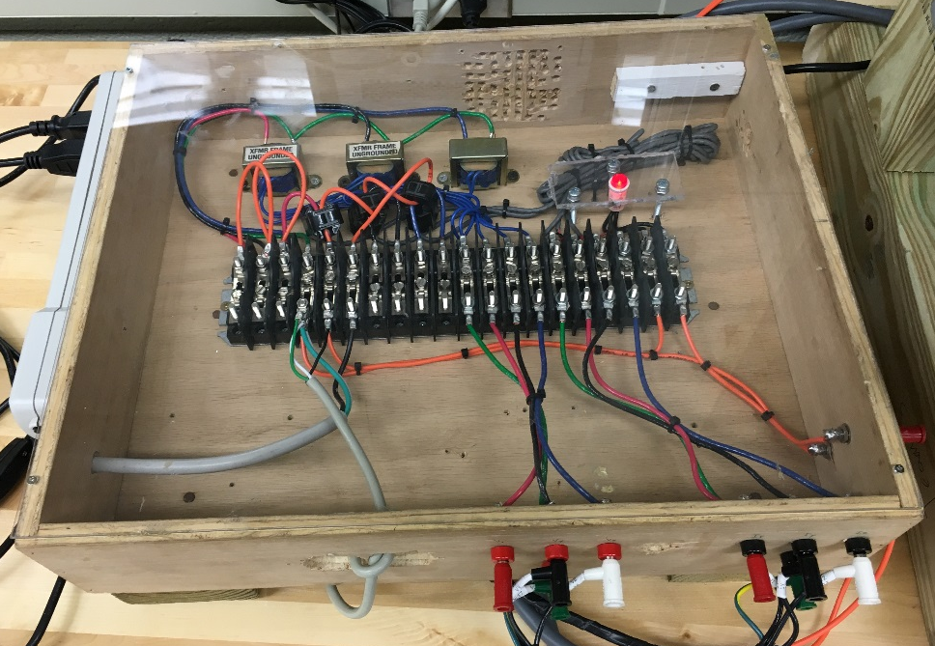

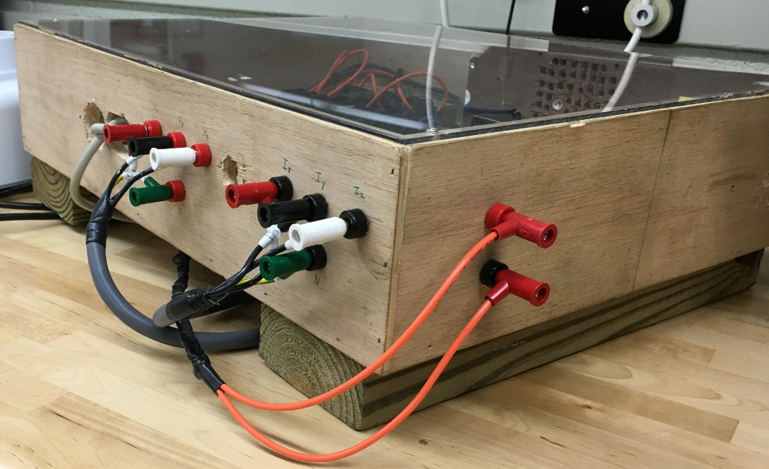

Design Specifications
Measure 600 120 Volts and 100 3 Amps
Inability to test high current and voltage
Safety Concerns
Assist Sponsor with conversion
to larger scale
Team 3 – Incoming Power Grid Monitor – 12-11-15
Notes:
Victor

Slide 6
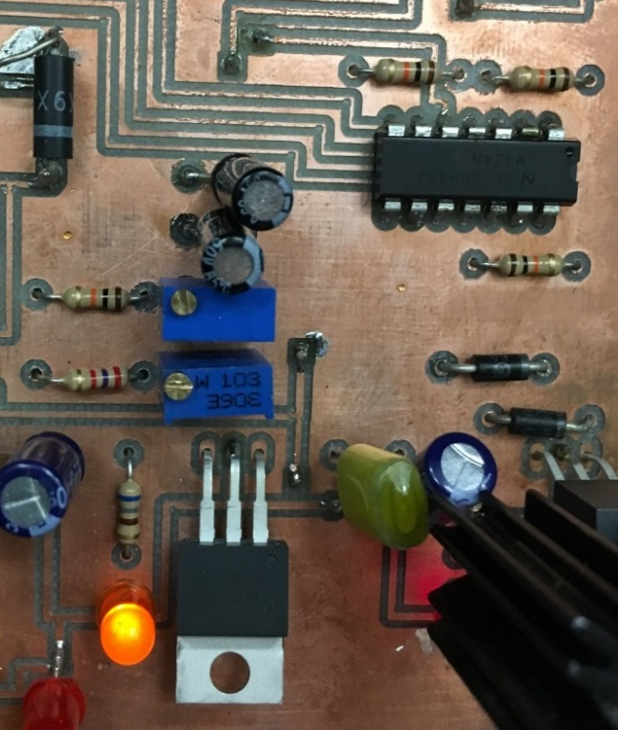

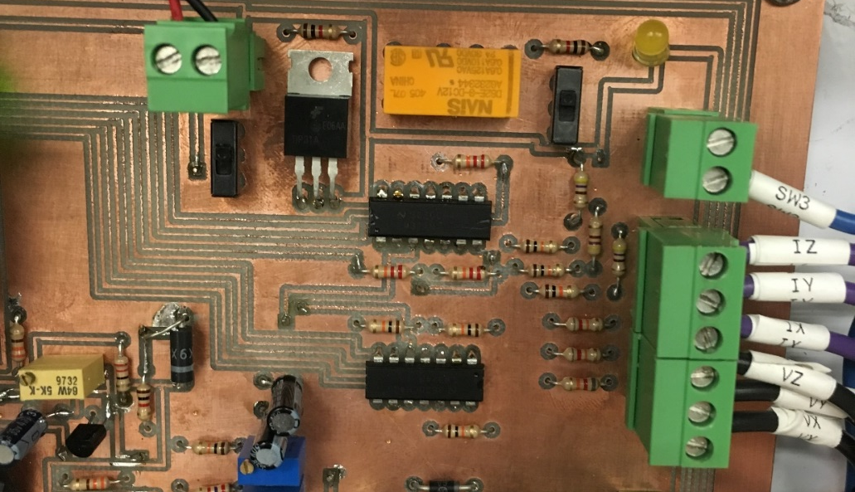

Final Design - Features
Voltage and Current Sampling:
  Differential Op-Amp to scale and add DC offset to signals
  Adjustable DC offset
  RMS calculation within Coding
Team 3 – Incoming Power Grid Monitor – 12-11-15
Notes:
Victor

Slide 7
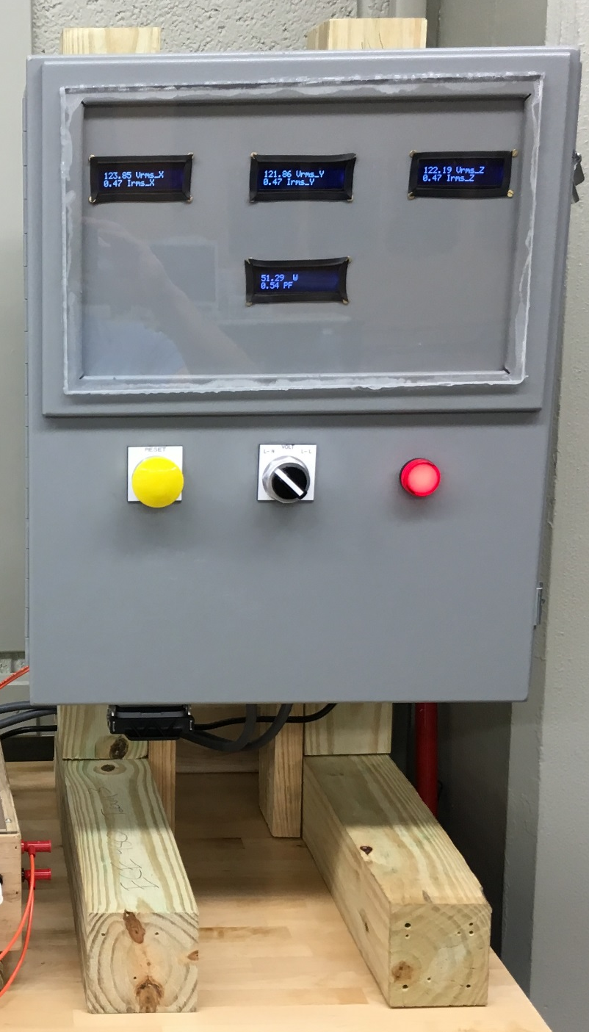
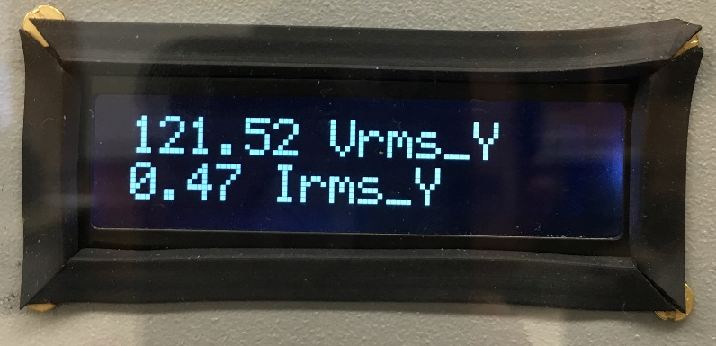
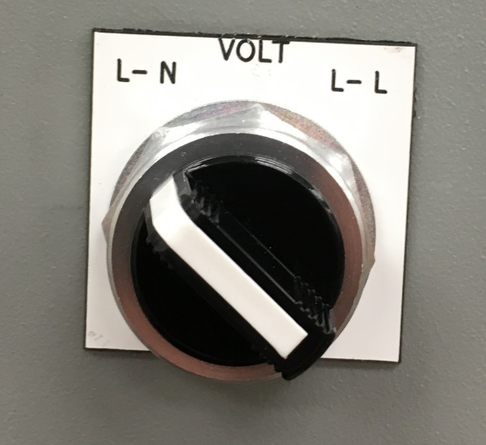
Final Design - Features
Human Machine Interface:
  Display Voltage (L-L and L-N), Current, Power, and Power Factor
  Alarm Light
  Reset button
  Selector Switch
Team 3 – Incoming Power Grid Monitor – 12-11-15
Notes:
J-Ho

Slide 8
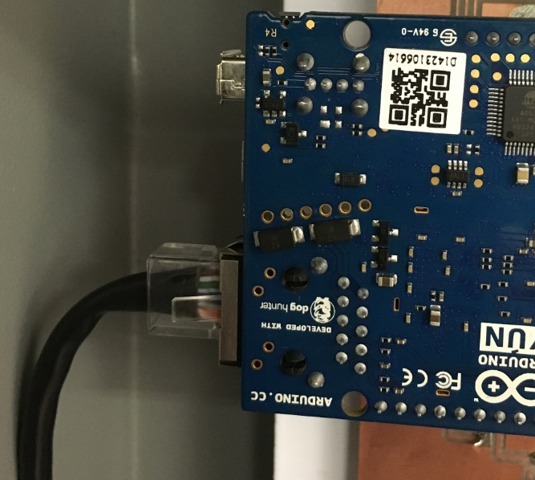
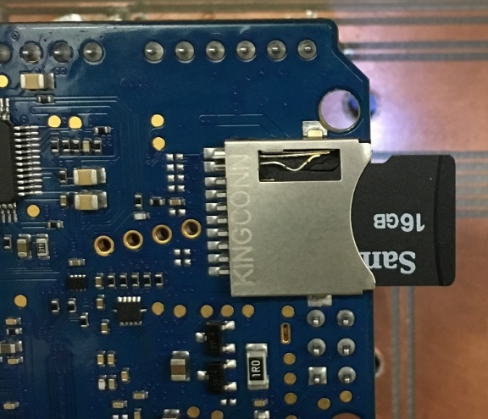
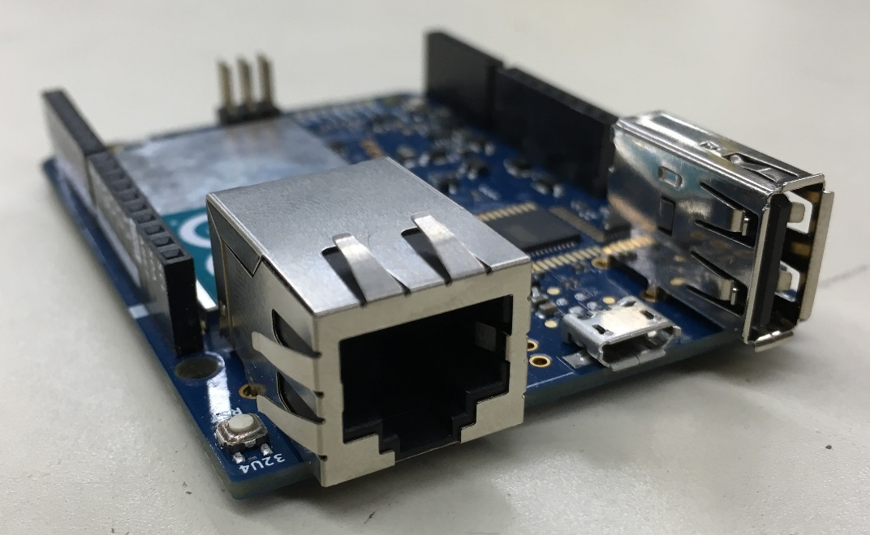
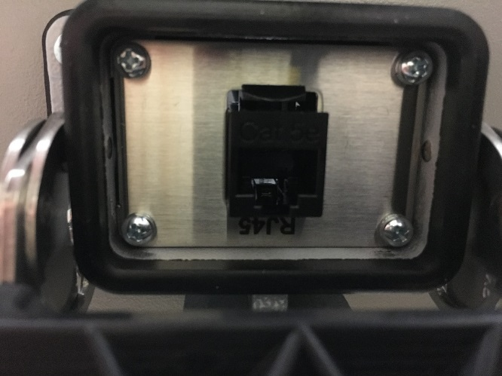
Final Design - Features
Data collection and Transfer:
  Saves data to Scan Disk
  Email through Ethernet of Wi-Fi
  Export and import saved data wirelessly
Team 3 – Incoming Power Grid Monitor – 12-11-15
Notes:
Jebb

Slide 9
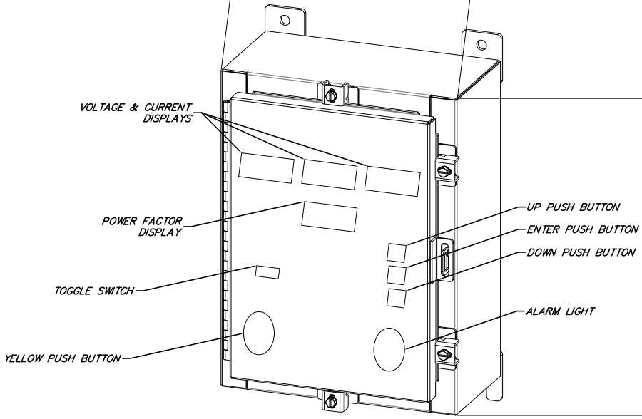
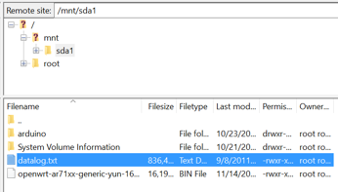
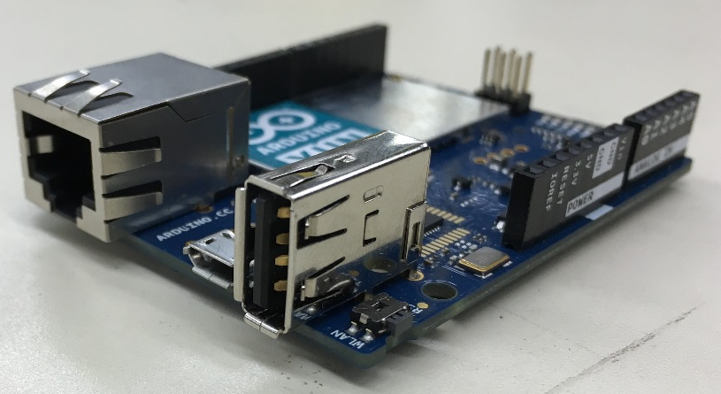
Final Design - Altered Parameters
Data transfer:
  USB exportation was desired - Used Wi-Fi instead
  Push buttons to change settings - Used Settings File through Wi-Fi instead
Picture push button design here
Team 3 – Incoming Power Grid Monitor – 12-11-15
Notes:
Jebb

Slide 10
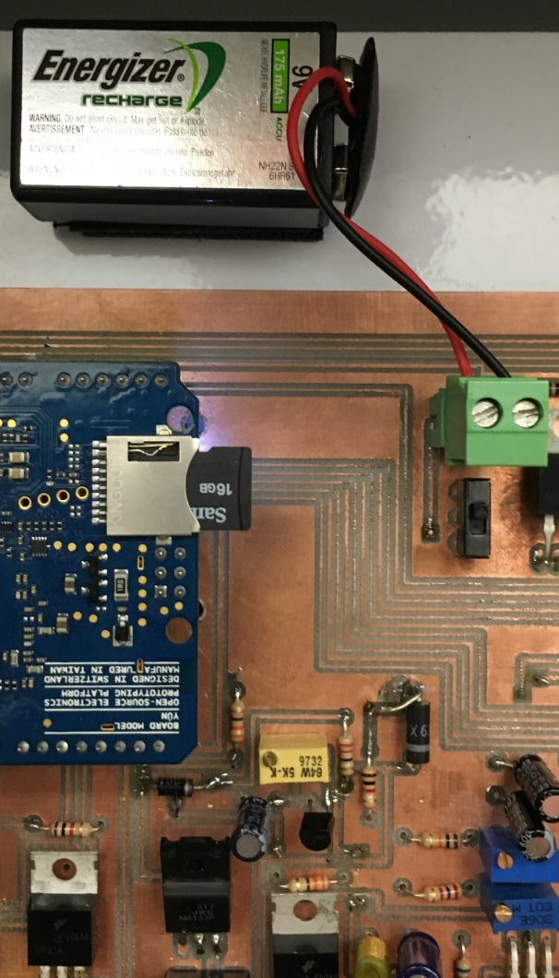
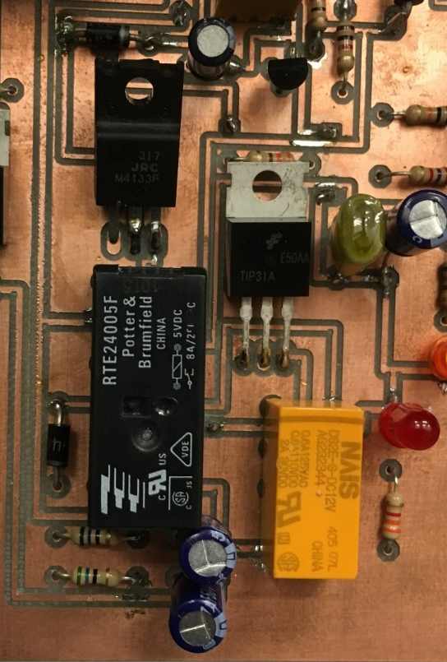
Final Design - Bonuses
Battery Power:
  Allows for loss of power email
  Battery charger:
    Adjustable current limit
    Voltage protection
  Battery shut-off circuit
Team 3 – Incoming Power Grid Monitor – 12-11-15
Notes:
James

Slide 11
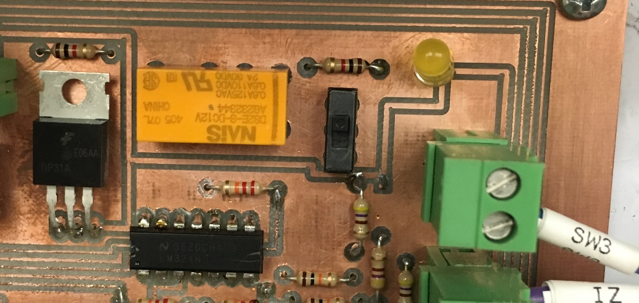
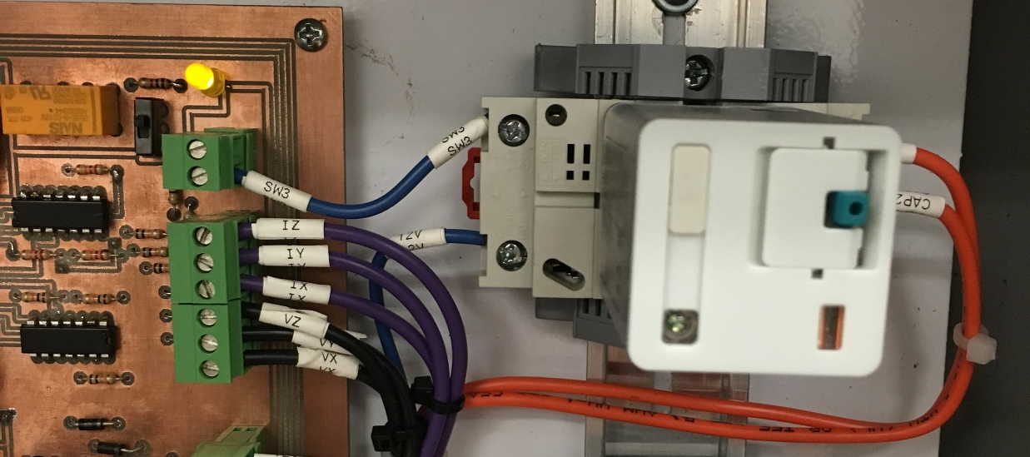
Final Design - Bonuses
Capacitor bank control:
  Operate off of Power Factor
  Cut-out switch
  Hysteresis loop
  Delay
  External source - Orange Wires
.81 PF
.9 PF
Open
Closed
Team 3 – Incoming Power Grid Monitor – 12-11-15
Notes:
alex

Slide 12
Final Design - Costs
Components | Cost | Quantity | Total
*Arduino YUN Micro-controller | $69.27 | 3 | $207.81
Basic 16x2 Character LCD – White on Black 5V | $9.95 | 4 | $39.80
I2C Serial Interface Board Module LCD | $2.09 | 4 | $8.36
16GB MicroSD Card | $12.00 | 1 | $12.00
24V KPR Relay | $7.55 | 1 | $7.55
RJ45 Port | $47.5 | 1 | $47.5
12V Power Supply | $24.00 | 1 | $24.00
5V Power Supply | $24.00 | 1 | $24.00
24V Alarm Light | $7.00 | 1 | $7.00
Reset Button | $6.45 | 1 | $6.45
2 Position Switch | $5.96 | 1 | $5.96
Terminal Block | $1.50 | 26 | $39.00
Fuse Block | $2.99 | 4 | $11.96
Enclosure | $244.00 | 1 | $244.00
PCB Board | $0 | 1 | $0
MISC PCB Components | - | - | $17.49
Total: |  |  | $702.88
* Extra costs incurred:
  Microcontroller to Prototype
  Broken Microcontroller
Cost to Reproduce: $591.98
Team 3 – Incoming Power Grid Monitor – 12-11-15
Notes:
J-Ho

Slide 13

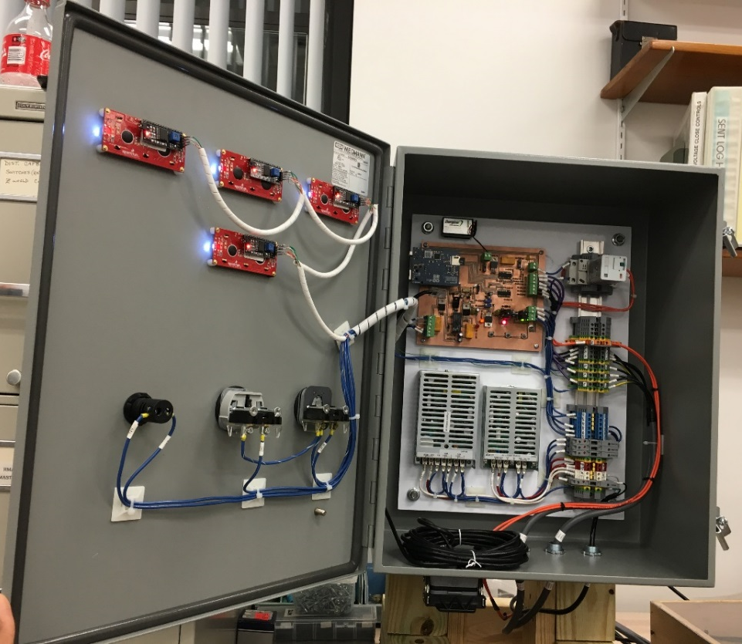
Final Design - Costs
Much cheaper than Comparable Devices on the Market
Price to Reproduce
$591.98
Team 3 – Incoming Power Grid Monitor – 12-11-15
Notes:
Jebb

Slide 14
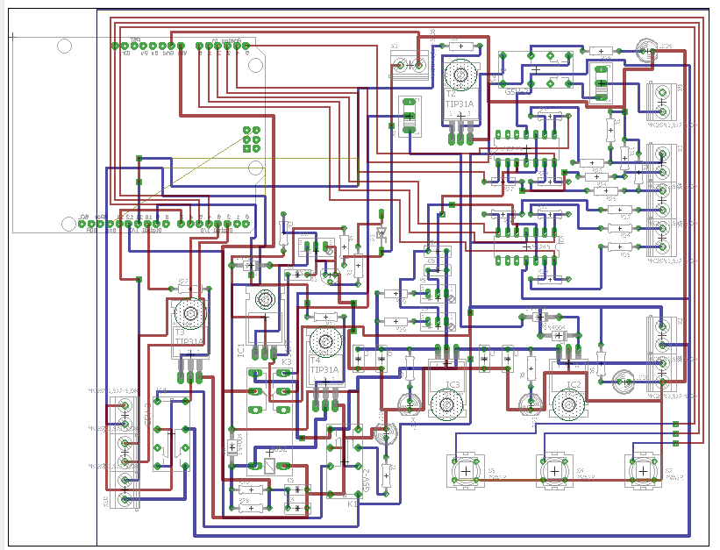

Schematics and Manual
Schematics and Details:
  PCB
  Box
Manual:
  Operations
  Maintenance
  Safety
Notes:
Jebb/Victor

Slide 15
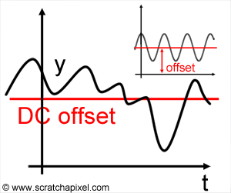
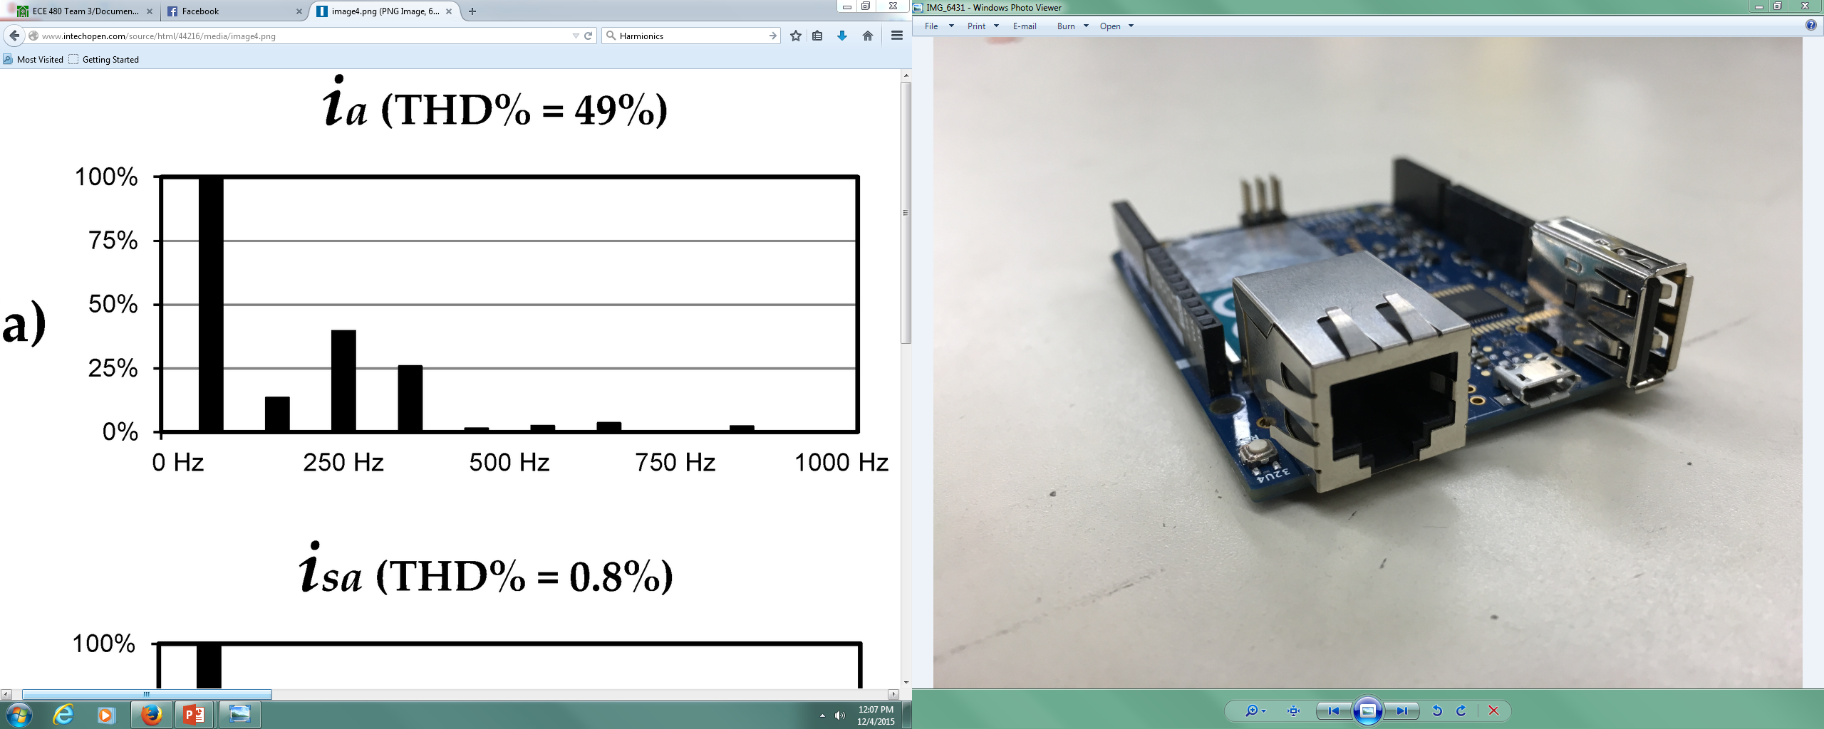
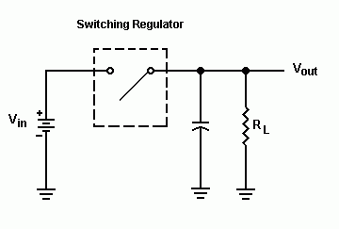
Future Suggestions
Average DC to subtract for next iteration
FFT for harmonics
12V
5V
Switching
Regulator
Team 3 – Incoming Power Grid Monitor – 12-11-15
Notes:
Alex

Slide 16

Summary
Completing an Industry-ready project:
  Hardware AND Software integration
    Programming Microcontroller
    Hardware integration for Professional Design
  System Testing
  Interfacing with Internet
Notes:
James

Slide 17
Demonstration and Questions
Team 3 – Incoming Power Grid Monitor – 12-11-15
Notes:
J-Ho

