Slide 1


Brushless DC Motor Controller
JR Alvarez, Matt Myers
Chris Sommer, Scott O’Connor

Slide 2
Table of Contents
Introduction/Background
Objectives
Microcontroller
Gate Drivers
MOSFET
Heat Sink
Interface
Budget
Future Additions

Slide 3
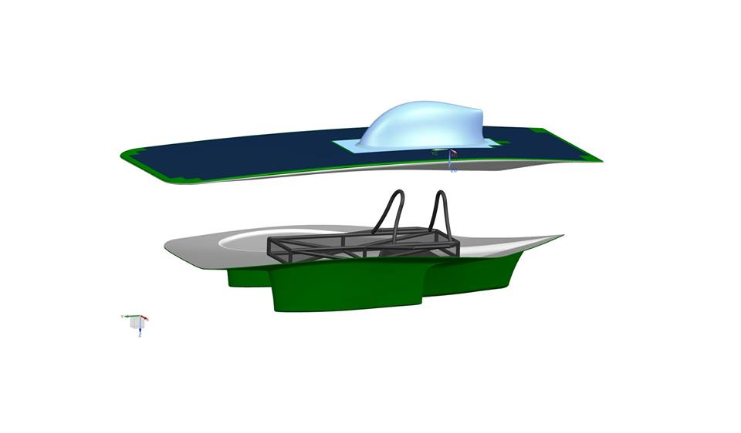
Introduction
Design, Build, Test, and Race a Solar Car
American Solar Challenge
  1600 Mile Race
30 College Teams from several different Countries

Slide 4
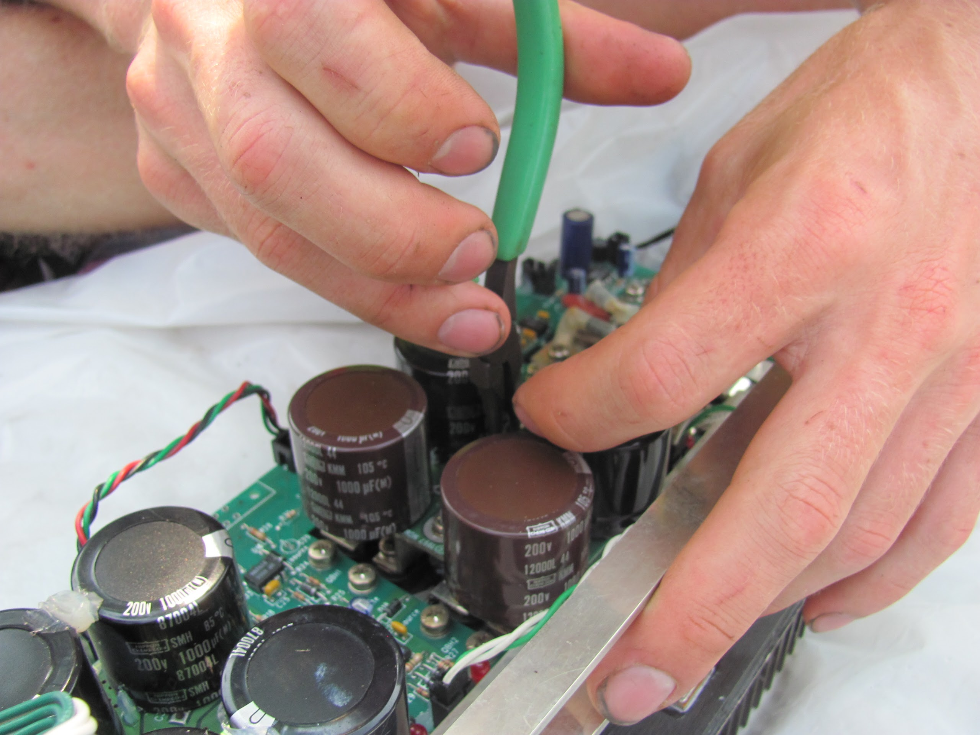

Slide 5
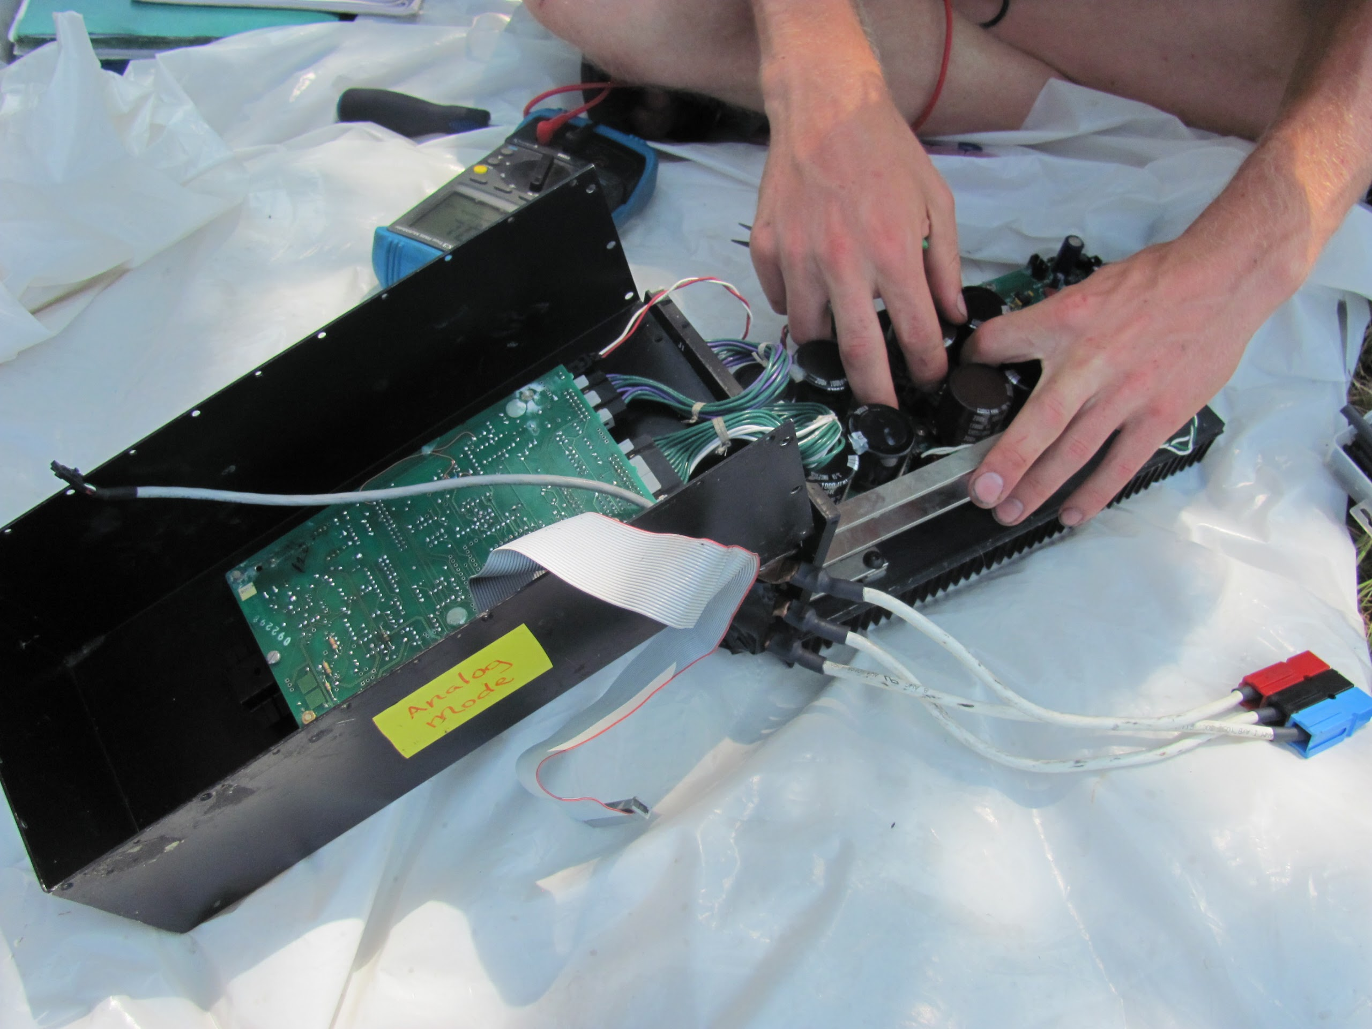

Slide 6



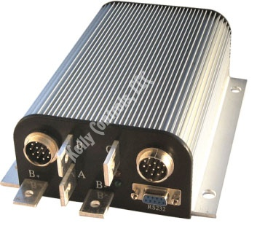
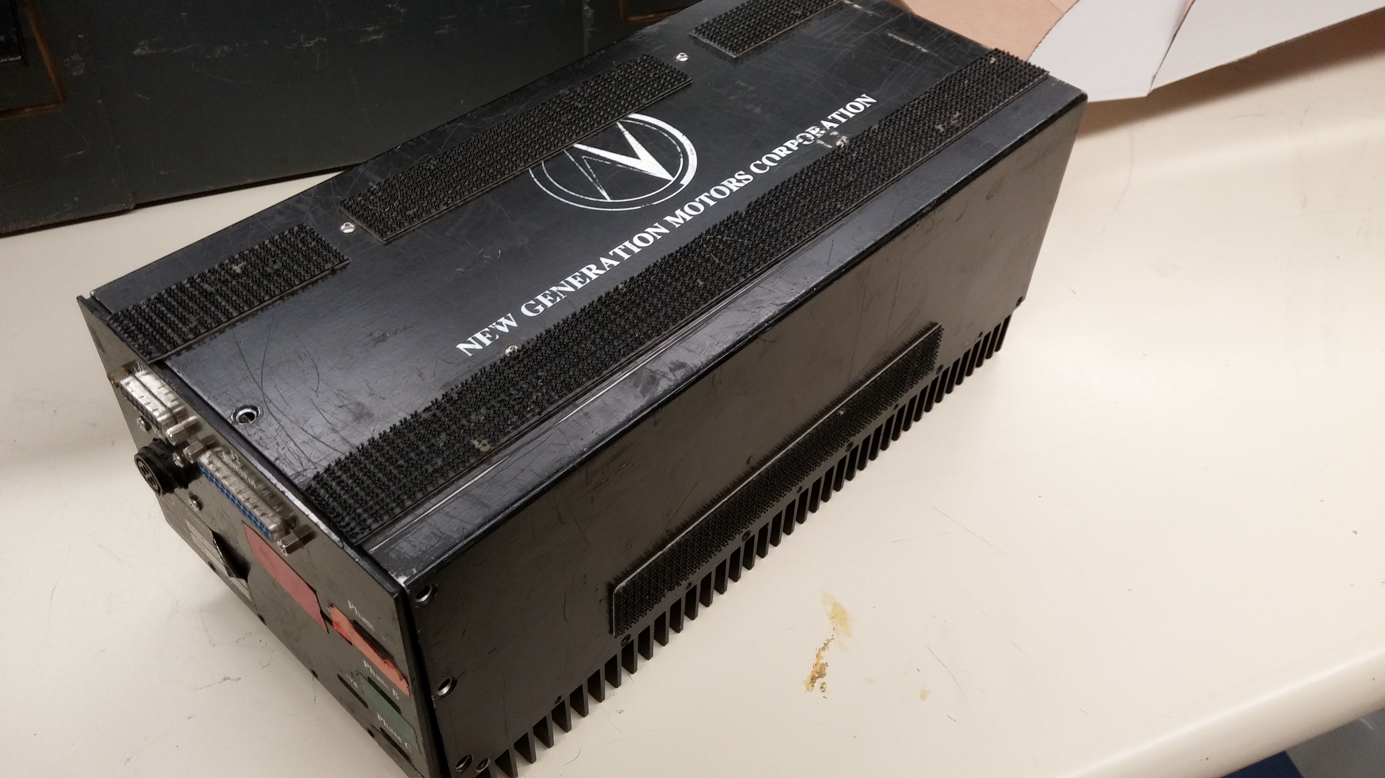
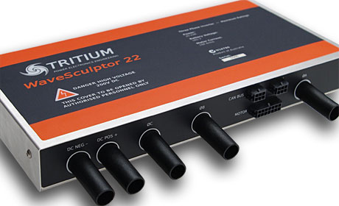
Background

Slide 7
Objectives
Spin Motor
Reliability
Modularity
90% Efficiency

Slide 8
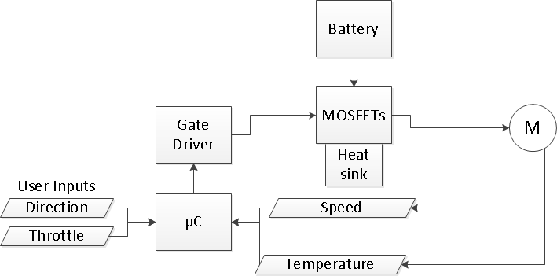
Block Diagram

Slide 9
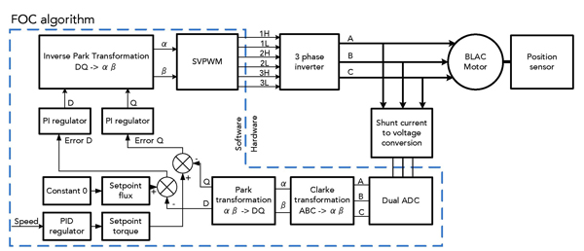
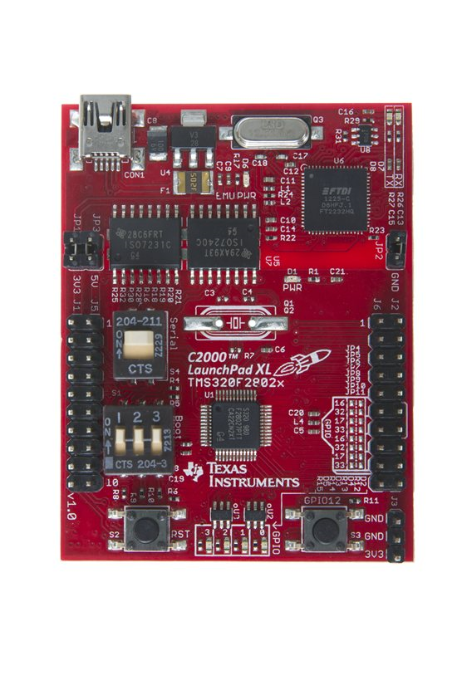
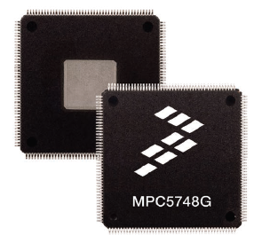


Microcontroller and DSP
The Freescale S12ZVM included gate drivers on chip.
The MPC5748G provided powerful options and control but offered little in the way of support.
The TI c2000 is not as powerful but comes with software and support.

Slide 10
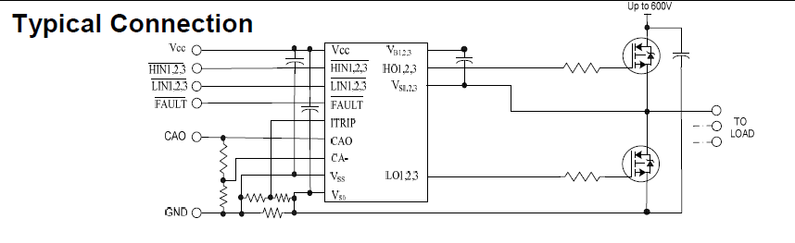
Gate Drivers
Function- Supply current and voltage to turn on MOSFET’s
Vgs 10 to 15 voltage
Low Source Resistance
Floating Output
Opto-Isolation
Low Internal Power Usage
Protection Logic and Circuitry

Slide 11
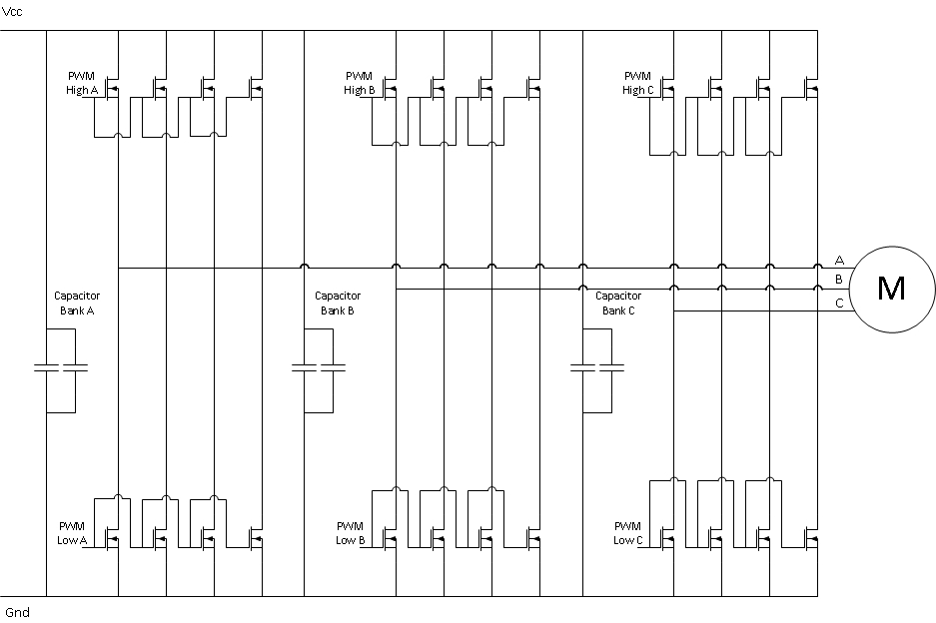
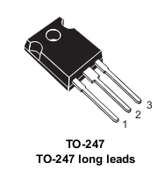
MOSFETs
Stmicroelectronics
High Drain to Source Break-down Voltage
  V_{DSS} = 650V
High Drain Current
  I_{DSS} @ 25°C = 84A
  I_{DSS} @ 100°C = 50.5A
Low on Resistance
  R_{ds(on)} = 0.024Ω (V_{GS} = 10V, I_{D} = 42A)

Slide 12
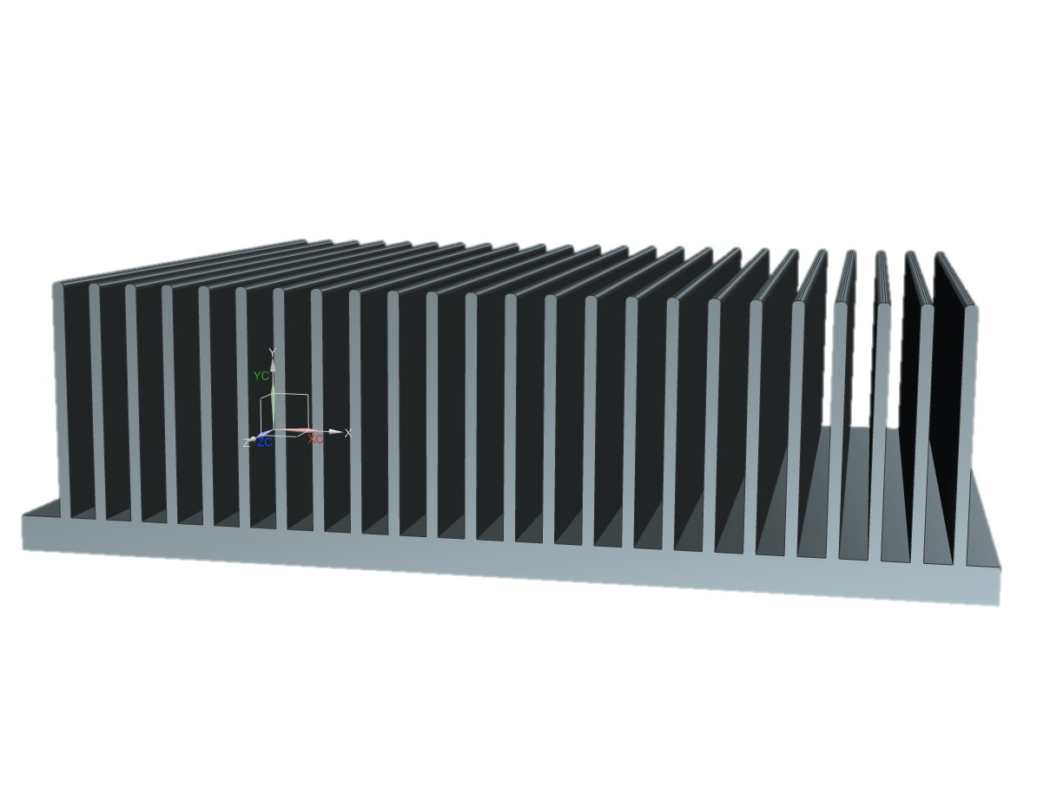
Heat Sink
Extruded Aluminum
0.3°C/W thermal resistance

Slide 13
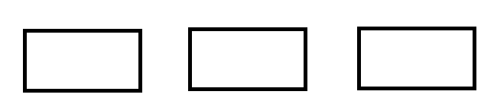
Interface
Dual Potentiometer Input
  Brake
  Throttle
Logic level converter
  Hall effect sensors
User
Motor
Controller
Motor

Slide 14
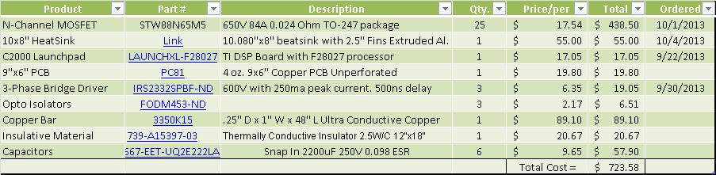


Budget

Slide 15
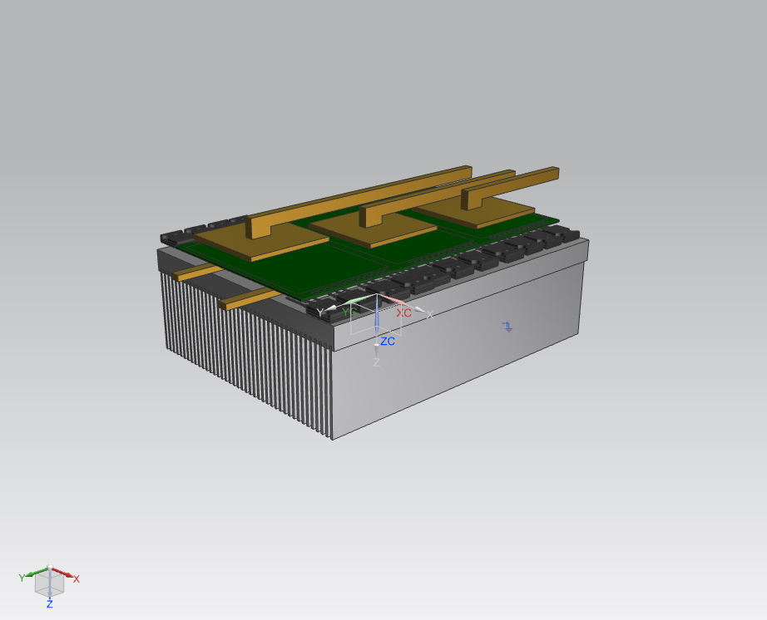

Slide 16
Future Additions
Power Monitoring
CAN Network
Sensorless Control Capabilities

Slide 17

Thank You

