Slide 1



MOSFET SELECTION FOR A THREE PHASE INVERTER
Team 9
JR Alvarez, Matt Myers
Chris Sommer, Scott O’Connor

Slide 2
Table of Contents
MOSFETs Overview
Three Phase Inverter
Gate Capacitance
Switching Losses
Breakdown Voltage
On Resistance
Heat Dissipation
Insulation
Heat Sink
Package Type
Mounting

Slide 3
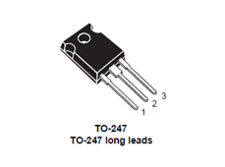
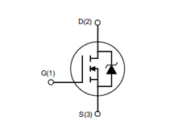
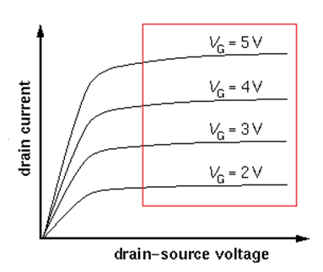
MOSFET Overview
Switching Device that acts as a voltage controlled current source.
A change in the gate to source voltage causes a change in the drain to source current.
To increase the current MOSFETs can be put in parallel.

Slide 4
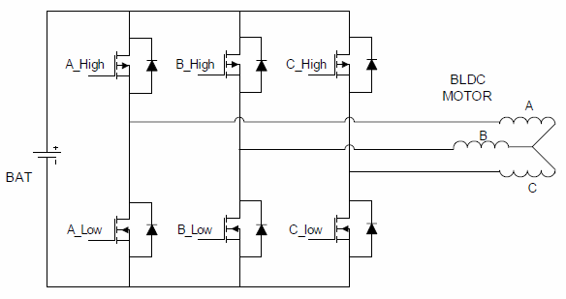
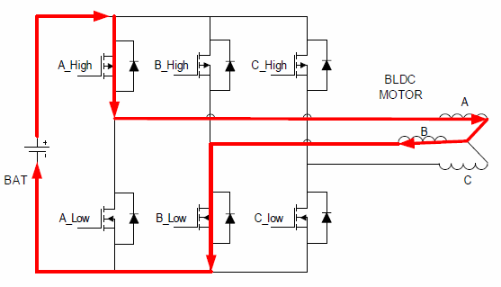
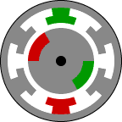
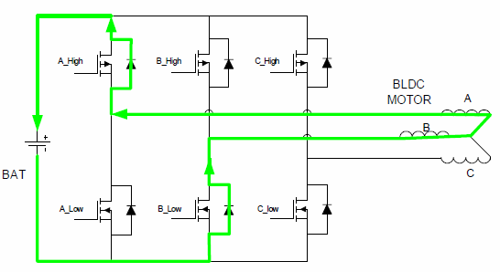
Three Phase Inverter
This configuration of MOSFETS allows the conversion of DC voltage to a 3-phase AC voltage

Slide 5
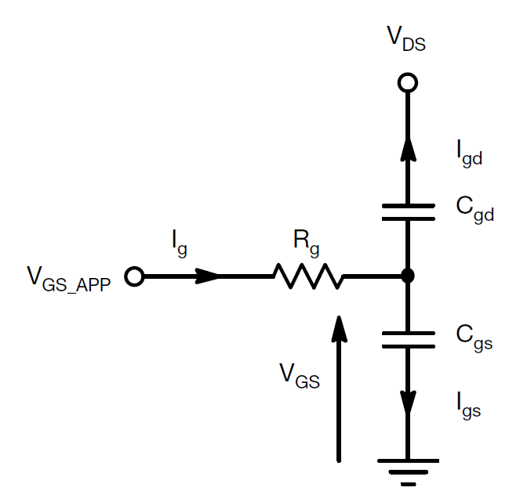
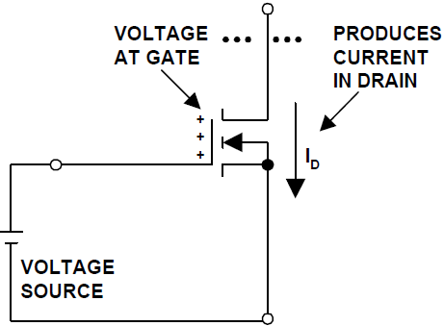
Gate Capacitance
V_{GS} - Gate to Source Capacitance
V_{DS} - Gate to Drain Capacitance

Slide 6

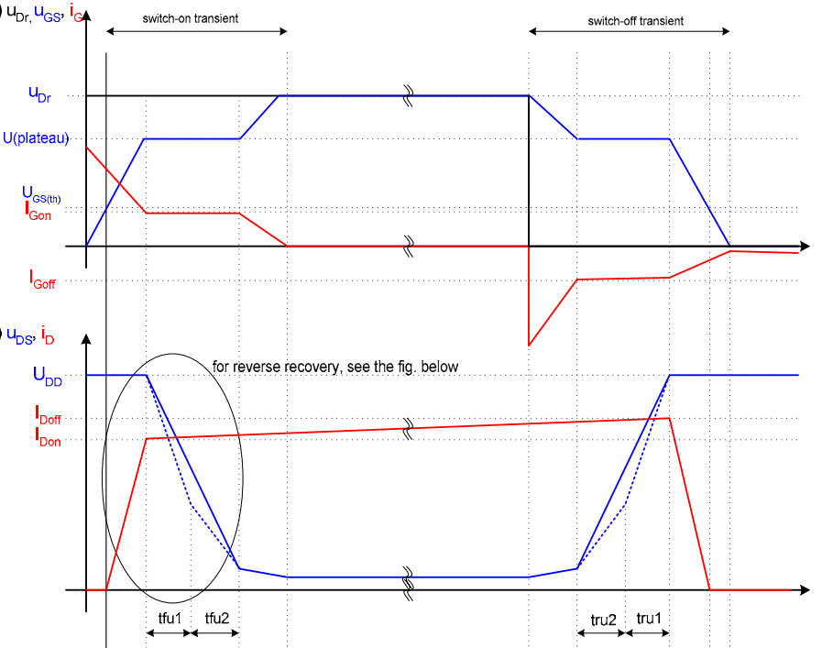
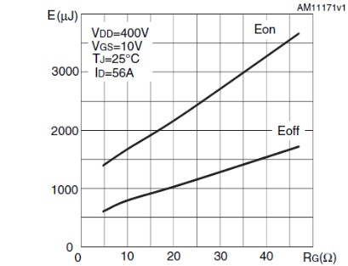
Switching Losses
Caused by the parasitic capacitance

Slide 7
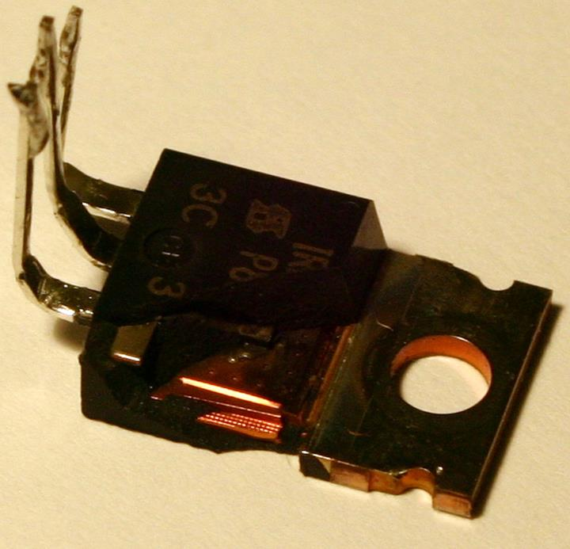
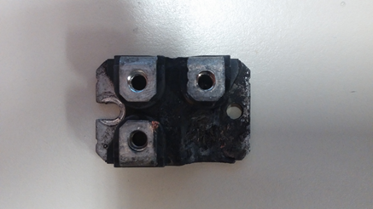
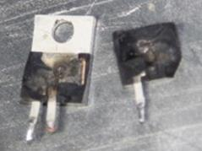
Drain to Source Breakdown Voltage
This specification is gives the maximum drain to source voltage a MOSFET can handle

Slide 8
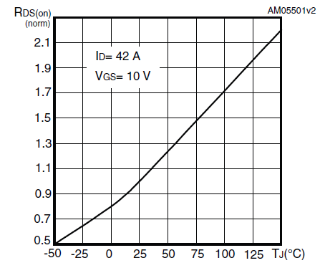
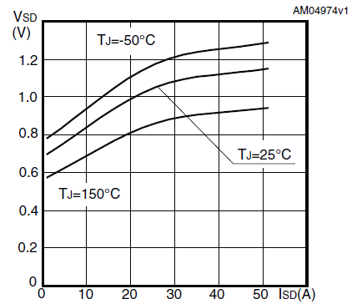
On Resistance
Effects efficiency
Temperature Dependent

Slide 9
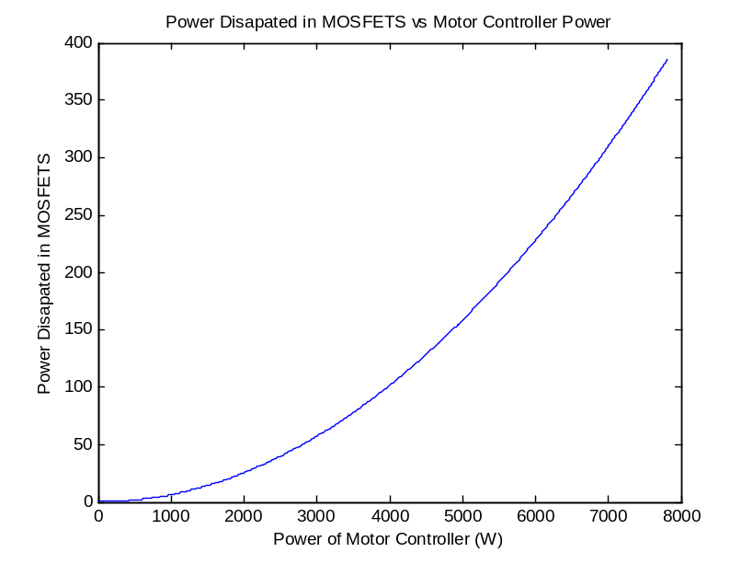
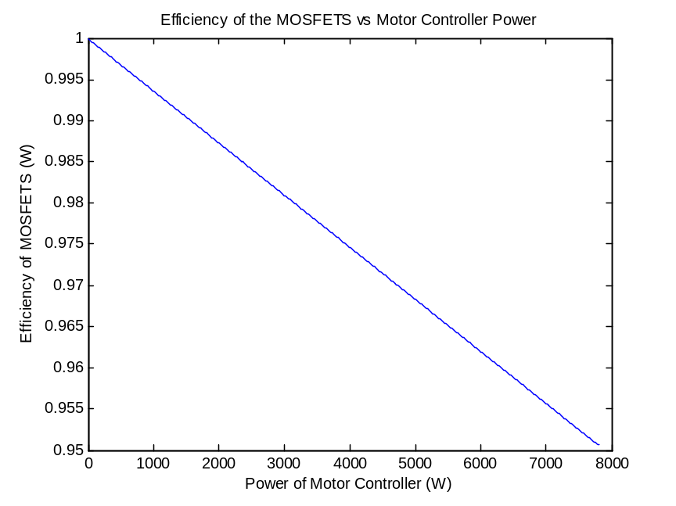
Heat Dissipation and Efficiency
Matlab analysis of power losses
Gives efficiency at different power outputs.
The Power Consumed by the motor controller varies with the square of the current and drain to source resistance.

Slide 10
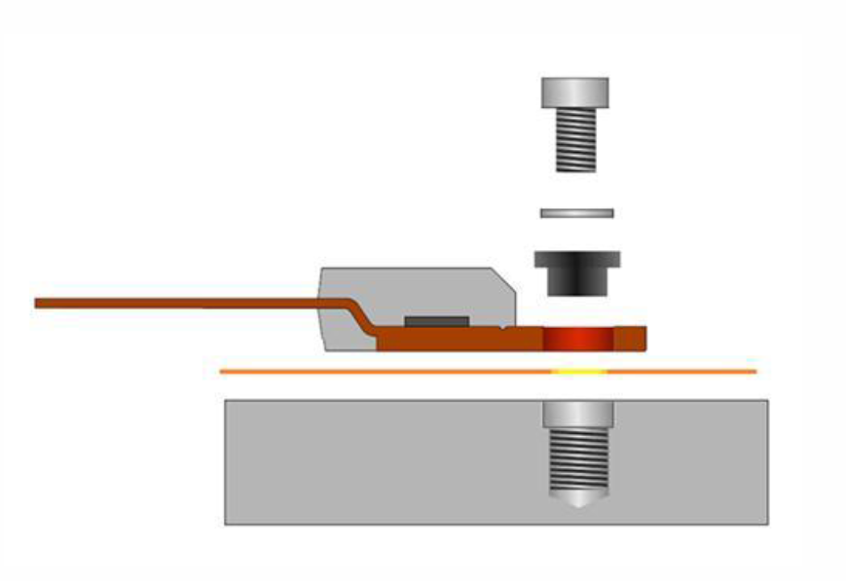
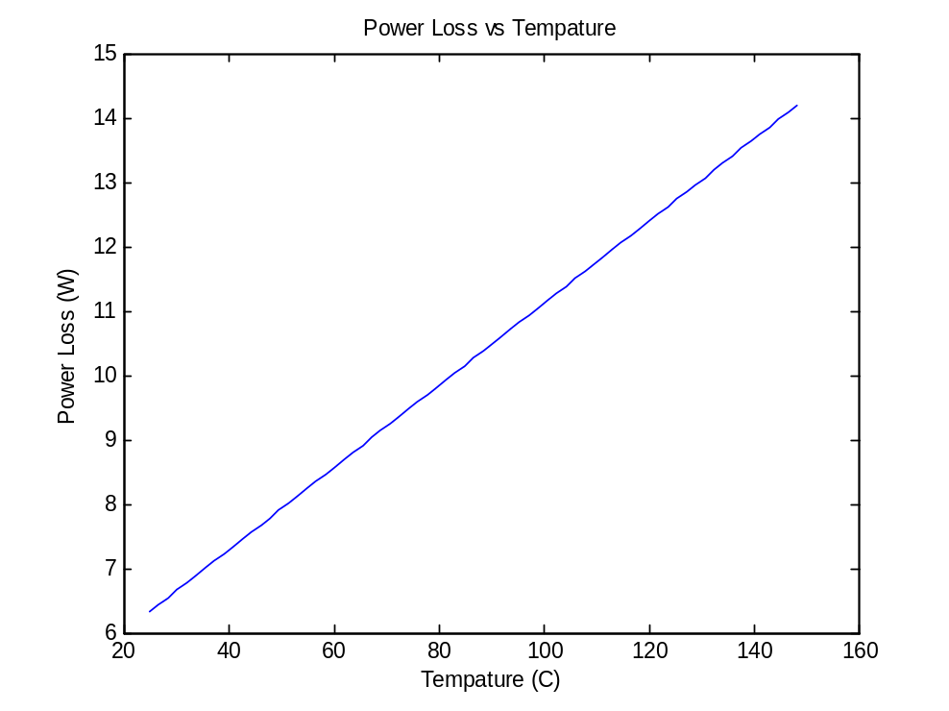
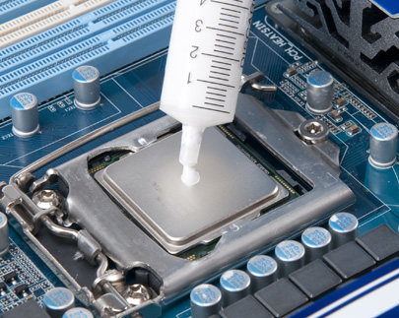
Insulation
Insulation needed to avoid undesired short circuits.
Thermally conducting
Electrical insulating
Pad vs. Grease

Slide 11
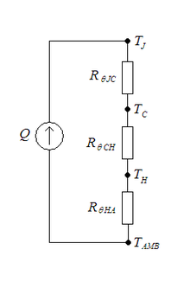
Thermal Properties and Heat Sink
R_{theta_jc} = .28, R_{theta_ja} = 50, R_{theta_cs} = 1
Temperature Difference / Power Dissipated = desired R_{theta}
Max Current^2*R_{don} = Desired power
For our heat sink this gives
125 C / 64 Watts = 1.93 C/W
1.93 – 1.28 = .65 C/W
Our heat sink < .65 C/W

Slide 12
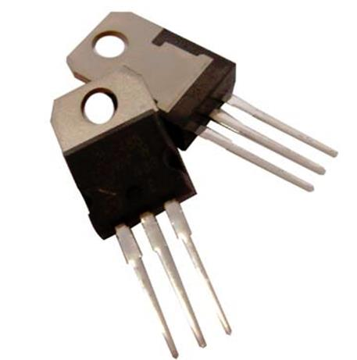
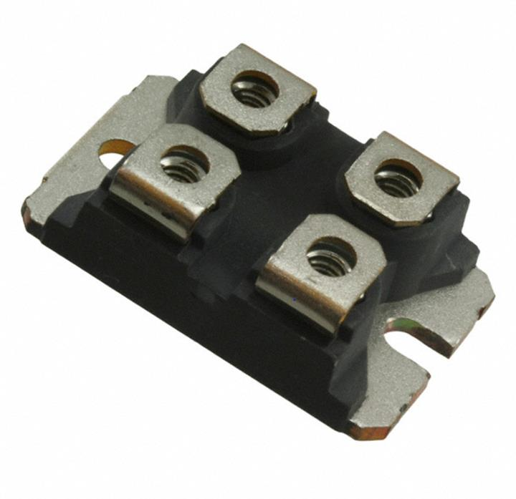
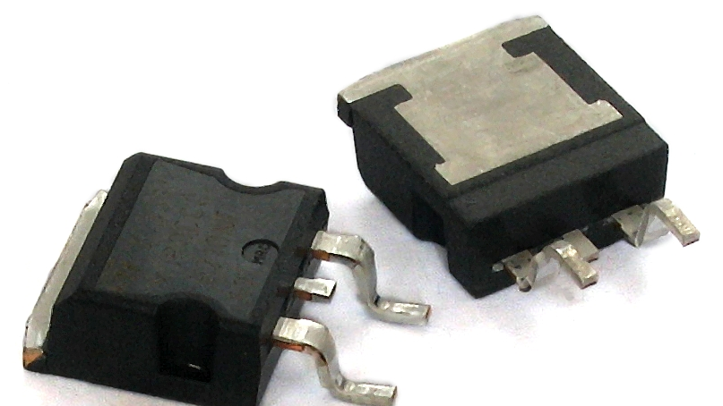
Package Type
Three common package types for MOSFETs
PCB
Power Electronics
Lower Powered Surface Mount
TO-247
SOT-227
D2PAK

Slide 13
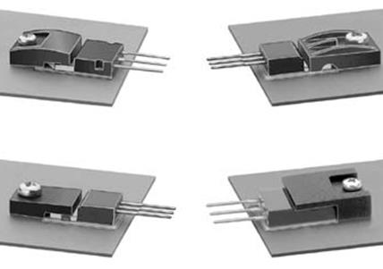
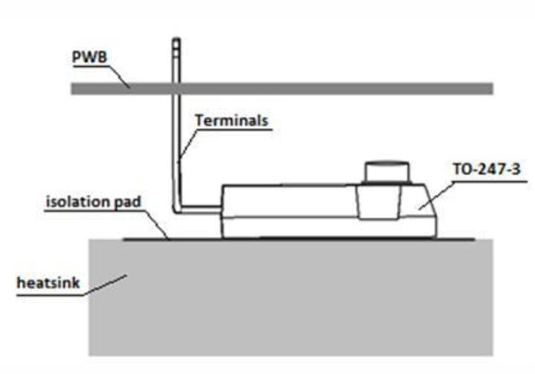
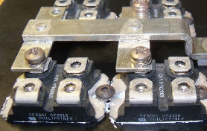
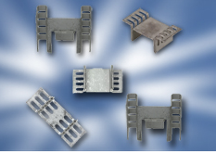
Mounting
Clipping
Screw Holes
Personal Heat Sink

Slide 14
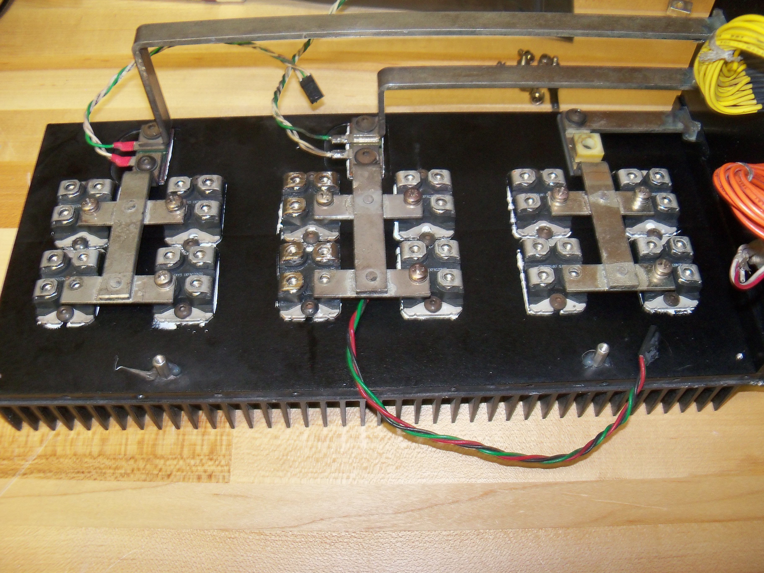
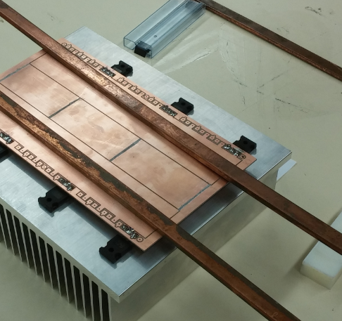
MOSFET comparison
Parameters | IXFN 120N20 |  | STW88N65M5
 | Single | 2 in parallel | Single | 4 in parallel
Break-down V_{DS} | 200 V | 200 V | 710 V | 710 V
On resistance | 17 mΩ | 8.5 mΩ | 29 mΩ | 7.25 mΩ
Drain current I_{D} | 120 A | 240 A | 84 A | 336 A
Thermal resistance | 0.22 °C/W | 0.22 °C/W | 0.28 °C/W | 0.28 °C/W
Gate-Source Capacitance | 5 nF | 2.5nF | 5.1 nF | 1.275 nF
Gate-Drain Capacitance | 16 nF | 8 nF | 8.4 nF | 2.1 nF

Slide 15

Thank You
Questions?

