Slide 1
Digital Image Processing
ECE 480 Technical Lecture
Team 4
Bryan Blancke
Mark Heller
Jeremy Martin
Daniel Kim

Slide 2
Background
What is digital image processing?
Modification of digital data for improving the image qualities with the aid of computer
Improvement of pictorial information for human interpretation
The processing helps in maximising clarity, sharpness and details of features of interest towards information extraction and further analysis. i.e. edge detection, removal of noise.

Slide 3
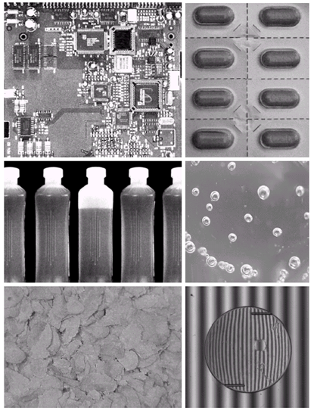
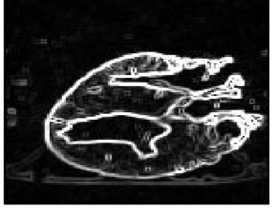
Applications
Image enhancement & restoration
Medical visualisation
Law enforcement
Industrial inspection
Artistic effects
Human computer interfaces

Slide 4
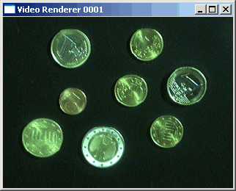
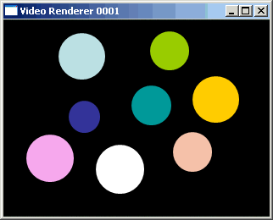

Segmentation
Segmentation is to subdivide an image into its component regions or objects.
No single segmentation technique is perfect

Slide 5
Segmentation (continued)
There are two most common types of segmentation
techniques:
1)Thresholding
2)Edge detection

Slide 6
Edge Detection
Motivation for edge detection.
Produce a line drawing of a scene from an image of that scene.
Important features can be extracted from the edges of an image (ex: corners,lines, curves).
These features are used by higher-level computer vision algorithms (ex: recognition).

Slide 7
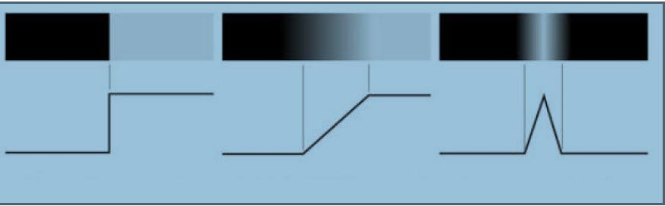
Edge Detection (continued)
Edge Models: can be modeled according to their intensity profiles
a)Step Edge b) Ramp Edge c) Roof Edge

Slide 8
Edge Detection (continued)
There are four steps for edge detection:
1) Smoothing: Remove noise as much as possible.
2) Enhancement: Apply a filter to enhance the quality of edges in the original image (ex: sharpening,contrast)
3) Detection: Determine which edge pixels should be thrown
as a noise or retained for edge detection.
4) Localization: Identify the location of an edge.

Slide 9
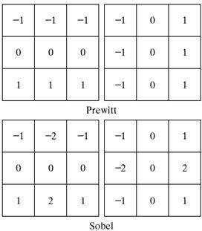
Detection Methods - Prewitt vs. Sobel
Edge detection filters
Only difference is the coefficient.
Sobel has better noise suppression
Both fail when exposed to high
level of noise (laplacian operator for a
better solution)

Slide 10
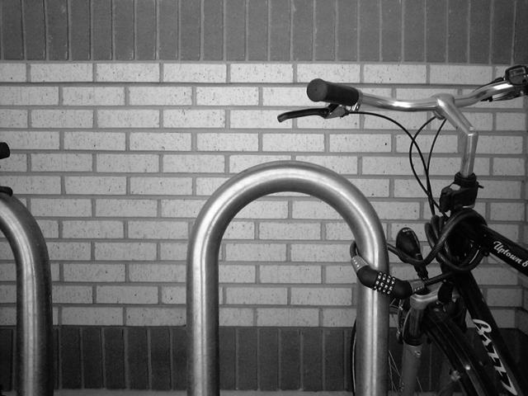
Example

Slide 11
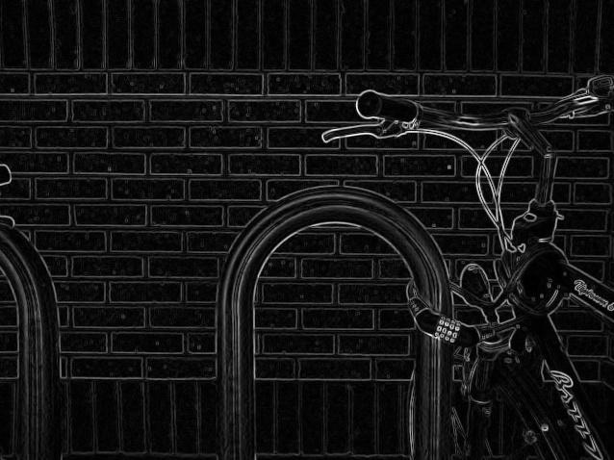
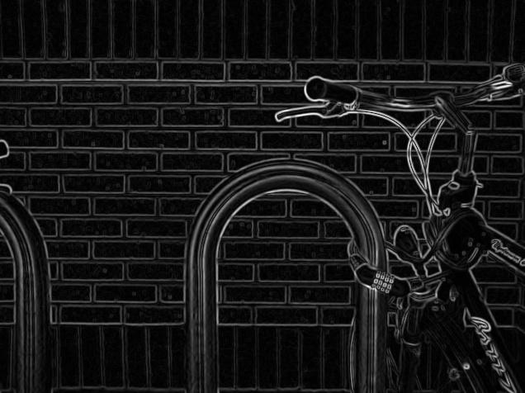
Example - Prewitt vs Sobel
Prewitt Sobel

Slide 12
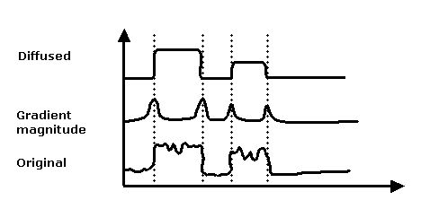
Anisotropic diffusion
Used to remove noise from images without removing critical parts of the image
Noise exists in images and is created from outside signals such as radio waves and light exposure

Slide 13


Diffused vs. Original Image

Slide 14
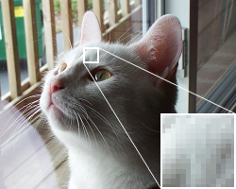
Pixelation and Antialiasing
Pixelation occurs when a section of a high-resolution is displayed and the single-colored square elements become visible
To solve this problem, antialiasing is used

Slide 15
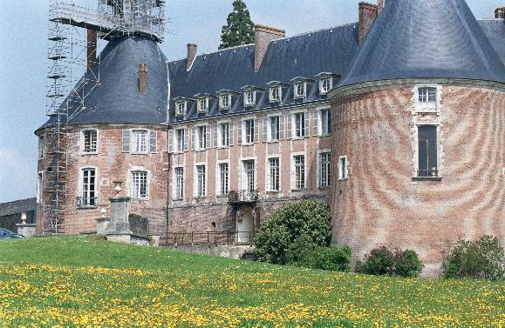
Antialiasing
Aliasing is an effect that will cause signals to be indistinguishable (cannot be reconstructed). What does antialiasing mean?
Antialiasing is the minimization of distortion and a small-scale reconstruction of a part of an image

Slide 16
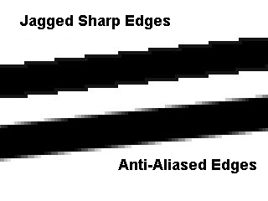
Pixel Interpolation
A type of antialiasing, pixel interpolation will occur when zoomed on a specific piece of an image
Pixel interpolation smoothly blends the color of one pixel into the next

Slide 17
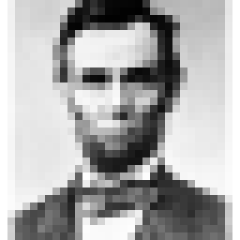
Pixelization
Occasionally, pixelation can be beneficial. The act of intentional pixelation is called pixelization.
Pixelization will essentially reverse interpolate the pixels, and enlarge them to create a jagged image.
Useful for obscenities and anonymity

Slide 18
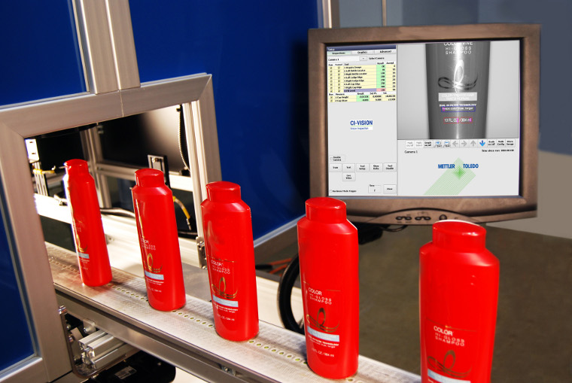
Computer Vision
Vision Systems and Image Processing
Manufacturing Facilities
  Increases Speed of Production
  Automates Inspection of Products

Slide 19
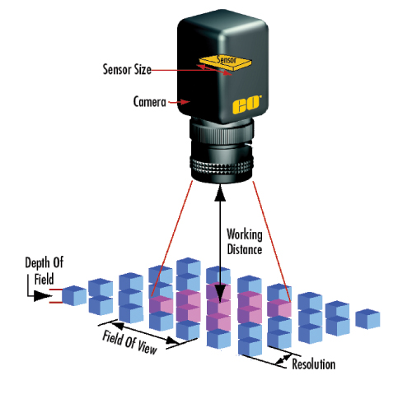
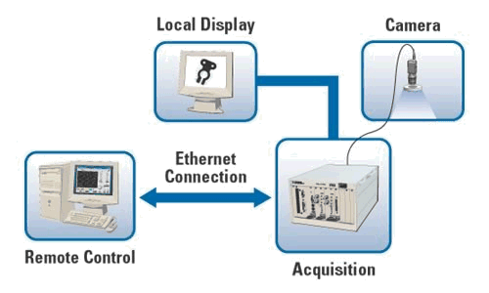
Methods of Vision Systems
Image Acquisition
Image Pre-processing
Feature Extraction
Detection/Segmentation
High-Level Processing
Decision Making

Slide 20
Methods of Vision Systems
Image Acquisition
Image Pre-processing
Feature Extraction
Detection/Segmentation
High-Level Processing
Decision Making

Slide 21
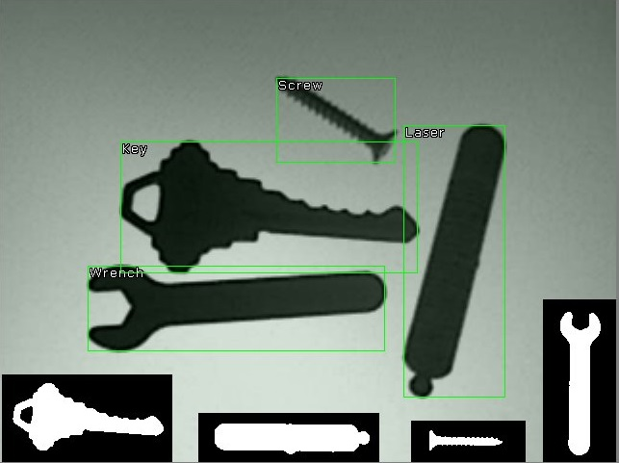
Object Identification
Differentiate Between Classes of Objects
Sort Objects

Slide 22
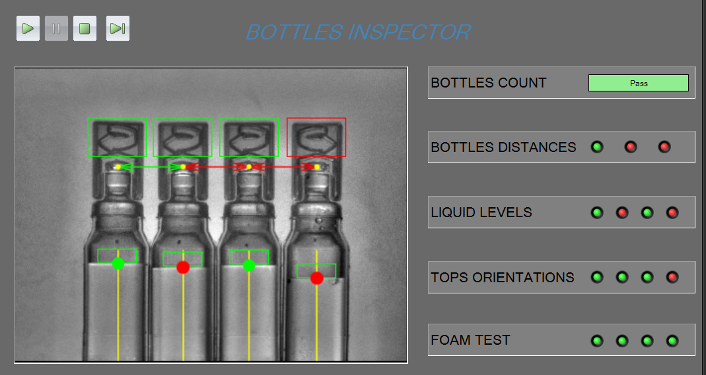
Fault Detection
Image Data Scanned for Pre-determined Conditions

Slide 23
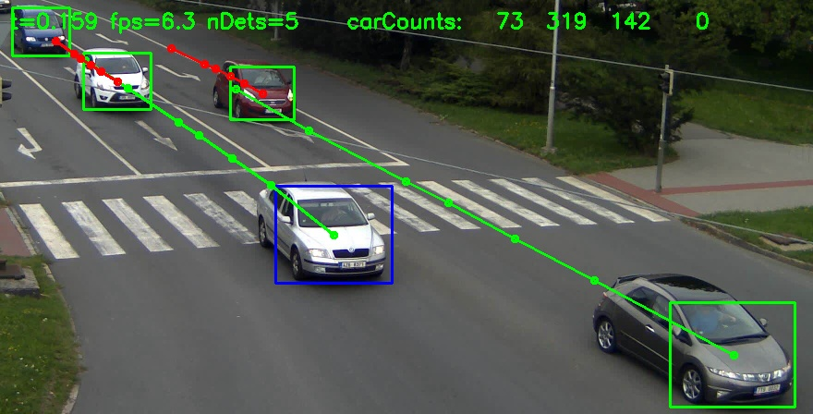
Object Tracking
Determine Relative Position of Objects

Slide 24
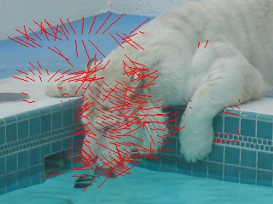
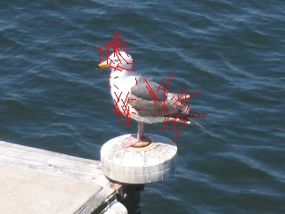
Optical Flow
Assumes Stationary Camera System
Estimates Motion and Acceleration of Objects
Motion Displayed as Vectors

Slide 25
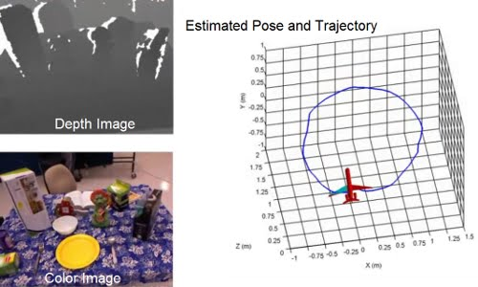
Egomotion
Motion Estimation of Camera System
Determines Position Relative to Surroundings
Creates 3D Computer Model of Observed Space

Slide 26
Digital Image Processing Tasks
Digital image processing is the only practical technology for:
Statistical Classification
Feature Extraction
Graphical Projection
Pattern Recognition

Slide 27
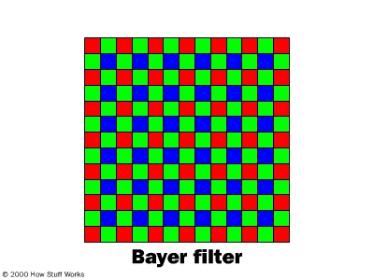
Statistical Classification
Identifying which set of sub categories new observations belong too based on sets of data whose category membership is known
Explanatory Variables: Individual observations are analyzed into quantifiable properties
Categories, ordinal, integer, or real value.
Example: Digital Camera Color Array Filtering
  Bayer Filter is put over the cameras
  phosphate layer
  Interpolation: Processor guesses colors of
  each pixel based on nearby information

Slide 28
Feature Extraction
Involves simplifying the amount of resources required to describe a large set of data accurately
Reduces processing by eliminating redundant and unnecessary data
It is expected that feature sets will extract relevant information from input data to perform the desired task
Uses in image processing
Edge Detection
  Points where image brightness changes sharply
Curvature edge direction
  Cross-correlation of image between time lag
Motion Detection
  Change of position relative to surroundings
Thresholding
  Forms greyscale images
Hough Transform
  Detects lines to estimate text

Slide 29
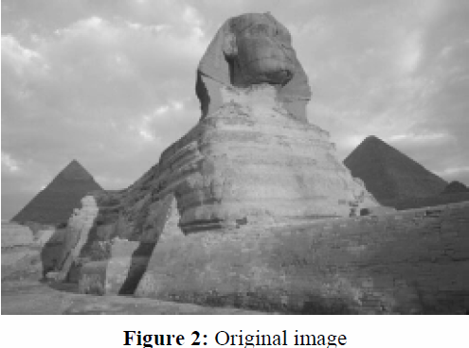
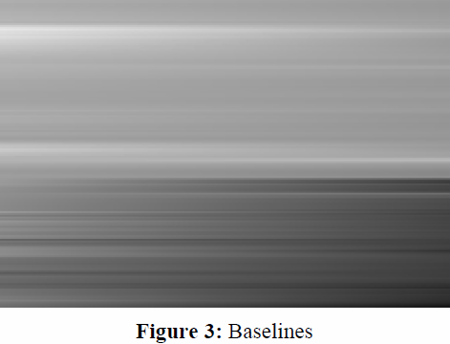
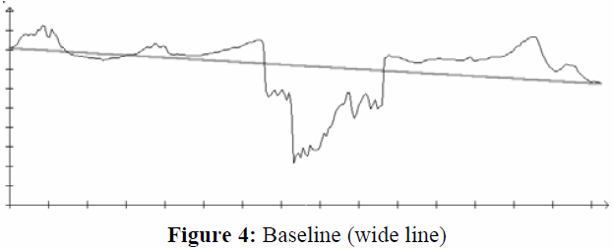


Graphical Projection
Process of projecting a three dimensional object onto a planar surface with mathematical computation
Converts complex 3D objects into a 2D equivalent
  Computations involve Fourier Transforms and Hermite Functions

Slide 30

Pattern Recognition
Which features distinguish objects from others?
  Algorithms classify objects or clusters of an image
Applications
  Face Recognition
  Fingerprint Identification
  Document Image Analysis
  3D Object Recognition
  Robot Navigation

Slide 31
Questions?

