Slide 1
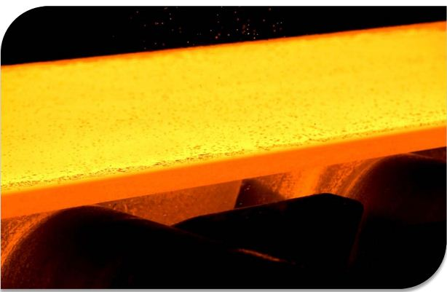


ECE 480 – Hot Strip Centerline Tracking
Team 4
Bryan Blancke
Mark Heller
Jeremy Martin
Daniel Kim
Facilitator:
Dr. Aviyente
Sponsor:
ArcelorMittal
Source: SMS

Slide 2
Outline
Problem Statement
Background
Design Specification
Conceptual Design
Final Design
Team Roles
Budget

Slide 3
Problem Statement
Centerline Tracking in the Hot Strip mill
  What is the hot strip mill?
  Why track centerline?
  What is cambering?
  What issues can this cause?

Slide 4
Background
Material Slab
Thickness: 8-10 inches, 9.9 inches average.
Width: 26-72 inches
Length: 110-383 inches
Weight: 10-40tons
Product: Hot Coil
Thickness: 0.06-0.5 inches
Width: 25-75 inches
Inside Diameter: 30 inches
Outside Diameter: 80 inches

Slide 5
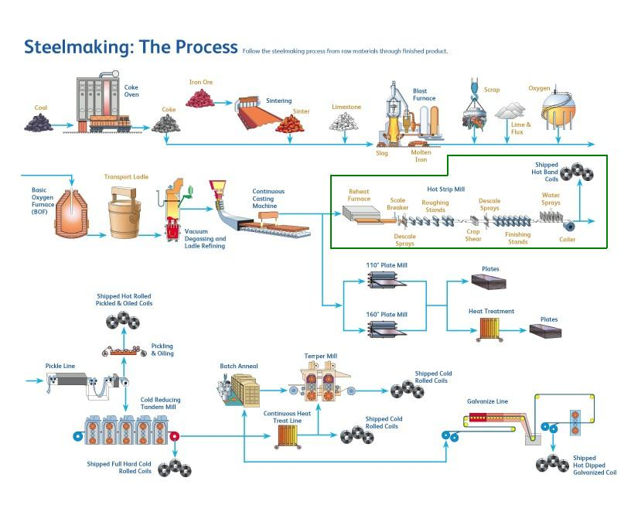
Background

Slide 6
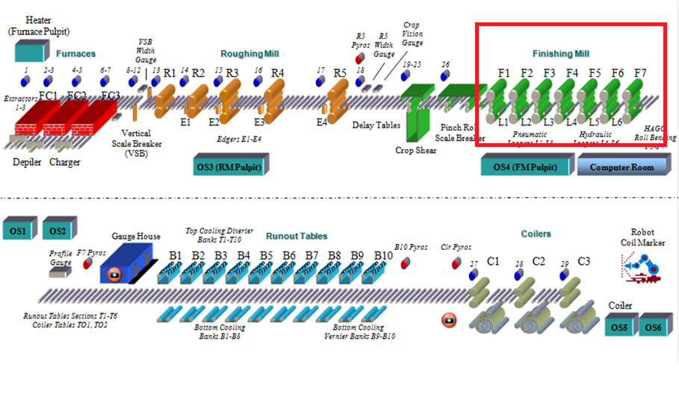
Courtesy of ArcelorMittal

Slide 7
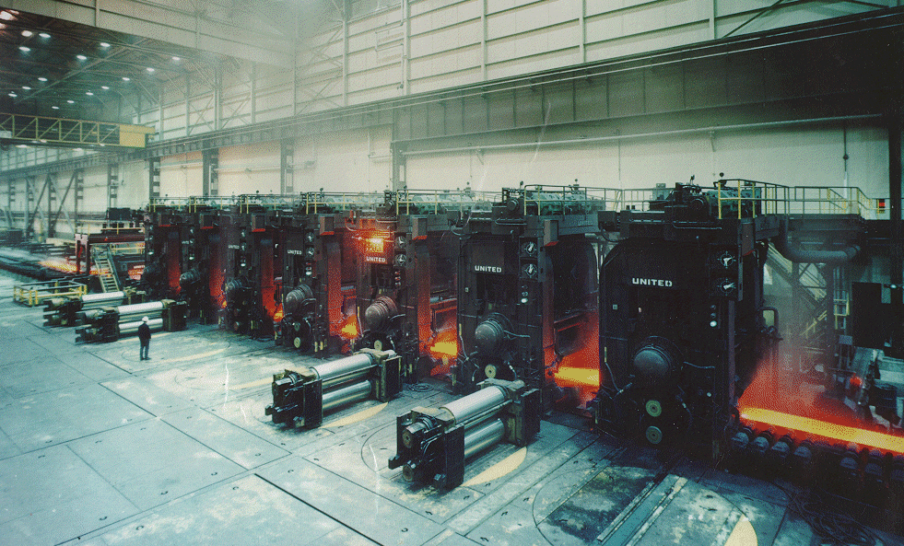
Finishing Mill Courtesy of ArcelorMittal

Slide 8
Design Specification
  High Resistance to Heat (2300◦F)
  High Resistance to Debris (scale)
  Waterproof
  Data processing at 50 Hz
  540p resolution
  Image capture from an 8 meter distance

Slide 9
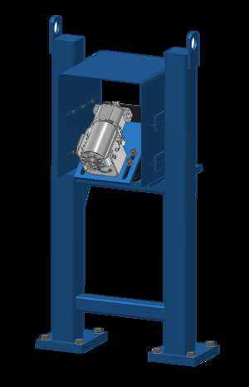
Conceptual Design 1
Centerline Tracking Production Monitor
A camera mounted 6-8 meters above the stand.
Records the metal strip and captures the image of the
camber.
Cost: $130,000.00
European Company: EMG Automation
Strengths | Weaknesses
Ideal solution | Expensive
 | No innovation

Slide 10
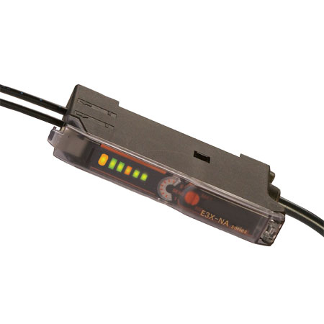
Conceptual Design 2
Fiber Optic Laser Sensor
Multiple lasers detecting each edge of steel strip
As strip moves, different sensors trip
Gives a visual representation of the strip
Data is approximate, not very
accurate
Strengths | Weaknesses
 | Low resolution
 | High risk Requires mechanical adjustments Might not detect through steam

Slide 11
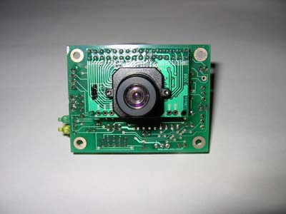
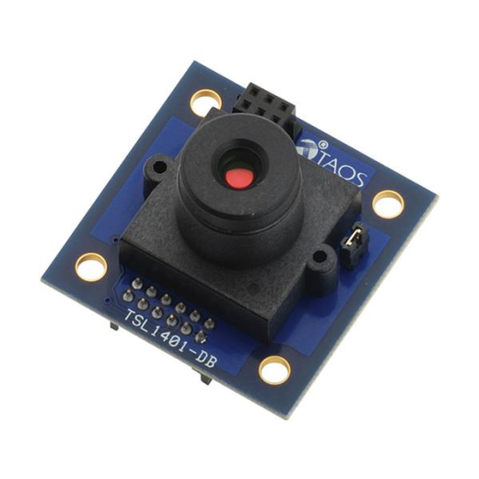
Conceptual Design 3
Low-power Micro-cameras
Initially a consideration due to the ease of integration with a microcontroller
Lower capture speeds, less accurate data
Instead, we used a more powerful microcontroller in order to utilize a regular 1080p 30fps camera
Strengths | Weaknesses
Fast processing | Low resolution
price | Low heat tolerance

Slide 12
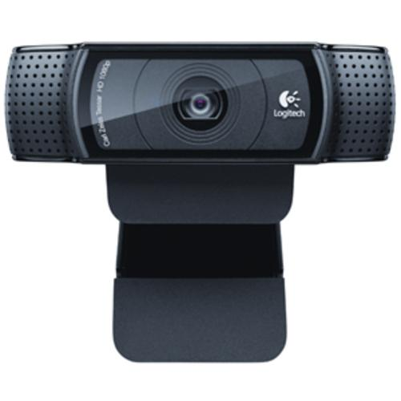
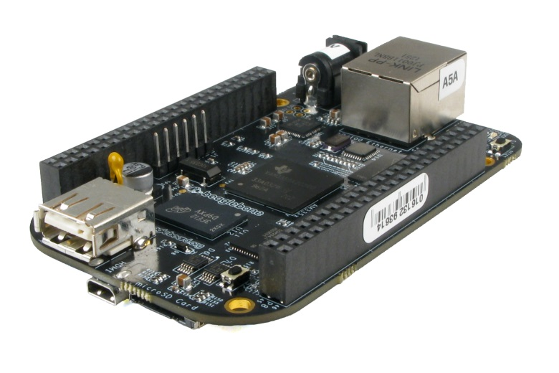
Final Design
Camera attached via USB to a Beaglebone Black Microcontroller
Captures images of position of strip
Use OpenCV to detect and compare strip edges
Output images and position data to a display screen

Slide 13
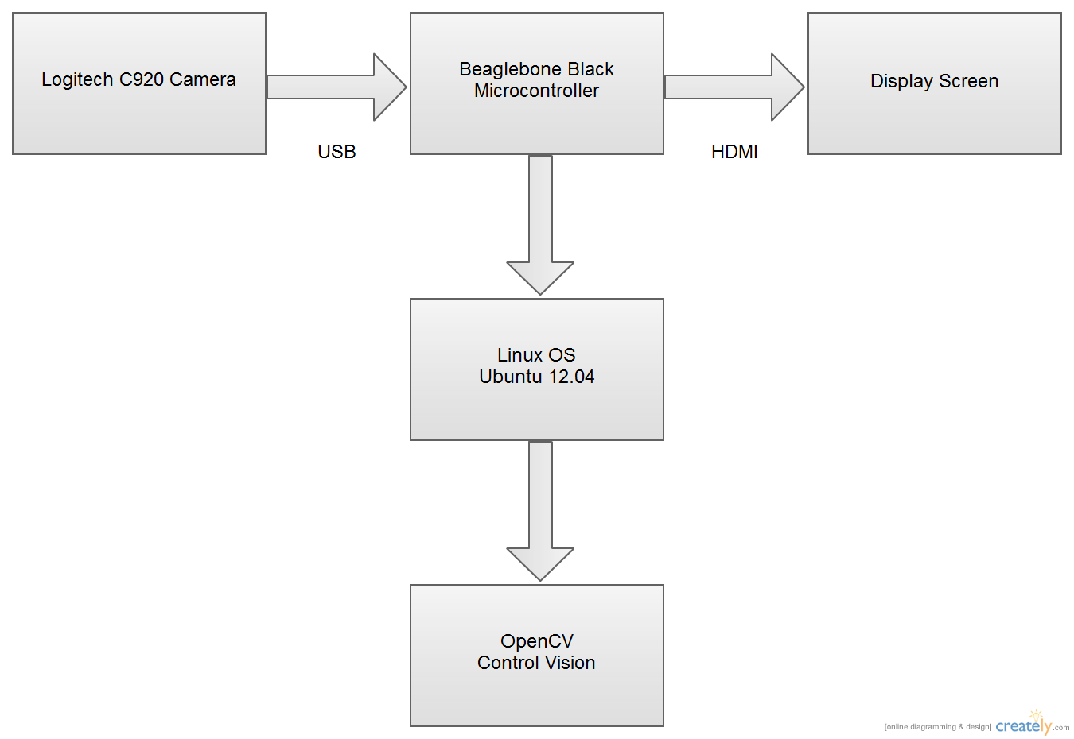
Block Diagram

Slide 14
Raspberry Pi vs. Beaglebone
Raspberry Pi | Beaglebone
More resources available | Easier set up
1080p display capability | Faster clock speed
 | More available connections
But why not Arduino?
Image processing requires heavy processing power which Arduino cannot provide within the scope of this project.

Slide 15
Issues
With the given budget, taking images and processing them at 50 fps is unfeasible.
Current cameras generally have a maximum of 30 fps.
The microcontroller might not be able to process the information as fast as the pictures are being captured.
We may have to sample the data at lower frequencies in order for our controller to be able to process the data.

Slide 16
Budget
Beaglebone Black - $45
Logitech C920 Camera - $75
HDMI cable - $7
Ethernet cable - $7
5V 2.5A power supply - $10
Beaglebone casing - $20
Demonstration bench materials - $50
Total - $214

Slide 17
Project Management
Team Roles
Bryan Blancke
Non-Technical: Team Management
Technical: Demonstration Bench
Mark Heller
Non-Technical: Document Preparation
Technical: Functionality Testing
Jeremy Martin
Non-Technical: Web Designer
Technical: Software Integration
Daniel Kim
Non-Technical: Presentation Preparation
Technical: Hardware Specialist

Slide 18
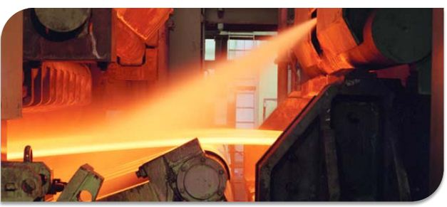
Questions?

