Slide 1
Technical Communications
Written Reports-
Full Proposal
Final Project Report
Professional Self-Assessment
Oral Presentations
Engineering Design Review
Proposal
Final presentations

Slide 2
Oral Presentation for Engineers
SUCCESSFUL PRESENTATION =
Good Content
+ Visuals
+ Practice
(lot of hard work
& good results)

Slide 3
Success Factors
Know your audience
You are the expert -- speak from experience
Think about the level of detail and how much will be remembered?
Think about the logical flow of the presentation: organize slides appropriately
Use good visuals, animations,
Don’t memorize - PRACTICE
Don’t read slides - PRACTICE

Slide 4
Preparing Content
Plan what you must cover to communicate ideas
Avoid using too many slides;
> 1 slide/1-2 minutes.
Use bullet items as prompts
Don’t write full paragraphs
Use LARGE ENOUGH fonts

Slide 5
Preparing Content
-Visual Tools
Use simple visuals: block diagrams and flowcharts
Proper use of slide template, photos, text, charts, graphs, animations and movies
Clarity – don’t clutter slides with too much information
Label your axes in plots

Slide 6
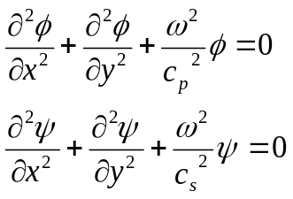
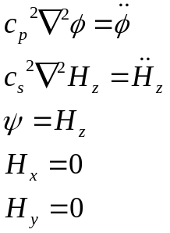
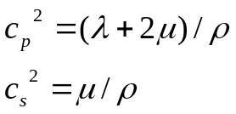
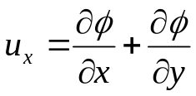
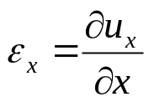
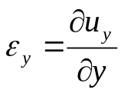
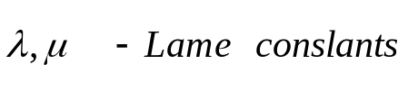
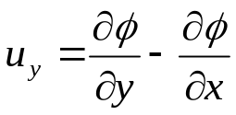
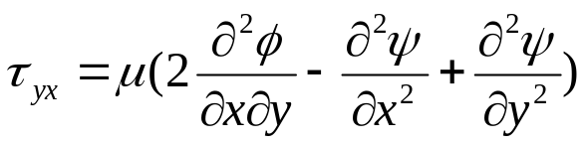
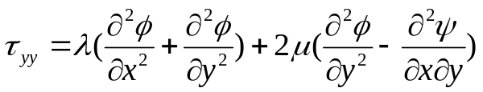

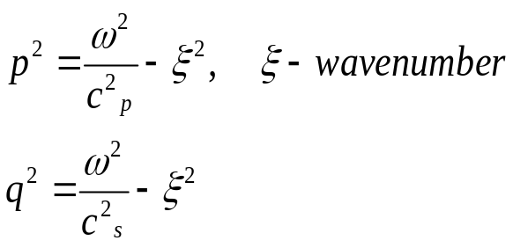
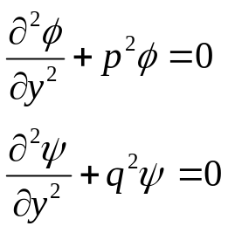
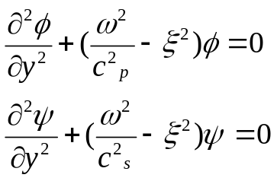
Lamb Waves
Lamb wave equations in terms of the two potentials
Material properties
Define displacement components
Results come from elasticity theory
Shear stresses
Consider harmonic wave propagation in the direction x

Slide 7
Preparing Content
– Support slides
Anticipate questions
Have some extra material “in reserve”
Handouts may have more detail

Slide 8
Delivery
Speak up, make eye contact
Do you believe what you’re saying?
Keep control: hecklers and distractions
Ask questions – and wait…
Look at people but beware of the magnet

Slide 9
Controlling Nerves
Who knows you’re nervous?
Holding your papers/notes
Use illustrations with which you are familiar
Practice, practice, practice

Slide 10
Remember Your Audience
Look at them
Respect them
Excite them
Listen to them
Thank them

Slide 11
Assignment -- Prep for Oral Presentation of Proposal
Prepare the PowerPoint material for the oral presentation of your proposal.
Each team will have 20 minutes.
Practice with teammates -- don’t just “discuss” it -- practice it! Give each other suggestions!
Everyone must talk an equal time (as practical).
Dry run for facilitator. Seek his/her critique.

Slide 12
Template for
Proposal Presentation
Title – Team# Team Members, Facilitator, Sponsor
Outline
  Introduction – Problem Statement
  Objectives
  Prior work by others
  Your Technical Approach – Block diagram
  Implementation Details
  Results
  Conclusions
  Issues, Limitations
  Suggestions for future work

