Slide 1
Introduction to
Project Management
ECE 480
Erik Goodman

Slide 2
What is Project Management?
a method for organizing tasks
a structured framework to help a group work productively
tools to aid in task sequencing, dependency analysis, resource allocation, scheduling, etc.
tools to track progress relative to plan

Slide 3
Why Need Project Management?
Complex project needs coordination of:
  Multiple people
  Multiple resources (labs, equipment, etc.)
  Multiple tasks – some must precede others
  Multiple decision points – approvals
  Phased expenditure of funds
  Matching of people/resources to tasks

Slide 4
Task Dependencies and the Critical Path
Sometimes task B cannot be started before task A is completed
Other types of constraints – calendar, lags, etc.
Critical path – any slippage slips whole project
Helpful to know what tasks are on the critical path
Useful to try to shorten the critical path

Slide 5
Suggested Steps in
Project Management
Generate a formal definition of the project, with goals, constraints, assumptions
Identify project start/end dates, any mandatory milestones, including reports, signoffs, deliverables, etc.
List constraints – money, equipment availability, holidays, etc.
Identify tasks to be accomplished – high level (i.e., by categories), then details within each, using brainstorming method – green light

Slide 6
Suggested Steps, cont.
Refine detailed task list, dropping/ combining, adding things omitted
Then, for each task in list:
Estimate time (person hours, calendar period)
Identify dependencies among tasks
Identify resources (people, money, parts, etc.)

Slide 7
Suggested Steps, cont.
Organize task groups roughly by starting date
List dependencies that should or MUST hold
Use MS Project to make a GANTT chart
First capture tasks and task groups, milestones
Identify critical path, see if it can be shortened (get more “slack”)
Assign person-hours and specific team member(s) to each task – identify “task leads”

Slide 8
Suggested Steps, cont.
As project progresses:
Monitor, record progress on all tasks, at least weekly – use “Tracking Gantt Chart”
Pay particular attention to those on critical path
Revise plan as needed to take into account changes, adapt to meet milestones

Slide 9
Project Management Using
Microsoft Project
Allows many different ways of entering and observing information
includes many features to help identify problems with a plan
regular use can help a group refine plans to make meeting targets more realistic

Slide 10
Our “Flyover” of Project 98
Adding tasks, durations
Setting dependencies
Seeing critical path, etc.
“Rolling up” subtasks
Assigning resources
Adjusting durations, time assignments, etc.

Slide 11
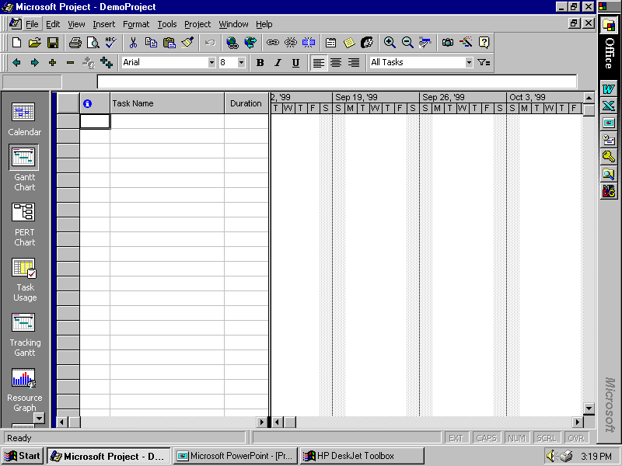

Slide 12
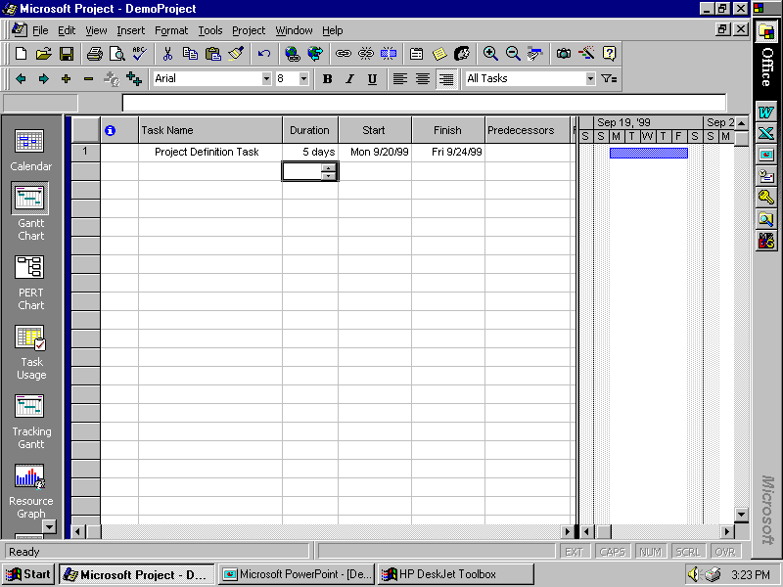

Slide 13
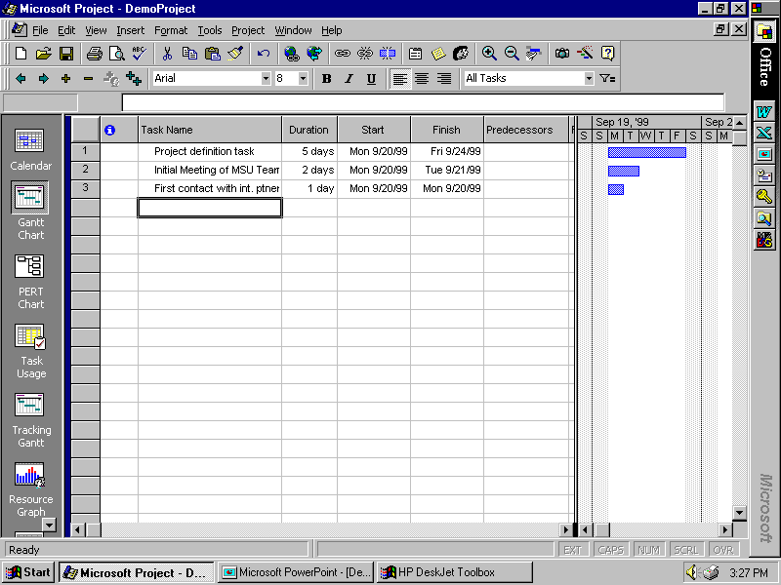

Slide 14
Our “Flyover” of Project 98
Adding tasks, durations
Setting dependencies
Seeing critical path, etc.
“Rolling up” subtasks
Assigning resources
Adjusting durations, time assignments, etc.

Slide 15
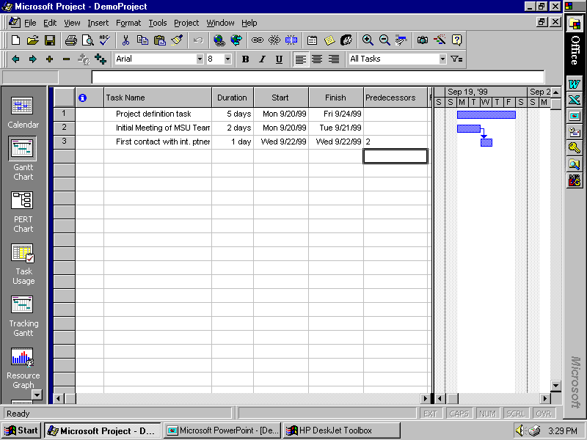

Slide 16
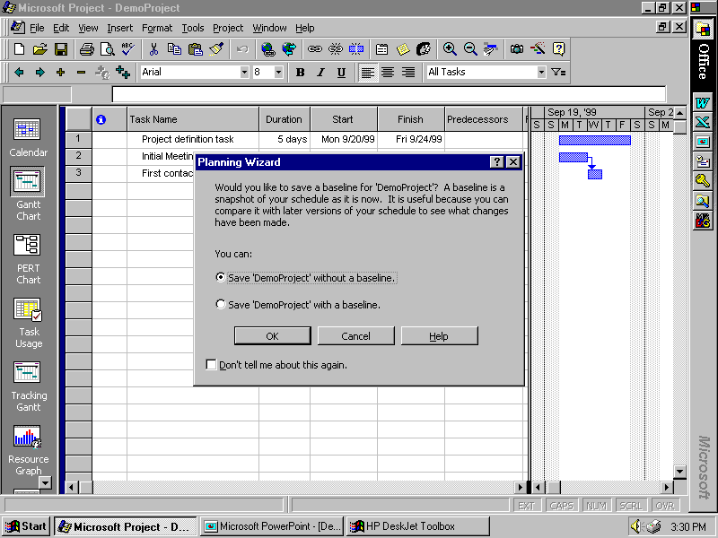

Slide 17
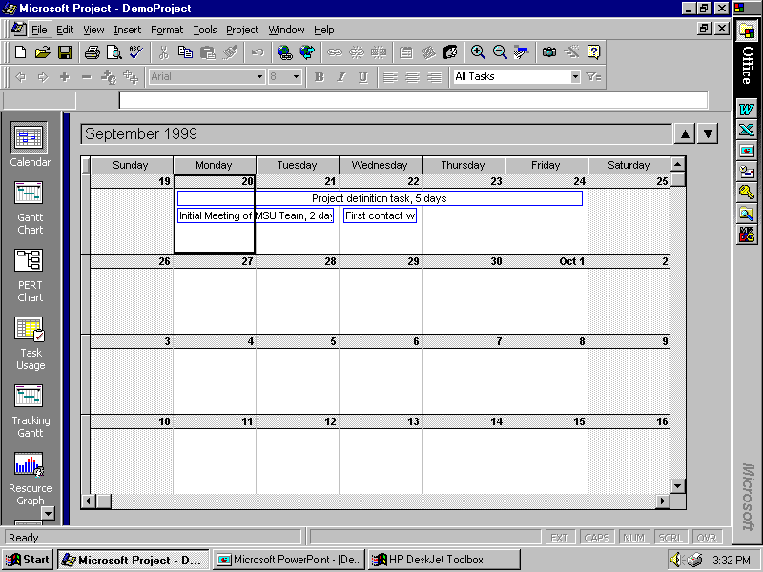

Slide 18
Our “Flyover” of Project 98
Adding tasks, durations
Setting dependencies
Seeing critical path, etc.
“Rolling up” subtasks
Assigning resources
Adjusting durations, time assignments, etc.

Slide 19
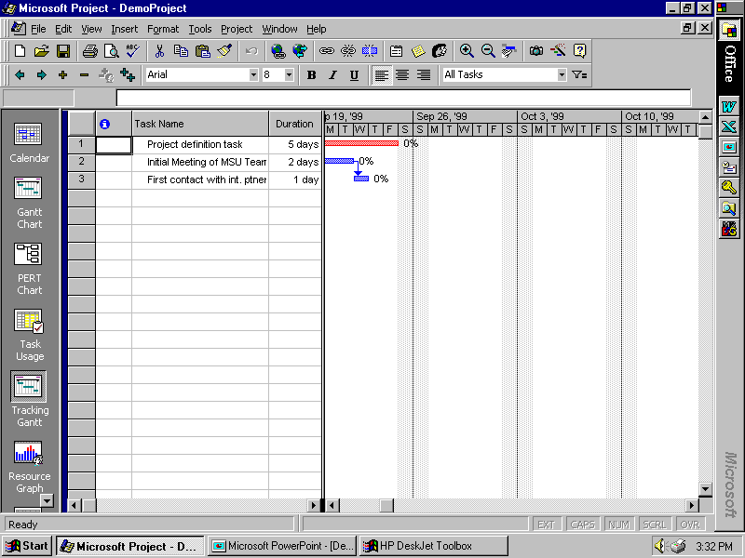

Slide 20
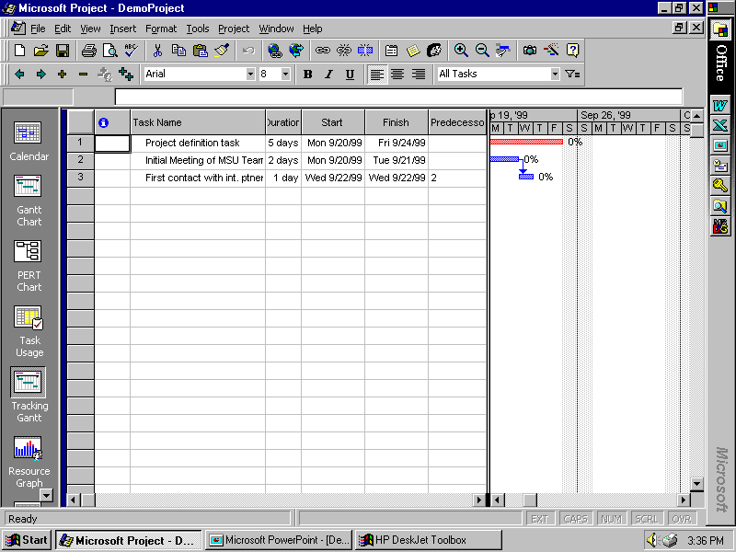

Slide 21
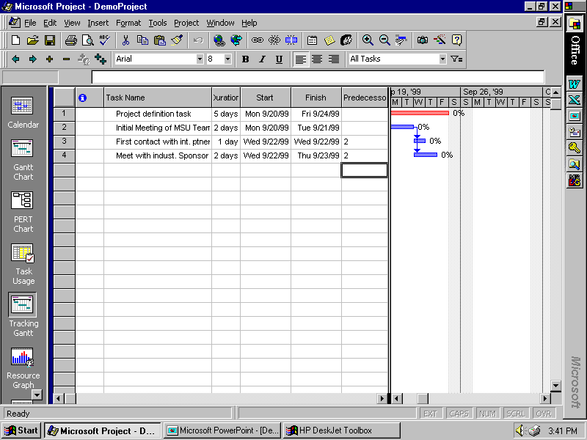

Slide 22
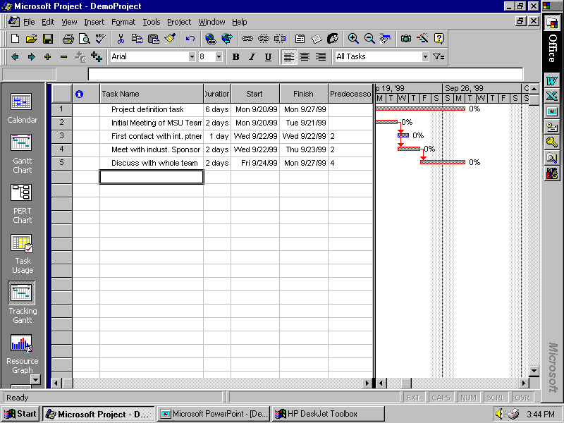

Slide 23
WATCH YOUR DEPENDENCY CHOICES!!!
If you choose something other than the “default” finish/start constraints, you will probably LOSE your ability to track the critical path
So AVOID “finish by” or “start by” with particular calendar dates, or other types of constraints.
Break tasks apart as needed, in order to make finish/start constraints realistic!

Slide 24
Our “Flyover” of Project 98
Adding tasks, durations
Setting dependencies
Seeing critical path, etc.
“Rolling up” subtasks
Assigning resources
Adjusting durations, time assignments, etc.

Slide 25
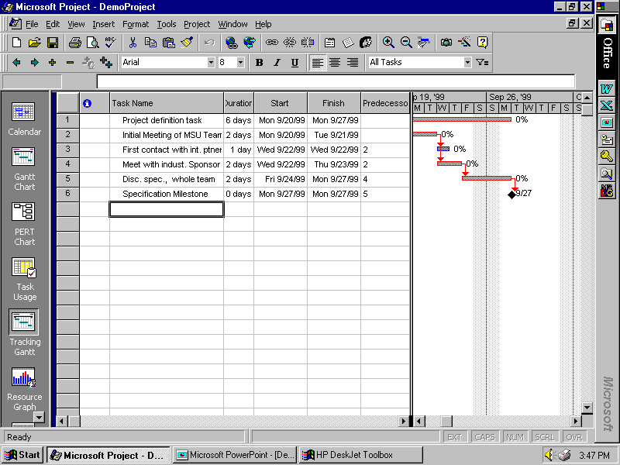

Slide 26
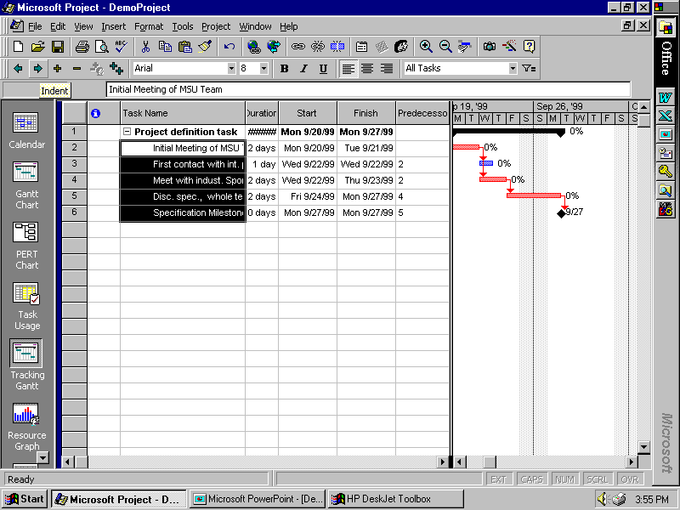

Slide 27
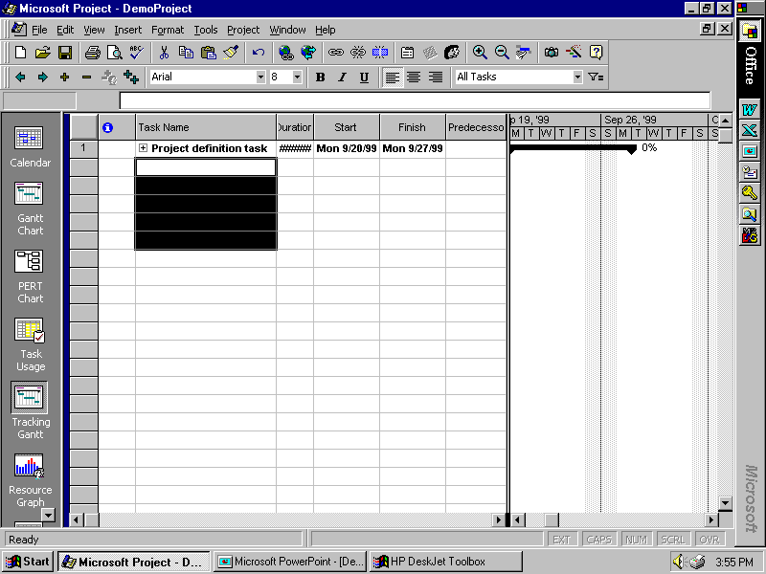

Slide 28
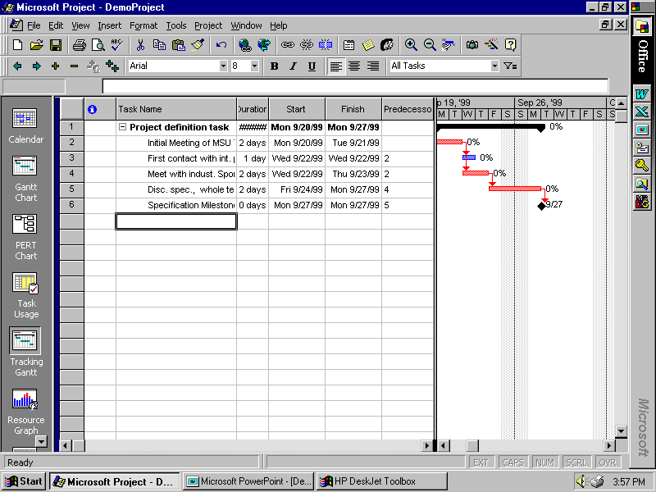

Slide 29
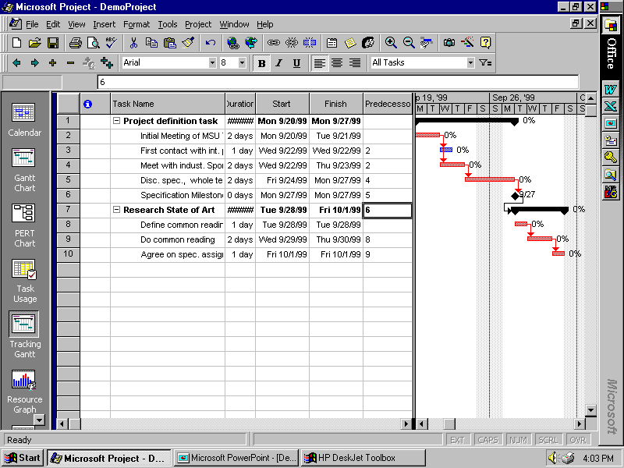

Slide 30
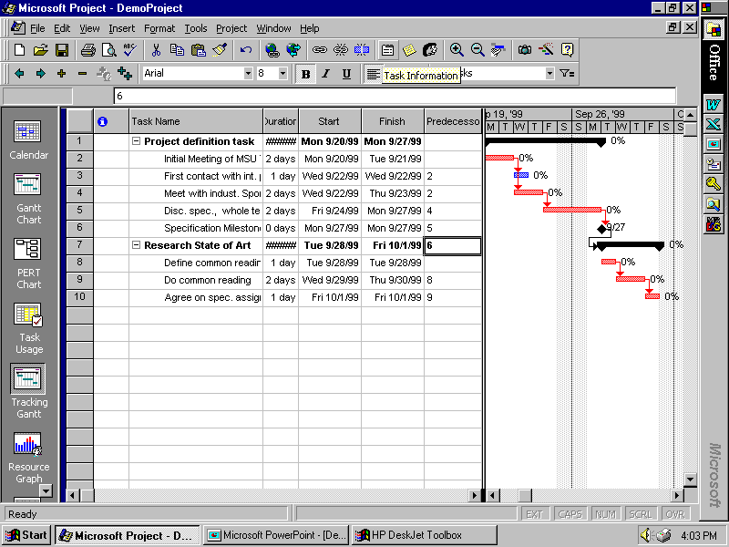

Slide 31
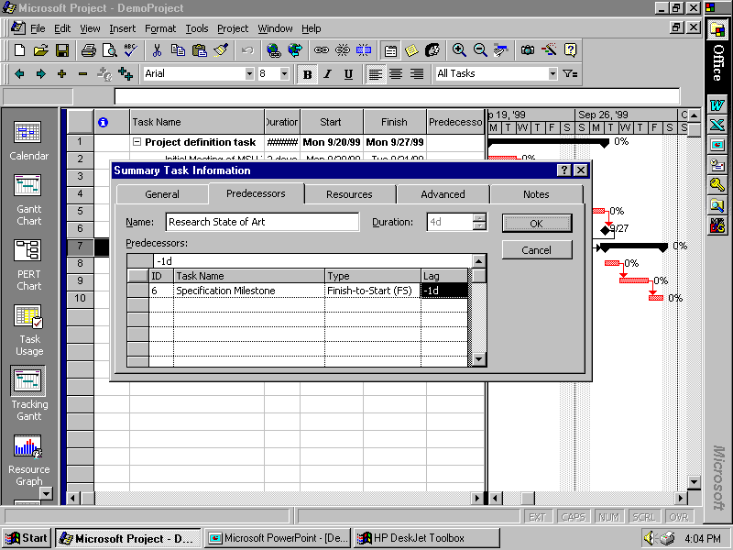

Slide 32
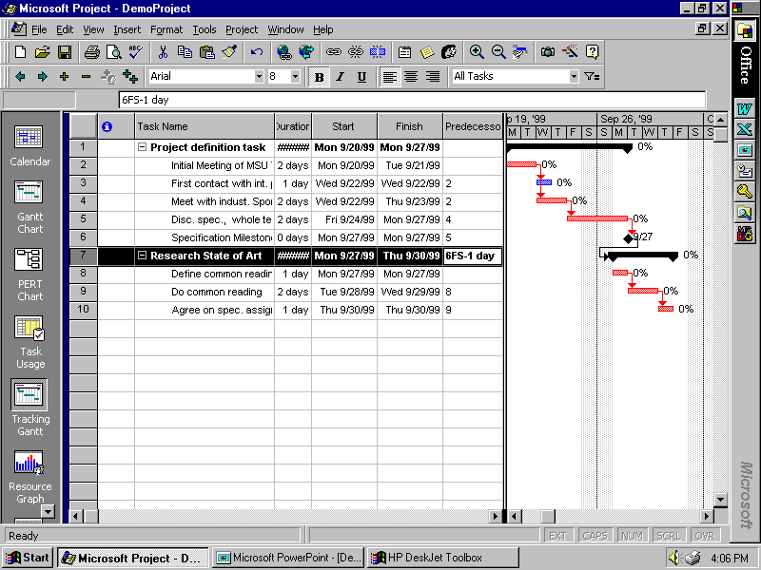

Slide 33
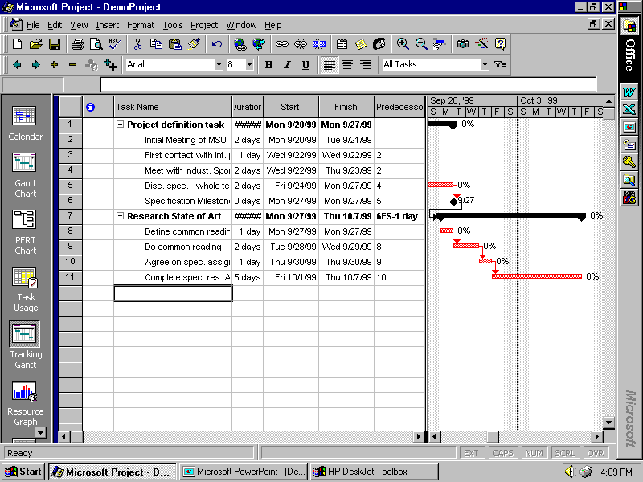

Slide 34
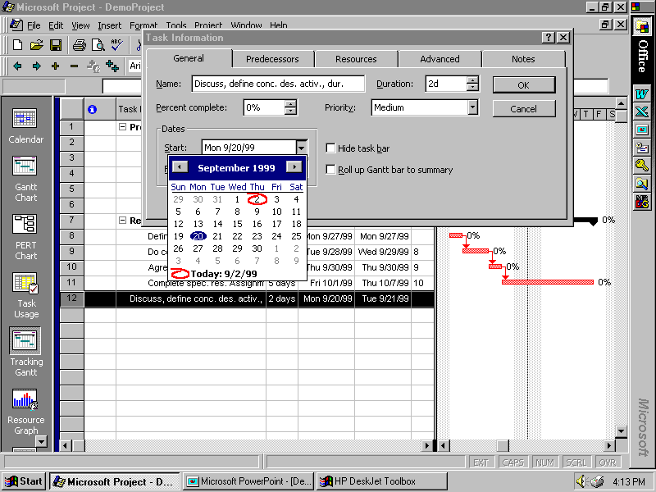

Slide 35
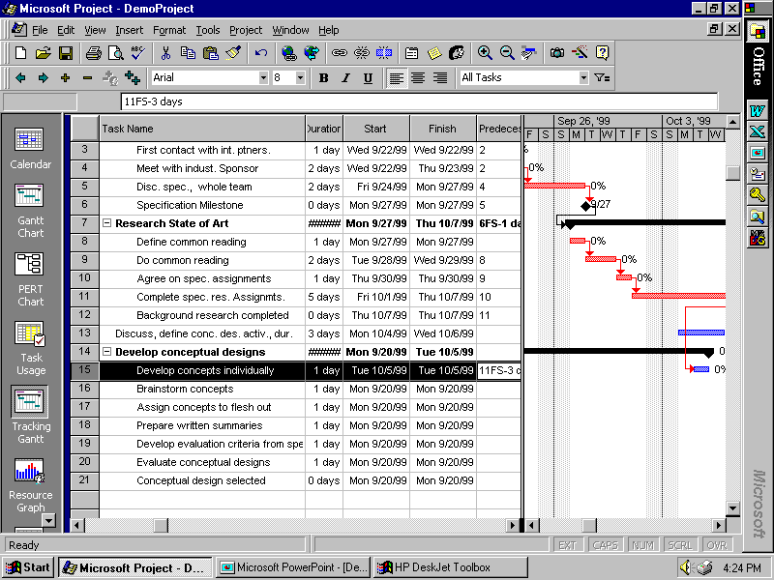

Slide 36
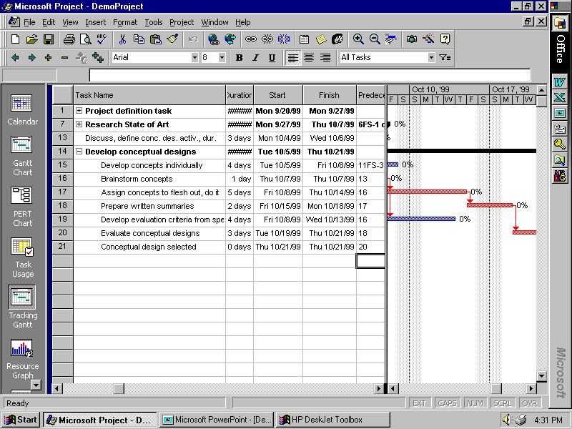

Slide 37
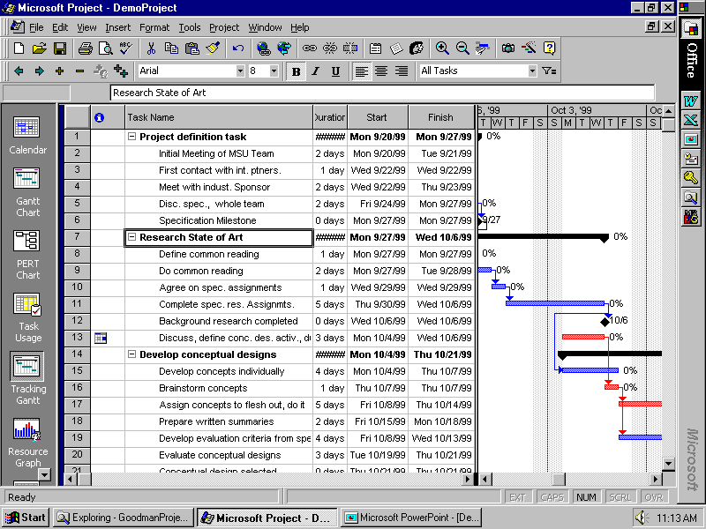

Slide 38
Our “Flyover” of Project 98
Adding tasks, durations
Setting dependencies
Seeing critical path, etc.
“Rolling up” subtasks
Assigning resources
Adjusting durations, time assignments, etc.

Slide 39
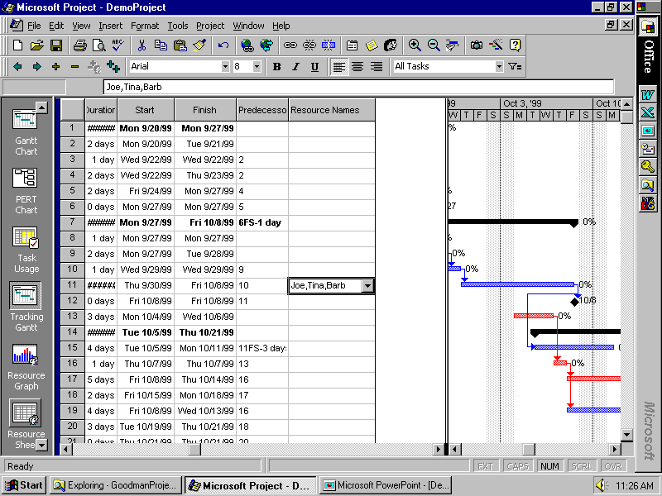

Slide 40
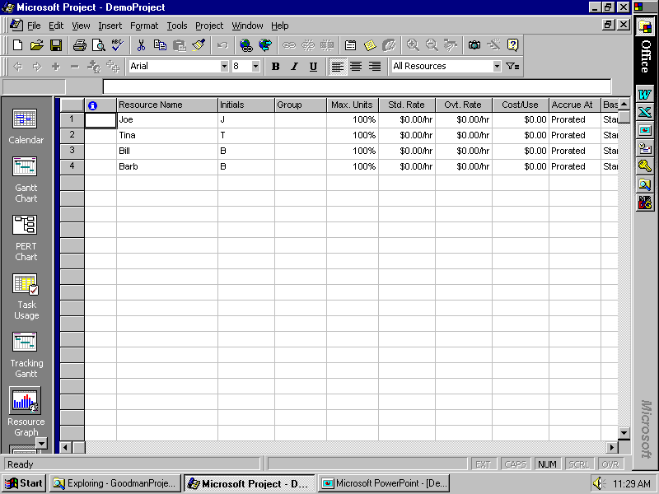

Slide 41
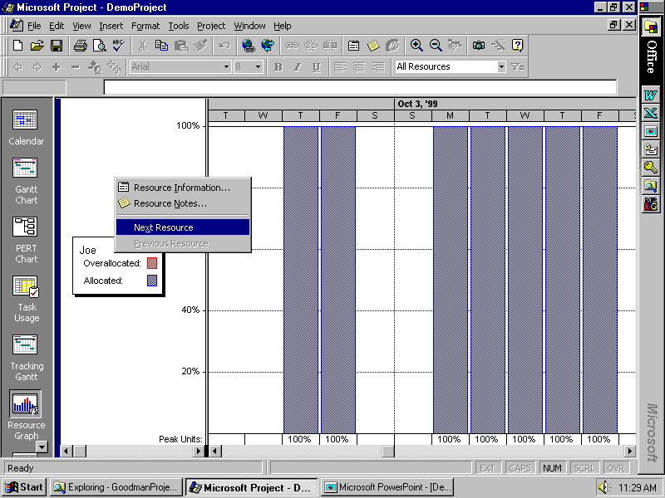

Slide 42
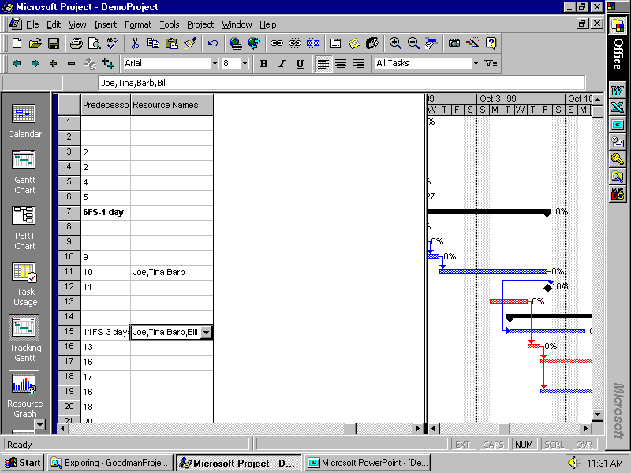

Slide 43
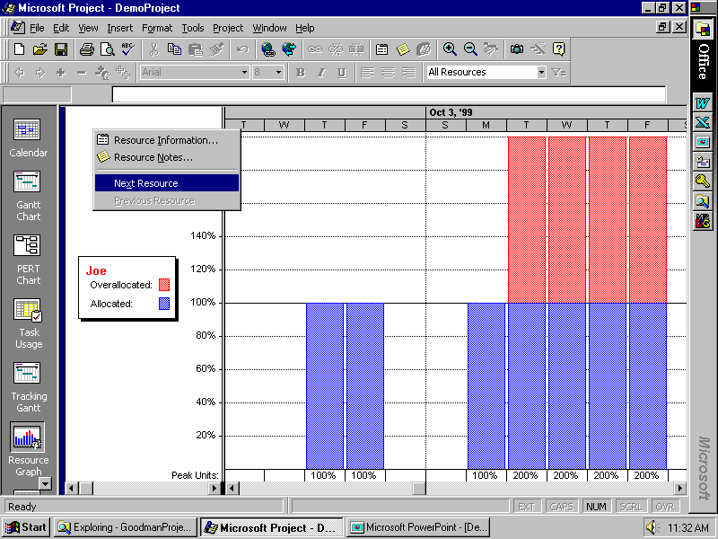

Slide 44
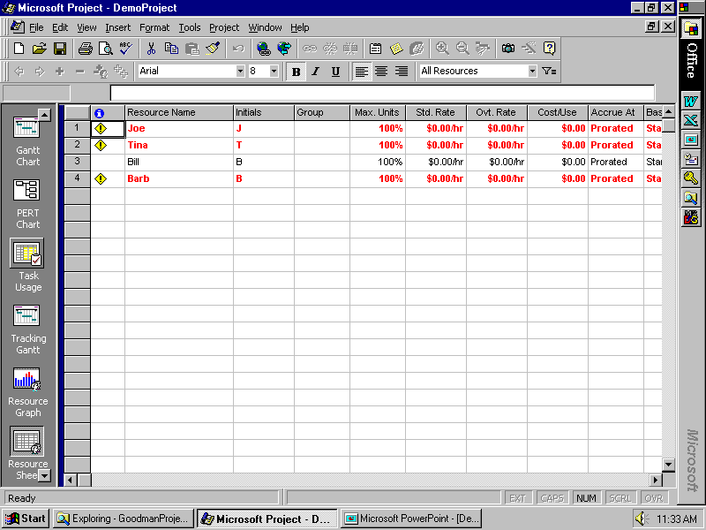

Slide 45
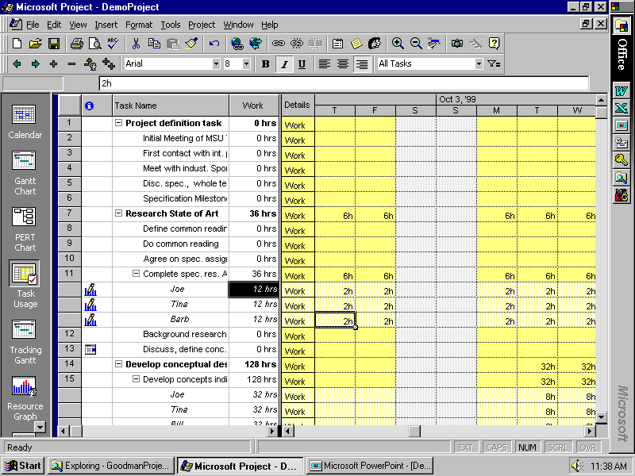

Slide 46
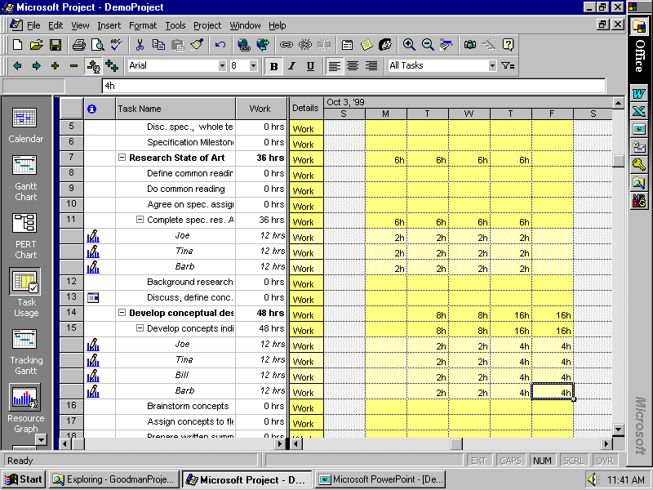

Slide 47
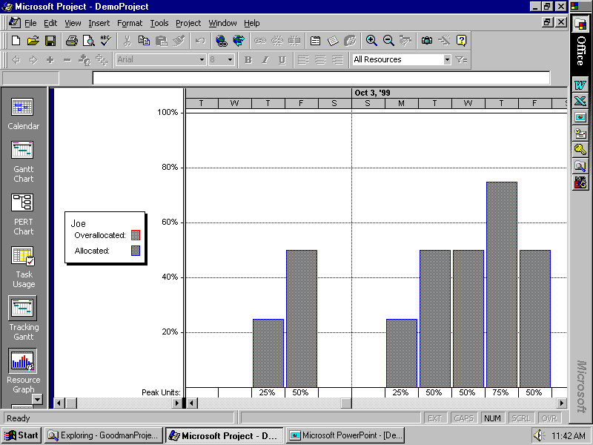

Slide 48
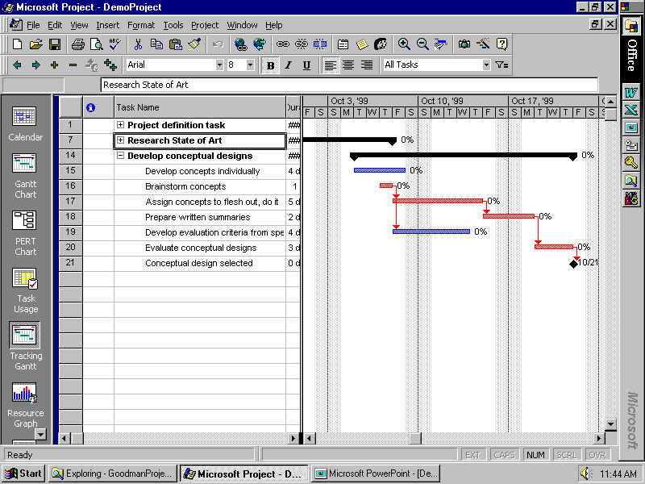

Slide 49
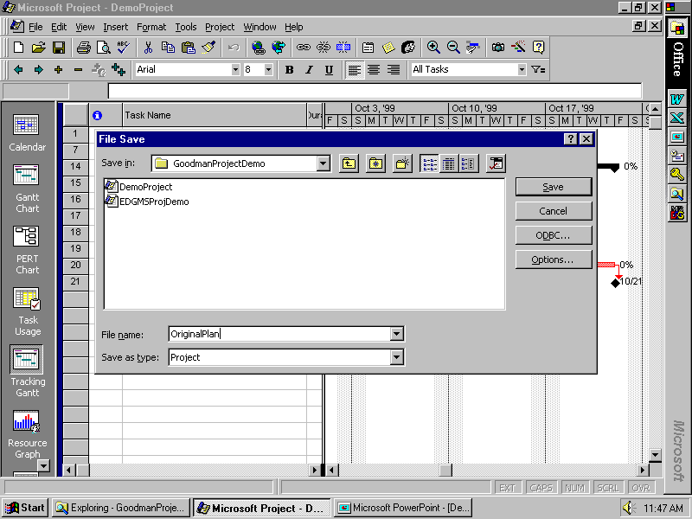

Slide 50
Our “Flyover” of Project 98
Adding tasks, durations
Setting dependencies
Seeing critical path, etc.
“Rolling up” subtasks
Assigning resources
Adjusting durations, time assignments, etc.

Slide 51
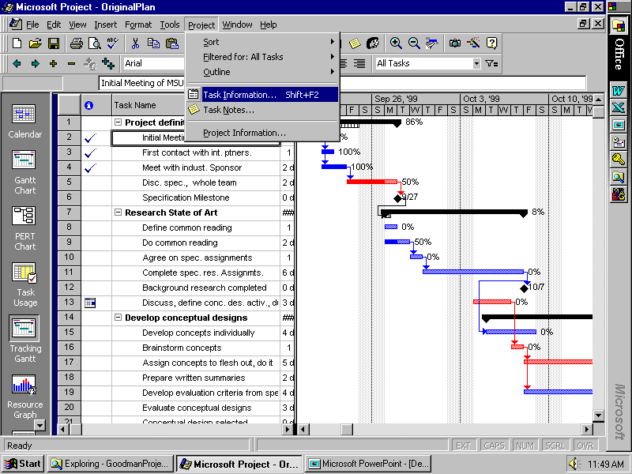

Slide 52
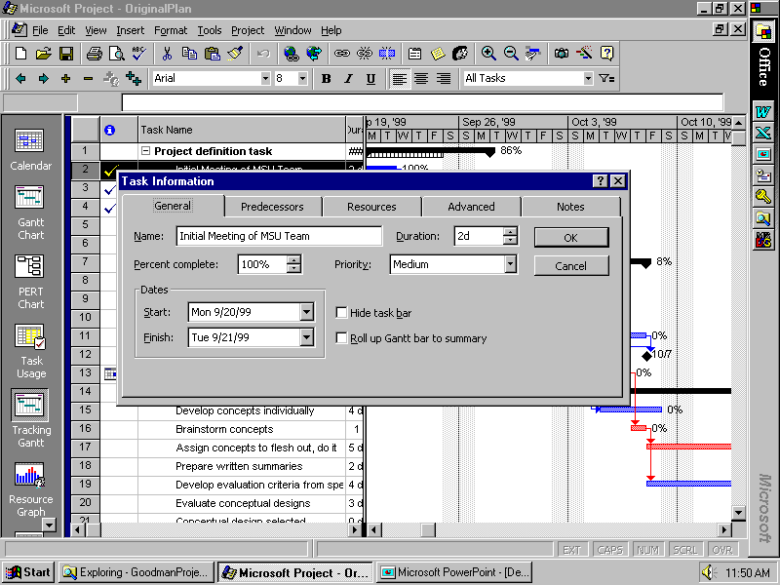

Slide 53
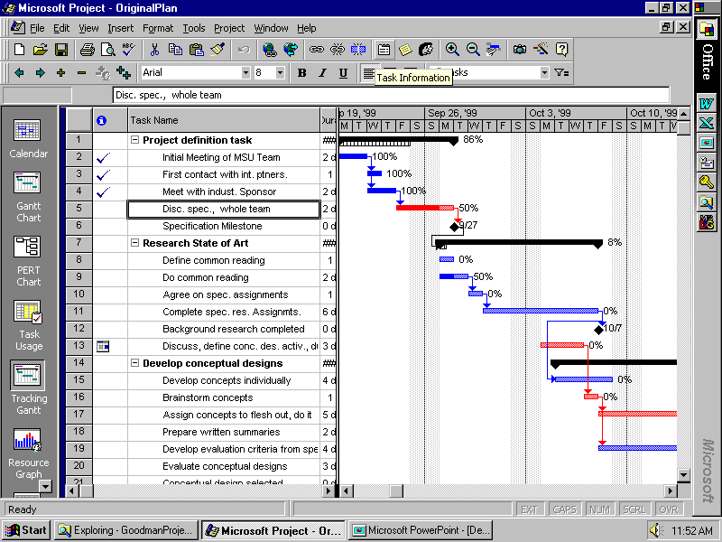

Slide 54
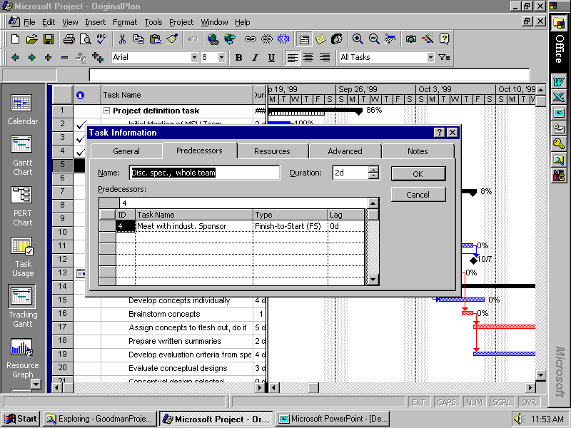

Slide 55
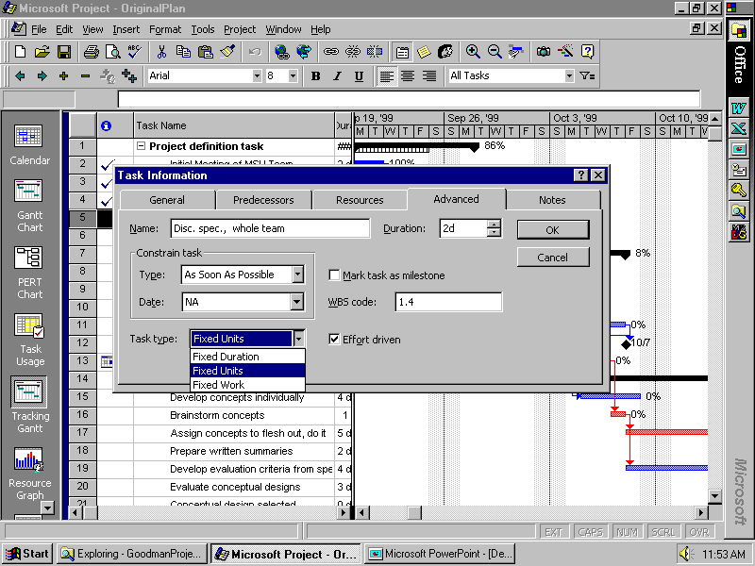

Slide 56
YOUR MS Project has a “Deadline” box
on this page! Use it to let you get warned when something gets pushed back too far, but STILL not assigning a “start no earlier than” or “finish no later than” constraint to it – still using “As soon as possible.”

Slide 57
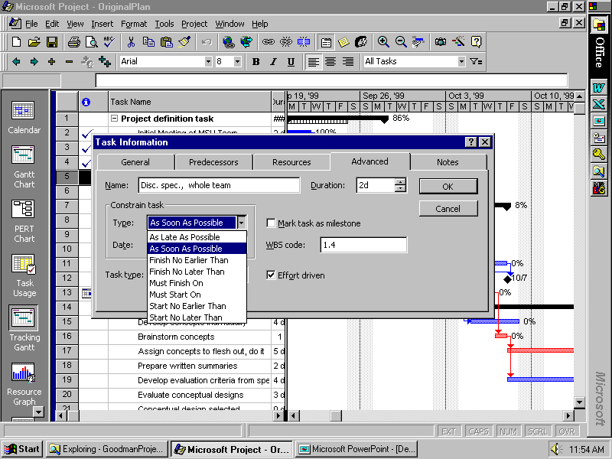

Slide 58
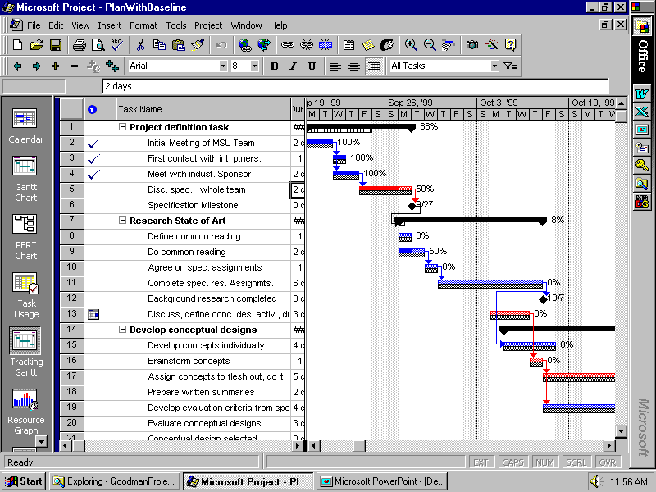

Slide 59
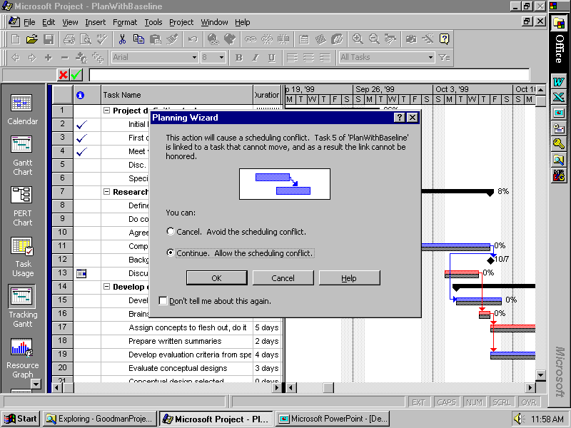

Slide 60
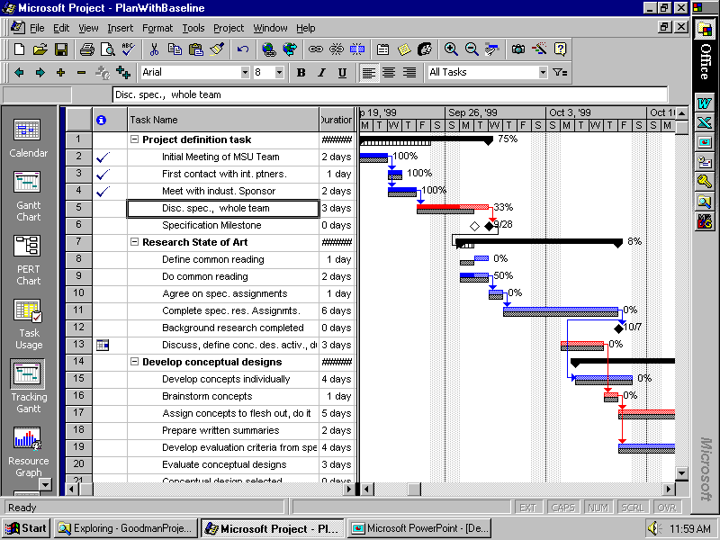

Slide 61
Management of YOUR Project
With your team members
Create a plan for the entire project
Set milestones for tracking progress
Provide more detail for near-term tasks
Use with your facilitator to report progress and revise/add detail to plan
Assign specific tasks to team members
Revise plan and activities as required to achieve objectives

