Slide 1
Request for Proposal
(RFP)
In response to the RFP – the first step is to prepare a proposal
1. Review Customer Requirements and come up with candidate designs
2. Review advantages and risks of design, decide development tools ( hardware and software)
3. Life-cycle model for the project – systematic breakdown of project phases, etc.

Slide 2
Step 1
Understand needs of end user
  Design constraints ( real time, operating temp..)
  Criteria for evaluating/ranking designs
  Feasible designs – ranking and trade-offs (cost vs time)
Assess and Manage Risks
Develop models for systems, sensors, interfaces,
  sequential or parallel interconnected systems
Validation of models (input-output)

Slide 3
Step 2
Decide development strategy
  Top down, bottom up, combination
Development tools
  Software components,(compilers, libraries, support s/w)
  Labview

Slide 4
Step 3
Project Design Phases
  Conceptual designs, overall approach as a block diagram, detailed design, coding development/ build and test) Document this well in the egr. notebook
  Project demos
  Identify deliverables & milestones
  Feasibility matrix and decision matrix (needed in full proposal)
  Determine specification list and evaluate against original design specs ( iteratively develop a proposal that meets the customer needs)

Slide 5
Proposal Requirements
Pre-proposal due Week 4
Full Proposal – due Week 7
3 major Sections
  Technical Details
  Project Management
  Cost Analysis - $500 ( Itemized and justified)

Slide 6
Proposal Requirements
Pre-proposal due Week 4
Full Proposal – due Week 7
Technical Section
  Identify customer needs (VOC Lecture)
    Understand the objectives, Meet with customer and Ask questions
  Constraints
    Generic - Standards, delivery date, quantity, safety, emi,
    Non-generic - environmental conditions, aesthetics, pacakging, etc.
  Background
    Prior work and their shortcomings
  Design Specifications (meet with your customer/sponsor)
  Design parameters –
    Translate customer needs to design parameters
    Relevance of each parameter to design criteria that must be satisfied
Candidate Designs (more than 1 design)
  Evaluate/rank designs ( feasibility and decision matrices)
  Iterative process

Slide 7
Feasibility matrix –
(needed in Full Proposal)
Feasibility Criteria | Wt. | Candidate 1 | Candidate 2 | Candidate 3
Operational Feasibility Functionality. A description of to what degree the candidate would benefit the organization and how well the system would work. Political. A description of how well received this solution would be from both user management, user, and organization perspective. | 30% | Score: | Score: | Score:
Technical Feasibility Technology. An assessment of the maturity, availability (or ability to acquire), and desirability of the computer technology needed to support this candidate. Expertise. An assessment to the technical expertise needed to develop, operate, and maintain the candidate system. | 30% | Score: | Score: | Score:
Economic Feasibility Cost to develop: Payback period (discounted): Net present value: Detailed calculations: | 30% | Score: | Score: | Score:
Schedule Feasibility An assessment of how long the solution will take to design and implement. | 10% | Score: | Score: | Score:
Ranking: | 100%

Slide 8
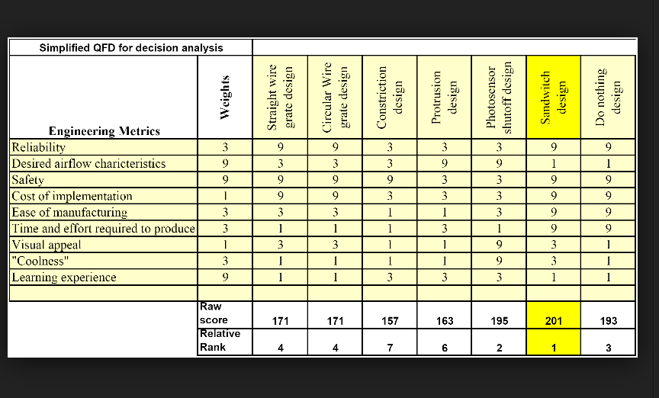
Feasible designs as Decision Matrix
(Only – in Full Proposal)
Weights assigned according to importance of needs
Rate feasibility of design

Slide 9
Proposed Design solution
Architectural Block diagram
  Hardware/software modules
  Sub-Tasks
  Expected outcomes
  Risk analysis
  Test plan - to demonstrate specs have been met

Slide 10
Project Management
Personnel
Tasks
Identify technical contribution of each team member (each member should document plans for their sub-task in the engineering notebook)
Resources needed/ plans for procurement
Timeline
  Tasks, integration, reports, presentations, demonstrations
Gantt Charts & critical pathways– (rough draft for pre-proposal)

Slide 11
Cost Management
Budget
  Itemized and Justified
  Try to keep within $500

Slide 12
Proposal Format
No more than 15 typed pages
  Cover page
    Title, design team #, facilitator, Document type (Pre or Full proposal)
    Design team members, date
  Executive summary(purpose, goals, expected outcomes, impact)
  TOC
  Introduction
  Background
  Objectives
  FAST Diagram
  Conceptual Designs, Ranking
  Proposed design
  Risk Analysis
  Project Management
  Budget
  References

